Slide 1
EE474 Term Project (Phase 1)
Onur Emirhan Çon
2304384

Slide 2
Contents
Problem Definition
Possible Solutions
Selected Features
Test Results
Code Explanation

Slide 3
Problem Definition
A method must be selected in order to forecast the power measurement of the PV array by using the given dataset.
The selected method must be implemented into a python 3.11.X function.

Slide 4
Possible Solutions
Time-Series Analysis
Kalman Filter
Artificial Neural Network

Slide 5
Selected Features
Temperature
Wind Speed
Solar Radiation
Cloudiness

Slide 6
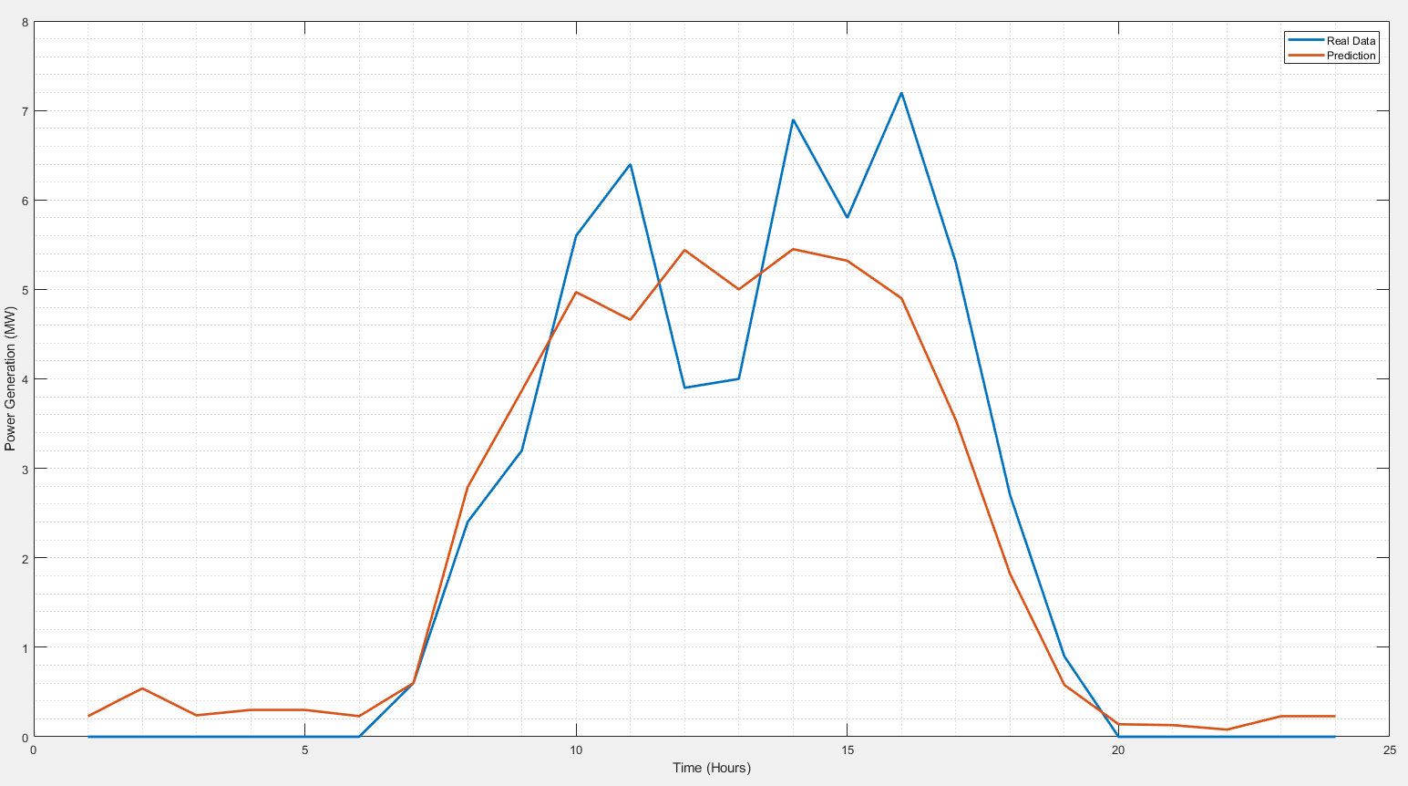
Test Results

Slide 7
Code Explanation
Reading Data From Excel
Predicting Null Data
Extracting Relevant Data
Training
Testing

