Slide 1


Statistics show that 93% of companies file for bankruptcy within one year of losing their data center and 50% companies file for bankruptcy immediately after going without any data management for a period of about 10 days.
Data Management Poses Major Challenges And Issues For Companies. Such as:-
Understanding Data / Getting the most out of it data
Using Data Management to maximize profits

Slide 2

Just a minimal inconsistency of data resulted in a rather costly and disastrous mistake by NASA in 1999. NASA LOST $125 MILLION when it lost the Mars Orbiter due to data inconsistency
According to:- https://pctechmag.com/

Slide 3
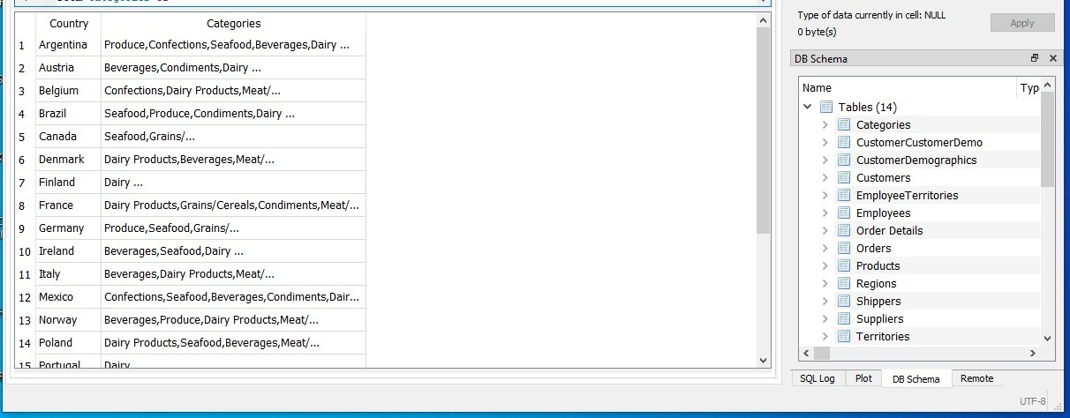
Our Solution :- Through our solution the company/stakeholders was able to inference on what categories of product each countries were buying this enables focus to maximize sales
Our Team First Task : -
was to find what countries does the company sell its products to and what are the categories sold to each country?

Slide 4
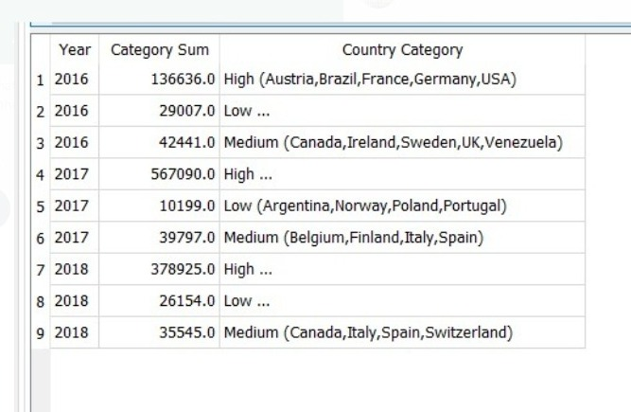
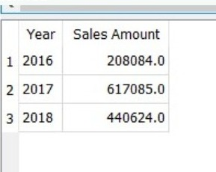
Our Solution :-
Our Team Second Task : -
Calculating the sales amount for the company 2016 2017-2018
Separate the sales amounts for 3 categories low-medium-high
Through our solution the company/stakeholders was able to determine what year they made much more profit and also to compare with the year they made lower profit this enables them to find out what caused the inconsistency in profit margin
Our solution also presented to the company/stakeholder what countries brought in higher, medium and low sales. With this, the company know where to put in more effort as a result of higher sales from these countries and make them think on what could be responsible for the low sales in the low sales countries.

