Slide 1

Northwind
Database
Data-Int-5-team-4

Slide 2

Introduction
What does our Company about?
Who are we?
How we come up with a data pipeline where Data users can be delivered with good meaningful data for Analysis?

Slide 3

Northwind Company
The Northwind database contains sales information from Northwind Traders
an imaginary specialties export-import firm.

Slide 4
Our Team
Adem Aktas – Employee Performance Analysis
Barnabas Obande – Country Performance Analysis
Onur Ertugrul – Shipment Performance Analysis
Vaibhav Koneti – Product Performance Analysis

Slide 5




Data Pipeline Workflow
Extracting Data
Transforming Data
Loading Data
Analysis report for Data User

Slide 6
Challenges
Data Management Poses Major Challenges And Issues For Companies. Such as:-
Understanding Data / Getting the most out of it data
Using Data Management to maximize profits
Statistics show that 93% of companies file for bankruptcy within one year of losing their data center and 50% companies file for bankruptcy immediately after going without any data management for a period of about 10 days.

Slide 7
Challenges
Data Management Poses Major Challenges And Issues For Companies. Such as:-
Understanding Data / Getting the most out of it data
Using Data Management to maximize profits
Statistics show that 93% of companies file for bankruptcy within one year of losing their data center and 50% companies file for bankruptcy immediately after going without any data management for a period of about 10 days.

Slide 8
Country Analysis
Annual Sales Amounts:
Year | Sales Amount
2016 | $208,083
2017 | $617,085
2018 | $440,623

Slide 9
Country Analysis
Company categories according to Annual Sales Amounts
Low Sales <$6,500
Medium Sales >$6,500 and <$14,300
High Sales >$14,300
Year | Category Sum | Country Category
2016 | $136,635 | High (Austria,Brazil,France,Germany,USA)
2016 | $29,007 | Low (Belgium,Denmark,Finland,Italy, Mexico,Norway,Poland,Portugal,Spain,Switzerland)
2016 | $42,441 | Medium (Canada,Ireland,Sweden,UK,Venezuela)
2017 | $567,089 | High (Austria,Brazil,Canada,Denmark,France, Germany,Ireland,Mexico,Sweden,Switzerland,UK,USA,Venezuela)
2017 | $10,198 | Low (Argentina,Norway,Poland,Portugal)
2017 | $39,796 | Medium (Belgium,Finland,Italy,Spain)
2018 | $378,924 | High (Austria,Belgium,Brazil,France, Germany,Ireland,Sweden,UK,USA,Venezuela)
2018 | $26,154 | Low (Argentina,Denmark,Finland,Mexico,Norway,Poland,Portugal)
2018 | $35,545 | Medium (Canada,Italy,Spain,Switzerland)

Slide 10
Country Analysis
Product Categories that countries buy

Slide 11
Country | # of Categories | Categories
Argentina | 7 | Produce,Confections,Seafood,Beverages,Dairy Products,Condiments,Grains/Cereals
Austria | 8 | Beverages,Condiments,Dairy Products,Confections,Seafood,Produce,Grains/Cereals,Meat/Poultry
Belgium | 8 | Confections,Dairy Products,Meat/Poultry,Produce,Beverages,Grains/Cereals,Condiments,Seafood
Brazil | 8 | Seafood,Produce,Condiments,Dairy Products,Beverages,Confections,Meat/Poultry,Grains/Cereals
Canada | 8 | Seafood,Grains/Cereals,Confections,Condiments,Meat/Poultry,Dairy Products,Beverages,Produce
Denmark | 8 | Dairy Products,Beverages,Meat/Poultry,Condiments,Confections,Seafood,Produce,Grains/Cereals
Finland | 8 | Dairy Products,Seafood,Beverages,Produce,Confections,Meat/Poultry,Grains/Cereals,Condiments
France | 8 | Dairy Products,Grains/Cereals,Condiments,Meat/Poultry,Beverages,Confections,Seafood,Produce
Germany | 8 | Produce,Seafood,Grains/Cereals,Confections,Beverages, Dairy Products,Meat/Poultry,Condiments
Ireland | 8 | Beverages,Seafood,Dairy Products,Confections,Condiments,Grains/Cereals,Produce,Meat/Poultry
Italy | 8 | Beverages,Dairy Products,Meat/Poultry,Confections,Condiments,Grains/Cereals,Seafood,Produce
Mexico | 8 | Confections,Seafood,Beverages,Condiments,Dairy Products,Meat/Poultry,Produce,Grains/Cereals
Norway | 7 | Beverages,Produce,Dairy Products,Meat/Poultry,Seafood,Confections,Condiments
Poland | 7 | Dairy Products,Seafood,Beverages,Meat/Poultry,Confections,Produce,Condiments
Portugal | 8 | Dairy Products,Condiments,Confections,Beverages,Meat/Poultry,Produce,Grains/Cereals,Seafood
Spain | 8 | Confections,Beverages,Seafood,Grains/Cereals,Condiments,Meat/Poultry,Dairy Products,Produce
Sweden | 8 | Beverages,Seafood,Condiments,Dairy Products,Meat/Poultry,Confections,Produce,Grains/Cereals
Switzerland | 8 | Beverages,Meat/Poultry,Produce,Confections,Seafood,Dairy Products,Grains/Cereals,Condiments
UK | 8 | Condiments,Grains/Cereals,Beverages,Seafood,Confections,Dairy Products,Produce,Meat/Poultry
USA | 8 | Condiments,Produce,Grains/Cereals,Dairy Products,Confections,Beverages,Meat/Poultry,Seafood
Venezuela | 8 | Confections,Beverages,Condiments,Meat/Poultry,Dairy Products,Seafood,Produce,Grains/Cereals

Slide 12

Product Analysis
What are the top three products in sales volume?
How can we boost product sales volume
for the above top three products?

Slide 13
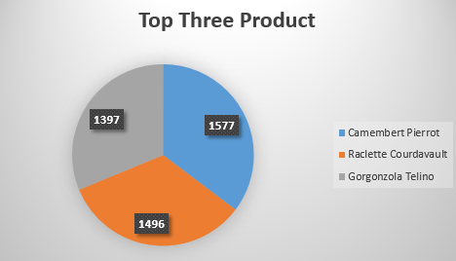
Sales Volume
Top three products and their each selling quantity.
All of the top three items are cheese.

Slide 14
Average Discounts of Countries
Sales Category | Country Name | Average Discount | Sales Amount
High | Ireland | 11.36% | $49,979
Low | Portugal | 9.5% | $11,472
High | Sweden | 7.06% | $54,495
High | Austria | 6.88% | $128,003
High | Venezuela | 6.69% | $56,810
High | Brazil | 6.65% | $106,925
High | Canada | 6.4% | $50,196
High | Germany | 6.31% | $230,284
High | USA | 5.95% | $245,584
High | France | 5.52% | $81,358
Low | Italy | 5.38% | $15,770
Low | Finland | 3.7% | $18,810
Low | Spain | 3.24% | $17,983
High | UK | 2.3% | $58,971
Low | Argentina | 0.0% | $8,119
Low | Norway | 0.0% | $5,735
Low | Poland | 0.0% | $3,531

Slide 15
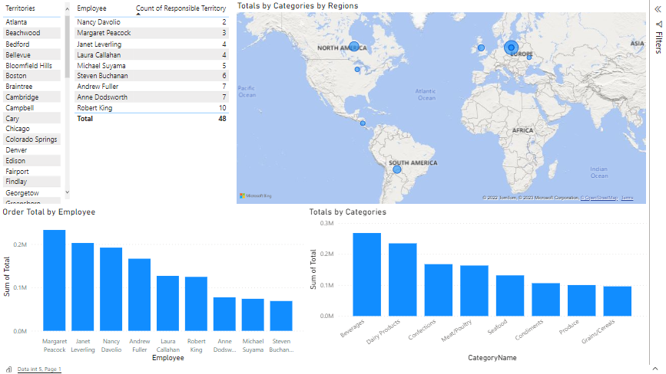

Slide 16
Shipment Performance

Slide 17
Shipment Performance

Slide 18
Thank you

