Slide 1
IS785 Social Network Analysis
Project Presentation
Analysis of DOTA 2 Heros Using SNA Techniques
Ali Onur Karalı - 1389642
Instructor: Banu Günel

Slide 2
Outline
Introduction
Hypothesis
Network Data
Analysis Methodology
Results
Discussions & Conclusions

Slide 3
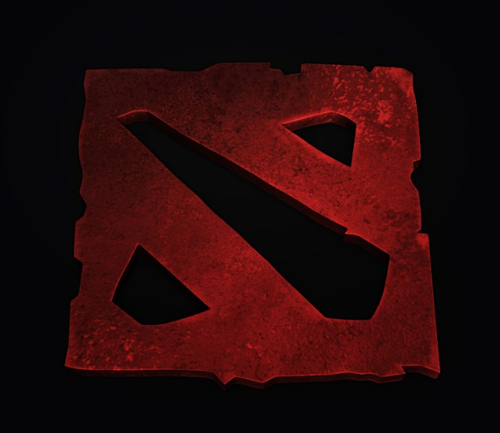
Introduction
Dota 2 is a free-to-play multiplayer online battle arena (MOBA) video game developed and published by Valve Corporation.
12,313,355 unique players last month.
Two five-player teams, referred to as the Dire and Radiant, compete in matches on an asymmetrical playing field.
Each player commands one of 111 "Hero" characters.
Each Hero's method of combat is influenced by its primary "attribute": Strength, Agility or Intelligence

Slide 4
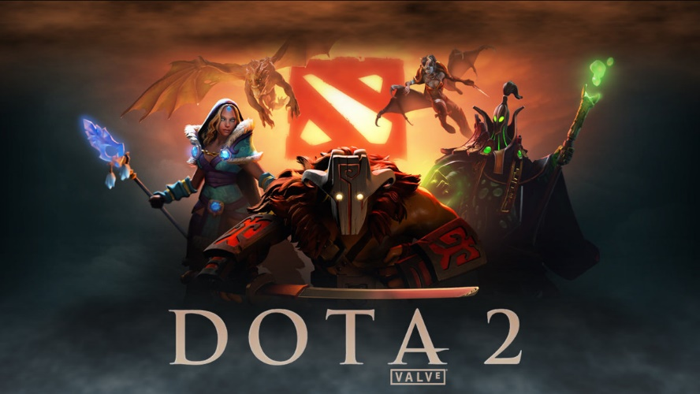
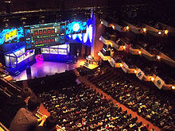
Introduction
Dota 2 has a widespread professional scene, with teams from across the world competing for prize money and glory in various competitive leagues and tournaments.
The largest of the professional tournaments is known as The International, which is hosted by Valve and takes place annually at the KeyArena in Seattle, Washington.
The 2015 edition of «The International» set a record for having the largest prize pool in eSports history, totaling over $18 million.

Slide 5
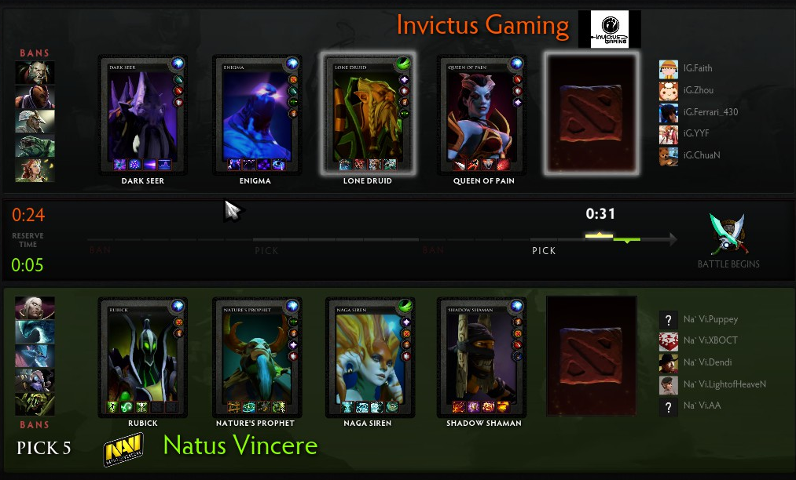
Hypothesis
Each game starts with a «Hero» pick and ban session.
Long gameplay statistics shows that there is a certain bias between heros wrt their abilities.
We can model each hero as a node in our social network and construct edges using these bias values.
So we find out the the best picks available against opponents teams hero picks.

Slide 6
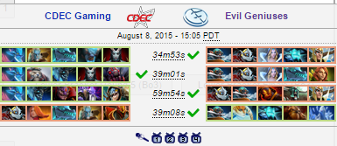
Hypothesis
The importance of the hypothesis is: Among the most talented players of the game, picks and bans play an impotant role on the way of victory.
No previous analysis exists to suggest best picks agianst a combination of multiple heros.
By shrinking our social network wrt to the opponent teams heros as a single cluster, we can analyse the rest of the network for the best counter picks.
We can analyse the picks of the final match of «The International 2015» for better reasoning the results.

Slide 7
Network Data
Whole gameplay statistics are kept and displayed in Dotabuff*.
«Advantage» measure is calculated from these gameplay statistics as defined below:
Sample, lessened match-up data for one of the heroes :Anti-Mage is as seen below:
Advantage measures the matchup between two heroes regardless of their normal win rate. It is calculated by establishing their win rates both in and outside of the matchup and comparing the difference against a base win rate. The calculation is procedural and advantage/disadvantage results are not designed to be symmetrical.
Heros | Advantage | Win Rate | Matches
Wraith King | 6.35% | 42.78% | 527,324
Zeus | 4.79% | 43.91% | 309,379
Abaddon | 4.42% | 39.73% | 155,106
Medusa | 4.27% | 46.88% | 223,879
Clockwerk | 4.22% | 50.57% | 160,619
. . . | . . . | . . . | . . .
Bloodseeker | -3.01% | 45.41% | 331,481
Slardar | -3.06% | 37.03% | 386,577
Legion Commander | -3.06% | 42.65% | 501,359
Phantom Assassin | -3.40% | 42.80% | 573,243

Slide 8
Network Data
Each hero is denoted as a vertex in the network.
One-to-one advantage value is denoted as an arc from the advantegous hero to less advantegeous hero with the value of advantage.
Since advantage value is reciprocal between two heroes, only one arc with a positive value is constructed. (Arcs with negative values are removed from the network)
Also there are three general groups where each hero belong to one: «Strength», «Agility» and «Intelligence»
Heros.clu is constructed for group level analysis.

Slide 9
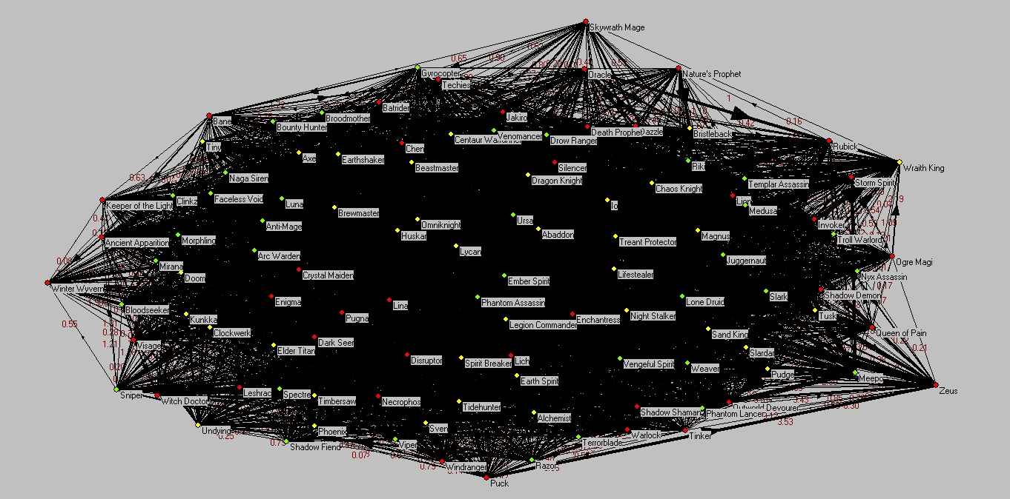
Network Data
Overall network with clusters can be seen below:

Slide 10
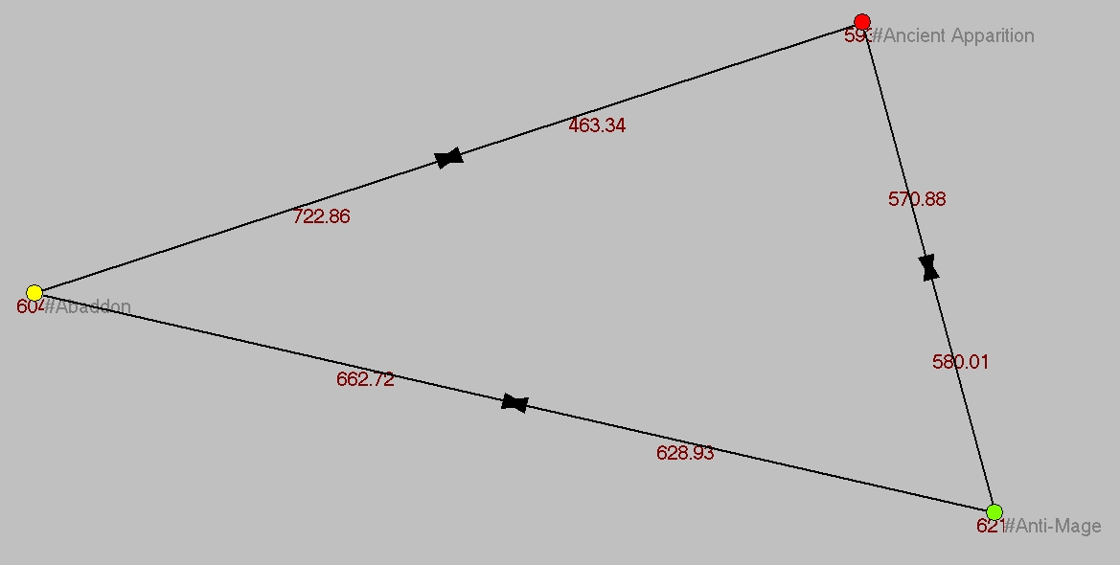
Analysis - 1
Group-level advantage status:
Purpose: find the overall advantage values between «Strength», «Agility» and «Intelligence» heroes.
Shrinking network to the clusters defined in heros.clu (Yellow: Strength, Green: Agility and Red: Intelligence):
Bidirectional arc exist between groups.

Slide 11
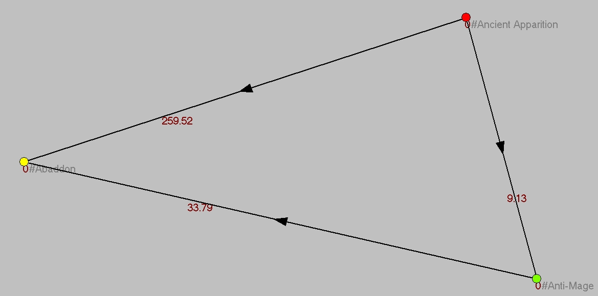
Analysis - 1
Group-level advantage status:
Converting bidirectional arcs to arc with values as the difference and direction as the advantegous group to disadvantegous one:
Select N3: Network/Create New Network/Transform/Bidirected Arcs->Arc/Select Max Value -> N4
Select N3: Network/Create New Network/Transform/Bidirected Arcs->Arc/Select Min Value -> N5
Select N5: Network/Create New Network/Transform/Transpose 1-mode-> N6
Select N10 and N3: Networks/Cross-Intersection/Subtract -> N7

Slide 12
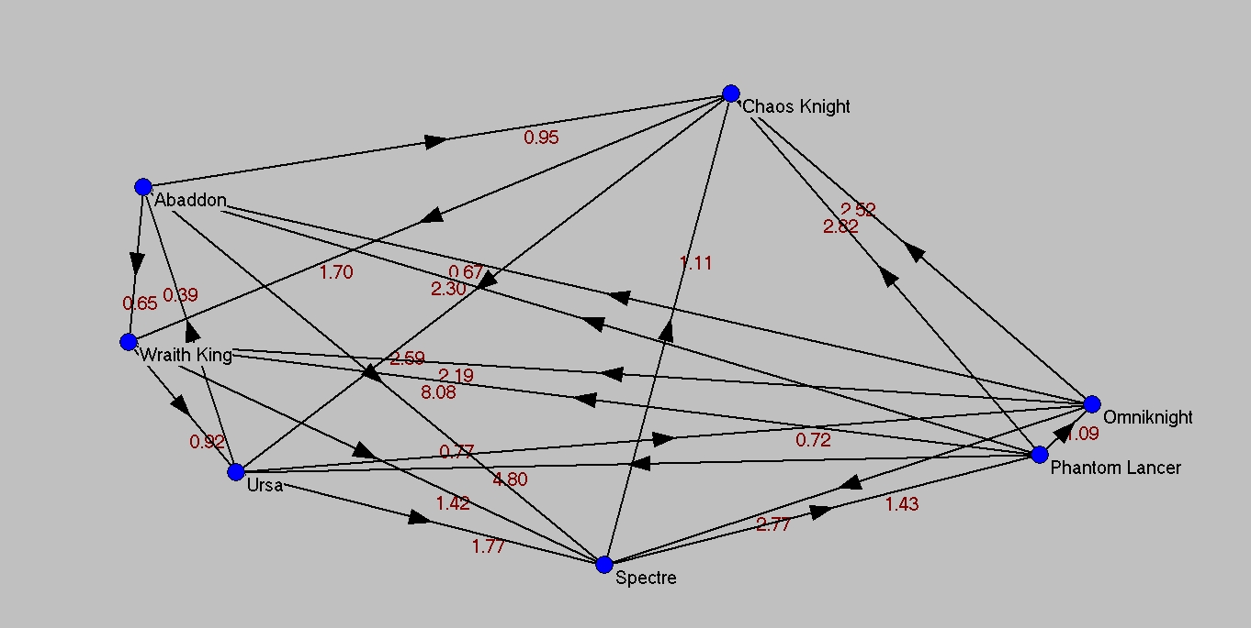
Analysis - 2
Hubs and authorities of the network is calculated,
A partition from this calculation is constructed,
Heroes with the maximum authorities are seen as below:

Slide 13
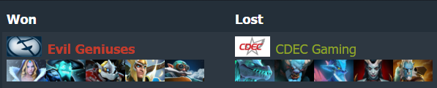
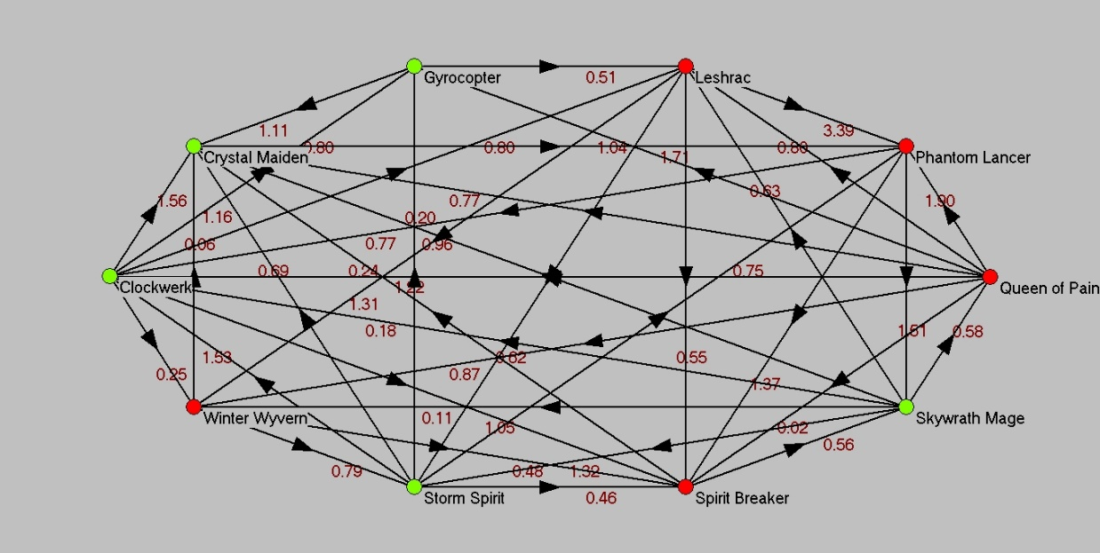
Analysis - 3
Analysis of «The International 2015» final match team selections:
Extracting subnetwork of these heros:

Slide 14
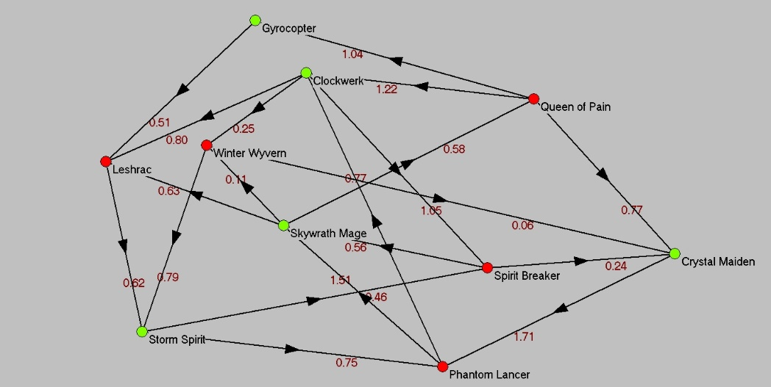
Analysis - 3
Lines inside the clusters are removed:

Slide 15
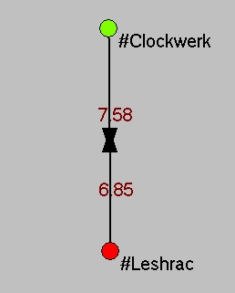
Analysis - 3
Shrinking the network of final match heroes:

Slide 16
Results
Analysis – 1
Intelligence heroes are better counter picks agianst strength heroes
Agility heros are also better counter picks agianst strength heros
Although there does not exists a certain bias between intelligence and agility heroes, still intelligence heros can be better as a counter pick
Analysis – 2
Heros listed in analysis 2 have superiority agianst other heroes wrt stattistics
They can be selected as first picks since there are less counter pick options
Analysis – 3
Picks of the winner team of the final match have certain disavantage agianst the oppoenet wrt statistics but gameplan and strategy also have effect on the victory

Slide 17
Discussions & Conclusions
This study shows that one can decide on a counter pick by considering overall statistical advantage aginst more than one hero.
Intelligence heros have superiority over other group heros.
Certain heros have higher authority and first pick of that heros can have advantage to win the game.

