Slide 1
IPSCORE: AN Intrusion Detection System (IDS) Based on Statistical Access Pattern Analysis
Onur Kocak
Bilkent University onur.kocak@bilkent.edu.tr
Omer Faruk Aktulum
Bilkent University omer.aktulum@bilkent.edu.tr
Notes:
Omer & Onur

Slide 2
Outline
Attacks, Attack Types
Prevention Approaches
Literature Review
Motivation
Proposed Method
Experiments
Next Steps
References
Questions
Notes:
Omer
- Our presentation outline will be as follows

Slide 3
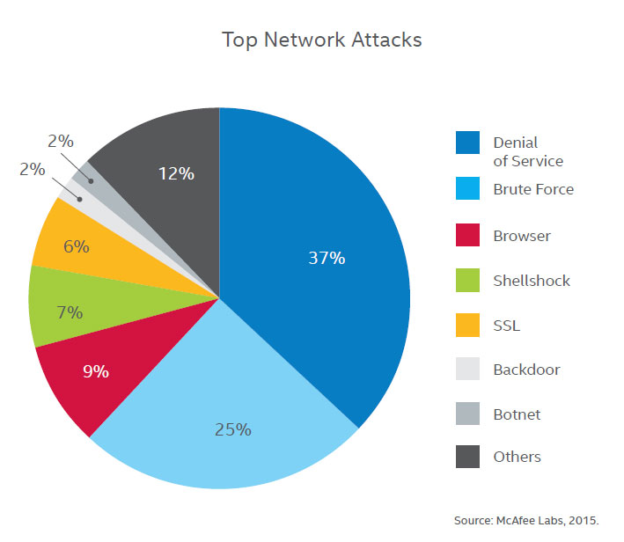
Network Attacks
Most common attack model: DoS & Brute Force
Notes:
Omer
-According to McAfee 2015 report, most common attack is Dos

Slide 4
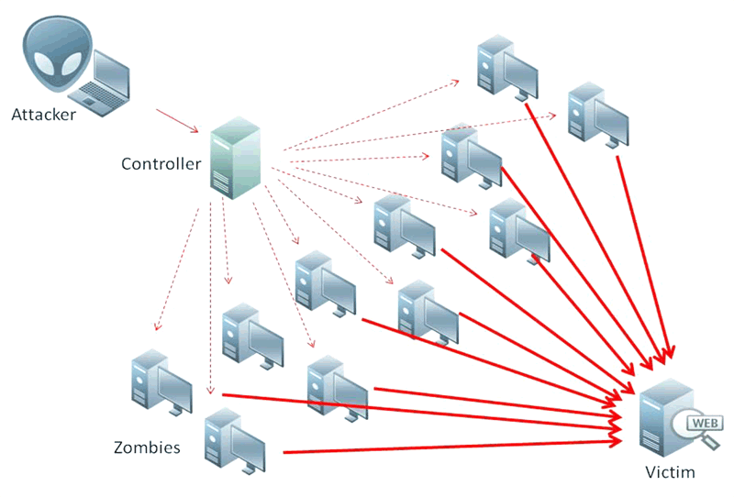
DoS & Distributed DoS
A denial of service (DoS) attack attempts to make a resource, such as a web server, unavailable to users.
Notes:
Omer
-What is DoS? The definition is …

Slide 5
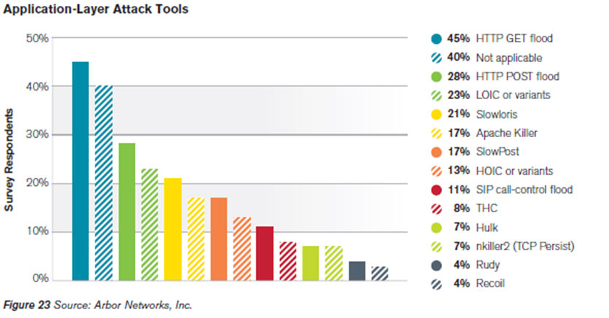
Types of DoS
Network Layer Attacks
TCP, UDP and ICMP Floods (SYN Flood, Ping of Death, etc. )
Application Layer Attacks
HTTP GET & POST Flood
Zombie machines attack the victim
server through legitimate packets
such that packets have legitimate
format and are sent through normal
TCP connections.
Notes:
Omer
-Two types of DoS is …
Volumetric attacks are easy to prevent
Application Later attacks are common and harder to prevent

Slide 6
Preventing DoS Attacks
On Network Layer
Analyzing # of TCP& UDP Packets in a Statistical Manner
Analyzing Behavioral Status of Network (Resource Usages, etc.)
On Application Layer
Analyzing payload of packet (DPI)
Client-side techniques (CAPTCHAs)
Notes:
Omer
There are several approaches to prevent DoS attacks
Basically these approaches analyzes these 2...

Slide 7
Literature Review
CAPTCHA Puzzles [1, 2]
A CAPTCHA puzzle is a challenge-response test used in web applications as an attempt to ensure that the response is generated by a human not by a machine.
Weaknesses:
- Several image recognition techniques to break CAPTCHA [3]
- Labor attacks: There are free/cheap 3rd party human labor to break CAPTCHAs [4, 5]
Yatagai’s method [6]
Measure session durations and browsing order
Weaknesses:
Vulnerable to advanced DDoS attack scenarios with randomized distribution
Notes:
Omer

Slide 8
Literature Review
ConnectionScore [8]
Statistical technique to protect from most common application layer DDoS attacks such as HTTP ﬂood. It measures request times, request rates, download rates, browsing behaviour (link depth).
Weaknesses:
24% of the malicious connections do not get negative scores
Notes:
Omer

Slide 9
Motivation
Develop a new statistical method somewhat similar but not limited to Connection Score to prevent application layer DDoS & brute force attacks by analyzing access logs in historic and volumetric distribution.
IPScore
5 different metrics
Some human defined constants to improve success ratio
Notes:
Onur
-Our motivation is to develop a new approach to prevent DoS attacks and most common instrusions such as port scanning etc.
-We call our approach as IPScore

Slide 10
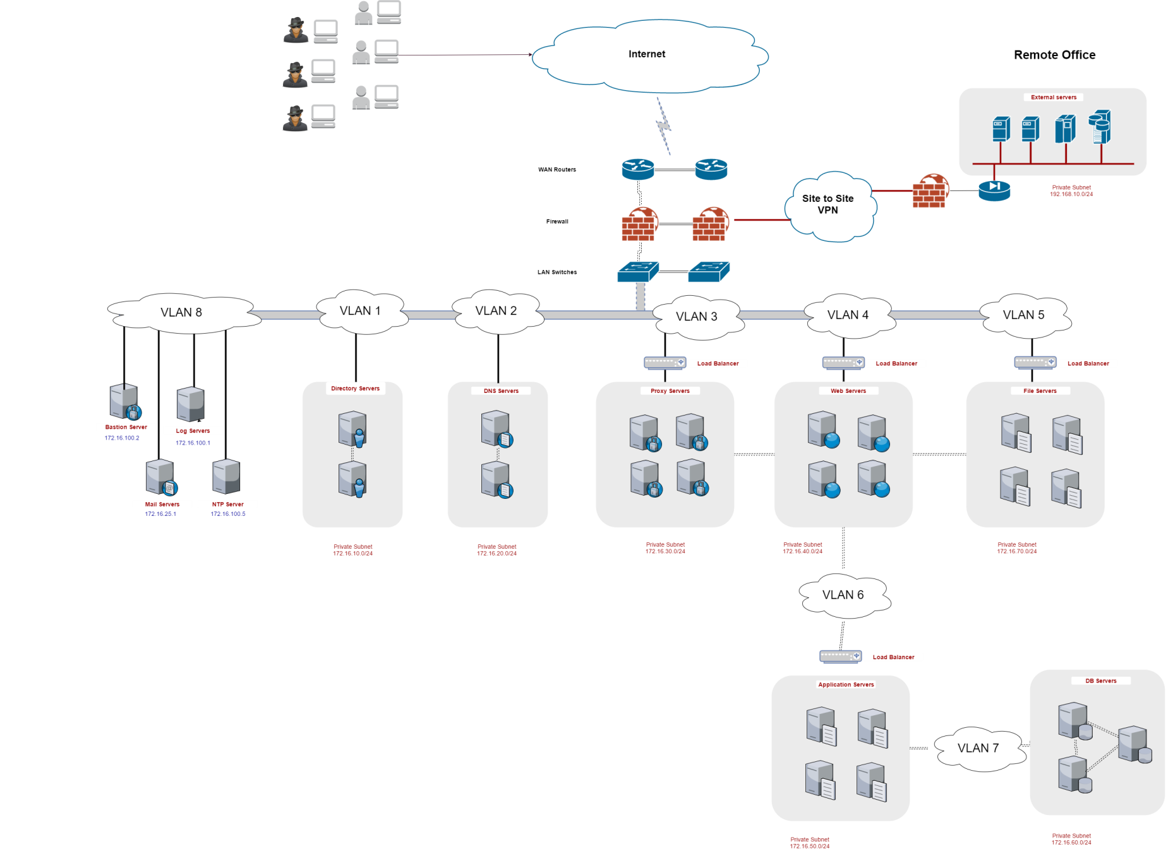
Network Infrastructure
Notes:
Onur
To create a model, we first analyzed enterprise network systems.
Lets have a look at the diagram which is taken from our case company’s network
There are several VLANs for various services. These services are protected by firewalls however firewall are not enough to prevent DoS attacks.
To prevent DoS attacks we need to analyze the network behavior instantly and we need proactive defense.
In most cases, we can observe regular traffic patterns in network. Because of scheduled tasks, updates, daily transactions, backup operations etc…

Slide 11
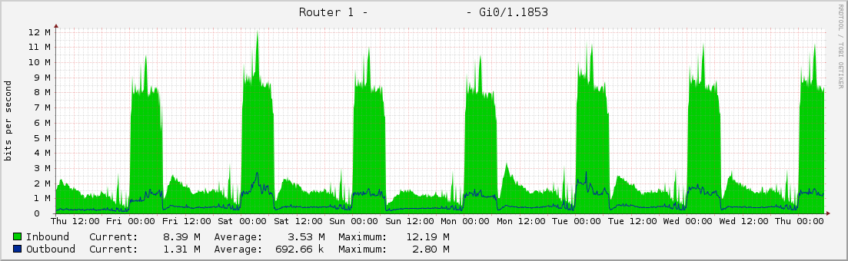
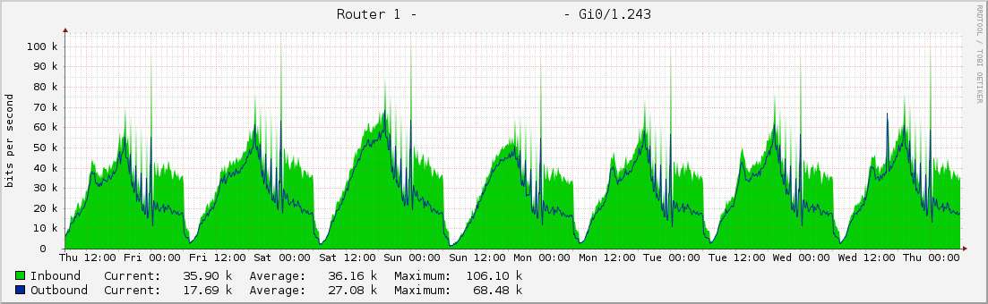
Traffic Patterns (Volume)
Notes:
Onur
This 2 figures show the data flow to 2 different services on the network. As you may see there is a regular trend during a week in both figures.
This figures belongs to the company we have investigated. The company processes banking transactions.

Slide 12
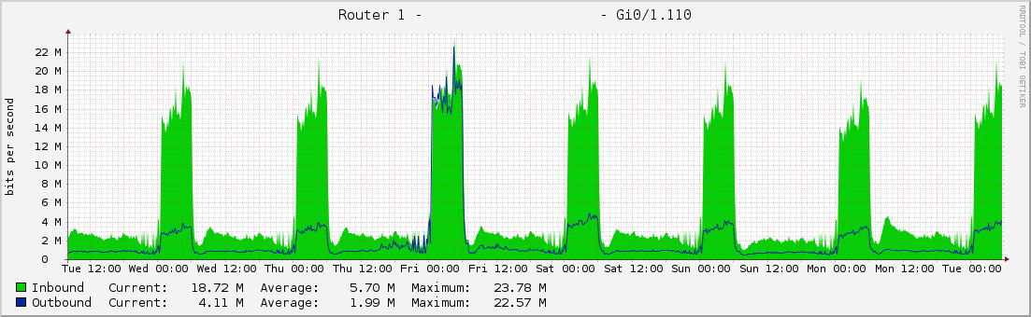
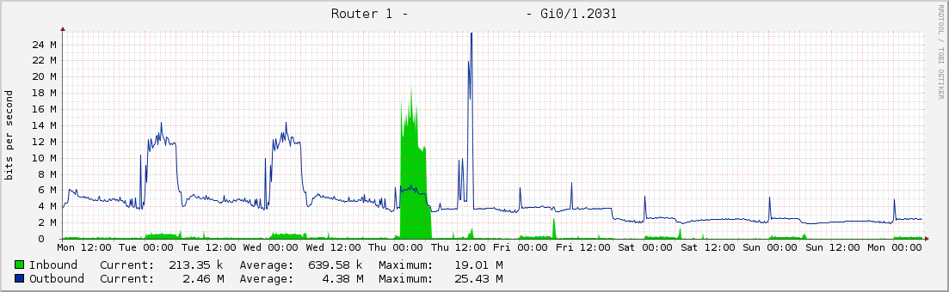
Traffic Patterns (Volume)
Notes:
Onur
However in this figure you may see anomaly on Friday on Outgoing traffic. In this incident, some private data has been leaked.
To prevent this kind of attacks the systems should proactively check the traffic patterns and anomalies and automatically create DENY rules to stop attackers to access the resources.

Slide 13
IPScore
We proposed a new approach to prevent mainly DoS attacks, brute force and network layer intrusions.
Our method analyzes network packets in 5 subjects
Source of traffic
Destination of traffic
Volume
Variation
Time distribution
Several constants and parameters to calculate IP reputation

Slide 14
IPScore - Constants
Constant | Definition | Description
N_{U} | Number of users/clients | The number of possible client connections (users/devices) that the system has. External connections to the system are made by users of the services. For instance, for a university system, the population of students and staff can be the maximum number for expected clients. This constant should roughly be defined by the system administrators. Clients can either be from users or devices.
N_{i} | Number of internal nodes | The number of IP addresses used for the services and servers including the clusters.
N_{s} | Number of services | The number of available services (such as FTP, HTTP, POP, SMTP, etc. ) that the system offers.
t | Tolerance | Tolerance ratio (%) (Default: %15)
L | Threshold Limit | Threshold score for deny operation defined by the system admin depending on the risk appetite of the organization 0.0 – 1.0
Notes:
Onur
- Table contains some constant that needs to be defined duing setup of system

Slide 15
IPScore - Parameters
Parameter | Definition
n_{max} | Maximum(peak) number of packets/10 minutes for a service in data set at all times
n_{avg} | Average of number of packets/ 10 minutes for a service in data set
n_{cur} | Number of packets to same service in last 10 minutes
t_{ns} | Number of distinct source addresses in last 10 minutes towards to same port
t_{nd} | Number of distinct destination addresses (ip+port) in last 10 minutes from same source
n_{days} | Number of days that source IP observed in history before the current day
h | Number of days that training data has
Notes:
Onur
- Table contains some runtime parameters

Slide 16
IPScore – Score Metrics
1. Static Rule Score (K)
2. Source Score (S)
IF t_{ns} < N THEN S = 1 - ( (1-L) * ( t_{ns} / N ) )
ELSE S = L + 1 - ( t_{ns} / N )
3. Familiarity Score (F)
IF n_{days} > 0 THEN F = L + ( 1-L ) * n_{days} / h
ELSE F= 0
4. Traffic Score (T)
IF n_{cur} > n_{max} THEN T=0 (n_{max} ± %t )
ELSE IF n_{cur} > n_{avg} then T = (n_{max} - n_{cur} ) / (n_{max} - n_{avg} )
ELSE T=1.0
5. Variation Score (V)
IF t_{nd} < N_{s} THEN V = 1 - ( (1-L) * ( t_{nd} / N_{s} ) )
ELSE V = L + 1 - ( t_{nd} / N_{s} )
Notes:
IPScore has 5 score metrics. These are ….

Slide 17
IPScore – Score Metrics
Overal Score:
P = K + AVG ( S + F + T +V )
IF P > L THEN allow packet
ELSE deny packet
We keep track of 10-minutes traffic in memory for faster processing
Notes:
Onur
-Overal score is calculated as follows.
-Hard to analyze data on runtime

Slide 18
IP Score – Implementation
Data taken from a payment gateway company
Processed traffic logs from all network devices
Training data: 1 week / 31 million requests
Each day: ~5 million requests
~ 50 internal nodes, 30 services, 400K clients
Data Sanitization before processing
Sensitive data removed
Analyzed data in 10-minute resolution
Simulate real time analysis on runtime

Slide 19
Experiments
Success rate depends on training data, risk appetite (threshold) and tolerance ratios
Training data updated on run time
Limited computing resource for longer duration run time analysis

Slide 20
Next Steps
Experiments on different attack scenarios
Future goals: Integrate resource usage for network & server components as a metric and geo-location data for IP reputation scoring. (Out of scope in the project)
Notes:
Onur
-Next step is to test our algorithms and method with test data (different logs)
-In the future, we would like to improve the tool by integrating …

Slide 21
References
W. G. Morein, A. Stavrou, D. L. Cook, A. D. Keromytis, V. Misra, D. Rubensteiny, Using Graphic Turing Tests To Counter Automated DDoS Attacks Against Web Servers, in: Proceedings of the 10th ACM conference on Computer and communications security, Washington, DC, USA, 2003.
J.-F. Podevin, Telling humans and computers apart automatically, COMMUNICATIONS OF THE ACM 47 (2) (2004) 57–60.
G. Mori, J. Malik, Recognizing Objects in Adversarial Clutter: Breaking a Visual CAPTCHA, in: Proceedings of IEEE Computer Society Conference on Computer Vision and Pattern Recognition, Madison, Wisconsin, 2003.
E. Athanasopoulos, S. Antonatos, Enhanced CAPTCHAs: Using Animation to Tell Humans and Computers Apart, in: Proceedings of Communications and Multimedia Security, 2006, pp. 97–108.
H. D. Truong, C. F. Turner, C. C. Zou, iCAPTCHA: The Next Generation of CAPTCHA Designed to Defend Against 3rd Party Human Attacks, in: Proceedings of IEEE International Conference on Communications, Kyoto, Japan, 2011.
T. Yatagai, T. Isohara, I. Sasase, Detection of HTTP-GET flood Attack Based on Analysis of Page Access Behavior, in: Proceedings of IEEE Pacific Rim Conference on Communications, Computers and Signal Processing, 2007, pp. 232–235.
Beitollahi, H., & Deconinck, G. (2012). Tackling Application-layer DDoS Attacks. Procedia Computer Science, 10, 432-441. doi:10.1016/j.procs.2012.06.056
H. Beitollahi, G. Deconinck, ConnectionScore: A Statistical Technique to Resist Application-layer DDoS Attacks, Tech. Rep. 01-2012-0130, Electrical Engineering Department, University of Leuven, Belgium, http://www.esat.kuleuven.be/electa/publications/fulltexts/pub 2313.pdf (2012).

Slide 22

Questions

