Slide 1
Clothes Classification
Segmentation and Clustering

Slide 2
Purpose
The purpose of our Project is to segment the clothes from the images at first.
After we completed the first part, we used K-means clustering to put the similar colored clothes into same folder.

Slide 3
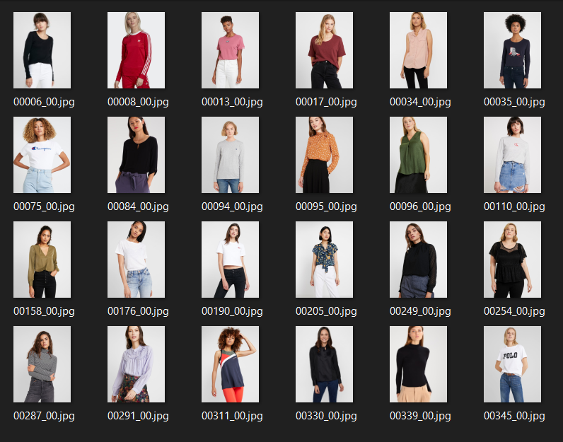
This is our dataset, the dataset has 2032 images.
https://www.kaggle.com/datasets/marquis03/high-resolution-viton-zalando-dataset/

Slide 4
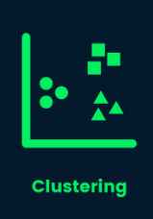
We used U-net segmentation to get the clothes and put them into another folder.
Then, we used K-means clustering to group these new images. We created different folders for each group and add similar colored images into same folder.

Slide 5
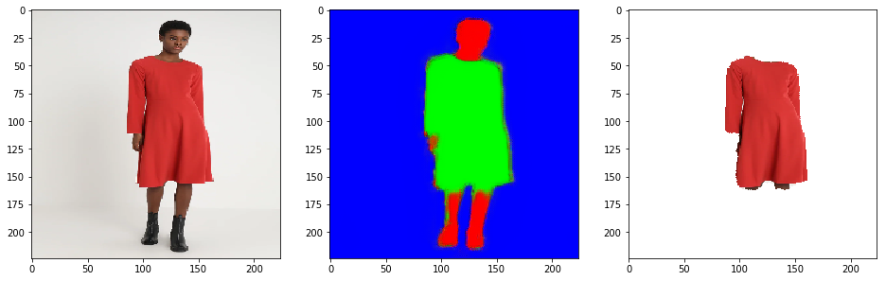
U-Net is a different architecture created from convolutional neural network layers and provides more successful results than classical models in pixel-based image segmentation. Even with a small number of training images!

Slide 6
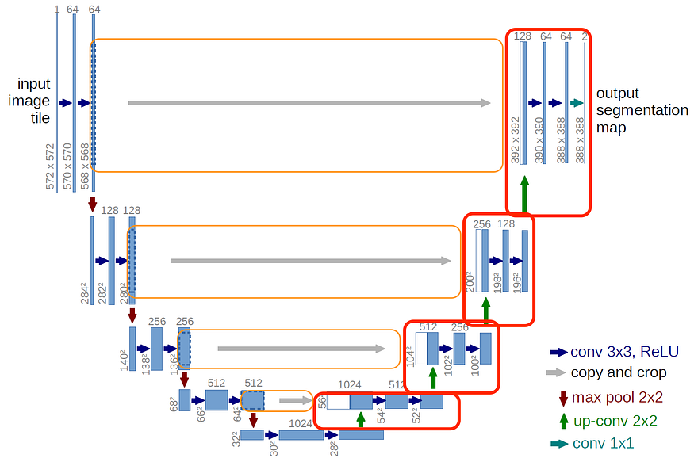

Slide 7
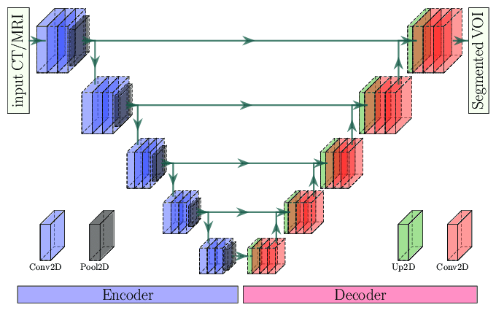
Encoder
It includes a series of convolutional layers that transform the input image into a small-sized feature map.
Each convolutional layer typically performs convolution operations using activation functions such as ReLU and features like max-pooling, reducing the size of the feature map while enhancing the representation with learned features.
The size of the feature map usually decreases with each convolutional layer, but the learned features become more complex.

Slide 8
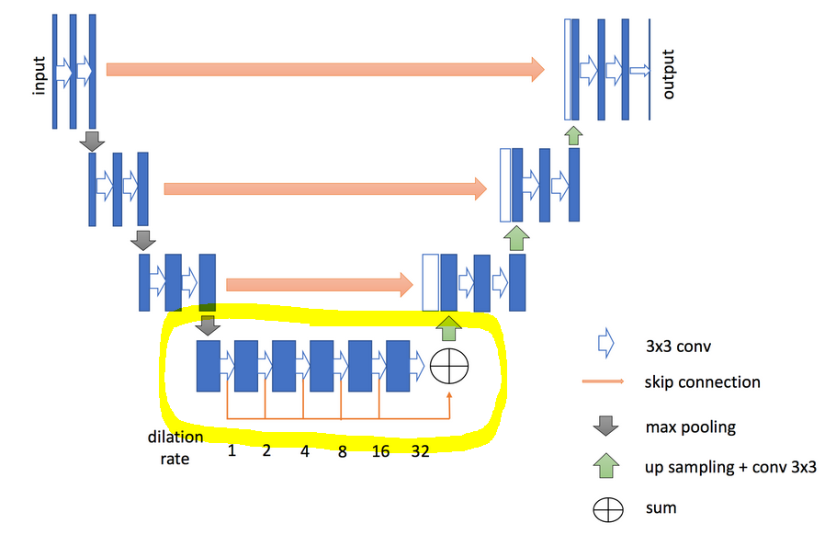
Bottleneck(Common Layer)
After the convolutional layers in the encoder, there is a bottleneck layer that compresses the feature map to a smaller size.
The bottleneck layer allows the network to capture the overall context and high-level features.

Slide 9
Decoder
It consists of a series of transpose convolutional layers that upsample the small feature map back to the original input size
Each transpose convolutional layer expands the feature map size and adds additional information to the output to reduce information loss.
Each layer in the decoder improves object boundaries and features using the learned features from earlier convolutional layers.

Slide 10
Output Layer
The final layer in the decoder produces the segmentation map.
Each pixel in the output layer contains a probability value indicating the likelihood that it belongs to a specific region in the original image.
This segmentation map can be transformed into labels specifying the class to which each pixel belongs.
The U-Net architecture is effective, especially when working with limited labeled datasets.

Slide 11
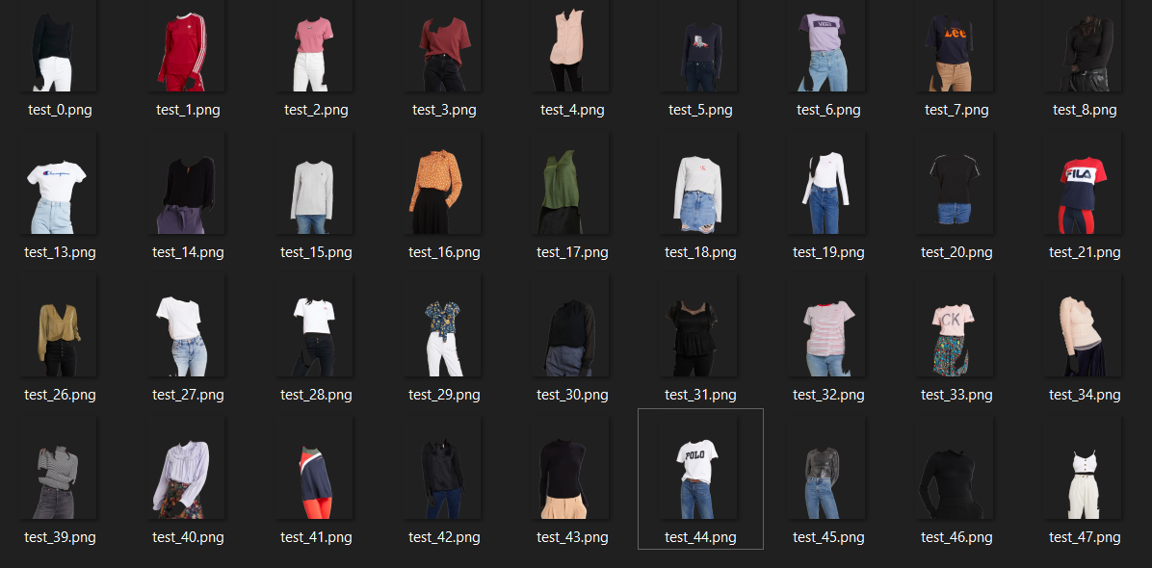

Slide 12
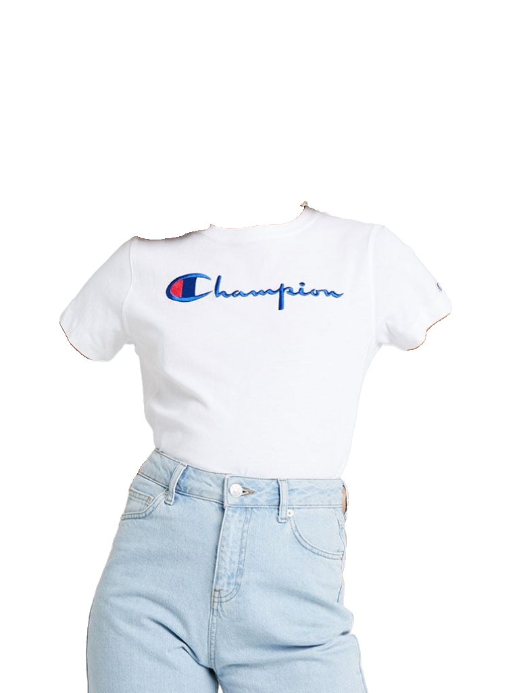
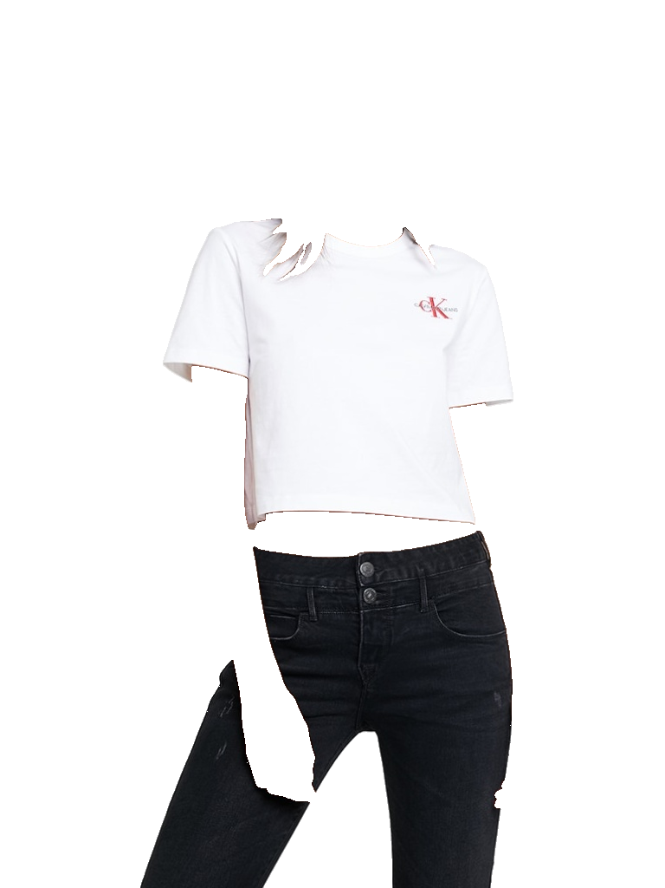
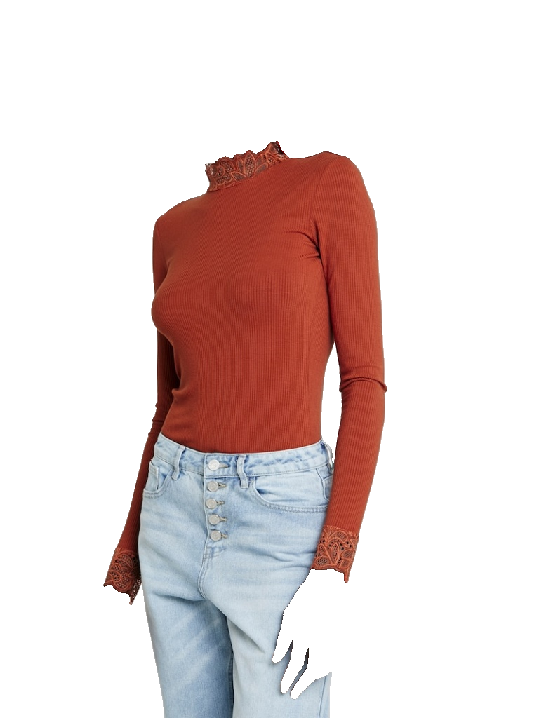

Slide 13
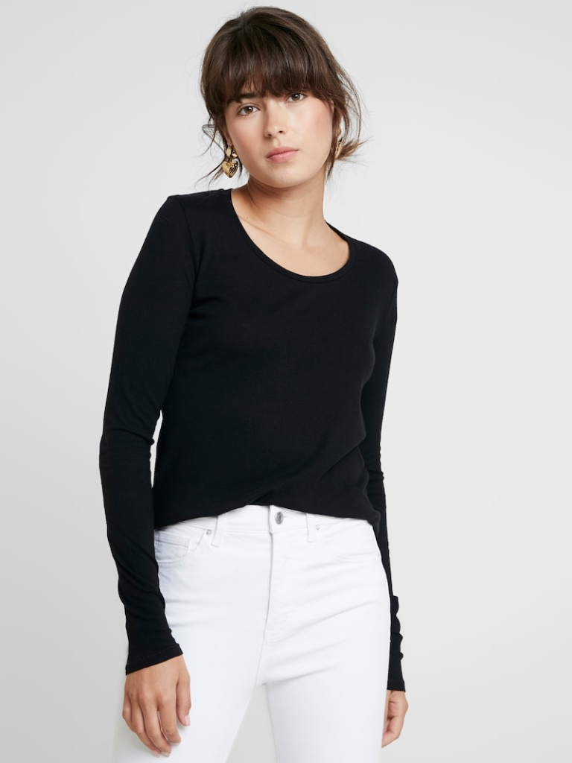
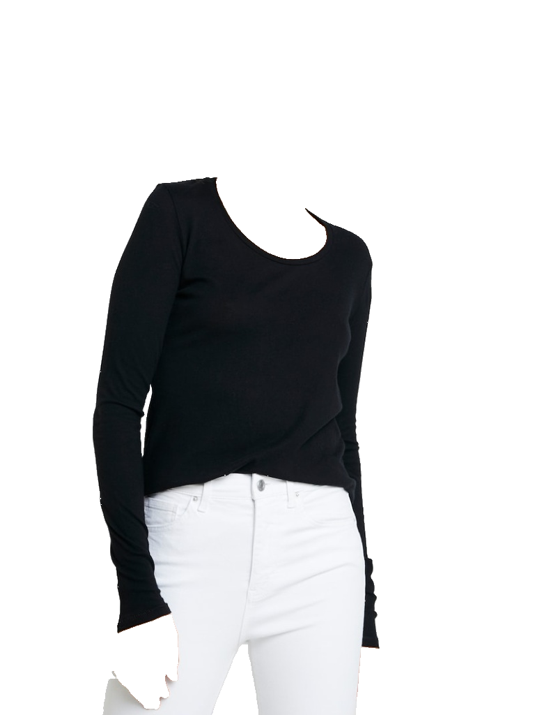
We completed the segmentation part. Now we have a folder contains the segmented images like as we see here.

Slide 14
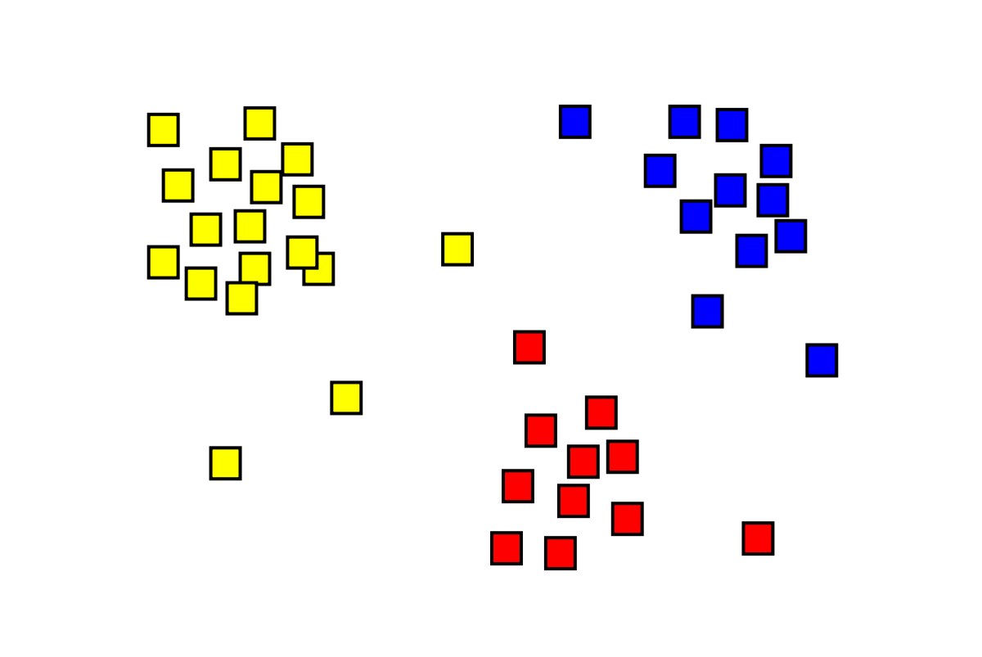
Clustering is a technique in machine learning and data analysis that involves grouping a set of objects or data points into subsets or clusters based on certain similarities or patterns. The goal of clustering is to divide a dataset into groups in such a way that objects within the same group are more similar to each other than they are to objects in other groups.

Slide 15
Different Clustering Algorithms
There are some clustering algorithms we can use.
K-Means, Hierarchical Clustering, DBSCAN, Mean Shift, Agglomerative Clustering
We used K-means in our projects because of its advantages and it is not a complex algorithm.
There are different algorithms made after K-means that can be used in different projects such as; K-means++, X-means

Slide 16
K-means Advantages
Efficiency: K-means is computationally efficient, making it suitable for large datasets.
Simplicity: K-means is conceptually simple and easy to implement, making it a good choice for initial exploration and prototyping.
Uniform Clusters: If clothes are expected to form relatively uniform and spherical clusters, K-means may perform well.

Slide 17
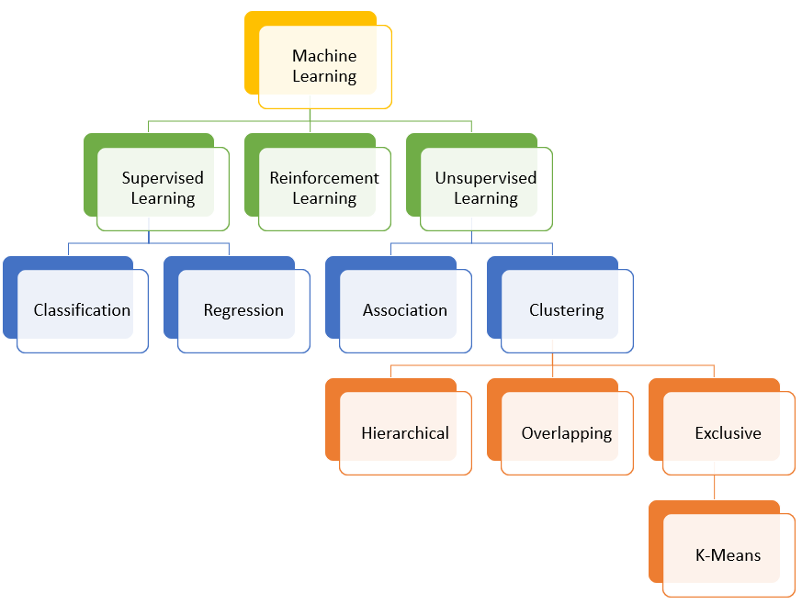
K-means is an Unsupervised Learning algorithm. It does not care the labels of the inputs.
It just groups the similar ones and clusters them.

Slide 18
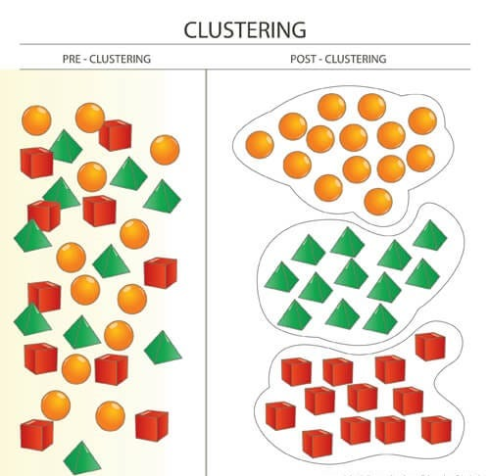
Determine the Number of Clusters (k)
The first step is to choose the number of clusters (k) that you want the algorithm to form. This is often determined by considering patterns in the data or specific information requirements.

Slide 19
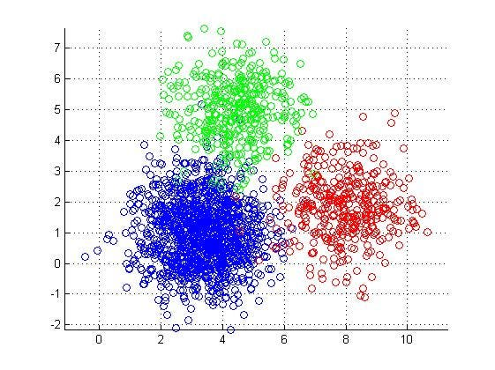
Initialize Cluster Centers
K-Means starts with k initial cluster centers, each representing the center of a cluster. These initial centers are usually randomly chosen, although more sophisticated methods like K-Means++ exist for a better initialization.

Slide 20
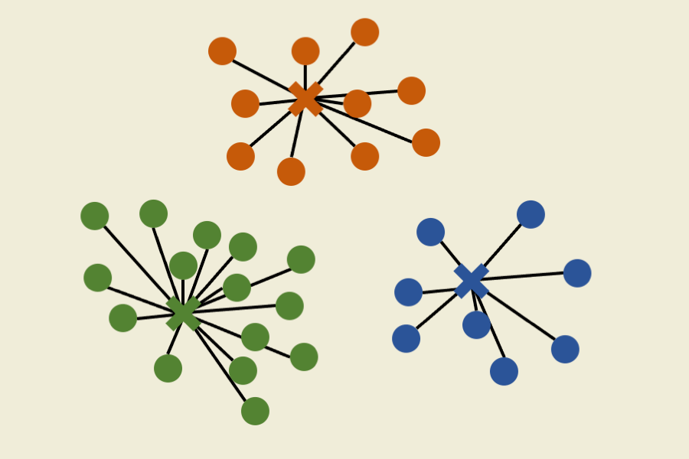
Assign Data Points to Clusters and Update Cluster Centers
Each data point is assigned to the cluster whose center is closest to it. This assignment is typically done using a distance metric such as Euclidean distance
The cluster centers are updated by computing the mean of all data points assigned to each cluster. This step is used to refine the cluster centers.
These steps are iteratively repeated until convergence.

Slide 21
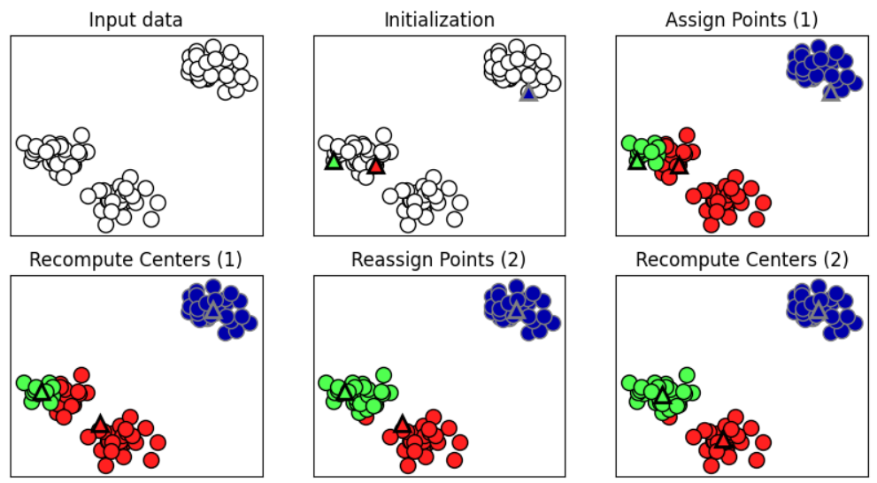

Slide 22
Convergence Check
The algorithm stops when the change in cluster centers falls below a certain threshold or after a specified number of iterations.

Slide 23
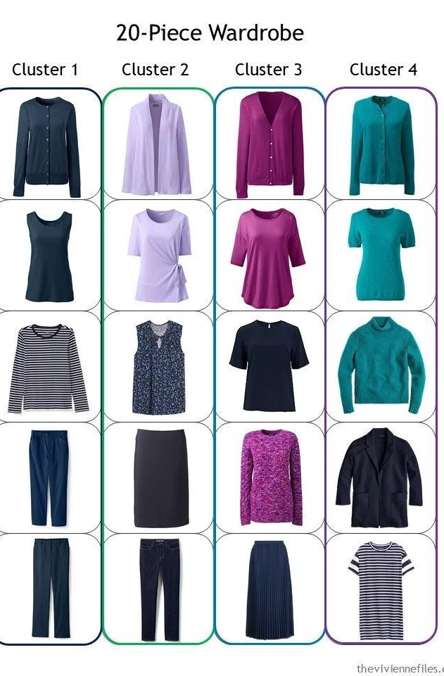
Result
Now we have K clusters(folders) and similar clothes are in the same folder. There might be some exceptation, this algorithm is very successful.

Slide 24
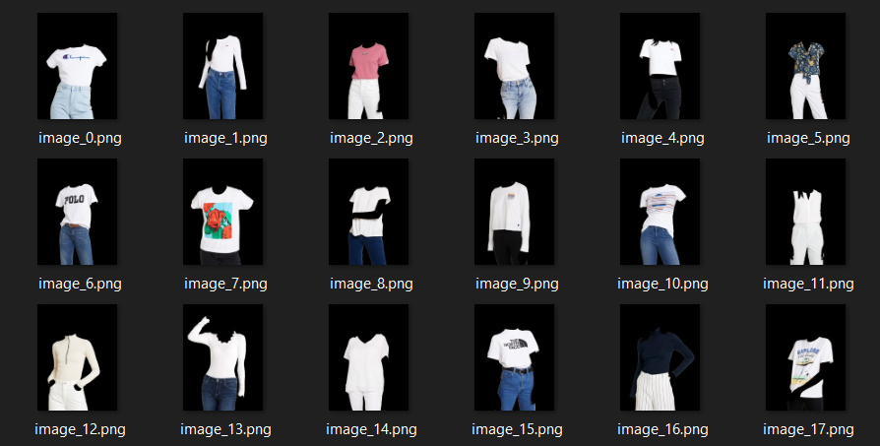

Slide 25
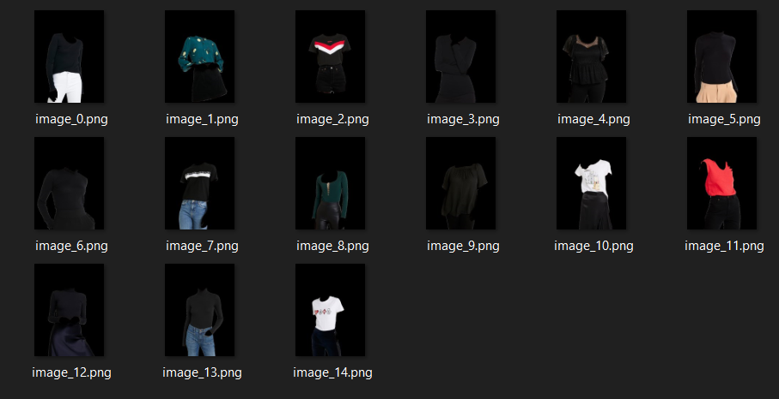

Slide 26
