Slide 1

Top Football Leagues Scorers
Numpy-Pandas-Data Visualization – GUI
Onur MERT – 1906102030
Muratcan AVCU - 1906102042

Slide 2
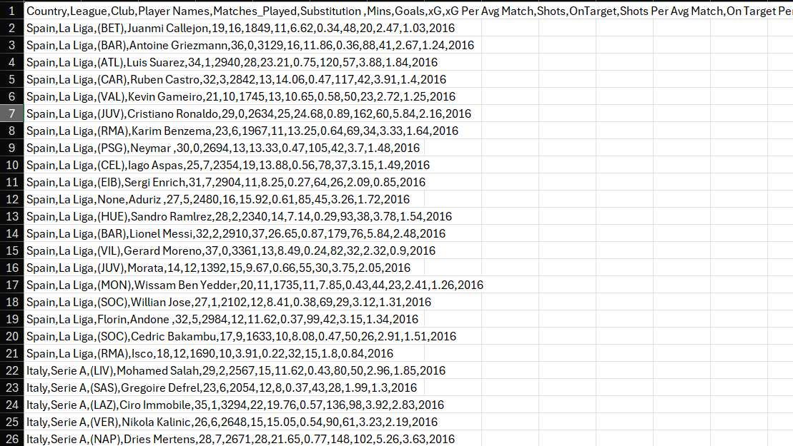
Dataset
https://www.kaggle.com/datasets/mohamedhanyyy/top-football-leagues-scorers/data

Slide 3
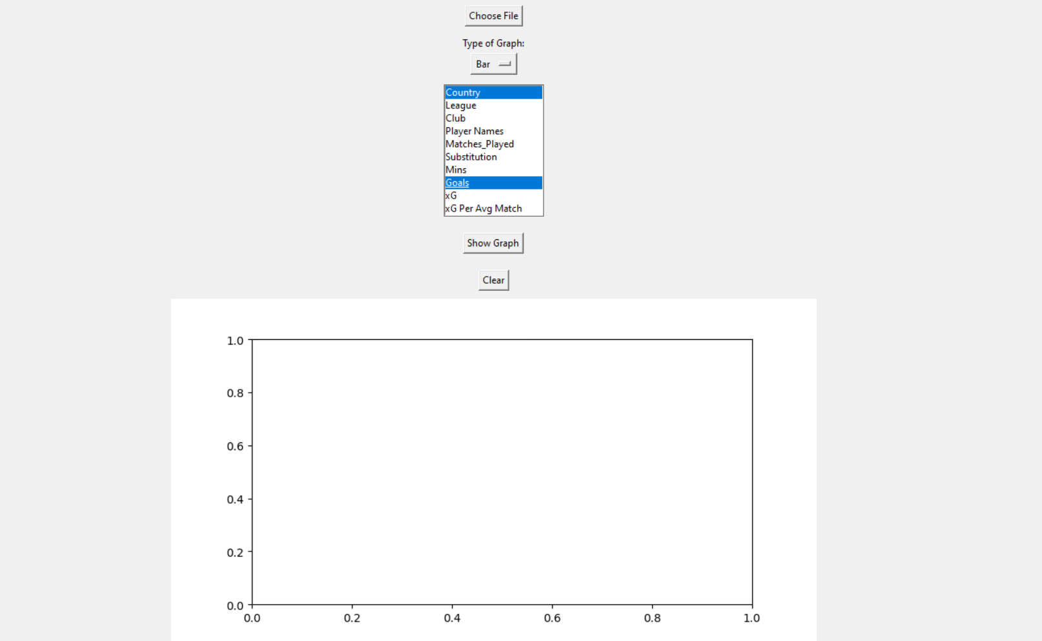
App
Upload file with ‘’Choose File’’ button.
Decide the type of graph.
Choose the categories you want to see on graph.
We have; Bar, Pie, Scatter, Histogram, Violin, Line graphs as options.

Slide 4
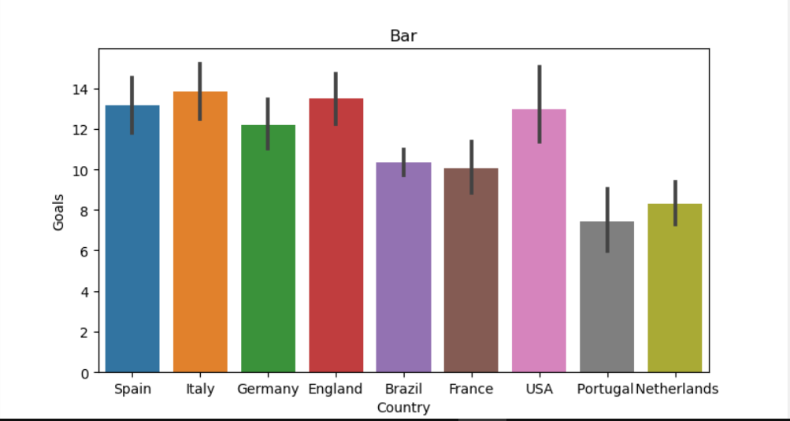
Bar
We can see the total goals for each country.
So, we can understand what country is easy to score.

Slide 5
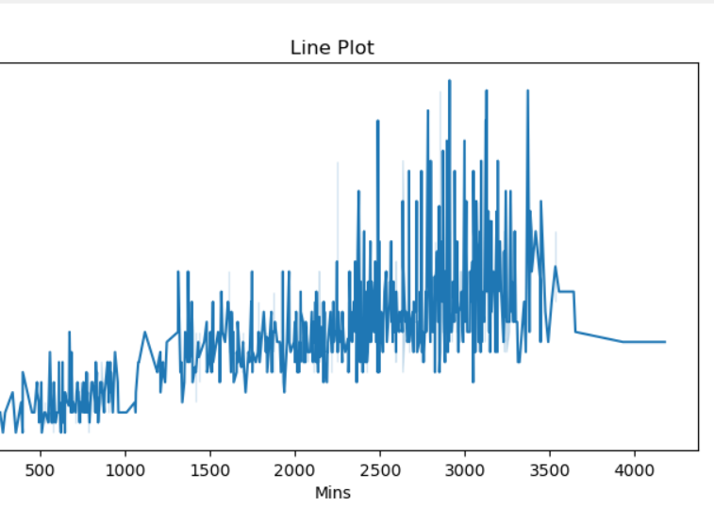
Line Plot
We see Goals-Minutes stats here.
We can say if players played more, they scored more.
But if more than 3500 minutes, they scored a bit less. Because they are not playing in Forward. (Generally Midfielders or Defenders play more consistently in football)

Slide 6
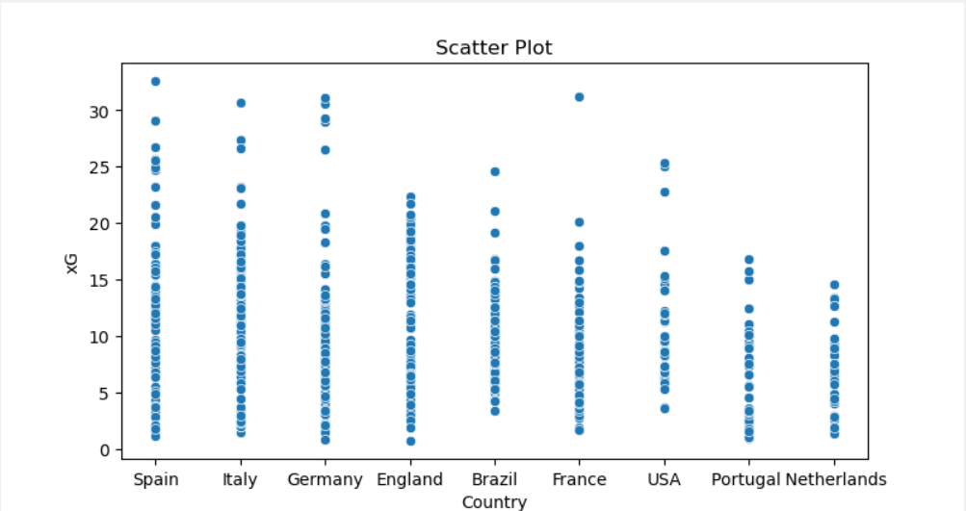
Scatter Plot
We can see xG-Country stats here.
It shows in which country , players can find more opportunities to score.

Slide 7
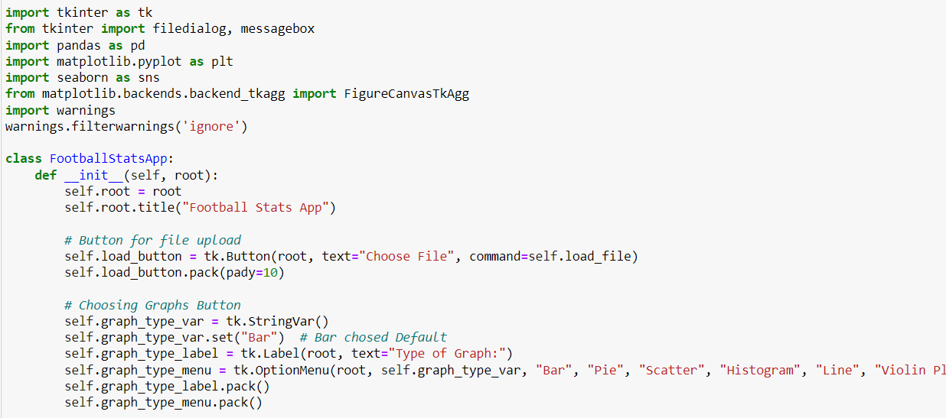
The parts we write our own

Slide 8
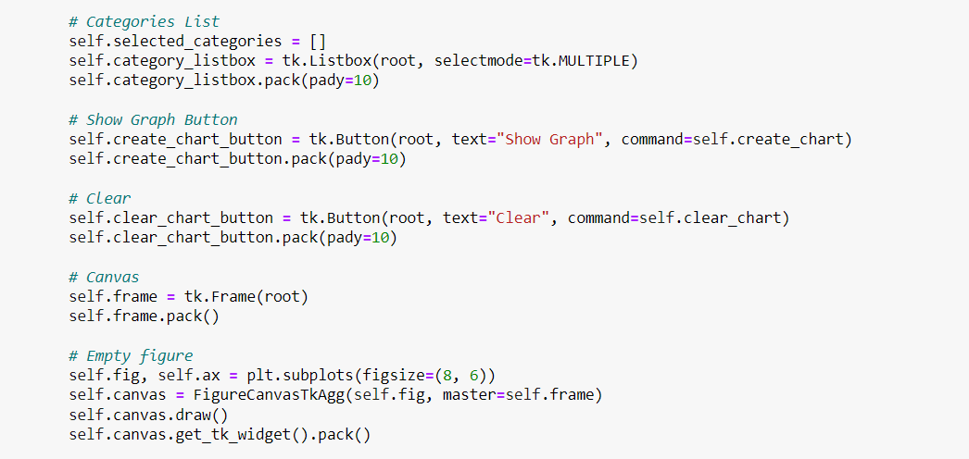
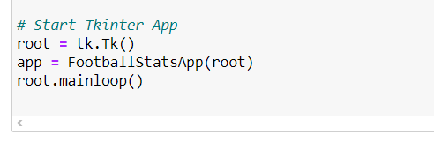

Slide 9
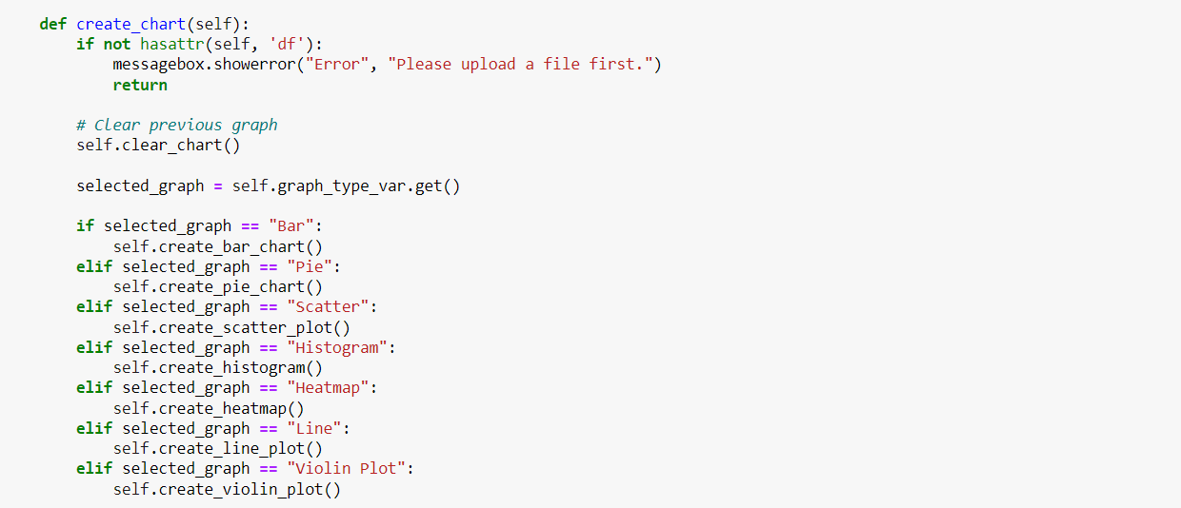
The parts we got help

Slide 10
