Slide 1


Tech ABC Corp - HR Database
Onur Özdemir 11/12/2023

Slide 2
Business Scenario
Business requirement
Tech ABC Corp saw explosive growth with a sudden appearance onto the gaming scene with their new AI-powered video game console. As a result, they have gone from a small 10 person operation to 200 employees and 5 locations in under a year. HR is having trouble keeping up with the growth, since they are still maintaining employee information in a spreadsheet. While that worked for ten employees, it has becoming increasingly cumbersome to manage as the company expands.
As such, the HR department has tasked you, as the new data architect, to design and build a database capable of managing their employee information.
Dataset
The HR dataset you will be working with is an Excel workbook which consists of 206 records, with eleven columns. The data is in human readable format, and has not been normalized at all. The data lists the names of employees at Tech ABC Corp as well as information such as job title, department, manager's name, hire date, start date, end date, work location, and salary.
IT Department Best Practices
The IT Department has certain Best Practices policies for databases you should follow, as detailed in the Best Practices document.

Slide 3
Step 1
Data Architecture Foundations

Slide 4
Step 1: Data Architecture Foundations
Hi,
Welcome to Tech ABC Corp. We are excited to have some new talent onboard. As you may already know, Tech ABC Corp has recently experienced a lot of growth. Our AI powered video game console WOPR has been hugely successful and as a result, our company has grown from 10 employees to 200 in only 6 months (and we are projecting a 20% growth a year for the next 5 years). We have also grown from our Dallas, Texas office, to 4 other locations nationwide: New York City, NY, San Francisco, CA, Minneapolis, MN, and Nashville, TN.
While this growth is great, it is really starting to put a strain on our record keeping in HR. We currently maintain all employee information on a shared spreadsheet. When HR consisted of only myself, managing everyone on an Excel spreadsheet was simple, but now that it is a shared document I am having serious reservations about data integrity and data security. If the wrong person got their hands on the HR file, they would see the salaries of every employee in the company, all the way up to the president.
After speaking with Jacob Lauber, the manager of IT, he suggested I put in a request to have my HR Excel file converted into a database. He suggested I reach out to you as I am told you have experience in designing and building databases. When you are building this, please keep in mind that I want any employee with a domain login to be have read only access the database. I just don't want them having access to salary information. That needs to be restricted to HR and management level employees only. Management and HR employees should also be the only ones with write access. By our current estimates, 90% of users will be read only.
I also want to make sure you know that am looking to turn my spreadsheet into a live database, one I can input and edit information into. I am not really concerned with reporting capabilities at the moment. Since we are working with employee data we are required by federal regulations to maintain this data for at least 7 years; additionally, since this is considered business critical data, we need to make sure it gets backed up properly.
As a final consideration. We would like to be able to connect with the payroll department's system in the future. They maintain employee attendance and paid time off information. It would be nice if the two systems could interface in the future
I am looking forward to working with you and seeing what kind of database you design for us.
Thanks,
Sarah Collins
Head of HR

Slide 5
Data Architect Business Requirement
Purpose of the new database:
HR department using excel for data operations. They don't have database technology. This situtaion decrease data management ability of data. In addition, HR Department face with issues such as keeping data in compliance with regulations, partial authorization of dataset with specific department, volume growth and difficulty in data tracking. Database technologies perfect solution all of these pain points. So, create database is needence on new database technology.
Describe current data management solution:
HR Department using shared Excel files for data management solution.
Describe current data available:
Data is available on shared excel spreadsheet.
Additional data requests:
Required by federal regulations to maintain this data for at least 7 years; additionally, since this is considered business critical data, we need to make sure it gets backed up properly. Also, database should be ready for future integration with payroll department's system

Slide 6
Data Architect Business Requirement
Who will own/manage data
HR department manages data. They resposible data operations on database.
Who will have access to database
Read Only User: Any employee of company
Read & Write User: Management & HR Employee
Read Only User Restriction: This role doesn’t have access to salary information

Slide 7
Data Architect Business Requirement
Estimated size of database
Database’ll create from one spreadsheet data which has 205 rows and 14 columns data.
Estimated annual growth
HR deparment expecting 20% growth a year for the next 5 year.
Is any of the data sensitive/restricted
Salary information must be restricted to HR and management level employees only, cause of sensitive data.

Slide 8
Data Architect Technical Requirement
Justification for the new database
Provide at least two justifications for building a database
Database objects
List the database objects (tables, views, special procedures) that will be created for the database.
Hint - you may want to circle back to this answer after completing the logical ERD in step 2.
Data ingestion
Direct feed

Slide 9
Data Architect Technical Requirement
Data governance (Ownership and User access)
Ownership: HR Deparment
User Access: HR Department Employees and Management Level has full access to data. Other employees have only read access, except for salary information.
Scalability
Database should has replication factor 3 for data loss protection. It should has state based sharding for query performance on each office.
Flexibility
Database should be ready for future integration with payroll department's system.
Storage & retention
Storage (disk or in-memory): Data should store on disk.
Retention: Required by federal regulations to maintain this data for at least 7 years. On each 7 years, data should be archived.
Backup
This database store business critical data. So, data should backup schedule is full backup 1x per week, incremental backup daily

Slide 10
Step 2
Relational Database Design

Slide 11
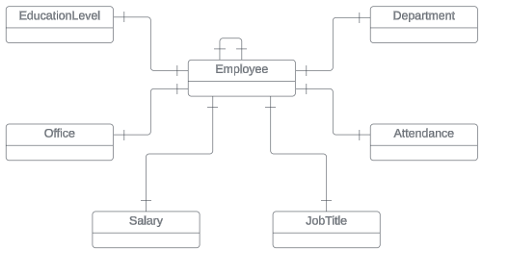
ERD
Conceptual

Slide 12
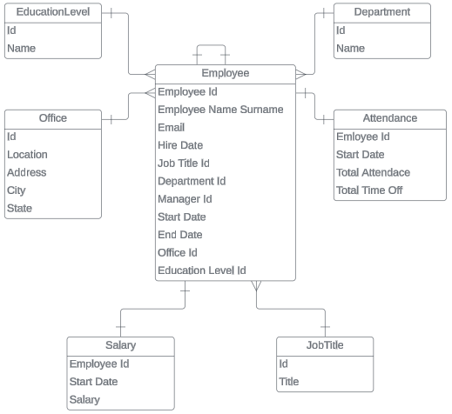
ERD
Logical

Slide 13
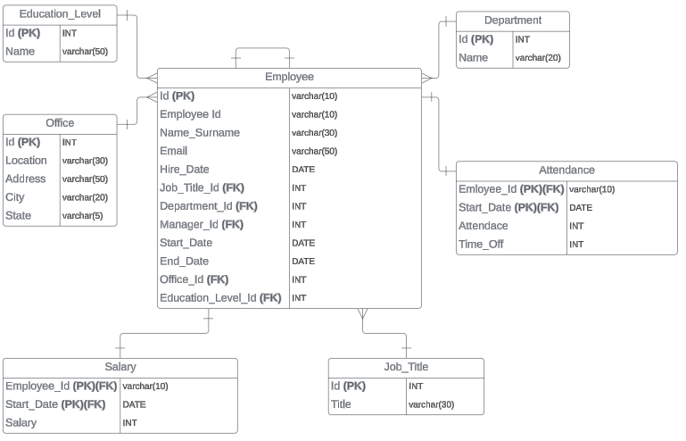
ERD
Physical

Slide 14
Step 3
Create A Physical Database

Slide 15
Step 3: Create A Physical Database
In this step, you will be turning your database model into a physical database.
You will:
Create the database using SQL DDL commands
Load the data into your database, utilizing flat file ETL
Answer a series of questions using CRUD SQL commands to demonstrate your database was created and populated correctly
Submission
For this step, you will need to submit SQL files containing all DDL SQL scripts used to create the database.
You will also have to submit screenshots showing CRUD commands, along with results for each of the questions found in the starter template.
Hints
Your DDL script will be graded by running the code you submit. Please ensure your SQL code runs properly!
Foreign keys cannot be created on tables that do not exist yet, so it may be easier to create all tables in the database, then to go back and run modify statements on the tables to create foreign key constraints.
After running CRUD commands like update, insert, or delete, run a SELECT* command on the affected table, so the reviewer can see the results of the command.

Slide 16
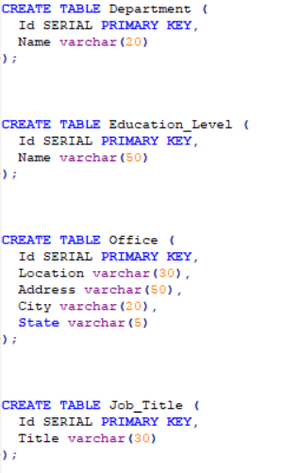
DDL

Slide 17
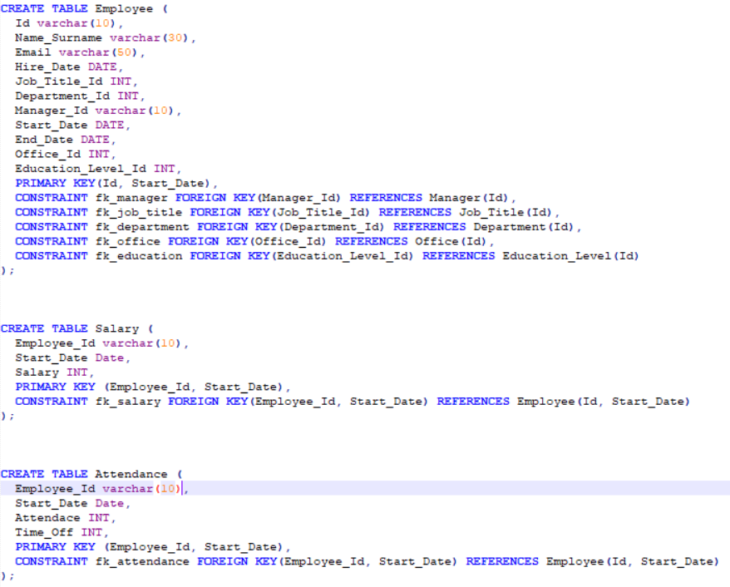
DDL

Slide 18
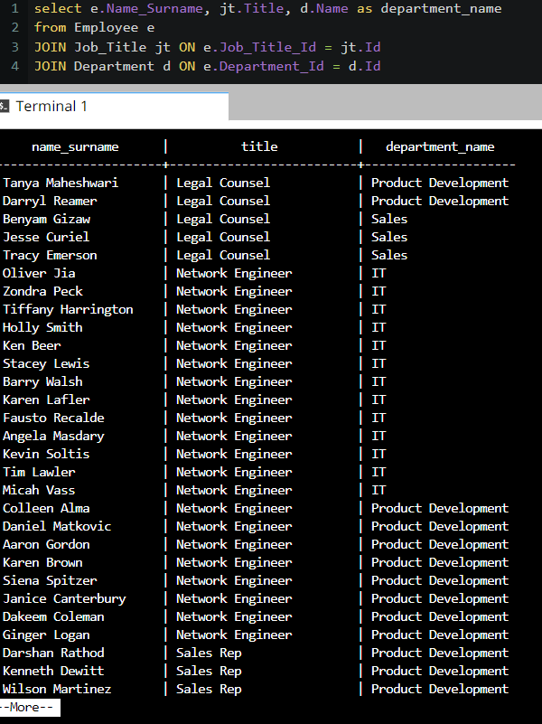
CRUD
Question 1: Return a list of employees with Job Titles and Department Names
Notes:
select e.Name_Surname, jt.Title, d.Name as department_name
from Employee e
JOIN Job_Title jt ON e.Job_Title_Id = jt.Id
JOIN Department d ON e.Department_Id = d.Id

Slide 19
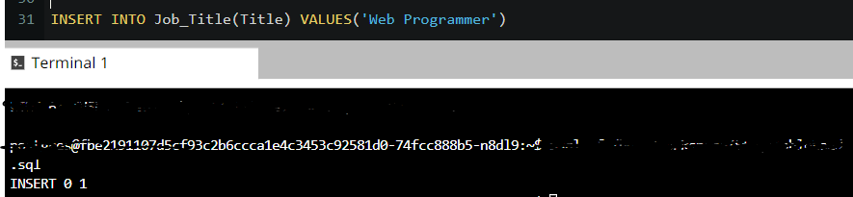
CRUD
Question 2: Insert Web Programmer as a new job title
Notes:
INSERT INTO Job_Title(Title) VALUES('Web Programmer')

Slide 20
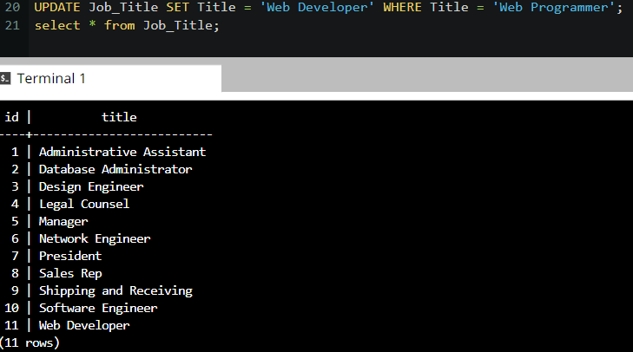
CRUD
Question 3: Correct the job title from web programmer to web developer
Notes:
UPDATE Job_Title SET Title = 'Web Developer' WHERE Title = 'Web Programmer';

Slide 21
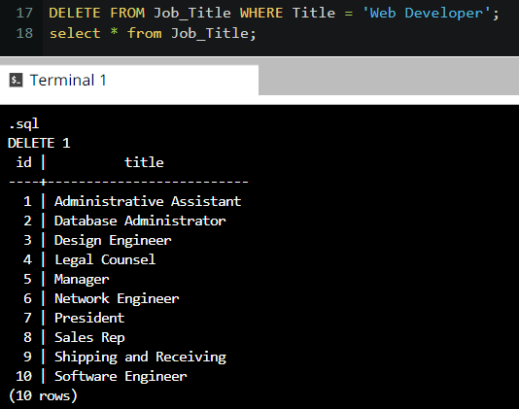
CRUD
Question 4: Delete the job title Web Developer from the database
Notes:
DELETE FROM Job_Title WHERE Title = 'Web Developer';

Slide 22
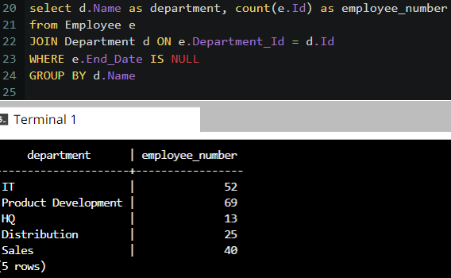
CRUD
Question 5: How many employees are in each department?
Notes:
select d.Name, count(e.Id) as employee_number
from Employee e
JOIN Department d ON e.Department_Id = d.Id
WHERE e.End_Date = NULL
GROUP BY d.Name

Slide 23
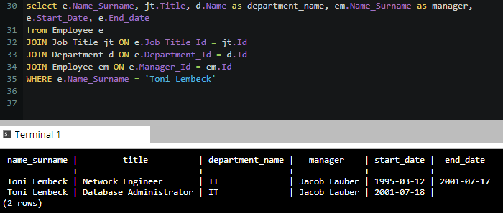
CRUD
Question 6: Write a query that returns current and past jobs (include employee name, job title, department, manager name, start and end date for position) for employee Toni Lembeck.
Notes:
select e.Name_Surname, jt.Title, d.Name as department_name, em.Name_Surname as manager, e.Start_Date, e.End_date
from Employee e
JOIN Job_Title jt ON e.Job_Title_Id = jt.Id
JOIN Department d ON e.Department_Id = d.Id
JOIN Employee em ON e.Manager_Id = em.Id
WHERE e.Name_Surname = 'Toni Lembeck'

Slide 24
CRUD
Question 7: Describe how you would apply table security to restrict access to employee salaries using an SQL server.
To ensure the security of salary information, I create a new salary table by removing this information from employee table. In this way, i can prevent information leakage by defining access permissions to groups or users on this table.

