Slide 1
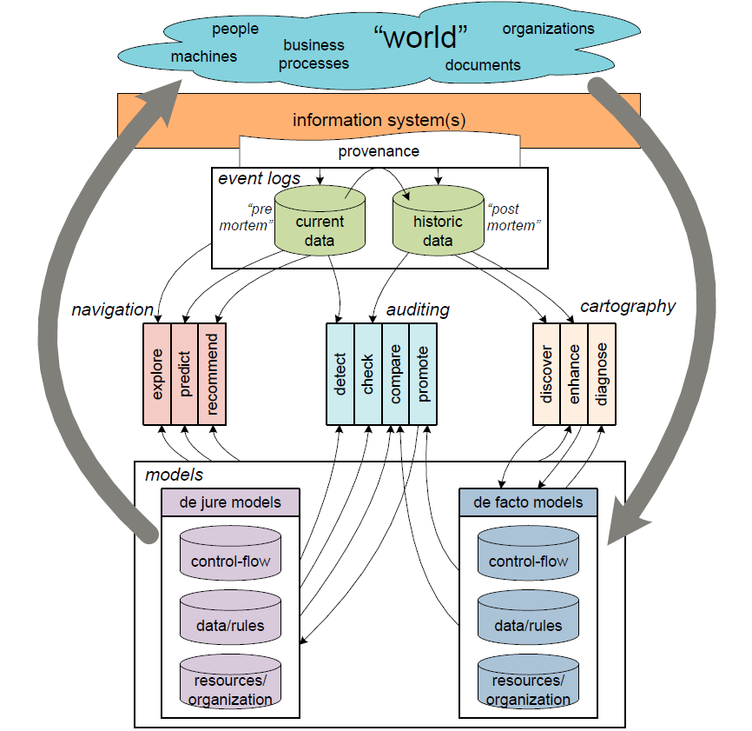

Slide 2
NAVIGATION
Explore
Predict
EVENT LOGS
Recommend
MODELS
Provenance
AUDITING
Current Data
(pre mortem)
Information Systems
De jure models
Detect
Check
Historic Data
(post mortem)
Compare
De facto models
Promote
CARTOGRAPHY
Discover
Enhance
Diagnose

