Slide 1
JSP Programming
Niraj Khadka

Slide 2
JSP Programming
JSP is another J2EE technology for building web applications using Java.
JSP technology is used to create web application just like Servlet technology. It can be thought of as an extension to Servlet because it provides more functionality than servlet such as expression language, JSTL, etc.
Java Server Pages (JSP) is a technology which is used to develop web pages by inserting Java code into the HTML pages by making special JSP tags.

Slide 3
JSP Programming
JSP technology is built on top of servlet technology. This is why we can call JSP as an abstraction over servlet. What does abstraction mean? In simple terms, abstraction is a simplified fine grained layer over a slightly more complex layer that makes the development faster and easier. More the abstraction, more the simplicity.
JSP technology is used to create dynamic web applications. JSP pages are easier to maintain than a Servlet. JSP pages are opposite of Servlets as a servlet adds HTML code inside Java code, while JSP adds Java code inside HTML using JSP tags. Everything a Servlet can do, a JSP page can also do it.

Slide 4
JSP Basics
A typical JSP page very much looks like html page with all the html markup except that you also see Java code in it. So, in essence,
HTML + Java = JSP
Therefore, JSP content is a mixed content, with a mixture of HTML and Java. If this is the case, one question arises. Can we can’t save this mixed content in a file with “.html” extension because the html formatter will also treat the Java code as plain text which is not what we want.
We want the Java code to be executed and display the dynamic content in the page. For this to happen, we need to use a different extension which is the “.jsp” extension.

Slide 5
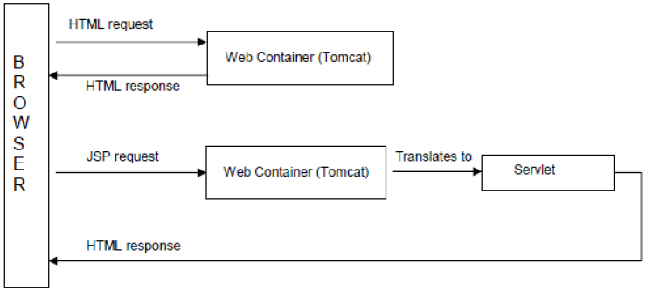
HTML and JSP Request

Slide 6
HTML and JSP Request
When the browser requests for html file, the web container simply responds with a html response without any processing.
However, when the browser sends a JSP page request, the web container assumes that the JSP page might include Java code, and translates the page into a Servlet. The servlet then processes the Java code, and returns the complete html response including the dynamic content generated by the Java code.
For a web container to translate JSP, it needs to identify from the JSP page, as to which is HTML markup and which is Java code. According to J2EE specification, a JSP page must use special symbols as placeholders for Java code. The web container uses the special symbols to identify it.

Slide 7
4 Placeholders in JSP
JSP Code | Translated to
<%! JAVA COE %> | Global Variables and methods in servlet
<% JAVA CODE %> | doGet{ JAVA CODE } doPost{ JAVA CODE }
<%= JAVA CODE %> | PrintWriter pw = res.getWriter(); pw.println( JAVA CODE);
<%@ %> | Mostly as imports in servlet

Slide 8
Summary about JSP
JSP : Java Server Pages
JSP is a technology for building web applications using Java
JSP is tag based
JSP = HTML + Java Code
Translation process and compilation process is automatically done by web container

Slide 9
LifeCycle of JSP
A JSP page is converted into Servlet in order to service requests. The translation of a JSP page to a Servlet is called Lifecycle of JSP.
Translation of JSP to Servlet code.
Compilation of Servlet to bytecode.
Loading Servlet class.
Creating servlet instance.
Initialization by calling jspInit() method
Request Processing by calling _jspService() method
Destroying by calling jspDestroy() method

Slide 10
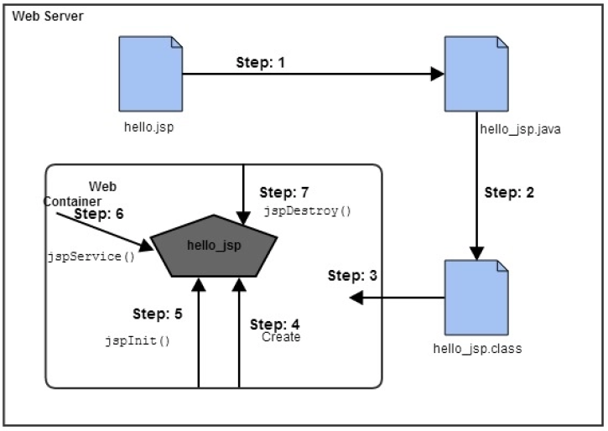
LifeCycle of JSP

Slide 11
LifeCycle of JSP
Translation – JSP pages doesn’t look like normal java classes, actually JSP container parse the JSP pages and translate them to generate corresponding servlet source code. If JSP file name is home.jsp, usually its named as home_jsp.java.
Compilation – If the translation is successful, then container compiles the generated servlet source file to generate class file.
Class Loading – Once JSP is compiled as servlet class, its lifecycle is similar to servlet and it gets loaded into memory.
Instance Creation – After JSP class is loaded into memory, its object is instantiated by the container.

Slide 12
LifeCycle of JSP
Initialization – The JSP class is then initialized and it transforms from a normal class to servlet. After initialization, ServletConfig and ServletContext objects become accessible to JSP class.
Request Processing – For every client request, a new thread is spawned with ServletRequest and ServletResponse to process and generate the HTML response.
Destroy – Last phase of JSP life cycle where it’s unloaded from the memory.

Slide 13
JSP Directives
Directive | Description
<%@ page ... %> | Defines page-dependent attributes, such as scripting language, error page, and buffering requirements.
<%@ include ... %> | Includes another file.
<%@ taglib ... %> | Declares a tag library containing custom actions which can be used in the page.

Slide 14
The page Directive
This directive is used to declare things that are important to the entire JSP page. The syntax for this directive is shown below
<%@ page attribute list %>
Following table lists the most widely used attributes with this directive:
page Attribute | Description
import | Used by the current JSP for importing the resources.
session | Used by current JSP for session management.
errorPage | Used to specify the error pages for the current JSP.
isErrorPage | Used to specify the current JSP as an error page to some other JSP.

Slide 15
Example page Directive pageDirective.jsp
<%@ page import="java.util.*" session= 'true' isErrorPage='false'%>
<HTML>
<HEAD><TITLE>PageDirectiveDemo</TITLE></HEAD>
<BODY>
<h4>Welcome to the world of JSP</h4>
This JSP uses the page directive
</BODY>
</HTML>

Slide 16
Example include Directive includeDirective.jsp
<HTML>
<HEAD><TITLE>IncludeDirectiveDemo</TITLE></HEAD>
<BODY>
<h4> This is the response from the current JSP page</h4>
<h3> Following is the response from another JSP </h3>
<hr/>
<%@ include file='/jsps/pageDirective.jsp' %>
<hr/>
</BODY>
</HTML>

Slide 17
Write a JSP program to display text “Apache Tomcat”.
<html>
<body>
<%! String str = “Apache Tomcat”; %> <!-- jsp declaration -->
<h4><%=str%></h4> <!-- jsp expression -->
</body>
</html>

Slide 18
Write a JSP program to display text “Apache Tomcat” 8 times.
<html>
<body>
<%!
void printNtimes(String str, int n){
for(int i=0; i<n; i++)
out.println(str);
}
%> <!-- jsp declaration -->
<h4><%=printNtimes(“Apache Tomcat”, 8)%></h4> <!-- jsp expression -->
</body>
</html>

Slide 19
Create a JSP page to display all odd numbers between 10 and 50.
<html>
<body>
<%!
void printodd(int start, int end){
for(int i=start; i<=end; i++){
if(i%2!=0)
out.println(i);
}
}
%> <!-- jsp declaration -->
<h4><%=printodd(10, 50)%></h4> <!-- jsp expression -->
</body>
</html>

Slide 20
Create a html document that contains header information of a page and include this html as a header file in JSP.
header.html
<HTML><HEAD> <TITLE> HELLO </TITLE> </HEAD>
<BODY> Hello this is header file.</BODY></HTML>
myjsp.jsp
<HTML><HEAD><TITLE>JSP PAGE</TITLE></HEAD>
<BODY>
<%@include file=“header.html” %>
<h2> Test </h2>
</BODY>
</HTML>

Slide 21
Create a method that takes two int numbers and return their sum as int, using JSP.
<html>
<body>
<%!
int sum(int x, int y){
return x+y;
}
%> <!-- jsp declaration -->
<h4>Sum of 5 and 4 is <%=sum(5,4);%></h4> <!-- jsp expression -->
</body>
</html>

Slide 22
Write a JSP program to print multiplication table of 5.
<HTML><HEAD><TITLE>multiplication table of 5</TITLE></HEAD>
<BODY>
<%! void printTable(int n){
for(int i=1; i<=10; i++){
out.println(n+” X “+i+” = “+n*i);
}}
%>
<h3>Multiplication table </h3> </hr>
<h4> <%printTable(9);%></h4>
</BODY> </HTML>

Slide 23
Java Beans
A Java Bean is a specially constructed Java class written in the Java and coded according to the JavaBeans API specifications.
A Java Bean is a java class that should follow following conventions:
(Unique characteristics that distinguish a Java Bean from other Java classes)
It should have a no-arg constructor.
It should be Serializable.
It should provide methods to set and get the values of the properties, known as getter and setter methods.

Slide 24
Java Beans
It is a reusable software component. A bean encapsulates many objects into one object, so we can access this object from multiple places. Moreover, it provides the easy maintenance.
Bean Class should be public
Bean Class should implement java.io.Serializable Interface (good practice)
Every variable of bean class are private
Should Contain getter and setter methods and they are public
Should contain no argument constructor ( default constructor is also no arg constructor)

Slide 25
JavaBeans Properties
A JavaBean property is a named attribute that can be accessed by the user of the object. The attribute can be of any Java data type, including the classes that you define.
A JavaBean property may be read, write, read only, or write only. JavaBean properties are accessed through two methods in the JavaBean's implementation class −
S.No. | Method and Description
1 | getPropertyName() For example, if property name is firstName, your method name would be getFirstName() to read that property. This method is called accessor.
2 | setPropertyName() For example, if property name is firstName, your method name would be setFirstName() to write that property. This method is called mutator.

Slide 26
Using JavaBeans in JSP
Using Java beans in JSP offers whole lot of flexibility and avoids duplicate business logic. JSP technology uses standard actions for working with beans
Following are the three standard actions for working with Java beans:
<jsp:useBean>
<jsp:setProperty>
<jsp:getProperty>

Slide 27
jsp:useBean
This action is used by the web container to instantiate a Java Bean or locate an existing bean.
The web container then assigns the bean to an id which the JSP can use to work with it.
The Java Bean is usually stored or retrieved in and from the specified scope. The syntax for this action is shown below:
<jsp:useBean id=”bean name” class=”class name” scope=”scope name”/>
where,
id - A unique identifier that references the instance of the bean
class - Fully qualified name of the bean class
scope – The attribute that defines where the bean will be stored or retrieved from; can be request or session (widely used)

Slide 28
jsp:useBean
<jsp:useBean id = “cus” class=”beans.Customer” scope=”session” />
With the above declaration, following is what the web container does.
Tries to locate the bean with the name cus in session scope. If it finds one, it returns the bean to the JSP.
If the bean is not found, then the container instantiates a new bean, stores it in the session and returns it to the JSP.

Slide 29
jsp:setProperty
This action as the name suggests is used to populate the bean properties in the specified scope. Following is the syntax for this action.
<jsp:setProperty name ="bean name" property ="property name" value= "data" />
For instance, if we need to populate a bean whose property is firstName with a value John we use this action as shown below:
<jsp:setProperty name="cus" property ="firstName" value= "John" />

Slide 30
jsp:getProperty
This standard action is used to retrieve a specified property from a bean in a specified scope. Following is how we can use this action to retrieve the value of firstName property in a bean identified by cus in the session scope.
<jsp:getProperty name=”cus” property=”firstName” scope=”session” />

Slide 31
Jsp: Handling form
<%= request.getParameter("firstName")%>
In the html side the code should be
<form action = “processdata.jsp” method =“POST>
<input type=“text” name=“firstName”/>
<input type= “submit” value=“OK”/>
</form>

