Slide 1

Customer Analysis Dashboard
Revenue Insights • Customer Behavior • Data Visualization

Slide 2

Project Overview
Comprehensive Analysis
Core Metrics Tracked
Strategic Purpose
This dashboard provides a multi-dimensional analysis of customer revenue trends, examining performance across diverse geographic regions and key demographic segments. Our data-driven approach enables strategic decision-making based on concrete behavioral patterns and purchasing trends.
The analysis encompasses month-wise revenue progression, state-level performance comparisons, age-based purchasing patterns, gender-specific spending behaviors, regional revenue distribution, and the relationship between discount strategies and customer response rates.
Our goal is to deliver actionable, business-ready insights that directly inform marketing allocation, inventory management, regional expansion strategies, and customer segmentation approaches. These findings empower leadership to make confident, data-backed decisions.
The dashboard transforms raw transactional data into strategic intelligence, revealing opportunities to optimize revenue generation across multiple business dimensions. By understanding where revenue concentrates geographically, which age cohorts drive the highest value, and how discount sensitivity varies across customer segments, business leaders can fine-tune their go-to-market strategies with precision. This analysis serves as the foundation for resource allocation decisions, helping prioritize high-impact initiatives that maximize return on investment.

Slide 3
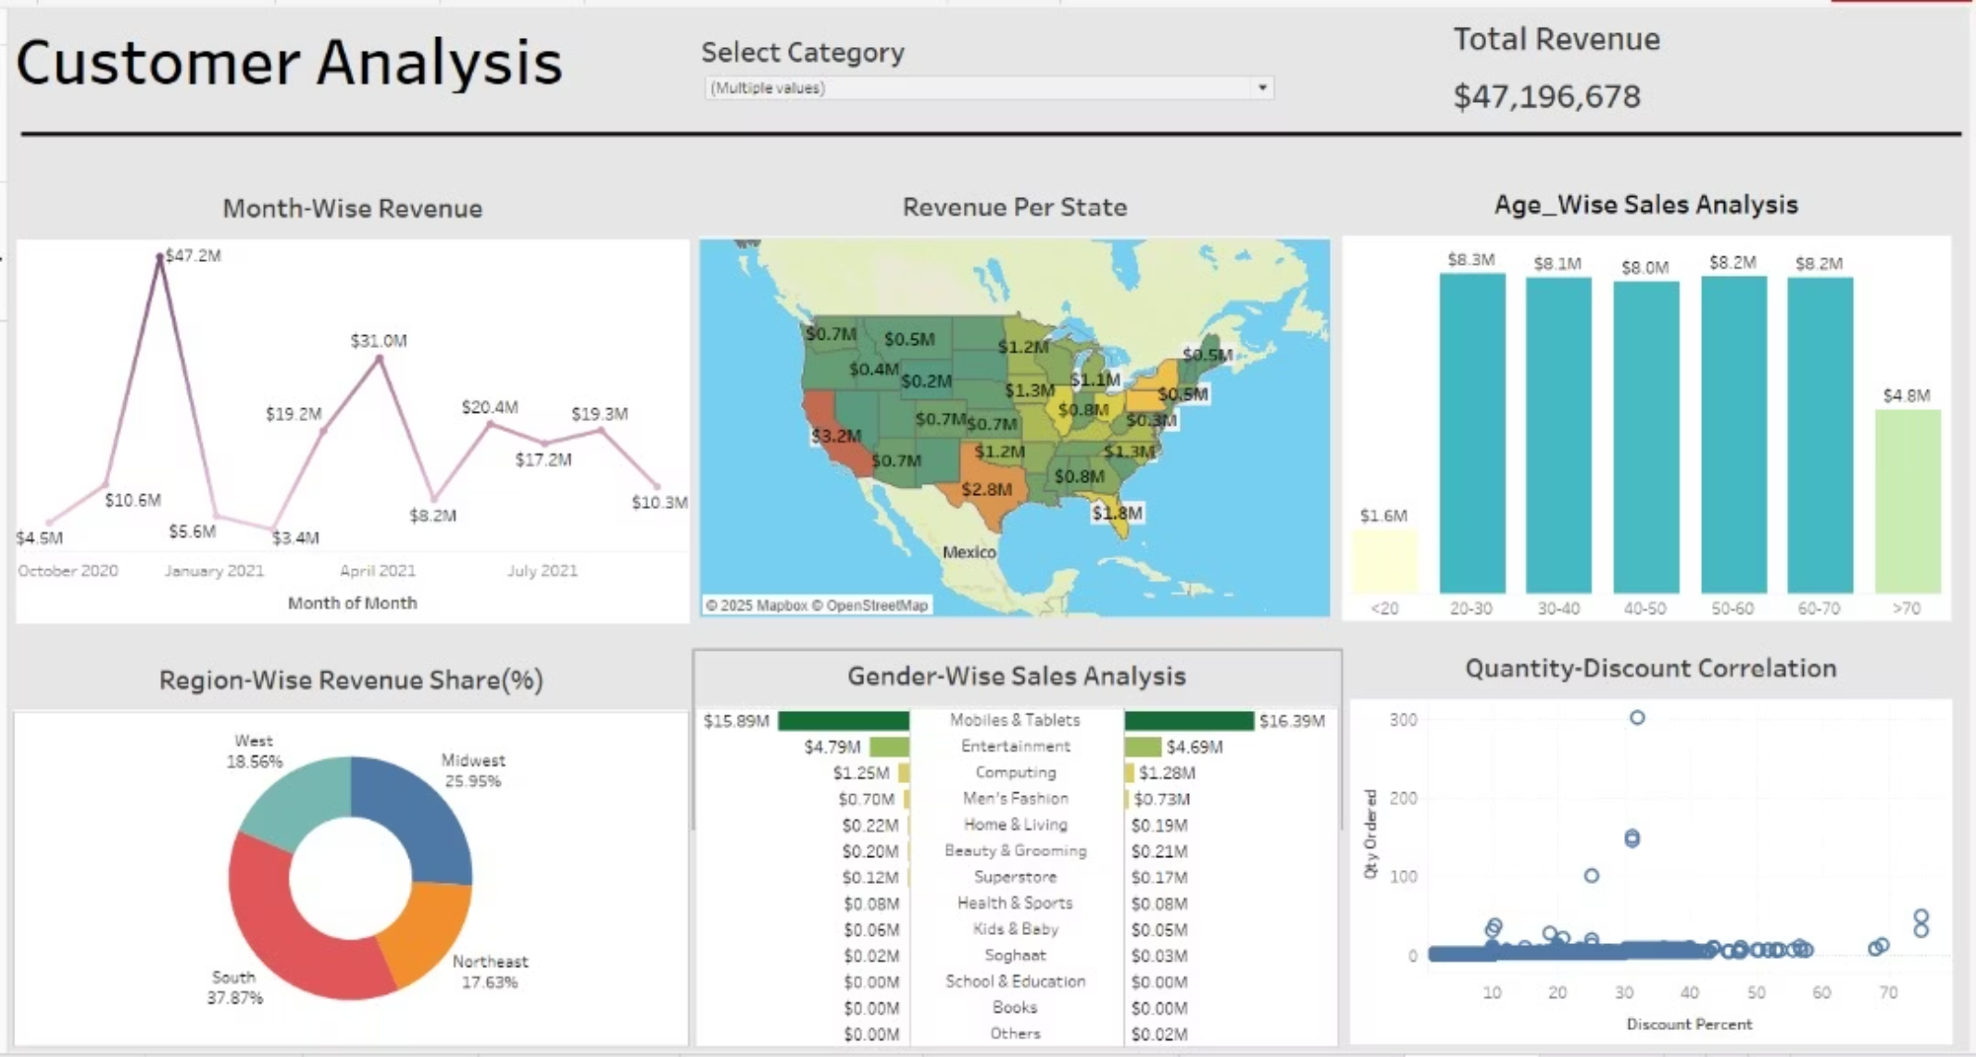
Customer Dashboard Overview
Interactive Visualization
Data Integration
The dashboard presents a comprehensive view of customer revenue patterns through six integrated visualization modules. Each panel reveals critical business intelligence, from temporal trends to geographic concentration, enabling rapid identification of growth opportunities and performance anomalies.
This unified view synthesizes multiple data streams including transactional records, demographic information, geographic identifiers, and promotional activity. The integration enables cross-dimensional analysis that reveals relationships invisible in isolated datasets.
The interface design prioritizes clarity and accessibility, allowing stakeholders at all levels to extract insights quickly. Color-coded metrics and intuitive chart formats eliminate friction in data interpretation, supporting faster strategic responses to market dynamics.
Real-time data processing ensures that decision-makers always work with current information, reducing the risk of strategy based on outdated patterns.

Slide 4
Key Insights
$47.2M
37%
3
Total Revenue Analyzed
South Region Share
Top Performing States
Comprehensive dataset spanning complete customer transaction history
Largest regional contributor to overall revenue performance
California, Texas, and Florida lead in revenue generation
Demographic Revenue Patterns
Category & Gender Dynamics
Age segmentation analysis reveals that customers between 30-60 years old represent the highest revenue-generating cohort. This demographic demonstrates both purchasing power and sustained engagement, making them the priority target for retention and upsell initiatives.
Both male and female customer segments show robust demand in electronics and fashion categories, though purchasing patterns differ meaningfully. Electronics purchases skew slightly male, while fashion demonstrates balanced cross-gender appeal with distinct product preference variations.
The 30-60 age range exhibits consistent buying behavior across product categories, with particular strength in higher-margin items. Their purchasing frequency and average order values significantly exceed younger and older segments, positioning them as the core customer base for revenue optimization strategies.
Understanding these gender-specific category affinities enables more precise marketing messaging and product positioning. Tailored approaches can improve conversion rates and increase customer lifetime value by aligning offerings with demonstrated preferences.
1
2
3
Geographic Concentration
Regional Leadership
Discount Optimization
California, Texas, and Florida emerge as dominant revenue generators, collectively accounting for a substantial portion of total sales. These states benefit from population density, economic strength, and established distribution infrastructure. Their performance suggests opportunities for deeper market penetration through targeted local campaigns and expanded retail presence.
The South region commands 37% of total revenue, reflecting both market size and customer engagement levels. This regional strength indicates successful brand positioning and effective distribution networks. The concentration presents opportunities to replicate successful regional strategies in underperforming markets while continuing to maximize Southern market share.
Analysis of the quantity-discount relationship reveals that moderate discount levels drive higher order volumes without excessive margin erosion. The data shows an optimal discount range where customer response peaks, enabling strategic promotion planning that balances volume growth with profitability. Extreme discounts show diminishing returns, suggesting that targeted, moderate promotions deliver superior ROI.

Slide 5





Business Recommendations
Strategic Budget Allocation
Redirect marketing investment toward California, Texas, and Florida, where customer acquisition costs demonstrate the strongest return on investment. These high-performing states offer proven market receptivity and established infrastructure that amplifies campaign effectiveness. Allocate 60-70% of regional marketing budgets to these core markets while maintaining baseline presence in emerging territories.
Demographic Focus
Concentrate customer acquisition and retention efforts on the 30-60 age bracket, which generates disproportionate revenue contribution. Develop age-appropriate messaging, product bundles, and loyalty programs tailored to this demographic's lifestyle needs and purchasing behaviors. This segment represents the highest lifetime value opportunity and warrants premium investment in engagement strategies.
Regional Inventory Optimization
Increase stock levels for top-performing categories in the South and Midwest regions to capitalize on demonstrated demand patterns. This inventory repositioning reduces fulfillment times, improves customer satisfaction, and minimizes lost sales due to stock-outs. Regional distribution centers should reflect actual purchasing concentrations rather than uniform allocation models.
Discount Strategy Refinement
Implement optimized discount ranges identified through quantity-discount analysis to maximize order volume while preserving margin integrity. Replace blanket promotional approaches with data-driven discount tiers that align with customer price sensitivity patterns. This precision pricing strategy improves both revenue and profitability simultaneously by matching incentives to actual purchase triggers.
Personalized Engagement
Deploy gender-specific marketing campaigns and product recommendations based on demonstrated category preferences. Electronics promotions should include messaging that resonates across gender lines while fashion campaigns can leverage gender-specific style preferences and purchase patterns. Personalization engines should incorporate both demographic data and behavioral signals to maximize relevance and conversion rates.
Implementation Priority: Begin with budget reallocation and demographic targeting initiatives, which offer the fastest time-to-impact. Follow with inventory optimization and discount refinement as supporting operational improvements. Continuous measurement and iteration will be essential to capture the full value of these recommendations.

