Slide 1
E-Commerce Sales
Performance Analysis
An End-to-End Data Analysis of Kaggle E-Commerce Dataset
Dec 2010 – Dec 2011 | 541,909 Transactions
Presented by: Happy Anwuli

Slide 2
Problem Statement & Objectives
Business Context
Core Objectives
An online retailer requires executive-level insight into: • Sales trajectory and seasonality
• Which customers generate the most value
• Product performance and portfolio health
• Customer retention and churn risk
The analysis covers 397,884 valid transactions across 37 countries, 4,338 customers and 3,665 SKUs.
1
Understand Revenue Patterns
Identify trends, seasonality, and geographic concentration
2
Analyse Customer Behaviour
Segment customers by value; measure retention
3
Evaluate Product Portfolio
Surface top performers and underperforming SKUs
4
Deliver Actionable Insight
Translate findings into concrete business strategies

Slide 3
Dataset Overview
541,909
397,884
4,338
Raw Transactions
Valid Transactions
Unique Customers
3,665
37
£8.9M
Unique SKUs
Countries Served
Total Revenue
Data Quality Notes: 135K rows removed (missing CustomerID) · Cancellations excluded · Zero/negative values filtered

Slide 4
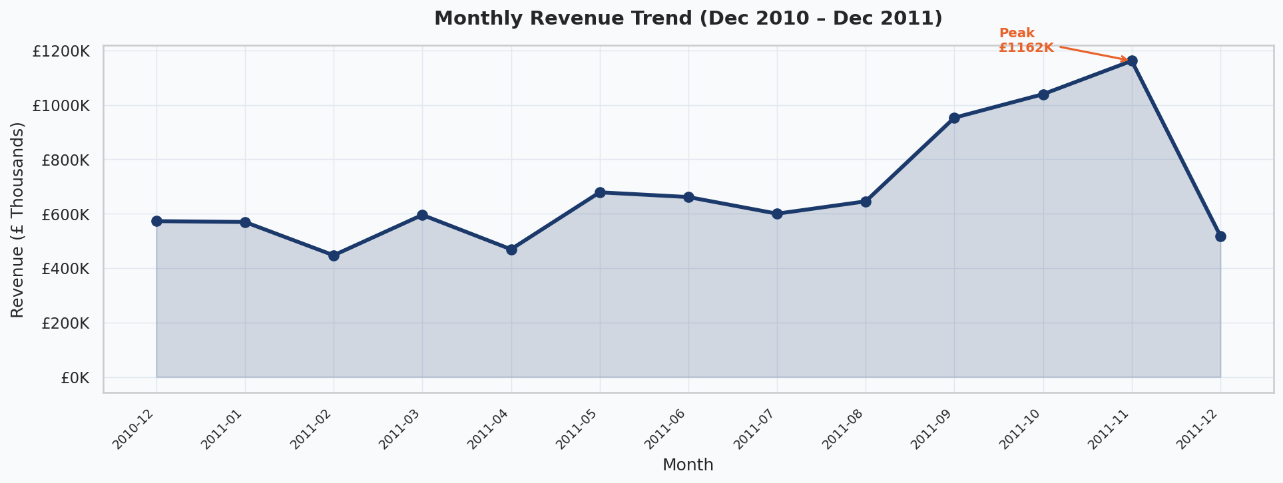
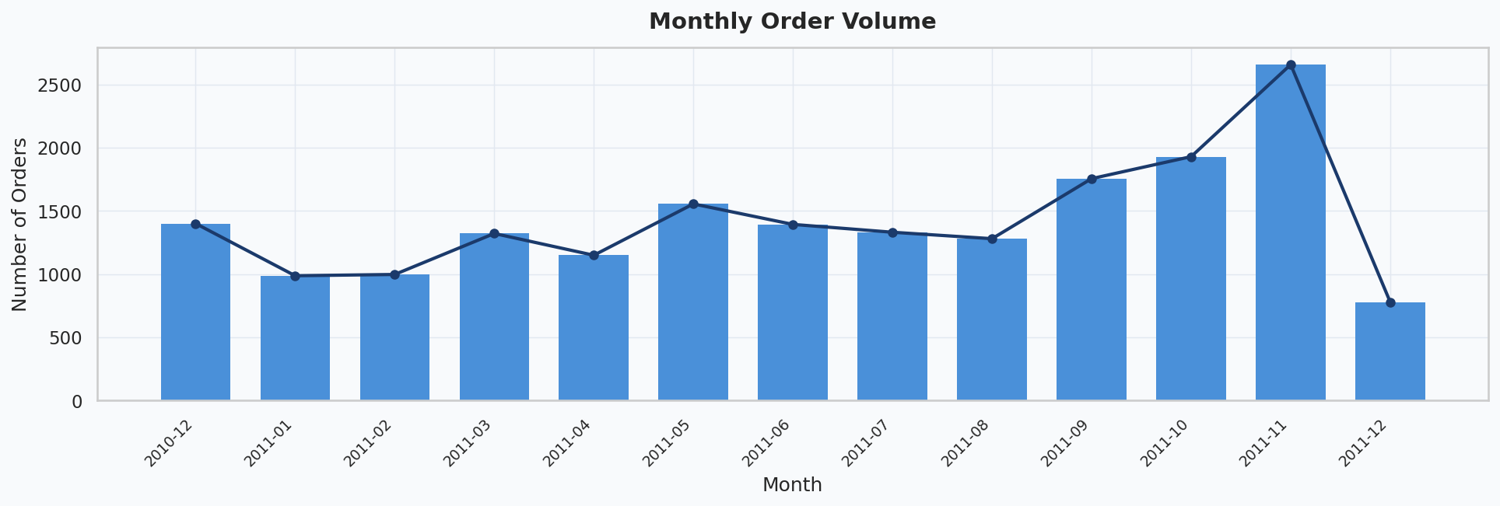
Revenue Trend & Order Volume
Key Insights
📈 Revenue grew consistently from Dec 2010
🎄 November 2011 was the peak month — Christmas demand surge
📦 Order volume tracks revenue closely, confirming volume-driven growth
⚠️ December 2011 data is partial (dataset ends 9 Dec)
💡 Q4 is critical — invest in inventory & marketing by September

Slide 5
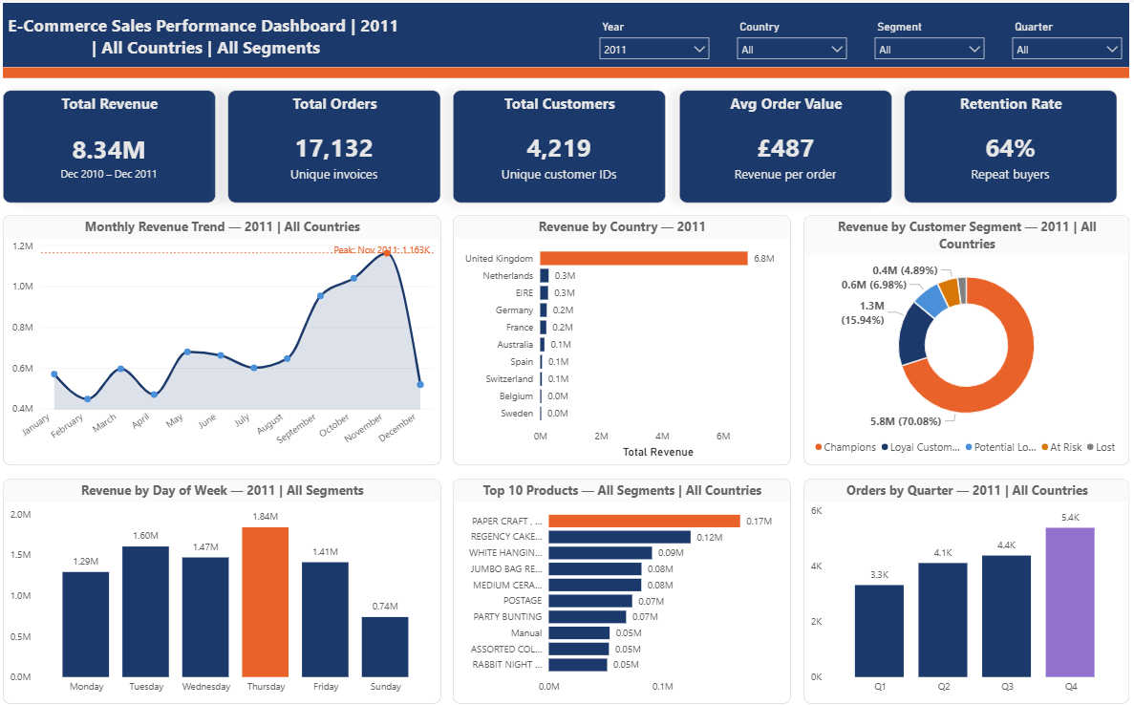
RFM Customer Segmentation
Champions
Loyal
At Risk
Lost
934 customers
£6.3M
800 customers
£430K
883 customers
£203K
Full dashboard available as an interactive Power BI file with dynamic filtering by Year, Country, Customer Segment, and Quarter.

Slide 6
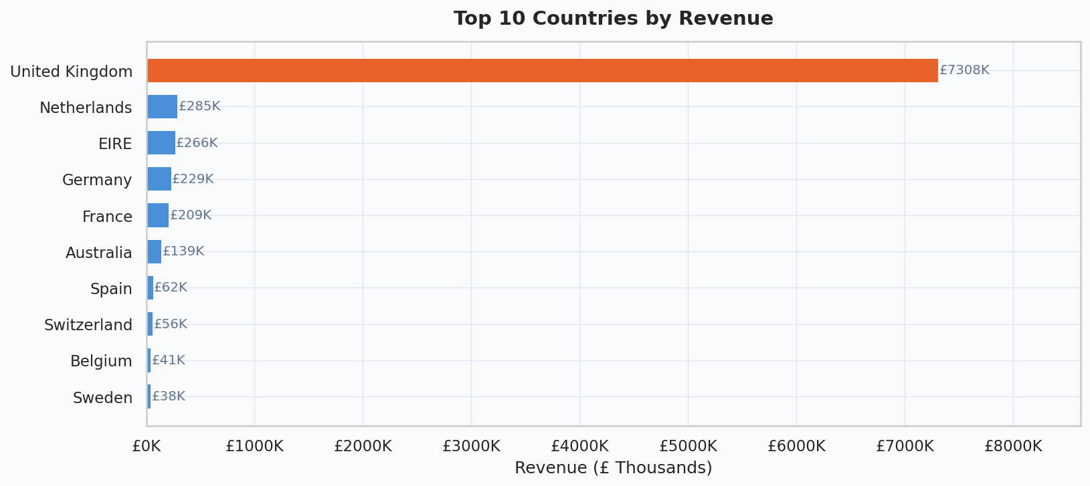
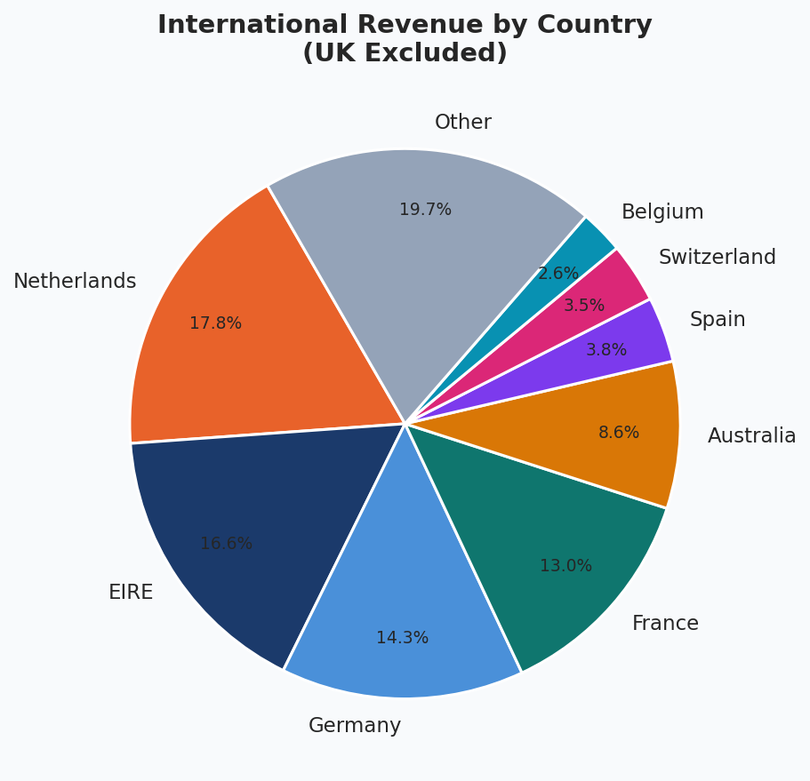
Geographic Revenue Performance
Key Insights
🇬🇧 UK = 83% of revenue — significant concentration risk
🇳🇱 Netherlands is the #2 market internationally
🇩🇪🇫🇷 Germany and France growing steadily
🌍 Top 5 intl. markets represent a £1.5M+ expansion opportunity
💡 Build localised experiences and EU fulfilment hubs to scale internationally

Slide 7
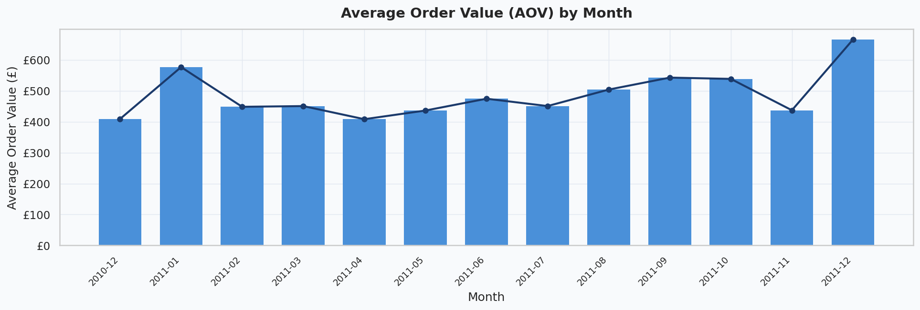
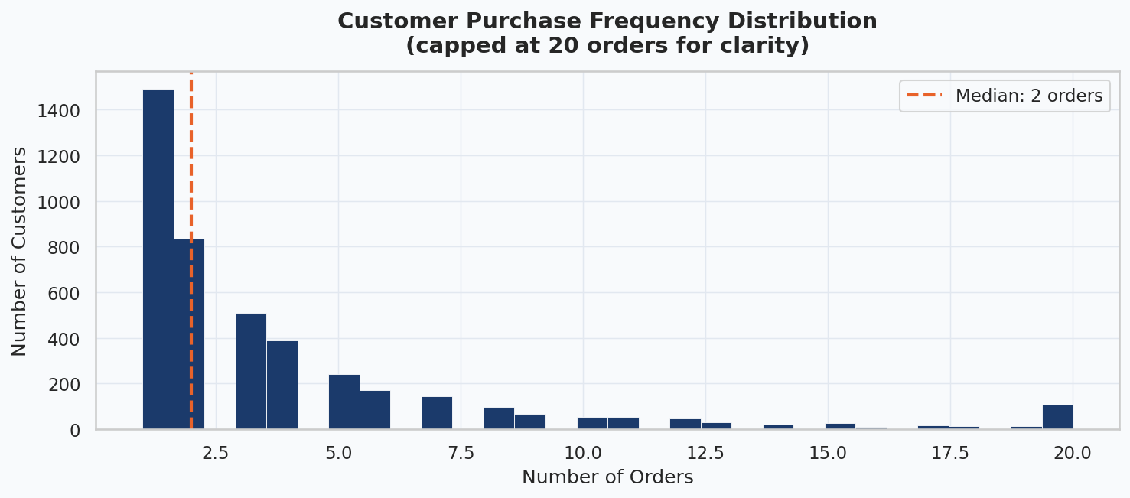
Customer Behaviour Analysis
Key Insights
💰 Overall AOV: £369 (mean); £230 (median)
📅 AOV spikes in Q4 — customers buy more per order for gifting
🔁 ~65% of customers are repeat buyers
👤 Median customer places 2 orders; max is 209
💡 Post-purchase nurture sequences can convert one-time buyers to repeat buyers

Slide 8
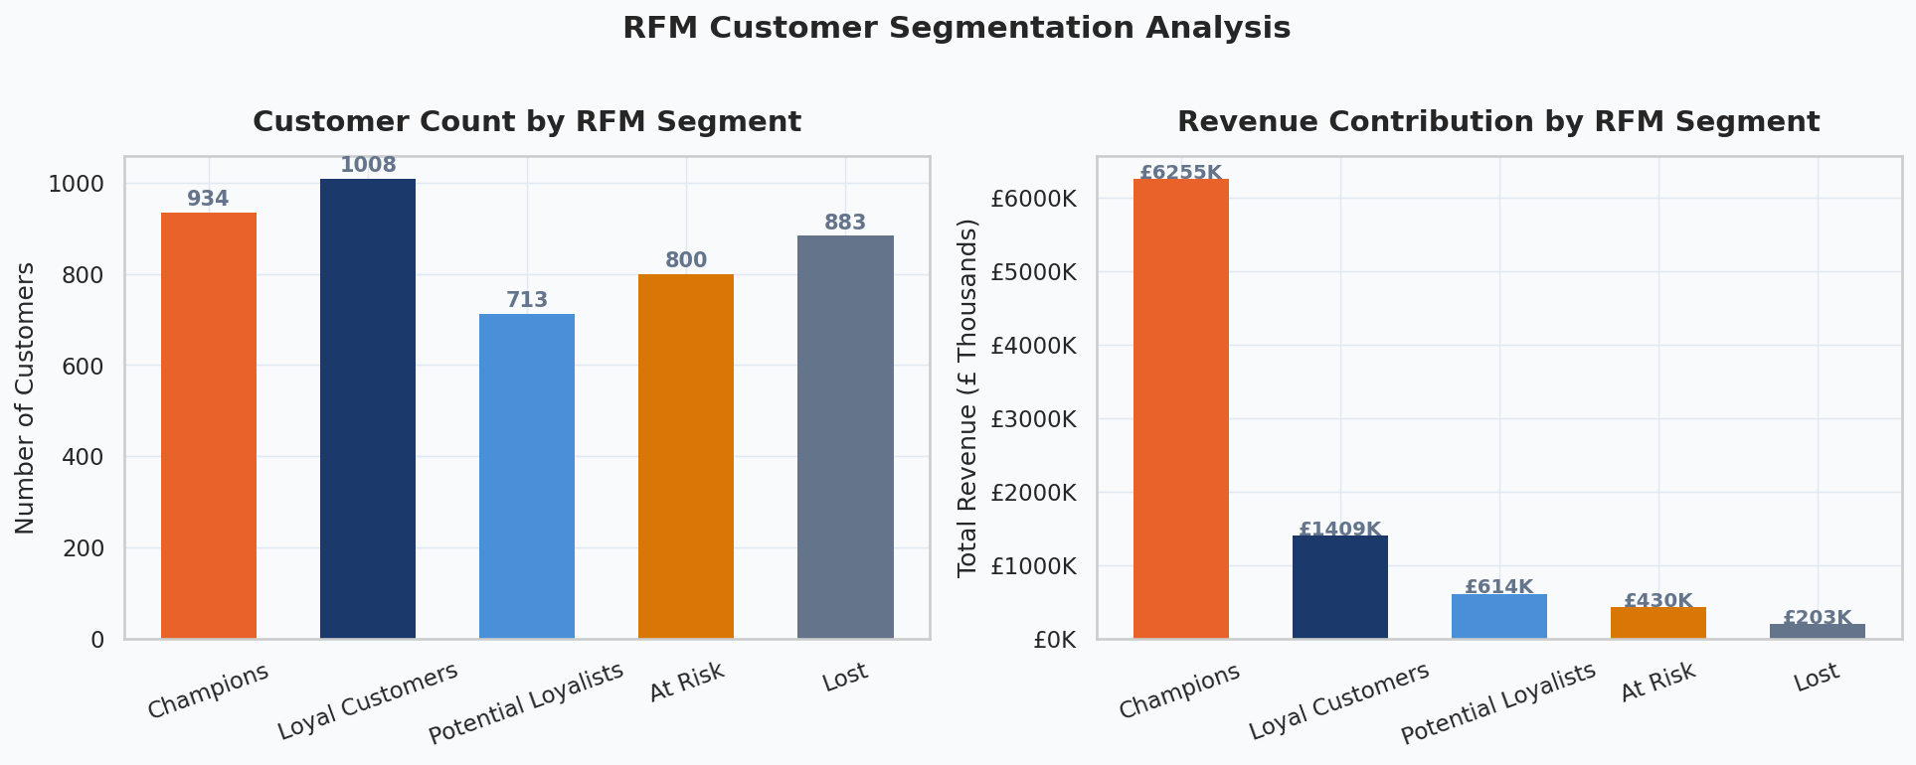
RFM Customer Segmentation
Champions
Loyal
At Risk
Lost
934 customers
£6.3M
1,008 customers
£1.4M
800 customers
£430K
883 customers
£203K
VIP loyalty tier, personal outreach
Rewards programme, early access
Win-back campaign, discount trigger
Re-engagement or remove from list

Slide 9
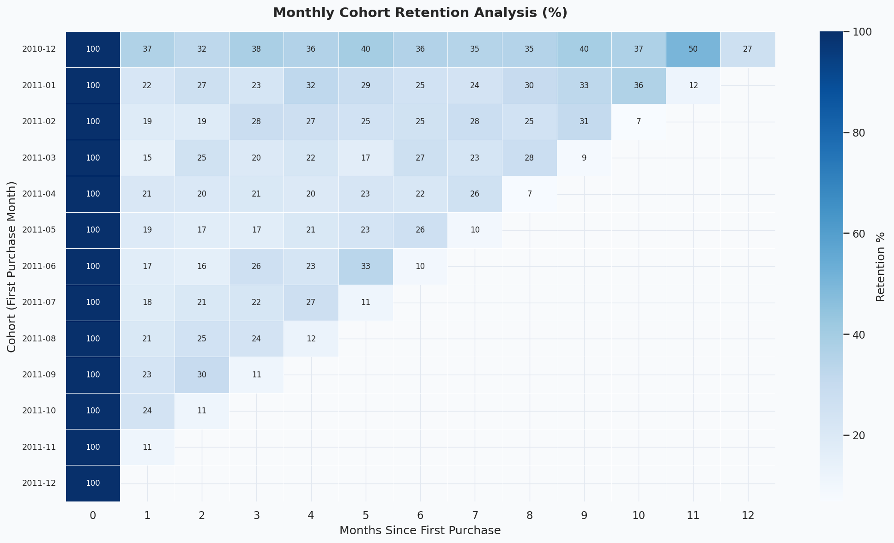
Cohort Retention Analysis
Key Insights
• Month-1 retention averages ~20-25%
• Dec 2010 cohort shows strongest long-term retention
• Retention drops sharply after month 1
• Holiday-acquired customers retain better
• 💡 Focus onboarding on first 30 days post-purchase — this is the critical retention window

Slide 10
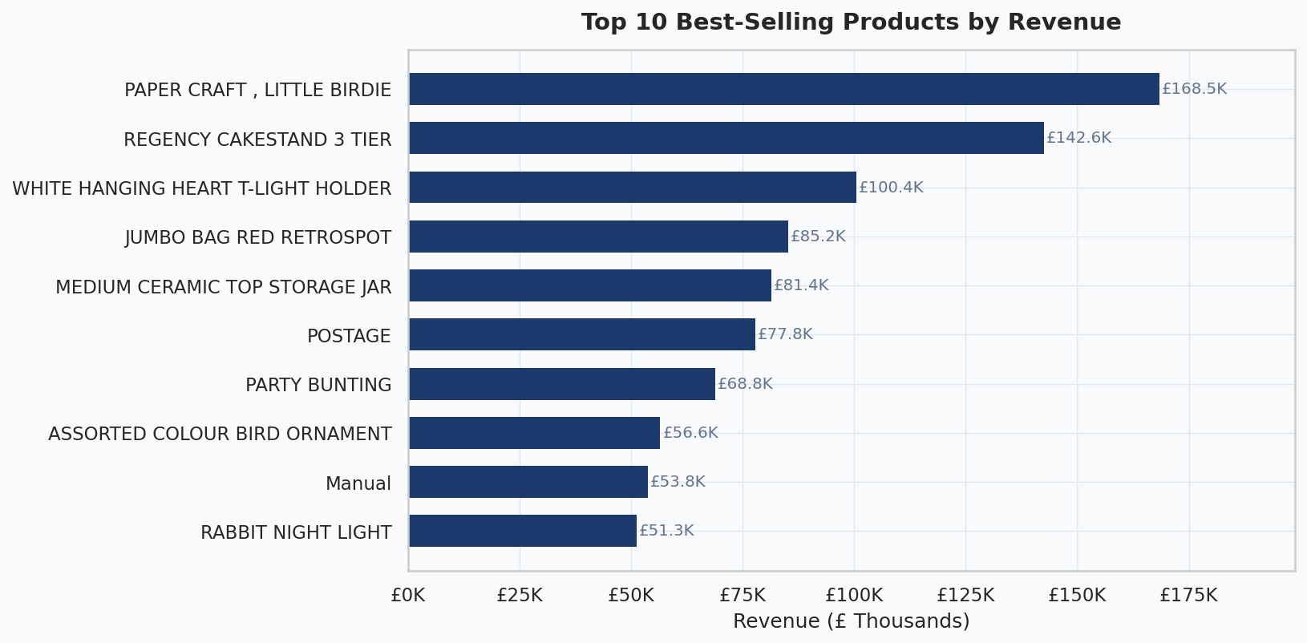
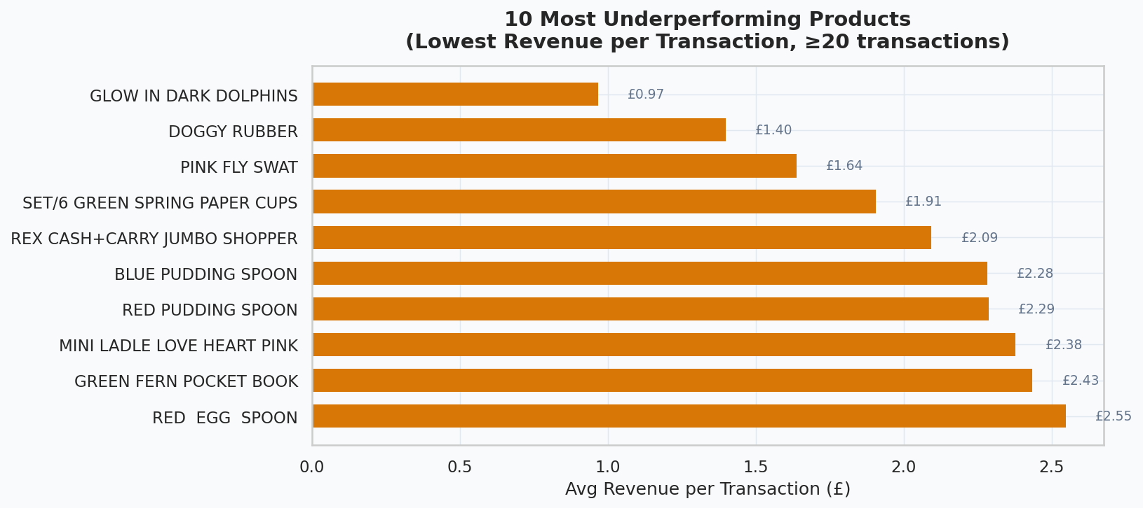
Product Performance Insights
Key Insights
🏆 Top 10 products generate disproportionate revenue
🕯️ Decorative / gift items dominate top sellers
⚠️ Many SKUs have <£2 avg revenue per transaction
📦 Bundling low-value items can boost basket size
💡 Apply 80/20 rule: focus marketing budget on top 20% of SKUs
🗑️ Consider discontinuing or repricing the bottom 50 SKUs

Slide 11
Strategic Recommendations
🏆 Protect Champions
🔄 Win Back At-Risk
🌍 Expand Internationally
Launch VIP tier with early access, free delivery & dedicated account support for top 100 CLV customers.
Deploy 3-step email win-back sequence with escalating discount. Target 800 at-risk customers (£430K revenue at stake).
Build localised landing pages & EU fulfilment hub for NL, DE, FR. Reduce geographic revenue concentration from 83%.
🎄 Maximise Q4 Seasonality
📧 Nurture One-Time Buyers
📅 Optimise Campaign Timing
Pre-stock top SKUs by September. Launch Q4 campaigns by late Sep. Create gift bundles at £25/£50/£75 price points.
Trigger post-purchase email flow at 14, 30, 60 days. Offer 10% off second order. Convert ~35% one-time buyers.
Schedule email & paid ads on Tuesdays and Thursdays (peak revenue days). Run weekend flash sales to lift Saturday revenue.

Slide 12
Conclusion
01 Revenue grew 60%+ over the analysis period with clear Q4 seasonal peaks
02 Champions (934 customers) generate 70% of revenue — protection is paramount
03 Month-1 retention of ~20-25% represents the single largest growth lever
04 Geographic concentration in UK (83%) poses strategic risk — international expansion warranted
05 Product portfolio can be optimised: reinvest in top 20% SKUs, rationalise the tail
Thank you

