Slide 1
네트워크프로그래밍-3주 과제 제출용
학번 1891179
이름 김현학

Slide 2
3주 과제
Linux 개발환경 구축
Vmware 설치
Ubuntu Linux 설치 및 환경 설정
Ubuntu Linux 개발 환경 프로그램 설치
make, gcc, net-tools
Linux / Windows Network 환경 확인
time client/server 실습 화면 capture
TCP Client/Server
UDP Client/Server
Linux / Windows 간 실습 (총 8가지 TCPx4, UDPx4)
Linux Client/Linux Server
Windows Client/Linux Server
Windows Client/Windows Server
Linux Client/Windows Server
Linux 또는 Windows 가 안되는 경우
Linux / Linux 또는
Windows / Windows 로 실습

Slide 3
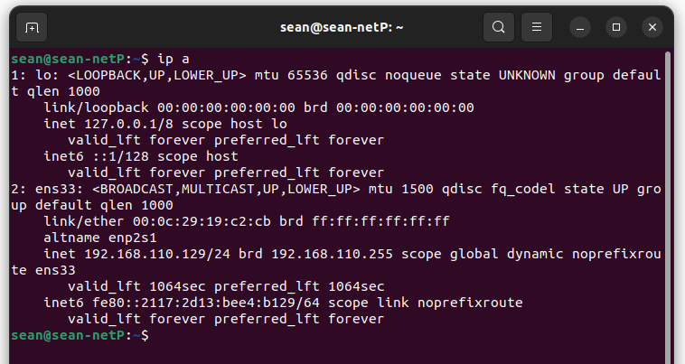
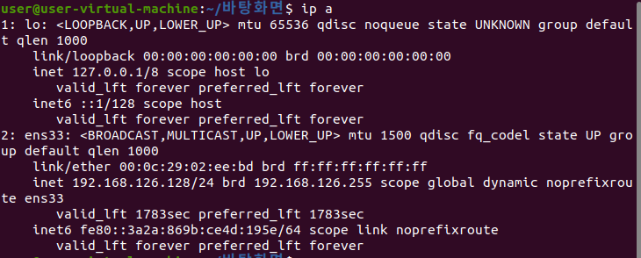
Linux 설치 후 IP 확인 화면 (예)
ip a

Slide 4
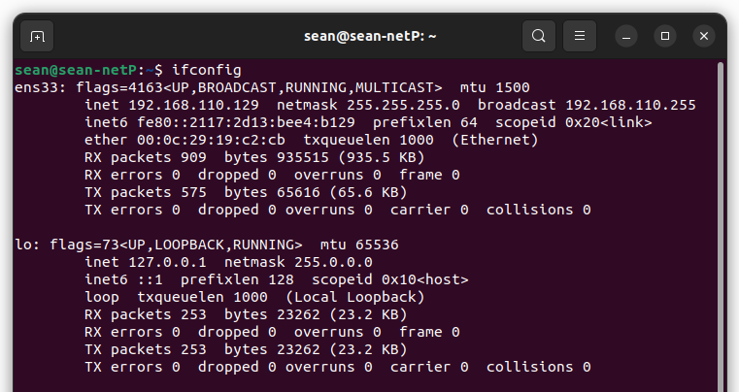
Linux 설치 후 IP 확인 화면 (예)
ifconfig

Slide 5
본인 Computer Linux / Windows IP 확인 수정
Window
Vmware
Linux
가상 Ethernet
Interface : ens33
192.168.110.129
가상의 Ethernet Adapter
게이트웨이(라우터) 역할
VMware Network Adapter VMnet8
192.168.110.1
Internet
실제 Ethernet Adapter

Slide 6
TCP time client/server 실습 화면 4 가지
Linux Client / Linux Server
Windows Client / Windows Server
Windows Client / Linux Server
Linux Client / Windows Server
Linux
192.168.110.129
Windows
192.168.110.1
Server
time_server
Server
wtime_server
Client
time_client
Client
wtime_clinet

Slide 7
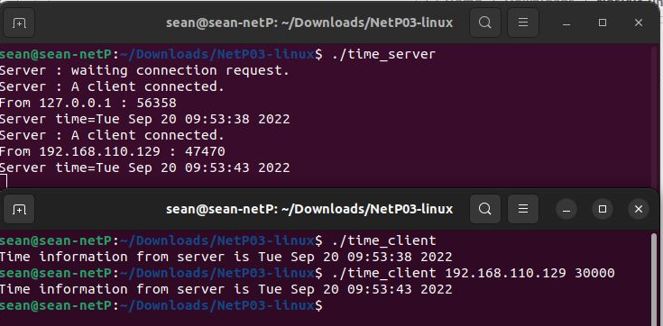
TCP time client/server 실습 화면
Linux Client / Linux Server
Linux Server
Linux Client

Slide 8
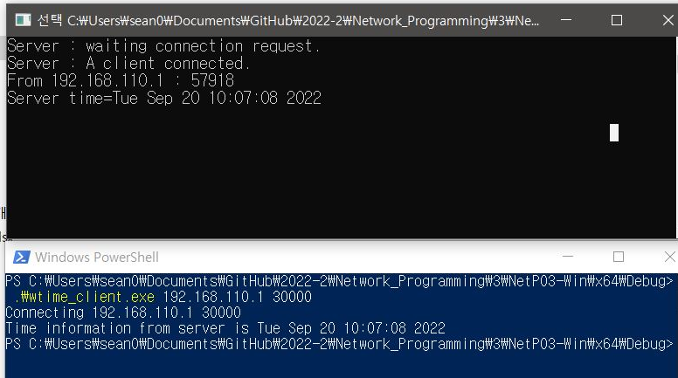
TCP time client/server 실습 화면
Windows Client / Windows Server
Windows Server
Windows Client

Slide 9
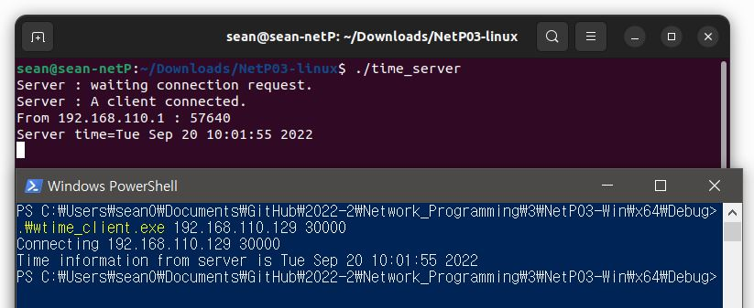
TCP time client/server 실습 화면
Windows Client / Linux Server
Linux Server
Windows Client

Slide 10
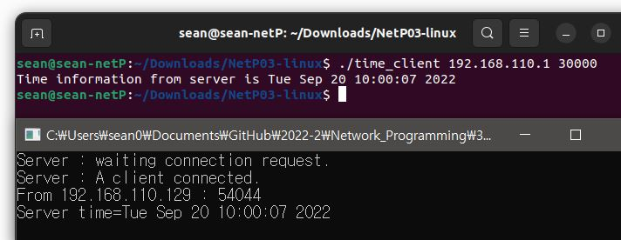
TCP time client/server 실습 화면
Linux Client / Windows Server
Linux Client
Windows Server

Slide 11
소켓프로그래밍 예2 – UDP time client/server
Linux Client / Linux Server
Windows Client / Windows Server
Windows Client / Linux Server
Linux Client / Windows Server
Linux
192.168.110.129
Windows
192.168.110.1
Server
udp_time_server
Server
wudp_time_server
Client
udp_time_client
Client
wudp_time_clinet

Slide 12
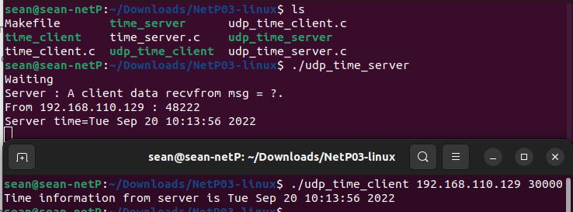
UDP time client/server 실습 화면
Linux Client / Linux Server
Linux Server
Linux Client

Slide 13
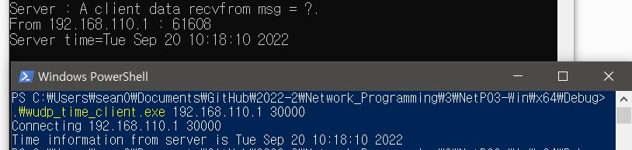
UDP time client/server 실습 화면
Windows Client / Windows Server
Windows Server
Windows Client

Slide 14
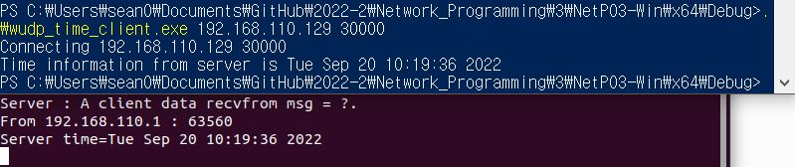
UDP time client/server 실습 화면
Windows Client / Linux Server
Windows Client
Linux Server

Slide 15
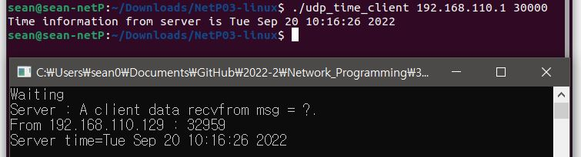
UDP time client/server 실습 화면
Linux Client / Windows Server
Linux Client
Windows Server

