Slide 1
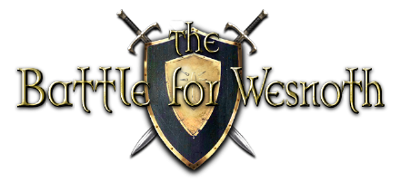

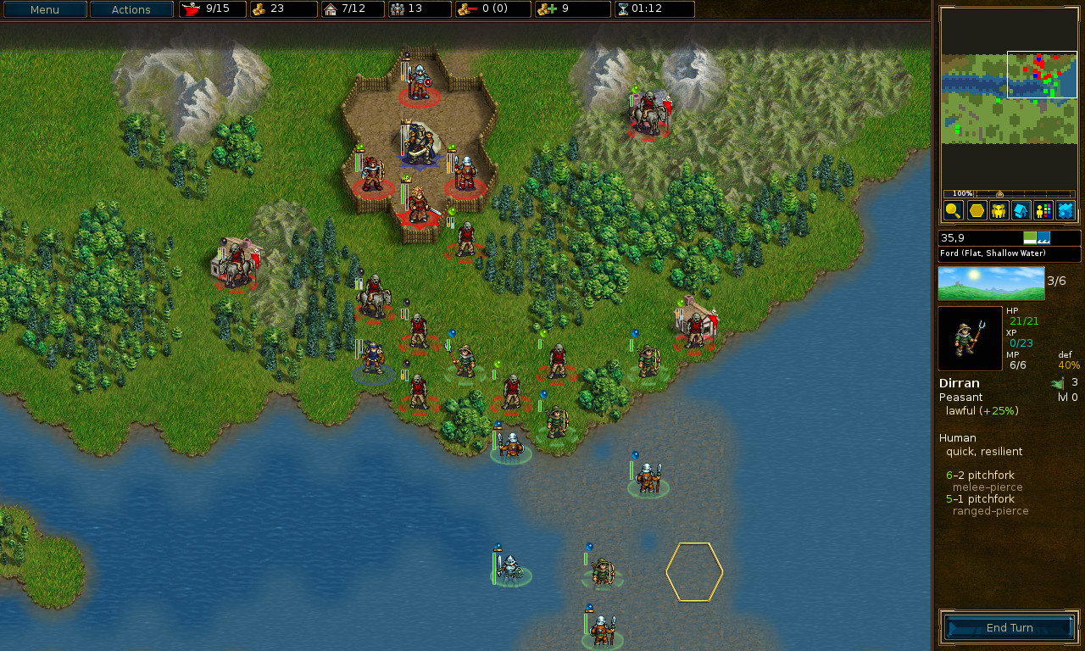

Domain specific language for Strategy Game AI by Nathan Livsey
Why this project?
Students can find it difficult to find motivation when studying artificial intelligence and related concepts. It may be beneficial in motivating students if a fun space to experiment with AI concepts was available, one example of this would be a strategy game
What is the project?
I will create a domain specific language for a strategy games AI, capable of describing the AI player. Tools would then translate this language into valid AI code that will run in the game. This would allow students to experiment with AI concepts in a simplified and fun way.
Why Wesnoth?
The strategy game that has been chose is The Battle for Wesnoth. This is due to the ease of modifying existing AI behavior present within the game. This ensures that behavior described by the domain-specific language can be turned to code with minimal fuss and can replace the existing AI behavior relatively simply.
How will it work?
A langauge will be defined with the aid of a language workbench such as Xtext. This will be the domain specific language and will be capable of describing AI behavior within the scope of Wesnoth. Tooling will also be created capable of “compiling” this language into Wesnoth AI code and inserting it into the Wesnoth code. allowing students to write in the domain specific language and see the effects their code has on the wesnoth AI.

