Slide 1
Fundamental Concepts
Change Control is the set of practices to ensure request for changes are properly taken care of
Configuration Management is the set of practices to ensure project outputs remain coherent over time
Change Control and Configuration Management span over the lifecycle of the project outputs
In software projects artifacts are extremely simple to change
(e.g., editing a file)
In software projects, connection with bug reporting/bug lifecycle

Slide 2
Configuration Management

Slide 3
Configuration Management
Configuration Management (CM) is a set of activities running in parallel to the development process, whose goal is establishing and maintaining system’s coherency over time
  Part of the project management plan
  Helps define project standards and best practices

Slide 4
Goals of Configuration Management
Configuration Control
  Controlling product release and its updates
Status Accounting
  Recording and reporting components’ status
Review
  Ensuring completeness and consistency of all parts
Build Management
  Managing the build process and its tools
Environment Management
  Managing the components that host our system
Teamwork
  Facilitate team interactions

Slide 5
Some Effects of a Good CM
Being able to build a system from a consistent set of components
Being able to retrieve a software component when needed (consider: storage time, storage means)
Being able to view the history of changes a system has undergone
Being able to retrieve a previous version of a system
Remark: closely related to the change management process

Slide 6
Some Examples
A bug is reported by a user on a software we have been selling for ten years
A client requests an enhancement to a one-off system we sold in 2005
We need to reproduce/understand an odd behavior of the control software of a space exploration probe which is now orbiting Jupiter

Slide 7
Steps and Tools: Establish Baseline
The first step is establishing what is the product
A good CM requires to:
  Clearly identify the items which constitute a product
  Identify the relationships among these items
  Choose an appropriate identification and numbering scheme for versions
  Being able to take “snapshots” (see next slide)

Slide 8
What is a baseline?
Baseline: One or more software configuration items that have been formally reviewed and agreed upon and serve as a basis for further development
Software Configuration Item: A collection of software elements treated as a unit for the purposes of Configuration Management
Configuration: A collection of all the elements of a baseline and a description of how they fit together

Slide 9
What makes a Software System
Sources
Files to generate source (e.g., Yacc)
Libraries & External libraries
Data/ER Schema/DBs
Developer Documentation
User Documentation
Data migration scripts
Build scripts and tools
...

Slide 10
Steps and Tools: Manage Changes
The second step is “maintaining coherency over time”
A good CM process requires to:
  Define the baseline record (the starting point)
  Identify and approve requests for changes (change control)
  Formally record changes and history of each item
  Maintaining old versions
For family of products there could be different baselines
Changes might need to be applied to one or more baseline (consider a security fix to a browser)

Slide 11
Software Development Models
Linear development:
  Only one version of an application is running at any given time
  Examples: one-offs; software as a service (even though for high-volume applications, the software might be deployed in different instances)
Branching development:
  Different versions of an application are running at a given time
  Examples: Base and Pro version, v1.0 and v2.0 (desktop computers)

Slide 12
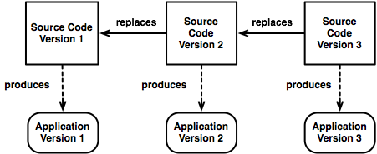
Linear Development Model

Slide 13
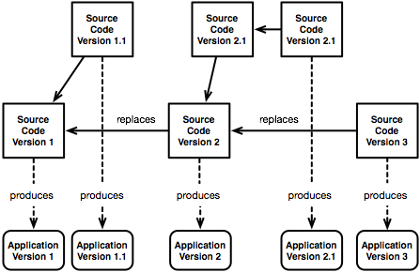
Branching Development Model

Slide 14
Version Control Systems

Slide 15
Steps and Tools: Considerations
For software development, a version control system implements various of the functions described above
Tools are not sufficient: an adequate process has to be in place
Semantic versioning is an example of numbering schema

Slide 16
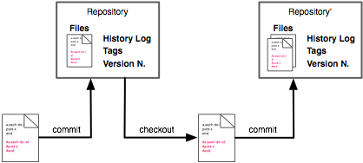
Version Control Systems: Main Concepts
Repository: the storage where all versions of a system and the required additional data are kept together
Working version: the file (or set of files we are currently editing)

Slide 17
Version Control: Operations
Check-Out
  The operation which gets a working copy from the repository
Change/Changeset
  A specific modification (or set of modifications) to one or more documents under version control
Commit or Check-in
  The operation which stores the working copy in the repository
Update
  The operation which gets changes from the repository
Conflict
  A situation in which the working version and the repository have “incompatible” changes
Merge / Integration
  The operation performed to resolve a conflict

Slide 18
Version Control: Operations
Revision/Version
  A specific changeset committed in the repository
Tagging/Labeling
  The process of assigning a symbolic name to a revision

Slide 19
Types of Version Control Systems
Centralized
  There is a single repo
  Examples: RCS, CVS, Subversion
Distributed
  There are many repositories
  Specific operations allows to sync repositories (push/pull)
  Examples: Git, Mercurial, Bazar
A distributed versioning system can be used in a centralized manner (but not viceversa)

Slide 20
Versioning Models
Lock-Modify-Unlock Solution:
  Only one person can change a file at a time
  Advantage: simple; it enforces organization of work
  Example: SCCS (If I remember right)
Copy-Modify-Merge Solution:
  Users modify private copies only - in parallel
  Private copies are merged together into a new, final version
  Advantage: allows the team to work in parallel
  Example: CVS, Subversion

Slide 21
GIT

Slide 22
What is GIT
A distributed software versioning system
Developed in 2005 by the Linux development community (and in particular Linus Torvalds, the creator of Linux) to support the development of the Linux Kernel
Open-source, mature, well documented, and with good community and tool support
https://git-scm.com/

Slide 23
Git Commands and Elementary Workflow
git init
git add
git commit
git push
git pull

Slide 24
Some Good Practices

Slide 25
Causes of Changes in Software Development
Incompleteness or incoherencies in the project requirements or in the description of work
A better comprehension of the system to be developed
A technical opportunity
A technical challenge
A change in the external environment
Non-compliance of a project deliverable

Slide 26
Define a Change Control Process
A software versioning system allows you to achieve some of the practices of Configuration Management
In order to maintain your system under control, you need to define a process for managing changes
The process should identify:
  People in charge (usually a change control board)
  Approval and verification steps
  Communication and dissemination

Slide 27
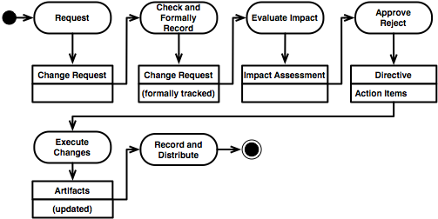
A Change Control Process

Slide 28
Remarks
A change control board might be appointed to approve/reject changes
The cost and risk of changes increase as the project moves to the delivery
The process ensures a formal record is kept and and a clear procedure is set to evaluate the impact of changes
Change and change management is embraced by agile methodologies (changes “treated” as requirements)

Slide 29
Releasing Software
Two approaches:
  Release only when required by the project plan
  (main milestones and deliverables)
  Release often, ideally with each changeset
  (agile practices tend to favour this approach)
When you release
  Ensure the baseline is formally stored in your VCS
  Ensure you have a “release notes” documents summarizing the changes
  (optionally) Package the system and its dependencies

Slide 30
How to identify releases
Define rules to assign names to your software versions
  It helps communicate “where” you are
Two simple approaches:
  Choose a sequence (the alphabet for Android versions, planets, numbers, …)
  Use semantic versioning is a standardized the way in which you communicate changes to your system (http://semver.org/)
Given a version number MAJOR.MINOR.PATCH, increment the:
  MAJOR version when you make incompatible API changes,
  MINOR version when you add functionality in a backwards-compatible manner, and
  PATCH version when you make backwards-compatible bug fixes.
Additional labels for pre-release and build metadata are available as extensions to the MAJOR.MINOR.PATCH format

Slide 31

Branching Model
http://nvie.com/posts/a-successful-git-branching-model/
Main goal: allow context-switching
It implements some o the requirements of a good CM

