Slide 1
Coding club
20230328

Slide 2
Summary of what we have done
Version control with git
Segmentation in imageJ
Recoding actions for small macros
Coding challenge
Using ChatGPT for coding

Slide 3



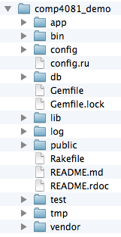
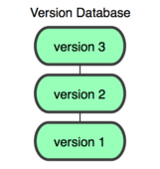
You
GitHub
Working Dir
Local Repos
Remote Repos

Slide 4
Basic Git nomenclature
Clone
make a clone or copy of that repository at in a new directory, at another location
Commit
Make a snapshot of your repository at a specific point in time
Push
upload local repository content to a remote repository
Pull
fetch and download content from a remote repository and immediately update the local repository to match that content

