Slide 1
ImageJ scripting Robust, readable, and sharable scripts
2022-12-12
Øyvind Ødegård Fougner

Slide 2

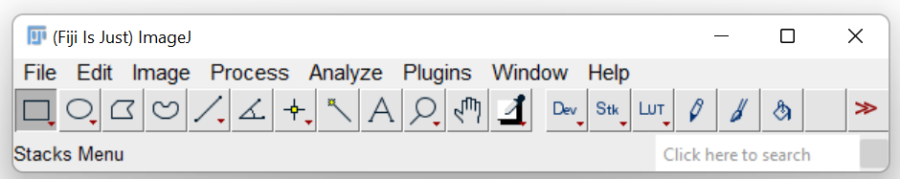
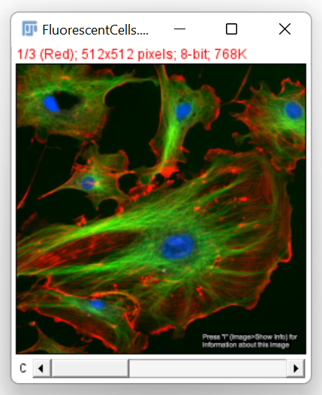
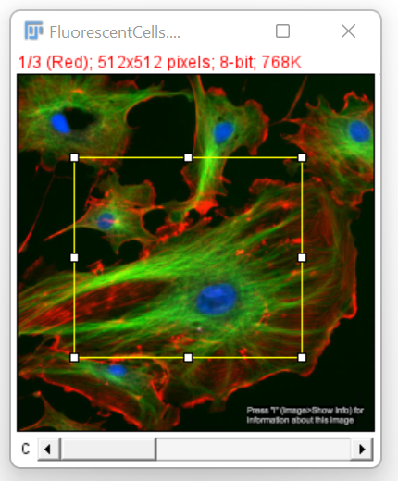
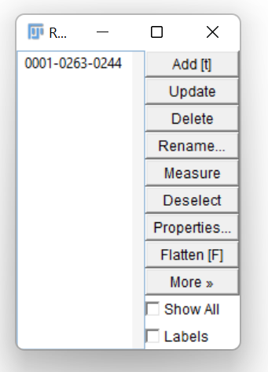
ImageJ – a great way to start with image analysis.
Graphical user interface
Everything can be scripted
Many functions available

Slide 3
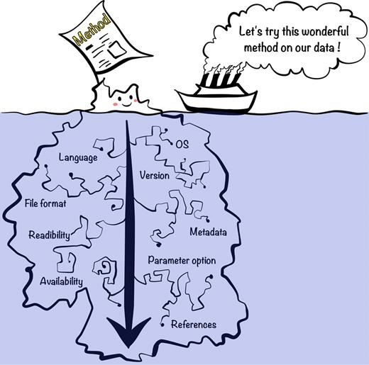
Why do you write your code?
Avoid manual analysis of large datasets
Tedious
Error prone
Not reproducible
Scripts can extract more information
Quantitative
Less bias
Fast
Reproducible (Is it really?)
Yang-Min Kim et. Al., 2018

Slide 4
How do you make your code Reproducible
Use version control (E.g. Git)
Document your code and usage
ImageJ //
Pyhton #
Re-use code and software
Eliminate hard coded variables
Include a small test
Make common operations easy to control
Taschuk M et. Al., 2017

Slide 5
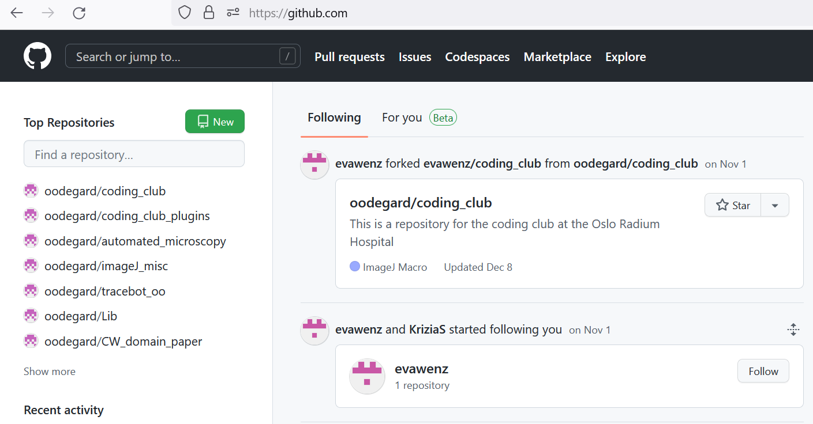
Check out github.com – A perfect place to save your code

Slide 6
Version Control Why track/manage different versions of code?
Backup: Undo or refer to old stuff
Branch: Maintain old release while working on new
Collaborate: Work in parallel with teammates

Slide 7
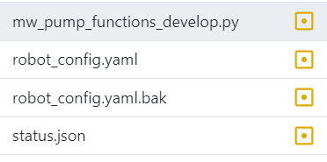
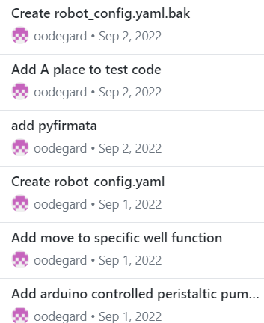
Todays topic - Github keeping track of changes with version control
Typical bad examples
The Better Git way
Data.analysis_v1.py
Data.analysis_v2_modified_for_Øyvind_v1 .py
Data.analysis_v2_modified_for_Øyvind_v2_oedegaard_et_al2021.py
Data.analysis_v2_modified_for_Øyvind_v2_use_this_v2 .py
Files in in git folder
History of all changes

Slide 8


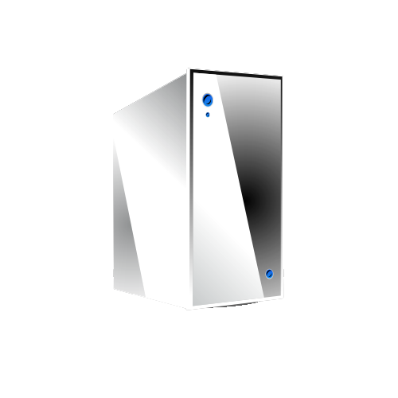
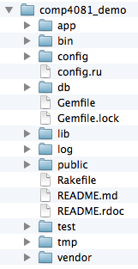
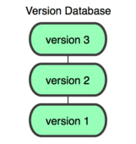
You
GitHub
Working Dir
Local Repos
Remote Repos

Slide 9
Basic Git nomenclature
Clone
make a clone or copy of that repository at in a new directory, at another location
Commit
Make a snapshot of your repository at a specific point in time
Push
upload local repository content to a remote repository
Pull
fetch and download content from a remote repository and immediately update the local repository to match that content

Slide 10
How do you make your code Reproducible
Use version control (E.g. Git)
Document your code and keep organized
ImageJ //
Pyhton #
Re-use code and software
Eliminate hard coded variables
Include a small test
Make common operations easy to control
Taschuk M et. Al., 2017

Slide 11
How I organize my code
Main loop (Workflow)
File management (open/close), Image management (select channel, timepoint etc.), saving of data
Pre-processing
Filters
Annotation
Segmentation
Manual input
Post-processing
Quantification
Adjusting manual input
Manual QC
Cropping

Slide 12
How do you make your code Reproducible
Use version control (E.g. Git)
Document your code and keep organized
ImageJ //
Pyhton #
Re-use code and software
Eliminate hard coded variables
Include a small test
Make common operations easy to control
Taschuk M et. Al., 2017

Slide 13
What is a “robust” software?
Software/Scripts that works for people other than the original author and on machines other than its creator’s.
it can be installed on more than one computer with relative ease,
it works consistently as advertised, and
it can be integrated with other tools.
Fiji will help you here!, but you need to make your code readable!!
Morgan Taschuk and Greg Wilson 2017

Slide 14
How do you make your code Reproducible
Use version control (E.g. Git)
Document your code and keep organized
ImageJ //
Pyhton #
Re-use code and software
Eliminate hard coded variables
Make common operations easy to control
Taschuk M et. Al., 2017

Slide 15
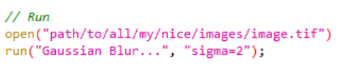
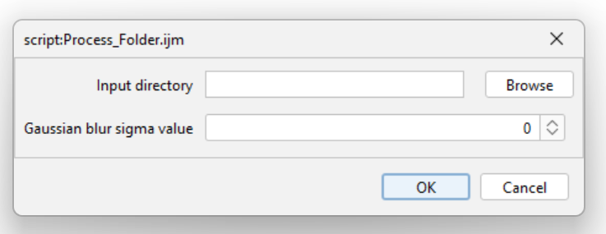
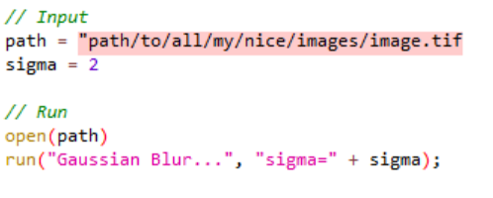
What is a hard coded variable?
Not good
User input
A bit better, but still hard coded
Run code

Slide 16
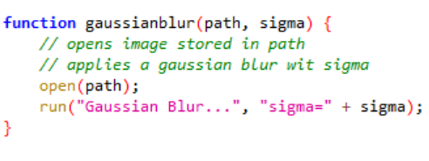
Use functions in your code
Rule of thumb: If more than one line of code is used more than once put it in a function.
It is tedious to repeat code many times
Code with functions are easier to:
Read
Debug
Edit
Share
Re-use
Notes:
Ref: https://able.bio/rhett/python-functions-and-best-practices--78aclaa (Rhett Trickett able.bio)

Slide 17
How do you make your code Reproducible
Use version control (E.g. Git)
Document your code and keep organized
ImageJ //
Pyhton #
Re-use code and software
Eliminate hard coded variables
Make common operations easy to control
Taschuk M et. Al., 2017

Slide 18
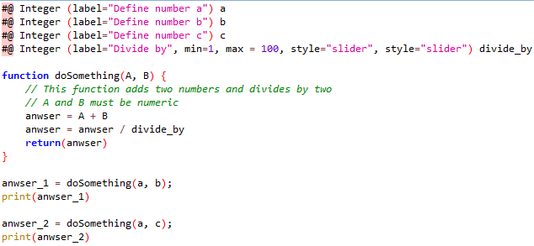
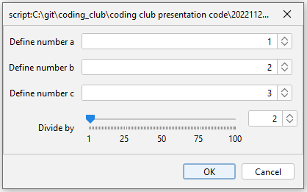
Make your script user friendly by making a graphical user interface (GUI)
#@ script parameters
Simple to use
Clearly defines input
Automatic error handling
E.g. accepts integers only
Easy to use for non-programmers
Can be accessed programmatically
Example 2
Code available at: https://github.com/oodegard/coding_club

Slide 19


Calling one script from another script
You can re-use your scripts and functions by calling them from other scripts.
Save your code in the imageJ folder called plugins
“C:\ProgramFiles_win\fiji-win64\Fiji.app\plugins”
Re-start ImageJ
Call your script
Example 3
Macro
Python
Code available at: https://github.com/oodegard/coding_club

Slide 20
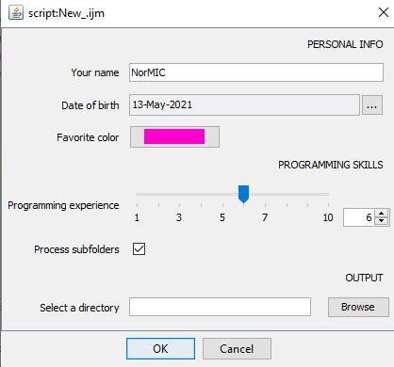
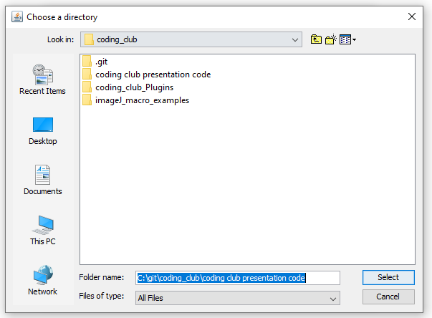
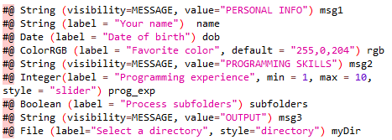
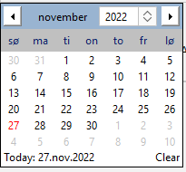
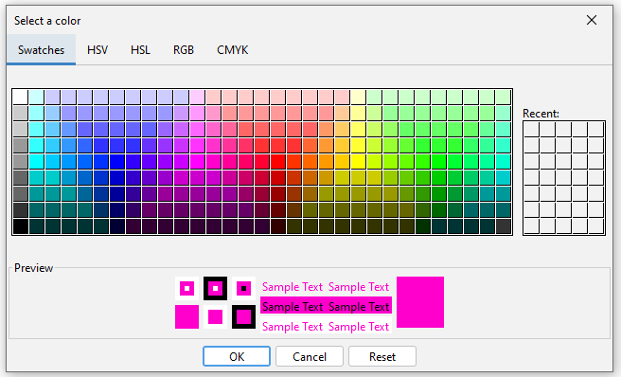
Many types of input
Example 4
RUN
Read more at
https://imagej.net/scripting/parameters
Code available at: https://github.com/oodegard/coding_club

Slide 21
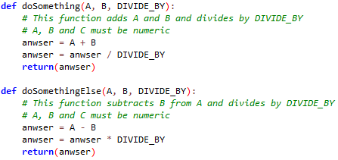
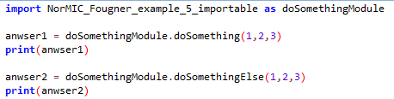
Getting the output from a script you have called
Example 5 (Python)
In the function definition
Save the output as a file
Store the output in a Results table or as an open image
Write python functions and import to main script
Write a proper java library / package (recommended by the community
Save in e.g. “C:\ProgramFiles_win\fiji-win64\Fiji.app\jars\Lib”
Then import and call your functions
Level 1
Level 2
Level 3
Code available at: https://github.com/oodegard/coding_club

Slide 22
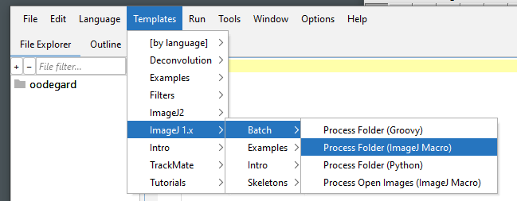
Using existing templates in ImageJ

Slide 23
Summary
Organize your code in discrete segments
Use #@ Script Parameters for input
Split code into functions, or separate macros rather than making copies of it
Have a data management plan
Have a code management plan
Make sure that you can reproduce your work
Stay sane
gfycat.com

Slide 24
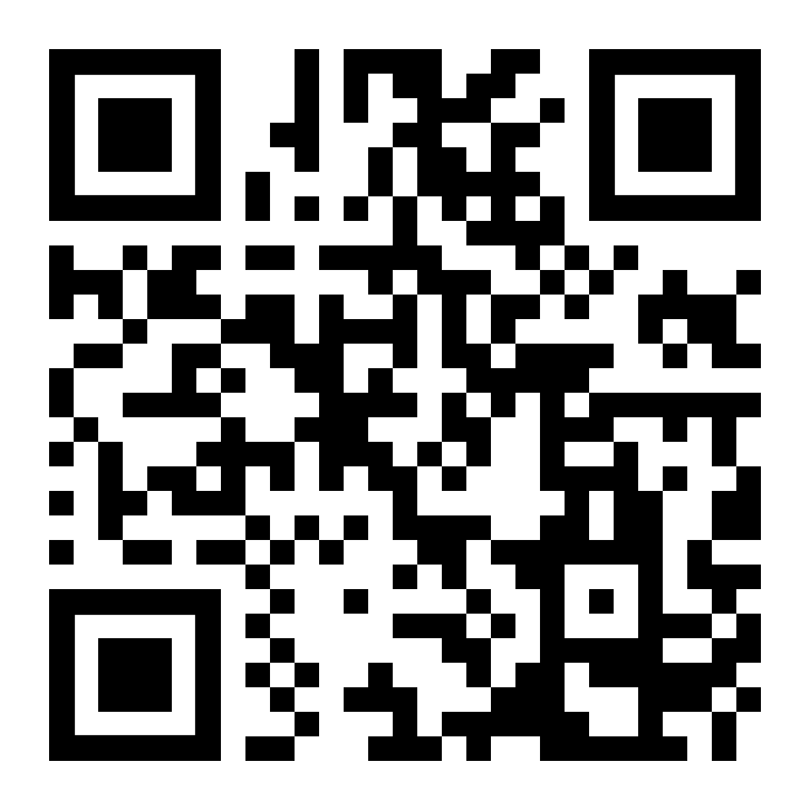
All example code is available online
https://github.com/oodegard/coding_club
In the folder called “coding club presentation code”

