Slide 1

Welcome to the coding club
20220111

Slide 2
Version Control
Why track/manage different versions of code?
Backup: Undo or refer to old stuff
Branch: Maintain old release while working on new
Collaborate: Work in parallel with teammates

Slide 3
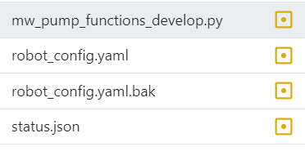
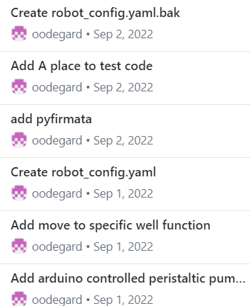
Todays topic - Github keeping track of changes with version control
Typical bad examples
The Better Git way
Data.analysis_v1.py
Data.analysis_v2_modified_for_Øyvind_v1 .py
Data.analysis_v2_modified_for_Øyvind_v2_oedegaard_et_al2021.py
Data.analysis_v2_modified_for_Øyvind_v2_use_this_v2 .py
Files in in git folder
History of all changes

Slide 4



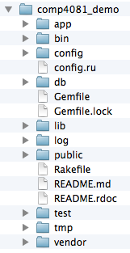
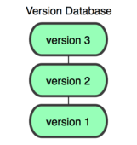
You
GitHub
Working Dir
Local
Repos
Remote
Repos

Slide 5
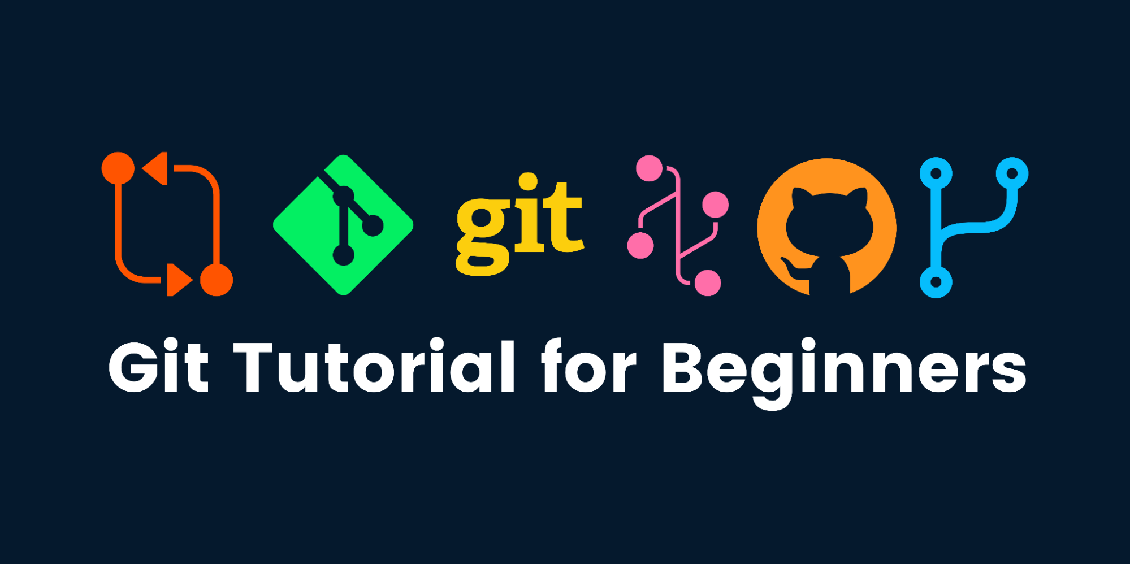

Slide 6
Basic Git nomenclature
Clone
  make a clone or copy of that repository at in a new directory, at another location
Commit
  Make a snapshot of your repository at a specific point in time
Push
  upload local repository content to a remote repository
Pull
  fetch and download content from a remote repository and immediately update the local repository to match that content

Slide 7
Tutorial
Getting started
Task
Go to https://github.com/
  Make an account if you do not have one
  Or use your UIO account at https://github.uio.no/
Download and install https://desktop.github.com/
Make a new repository at github.com
Clone the repository to your computer
Make a file with some content
Commit and push using github desktop
Check that it worked at github.com
Bonus1. Make a change to your file and commit and push again.
Bonus2. Share your code with someone else, make them do a change in the file

