Slide 1
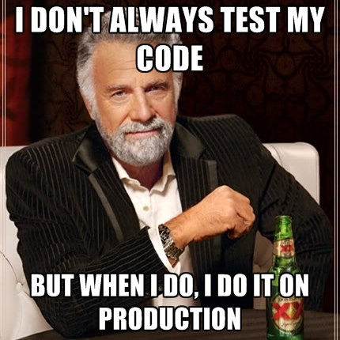
Notes:
All I’m talking about is a summary of what I’ve learned in the past weeks.
This is just my opinion, if you have any suggestions, please just talk.

Slide 2
Agenda
What is a unit test.
Where does Unit test stand in relative to other test types.
What can be gained by Unit tests. What can’t.
Why should we trust a unit test.
5. Example preparations.
Example.

Slide 3
What is a Unit Test?

Slide 4
What is a Unit Test? (From Wikipedia)
The smallest system/module test that verifies the system’s behavior.
Notes:
If this piece of code is doing something you can split, it might be worth doing so.

Slide 5
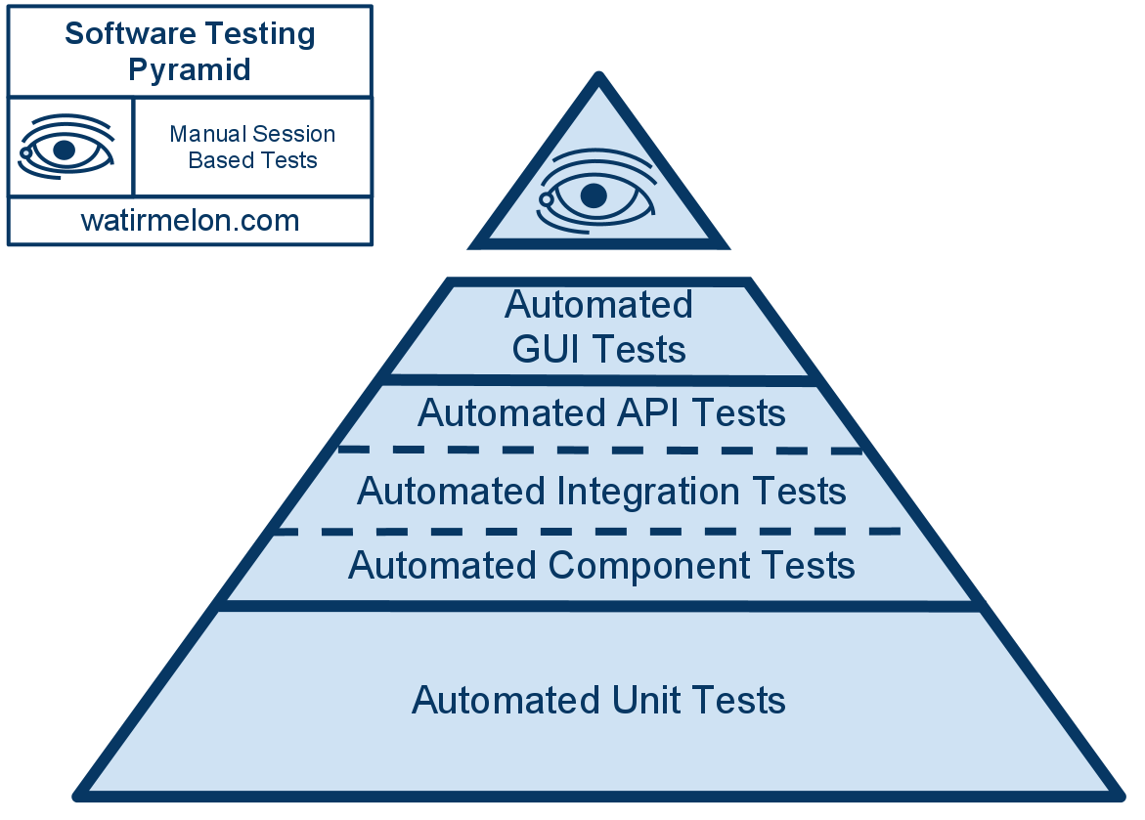
Notes:
What we strive to achieve:
The lowest test on the pyramid are the “cheapest” to run – fastest, and require less external components.
Therefore, they also cover less parts of the system.
Unit tests can be run after each commit.
Integration tests – on nightly builds.
Manual tests – before releases, after major code changes.

Slide 6
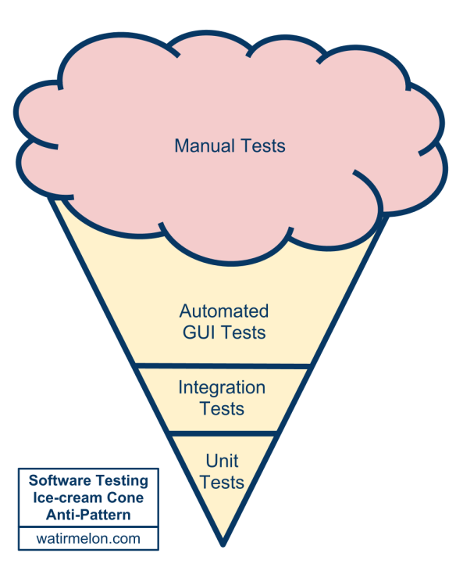
Notes:
The anti pattern – we don't have any or a considerable automatic coverage, so the tests at the bottom are rather scarce, but the manual tests at the top are growing beyond control, and this how we achieve most of the coverage.
Symptoms:
Merging big changes is scary and often breaks a lot of things.
Releases a headache. There's a blockade of manual testing workforce, and before a release is made, there's a long and painfull regression that blocks development.

Slide 7
Notes:
We’re only covering Unit tests in this talk. Automated GUI Tests is what Guy’s team is doing. All that’s in the middle is something that still needs studying.

Slide 8
What can be gained by Unit Testing? What Can’t?

Slide 9
What can be gained by Unit Testing? What Can’t?
Can’t:
Acceptance Tests/ Regression.
Integration Tests.
Most UI Tests.
Other objects, other libraries, the SDK.
Can
Testing the small components.
Have some degree of faith in the code before it reaches QA, or other more expensive tests.
Changes are safer - you know if you broke something basic very fast.
Notes:
Unit tests tell us a partial story. We only know that all the parts are working separately. We don’t know if the whole thing is working when connected.
If you wish to test a flow, Unit Testing probably isn’t what you need.
It doesn’t and shouldn’t test someone else’s code (from the SDK, or some other lib).

Slide 10

Why trust Unit Tests?
Notes:
Why should we trust a unit test?
We’ve seen it fail, and then work again after applying the relevant code changes.
It’s supposed to be in a much clearer fashion.
This leads to how a unit test should be written (the very next slide).

Slide 11
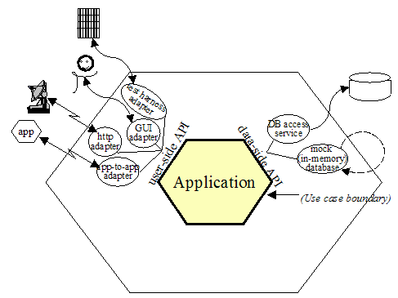
Example + Guidelines:
Notes:
The crucial lecture time starts now.
The Hexagon pattern. I know it from TDD, it talks about separating your logic from external independent components (DBs, GUI, network layers).
What I’d like to take from this slide is the limits concept- in order to be easy to test, a class/component need to be well defined.
We should always strive to not-test APIs and framework components, or any other component.
We should always strive to assume that everything around the tested class is working as planned/mocked.

Slide 12
How to write Unit-Testable code?
Thorough unit testing helps us improve the internal quality because, to be tested, a unit has to be structured to run outside the system in a test fixture.
A unit test for an object needs to create the object, provide its dependencies, interact with it, and check that it behaved as expected. So, for a class to be easy to unit-test, the class must have explicit dependencies that can easily be substituted and clear responsibilities that can easily be invoked and verified.
In software engineering terms, that means that the code must be loosely coupled and highly cohesive —in other words, well-designed.
Steve Freeman and Nat Pryce, Growing Object Oriented Software Guided by Tests
Notes:
Say again, know the (SUT’s) limits.
Know what is a dependency/limit.
Once the limit is clear, it’s much easier to

Slide 13
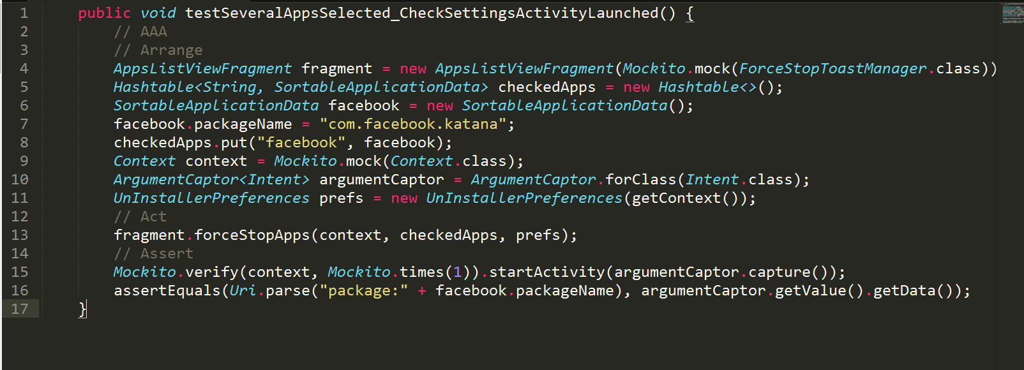
Some guidelines!
Notes:
The AAA pattern.
Naming convention.
Package placing.
Dependency injection.
See the test fail!
Not all methods can be tested against their return value. Sometimes a calculation’s result is an invokation of another
What’s not good in this test:
1. The usage of real prefs.
2. DI : The “by the book way” : have it done with a “factory” – not the design pattern.
3. Everything that isn’t the SUT should be mocked – there test correctness should not depend on any other implementation.
5. Test should only test one thing, so hopefully there should be one assertion – DAMP vs DRY
6. Talk about how using interfaces can ease testing, even if we don’t have Mockito.

