Slide 1
Branch Prediction Performance
Roy Rodriguez

Slide 2
Brief Intro
Branch prediction used to update next PC preemptively
3 branch predictors used in this project

Slide 3
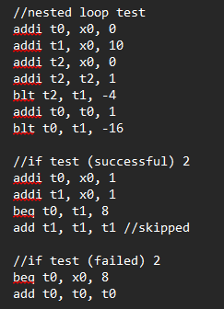
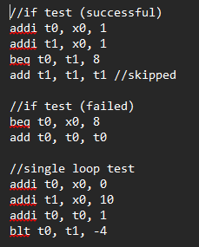
Test Program
Multiple if statements
Single loop
Nested loop

Slide 4
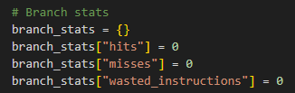
Test 1 – Never Take
Identical to Assignment 5
Uses branch stats to take note of accuracy

Slide 5
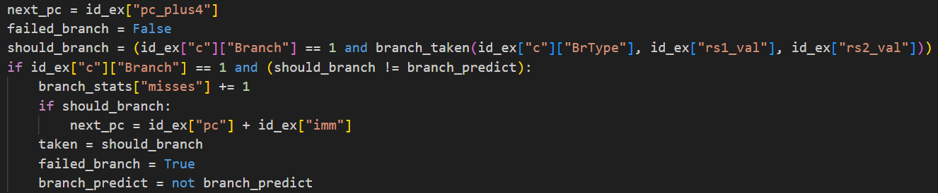

Test 2 – 1-Bit Predictor
Starts by always taking
Switches whenever it’s wrong
(in IF stage)

Slide 6
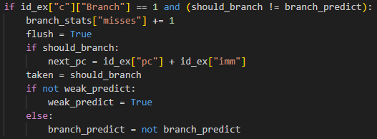
Test 3 – 2-Bit Predictor
Starts by weakly taking
Weak bit changes before main branch predictor does

