Slide 1
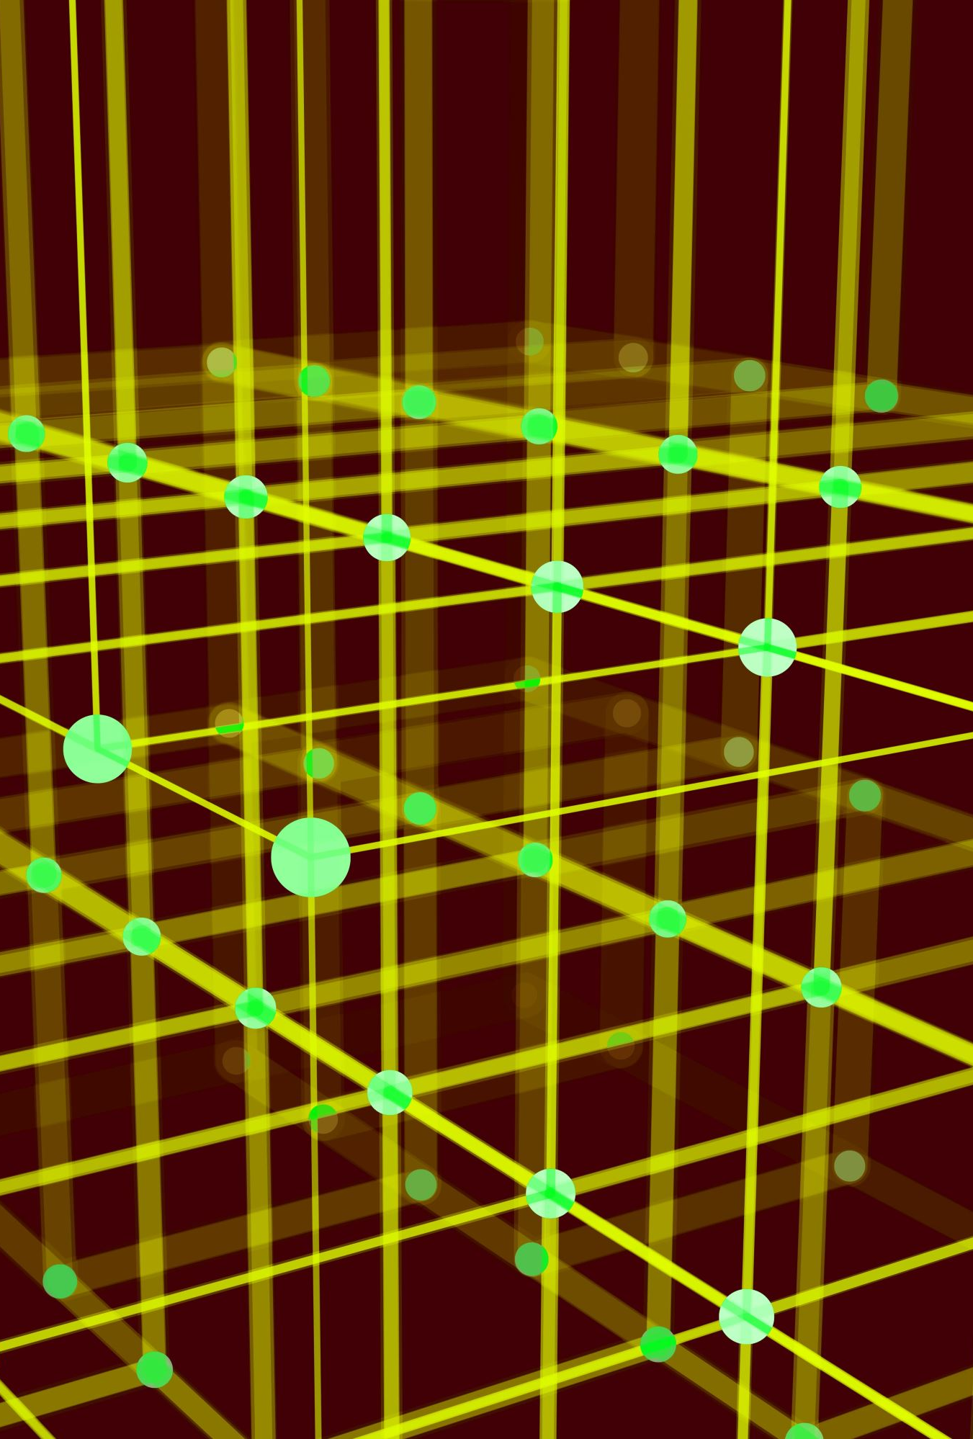
Image Colorization using GENERATIVE ADVERSARIAL NETWORK(GAN)
By
OOHA REDDY BIRRU

Slide 2
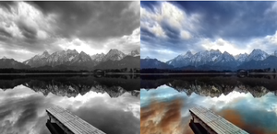
Introduction
Image Colorization is the process of adding color to black and white images.
Restoration of historical photos
Enhancing visual appeal in media production
Facilitating better interpretation in medical imaging

Slide 3
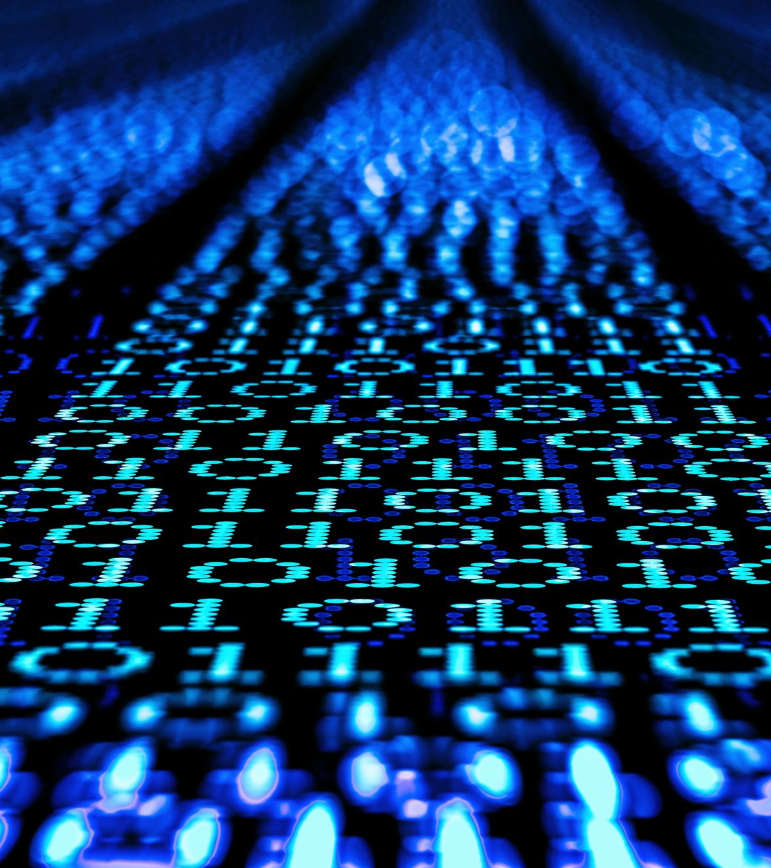
Dataset
ImageNet dataset with 1.3 million images
Opted some number of images from COCO dataset
It contains training and validation data

Slide 4
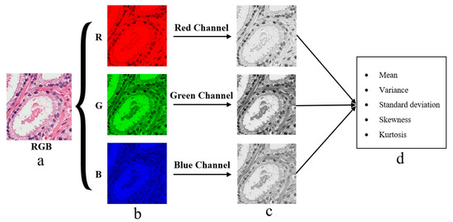
Data Preprocessing
Color Space Transformation
Convert RGB images to the Lab color space.
Grayscale(L channel) serves as input
Color channels(a,b) as corresponding targets for model training.

Slide 5
Model architecture
Generator (U-Net):
U-Net architecture for image colorization.
Encoder-decoder structure with skip connections.
Input: Grayscale image (L channel).
Output: Colorized image (a, b channels).
Discriminator (PatchGAN):
PatchGAN discriminator for adversarial training.
Evaluates realism of colorized images.
Input: Concatenation of L channel and colorized

Slide 6
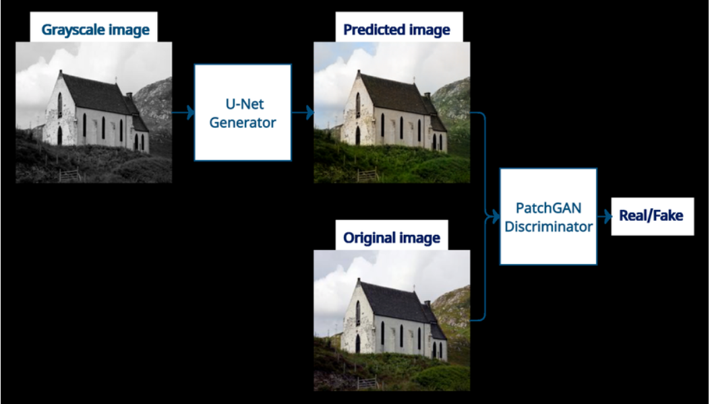

Slide 7
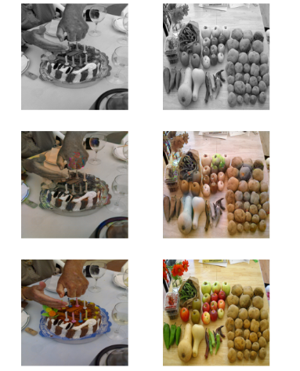
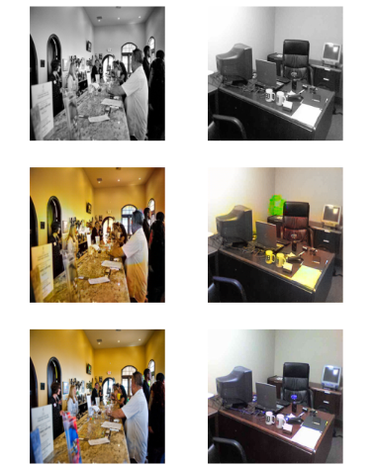
Image colorization results

Slide 8
Conclusion
The utilization of U-Net and GAN resulted in successful image colorization.
Adversarial training significantly improved the realism of colorized images.
Consistency in colorization outcomes demonstrated the model's effectiveness.

Slide 9
References
X. Jin, Z. Li, K. Liu, D. Zou, X. Li, X. Zhu, Z. Zhou, Q. Sun, and Q. Liu, “Focusing on persons: Colorizing old images learning from modern historical movies,” CoRR, vol. abs/2108.06515, 2021. [Online]. Available: https://arxiv.org/abs/2108.06515
Jun-Yan Zhu, Taesung Park, Phillip Isola, and Alexei A. Efros. Unpaired image-to-image translation using cycle-consistent adversarial networks. CoRR, abs/1703.10593, 2017. URL https://arxiv.org/abs/1611.07004

Slide 10

Thank you

