Slide 1


BLOCKBENCH: A Framework for Analyzing Private Blockchains
Presented by:
Wejdene HAOUARI
Supervisors:
Prof. Marios-Eleftherios Fokaefs
Mr. Mohammadreza RasolRoveicy

Slide 2
01
04
Scope of Work
key findings
02
05
BlockBench design
Conclusion
03
06
Workloads
Sawtooth

Slide 3
01
Scope of Work

Slide 4
MOtivation
Overview of the Research
Blockchain technologies become more and more popular, it can be used as public secure means of transactions as well as private ledgers for finance and banking applications.
The security and performance of public blockchains are demonstrated by an expanding number of related works, but with the emergence of private blockchains it is important to have way to analyse and compare them.

Slide 5
Overview
Research paper
The authors present the result and a set of recommendations for future private blockchain
The authors discuss the benefits of private blockchain
The authors describe the core layers in private blockchain
The authors describe the implementation of Blockbench tool

Slide 6
Why using blockchain?
02
Blockchain immutability and transparency help reduce human errors and the need for manual intervention due to conflicting data.
Blockchain can streamline processes by removing duplicate efforts in data governance.
01
03
Blockchain provides a basis for cooperation among competing entities that may not fully trust each other.

Slide 7
Blockbench features
01
A flexible and extensible framework
02
Workloads to macro-benchmark and micro-benchmark blockchain
03
Comes with Ethereum, Parity, and Hyperledger as back-ends
04
Quantifies the performance of a backend system in several dimensions
05
Supports security evaluation by simulating network level attacks

Slide 8
02
BlockBench design

Slide 9
Blockbench layers
Blockchain system comprises many parts with a wide variety and design choices.
To meaningfully compare private blockchain systems, the authors identify four abstraction
Layers and design workloads to target these layers.
Application
Execution Engine
Data Model
Consensus
Notes:
We now discuss these layers in turn.

Slide 10
Consensus
Blockbench
layers
The consensus layer is a fault-tolerant mechanism that used to establish an agreement on the blockchain content among distributed nodes.
Choosing consensus is crucial as it play an important role in ensuring security.
For example POW works against Sybil attack, however it is vulnerable to double spending attacks.
In the other hands PBFT tolerate more failures than PoW

Slide 11
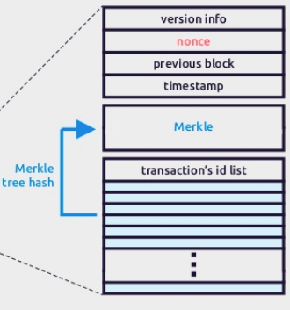
Data model
Blockbench
layers
The data model in blockchain is different from one system to another. However most blockchain systems use Merkle tree to organize transactions.
Ethereum and Parity employ Patricia-Merkle tree that supports efficient update and search operations. Hyperledger fabric implements BucketMerkle tree which uses a hash function to group states into a list of buckets.

Slide 12
Execution layer
Blockbench
layers
The execution of a contract or chaincode must be fast and deterministic.
The runtime environment is different from a framework to another, ethereum and parity use a virtual machine EVM to execute code (bytecode) and every write transaction costs gas.
Hyperledger supports running of compiled machine codes inside Docker images.
Hyperledger supports multiple high-level programming languages such as Go and Java, as opposed to Ethereum’s own language

Slide 13
Application Layer
Blockbench
layers
Many application are proposed to blockchain due to the transparency and immutability of the data, and because it is resilient to dishonest and malicious participants.
The most popular application on blockchain are cryptocurrency application, Decentralized Autonomous Organization and wallet management.
Blockchain is also suitable for finance application and IOT communication.

Slide 14
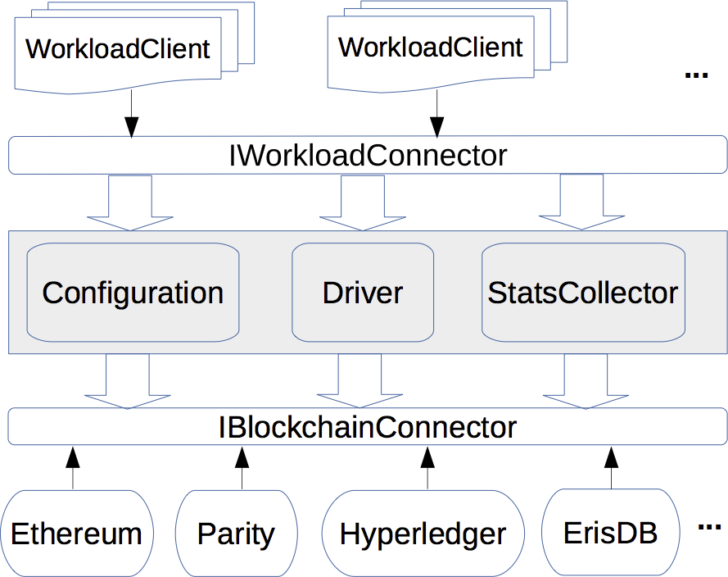
BLOCKBENCH Implementation
Blockbench is structured such that you can write an adapter to plugin the blockchain platform of your choice.

Slide 15
IBlockchainConnector
IBlockchain Connector operations
Blockbench
Implementation
To evaluate a blockchain system, the first step is to integrate the blockchain into the framework’s backend by implementing IBlockchainConnector interface
deploying applications
sending a transaction
Querying the blockchain’s states

Slide 16
IWorkloadConnector
Blockbench
Implementation
For evaluation the system a user can use one of the existing workload or create a new workload using IWorkloadConnector interface in addition to the smart contract that handle the workload logic.
This interface essentially wraps the workload’s operations into transactions to be sent to the blockchain. Specifically, it has a getNextTransaction method which returns a new blockchain transaction.

Slide 17
Driver
Blockbench
implementation
The driver is the core component of blockbench . It take as input the workload and a configuration, executes it on the blockchain and output statistics .
Blockchain system are asynchronous meaning that transactions submitted to the systems are processed at a later time. When submitting a transaction a transaction ID is returned which can be used for checking the transaction status at a later time
Workload
Configuration
Driver
The Drive must periodically poll for the status of the submitted requests
statistics
Notes:
the Driver which takes as input a workload, user-defined configuration (the num-
ber of operations, the number of clients, threads, etc.), executes it on the blockchain and
outputs running statistics.

Slide 18
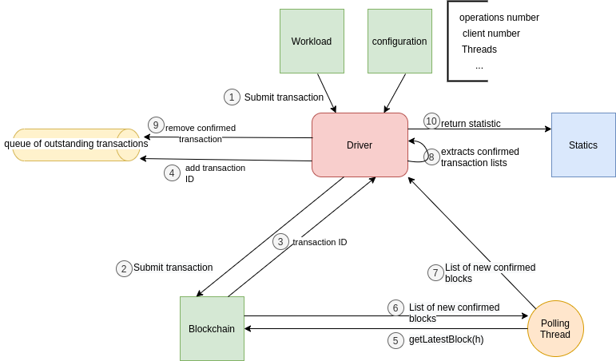
Driver Implementation

Slide 19
03
Workloads

Slide 20
Performance Metrics
Evaluation Metrics
Throughput
Latency
Scalability
Fault tolerance
Measured as the number of successful transactions per second
Measured as the response time per transaction. Driver implements
blocking transaction
Measured as the changes in throughput and latency when increasing number of nodes and number of concurrent workloads
Measured as how the throughput and latency change during node
Failure:
Node stop
network delay
random response

Slide 21
Security attacks
double spending
selfish mining
The attacker sends a transaction to a block in the fork, waits for it to be accepted by the users,then sends a conflicting transaction to another block in the main branch
When the attacker compromise 25% of the nodes by creating a long fork which force other participants to join the attacker’s coalition, the attacker can control the entire network’s block generation
Eclipse attack
Exploits the application-level protocol to surround the targeted nodes with
ones under the attacker’s control

Slide 22
Security Metrics
Evaluation Metrics
The authors quantify security as the number of blocks in the forks as they represent the window of vulnerability in which the attacker can perform double spending or selfish mining.
BLOCKBENCH implements a simulation of these attacks by partitioning the network for a given duration.
Security is measured by the ratio between the total number of blocks included in the main branch and the total number of blocks confirmed by the users.
The lower the ratio, the less vulnerable the system

Slide 23
Workload
The authors divide the workloads into two major categories: macro benchmark for evaluating the performance of the application layer, and micro benchmark for testing the lower layers.
They have implemented the smart contracts for all workloads for Ethereum, Parity, and Hyperledger fabric.

Slide 24
Macro benchmark
Smart contracts | Description
Key-value storage | Preloads each store with a number of records, and supports requests with different ratios of read and write operations. Based on YCSB driver
Smallbank | Smallbank is a popular benchmark for OLTP workload. It consists of three tables and four basic procedures simulating basic operations
EtherId | A popular contract that implements a domain name registrar
Doubler | A contract that implements a pyramid scheme
WavesPresale | This contract supports digital token sales. It maintains two states: the total number of tokens sold so far, and the list of previous sale transactions
Notes:
Online transaction processing

Slide 25
Micro benchmark
Smart contracts | Layer | Description
DoNothing | consensus layer | This contract accepts transaction as input and simply returns. the overall performance will be mainly determined by the consensus layer
Analytics | data model | This workload evaluates how the system implements scan-like and aggregate queries, which are determined by its data model
IOHeavy | Data model | This workload is designed to evaluate the IO performance by invoking a contract that performs a large number of random writes and random reads
CPUHeavy | execution layer | This workload measures the efficiency of the execution layer for computationally heavy tasks by running the quick sort algorithm over large preloaded array

Slide 26
04
key findings

Slide 27
Configuration
The authors used in their experience the following settings:
Go implementation of Ethereum, geth v1.4.18
The Parity release v1.6.0
The Hyperledger Fabric release v0.6.0-preview
The experiments were run on 48 node commodity cluster. Each node has:
E5-1650 3.5GHz CPU
32GB RAM
2TB hard drive
running Ubuntu 14.04 Trusty
connected to the other nodes via 1GB switch
For Ethereum, the authors reserved 8 cores out of the available 12 cores per
machine, so that the periodical polls from the client’s driver process do not interfere with the mining process

Slide 28
Key finding
H. Fabric performs consistently better than Ethereum and Parity across the benchmarks. But it fails to scale up to more than 16 nodes
Ethereum and Parity are more resilient to node failures, but they are vulnerable to security attacks that forks the blockchain.
The main bottlenecks in H. Fabric and Ethereum are the consensus protocols, but for Parity the bottleneck is caused by transaction signing
Ethereum and Parity incur large overhead in terms of memory and disk usage. Their execution engine is also less efficient than that of Hyperledger.
H. Fabric’s data model is low level, but its flexibility enables customized optimization for analytical queries of the blockchain data.

Slide 29
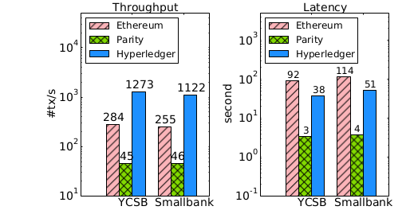
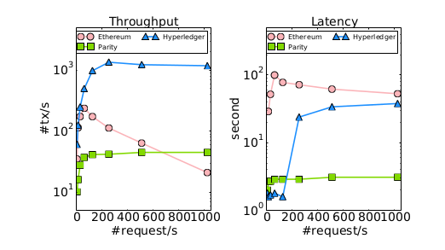
Throughput and latency
H. Fabric performs consistently better in term of throughput than Ethereum (5.5x) and Parity (28x) across the benchmarks
The gap between H. Fabric and Ethereum in term of latency is because of the difference in consensus protocol.
Parity’s throughput and latency remain constant with increasing transaction rates because it processes transactions at a constant rate.

Slide 30
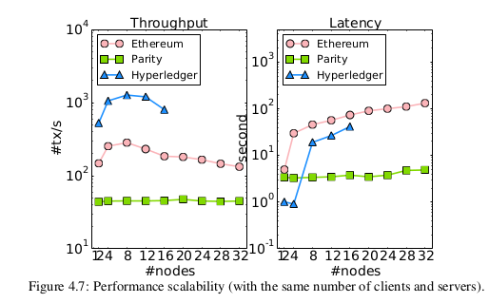
Scalability
Hyperledger Fabric fails to scale up to more than 16 nodes.
Parity’s performance remains constant as the network size and offered load increase, due to the constant transaction processing rate at the servers.
Ethereum’s throughput and latency degrade almost linearly beyond 8 servers

Slide 31
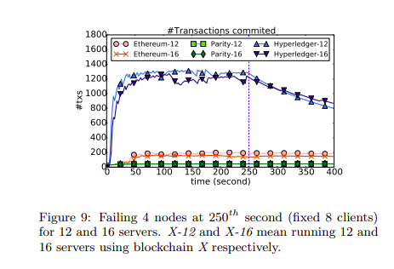
Fault tolerance and security
Ethereum is nearly unaffected by the change, suggesting that the failed servers do not contributing significantly to the mining process
In Parity, each node generates blocks at a constant rate, thus failing 4 nodes means the remaining nodes are given more time to generate more blocks, therefore the overall throughput is unaffected.
H. Fabric stops generating blocks after the failure, which is as expected because the PBFT can only tolerate fewer than 4 failures in a 12-server network. With 16 servers, the system still generated blocks but at a lower rate.

Slide 32
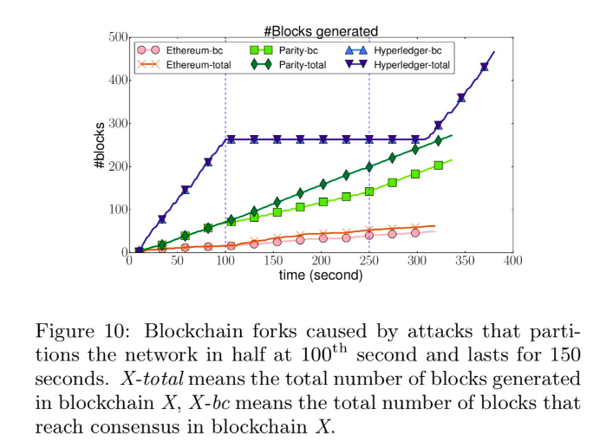
Fault tolerance and security(2)
H. Fabric has no fork because its consensus protocol is proven to guaranteed safety however it take longer time to recover because of the synchronization protocol.
Both Ethereum and Parity blockchains fork at 100th seconds upto 30% of the blocks are generated in the forked branch
When the partition heals, the nodes
come to consensus on the main branch and discard the forked
blocks.
Notes:
Figure 10 compares the vulnerability of the three systems running with 8 clients and 8 servers.

Slide 33
05
Conclusion

Slide 34
Authors Recommendation
Decouple the storage, execution engine, and consensus layer from each other and then optimise and scale them independently.
Support declarative languages for smart contracts, opening up opportunities for low-level optimisations that speed up contract execution.
Embrace new hardware primitives to boost performance
Consider how the concept of sharding might be applied (research agenda)
Notes:
The authors advocate four design principles from the world of database systems which they believe can help to address performance bottlenecks

Slide 35
Conclusion
BlockBench is a tool to study the performance of private blockchains, to study and comparing the performance of Hyperledger Fabric, Ethereum and Parity.
The result that the authors found enable developer to understand the difference between blockchain performance in term of performance and security however, this tool does not measure the CPU and the memory usage of different platform, this metrics are extremely important in order to choose the accurate server resources.
Notes:
The authors advocate four design principles from the world of database systems which they believe can help to address performance bottlenecks

Slide 36
06
Sawtooth

Slide 37
Sawtooth layer
Application
Cient
Execution Engine
transaction processor
Data Model
Transaction family
Consensus
Consensus
engine
Notes:
I would caution against viewing a transaction processor as direct equivalent of a smart contract or, to a lesser extent, chaincode. It is more accurate to view transaction processor as a form of computing platform to enable smart contracts to execute

Slide 38
Conclusion
In order to test Sawtooth performance. We can use the existing workload for Key-value storage and smallbank as Sawtooth includes IntegerKey Transaction Family and Smallbank Transaction Family as examples.
However for the others, we need either to implements the corresponding transaction family or we can use Seth (Sawtooth-Ethereum integration project) to run Ethereum Virtual Machine smart contracts to the Hyperledger Sawtooth platform
Notes:
Transaction language and the data model are implemented in a transaction family.
1. IntegerKey for testing deployed ledgers.
2. Identity for managing on-chain permissioning for validator and transactor keys to simplify identity management for public keys’ lists.
3. Settings to provide an implementation for saving on-chain configuration settings.
4. BlockInfo for providing an approach to store information about a number of historic blocks.
5. Smallbank for managing performance analysis for performance testing and benchmarking when doing the comparison of blockchain systems’ performance.

