Slide 1

Sumea
Instant Fun for Everyone!
Company Presentation

Slide 2
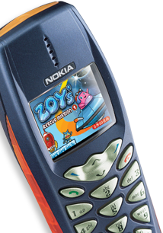
Introducing Sumea
Sumea is a publisher and developer of high-quality downloadable mobile games for Java and BREW platforms
Portfolio of 17 games
Winner of several international game development awards
Based in Helsinki, Finland

Slide 3




Proven Track Record
Games live in 40 countries world-wide
Key customers include leading telecom operators, media companies and entertainment portals in Europe, US and Asia
Game Development Awards
  Winner of Hutchison 3G game development competition
  Runner-up in Nokia Series 60 competition
  Handango Java Developer of the Year 2003

Slide 4














Sumea Game Portfolio
And
More
to
Come

Slide 5




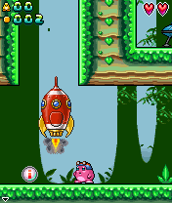
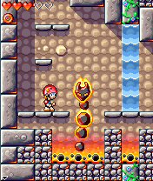
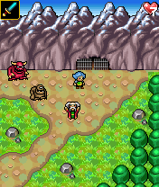
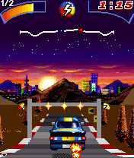
Recent Game Releases

Slide 6













Distribution Partners

Slide 7

Sumea
Itämerenkatu 5
00180 Helsinki
Finland
email: info@sumea.com
web: www.sumea.com

