Slide 2
A Brief Introduction to Sumea

Slide 3
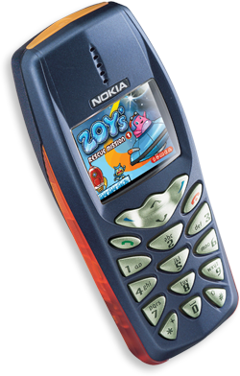
Company
Sumea is a development company for mobile games.
Focuses exclusively on producing high-quality Java (J2ME/MIDP) games.
Based in Helsinki, Finland.
Founded in 1999.
Notes:
the ”navi” down there now functions

Slide 4
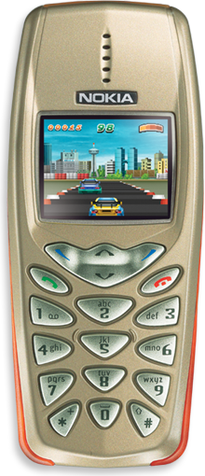
Mission & Aims
To bring the PC/console-style gaming
experience to mobile phones.
To create mobile games that are:
  Captivating.
  Visually attractive.
  Fun to play!

Slide 5












Selected References

Slide 6
Sumea Games Portfolio

Slide 7





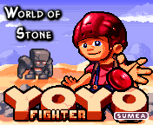






Games Portfolio

Slide 8

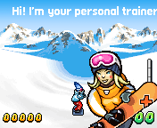
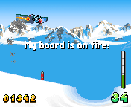
“Snowboarding Fever”
Genre: Extreme Sports
Goal: It's time to hit the tube dudes! It's a race against the clock as you must attempt to pull off as many tricks as possible to impress the judges.
Phones: Nokia 7650, 3650
Availability: Now

Slide 9
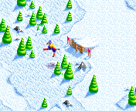
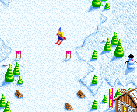
”Freestyle--X”
Genre: Extreme Sports
Goal: Make your way through the ski slope as fast as possible. Make tricks to gain extra points. Multiplayer features (single device).
Phones: Nokia 3510i, 3650, 6100, 6610, 7210, 7250, 7650
Availability: Now

Slide 10

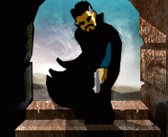
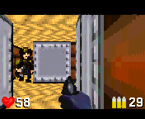
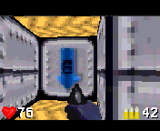
”Stalk ’N’ Shoot”
Genre: 3D Action
Goal: Grab whatever weapon you can and fight your way out of the dungeon in this awesome 3D action shooter.
Phones: Nokia 7650, 3650, 6310i
Availability: Now

Slide 11
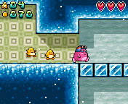
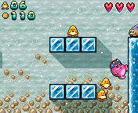
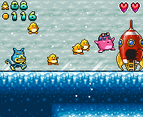
“Zoy’s Rescue Mission”
Genre: Action
Goal: Zoy's juniors have crash- landed on a distant planet! It is up to Zoy to rescue them and take them home.
Phones: Nokia 3410, 3510i, 3650, 6100, 6610, 7210, 7250, 7650
Availability: now

Slide 12
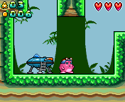
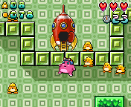
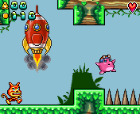
“Zoy’s Rescue Mission 2”
Genre: Action
Goal: Zoy juniors have crash- landed again – this time on a Forest Planet! Find them and take them to the safety of their spacecraft. Luckily, this time you have the commander on board to help you out!
Phones: Nokia 7650, 7210, 7250, 3650, 3510i,3410
Availability: now

Slide 13
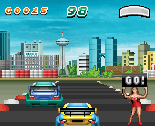
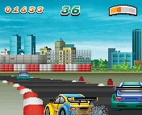


“Racing Fever”
Genre: Racing
Goal: Get ready to be taken over by racing fever. Storm down the racetrack in this fast-paced racing game, but watch out for the other racers!
Phones: Nokia 3410, 3510i, 3650, 6100, 6310i, 6610, 7210, 7250, 7650
Siemens M50/SL45i
Motorola V60i/V66i
Availability: now

Slide 14
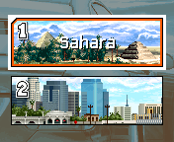
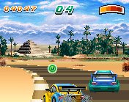
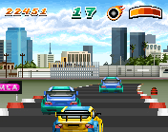
“Racing Fever Deluxe”
Genre: Racing
Goal: Racing Fever is back, this time with two totally new courses and a bunch of bonuses thrown in!Complete both of the exciting courses with the help of turbo boosts and time-bonuses.
Phones: Nokia 3650, 6650, 7650
Availability: now

Slide 15
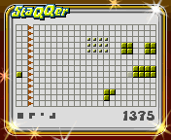
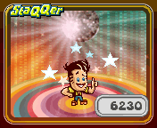


“Staqqer”
Genre: Puzzle / action
Goal: Want to get stressed? Fight against time and challenge your nerves! Blocks in different shapes approach you from the right border of the playing field, and you must prevent them from reaching the left side by throwing appropriate particles at them.
Phones: Nokia 3410, 3510i, 3650, 6310i, 7650
Siemens M50/SL45i
Motorola V60i/V66i
Availability: now

Slide 16
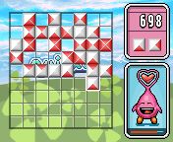
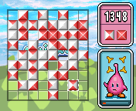


“Quicxo”
Genre: Puzzle
Goal: Poor Quicxo... So many blocks and so little time! Help Quicxo: place the blocks next to each other so that the colors on the sides match. Quicxo is happy as long as you can help him quickly enough.
Phones: Nokia 3410, 3510i, 3650, 6100, 6310i, 6610, 7210, 7250, 7650
Siemens M50/SL45i
Motorola V60i/V66i
Availability: now

Slide 17
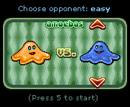
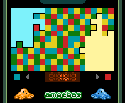


“Amoebas”
Genre: Puzzle
Goal: You control the amoeba in this action / puzzle game, as you try to conquer the game field by changing the cell colours to your advantage. The winner is the one who controls the most territory. Good Luck!
Phones: Nokia 3410, 3510i, 3650, 6100, 6310i, 6610, 7210, 7250, 7650
Siemens M50/SL45i
Motorola V60i/V66i
Availability: now

Slide 18
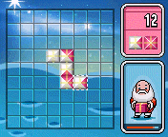
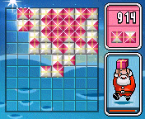
“Santa’s Challenge”
Genre: Puzzle
Goal: It is Christmas Eve and Santa is late. Help him to sort out the presents in time!
Phones: Nokia 3410, 3510i, 3650, 6100, 6310i, 6610, 7210, 7250, 7650
Siemens M50/SL45i
Motorola V60i/V66i
Availability: now

Slide 19
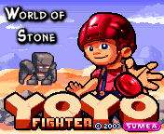
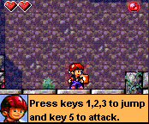
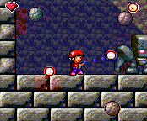
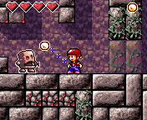
”Yo-Yo Fighter”
Genre: Action / Adventure
Goal: You have entered the World of Stone to save your friend who is being held as a prisoner by the mighty Golem Boss. Use your yo- yo to fight the enemies and look for special yo-yos to gain even better leverage!
Phones: Nokia 7650, 3650, 3510i
Availability: Q1/2003

Slide 20
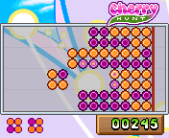



“Cherry Hunt”
Genre: Puzzle
Goal: Help the squirrel to take home as many cherries as possible in this exciting puzzle game!
Phones: Nokia 3410, 3510i, 3650, 6100, 6310i, 6610, 7210, 7250, 7650
Availability: Now

Slide 21
Sumea Interactive Ltd
Uudenmaankatu 40 B
00120 Helsinki
Finland
info@sumea.com

Slide 22

the end
Notes:
this is the end

