Slide 2
A Brief Introduction to Sumea

Slide 3





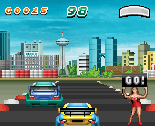

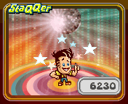

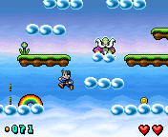

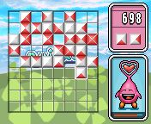
We Are All About Games!

Slide 4
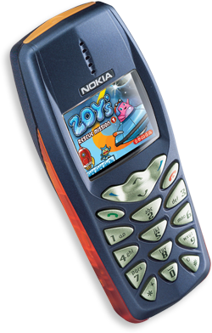
Experience
Sumea focuses exclusively on producing high-quality downloadable mobile games.
Founded in 1999.
Roots in the traditional PC / console games industry
Instant fun for casual gamers!
Notes:
the ”navi” down there now functions

Slide 5




Proven Track Record
Games live in 40 countries world-wide
Key customers include leading telecom operators, media companies and entertainment portals in Europe, US and Asia
Game Development Awards
  Winner of Hutchison 3G game development competition
  Runner-up in Nokia Series 60 competition
  Handango Java Developer of the Year 2003

Slide 6












Selected Distibution References

Slide 7



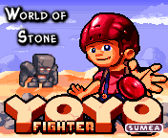




Current Games – More to Come!
Racing
Sports
Adventure
Action
Puzzles
Seasonal

Slide 8
Sumea Interactive Ltd
Uudenmaankatu 40 B
00120 Helsinki
Finland
CEO Ilkka Paananen
ilkka@sumea.com

Slide 9

the end
Notes:
this is the end

