Slide 1

An Intelligent
Decision-Support System
for Recruitment - RecruitIQ
METHODOLOGY PRESENTATION
STUDENT
SUPERVISOR
Department of Computer Science
BSc (Hons) Computer Science
Academic Year 2025/2026
Name: OLADAPO OLALEKAN OLANREWAJU
Matric No: 230912
Supervisor: Mr. AYETUOMA I. O.

Slide 2


INTRODUCTION
Background & Motivation
Recruitment is one of the most resource-intensive functions in Human Resource Management (HRM). Organisations routinely receive hundreds of applications per vacancy, yet continue to rely on manual, subjective review processes that are slow, inconsistent, and riddled with bias.
Beyond inefficiency, existing systems fail to treat candidates equitably — discriminating consciously or unconsciously based on race, nationality, gender, educational institution, and more. Rejected applicants receive no constructive feedback, leaving them unable to improve.
AI — specifically ML, NLP, and Explainable AI — can automate screening, ensure fairness, and empower both recruiters and candidates with transparent, actionable decisions.
250+
Avg. Applications
per Job Posting
70%
Reduction in
Screening Time with AI
This project designs an IDSS that automates CV screening, eliminates bias of all kinds, ranks candidates fairly, and provides meaningful feedback to every applicant.

Slide 3
LITERATURE REVIEW & RELATED WORKS
Resume Screening & Candidate Ranking Systems
Najjar et al. (2022)
I-Recruiter: An Intelligent Decision Support System for Recruitment
Method: Word Embeddings + Cosine Similarity
Result: Effective CV ranking via semantic similarity between CVs and job descriptions
Gap: No bias removal; limited evaluation across multilingual datasets and job domains
Tejaswini et al. (2022)
Design and Development of Machine Learning Based Resume Ranking System
Method: Content-based filtering; Cosine Similarity + KNN Algorithm
Result: Text parsing accuracy 85%; ranking accuracy 92%
Gap: No fairness metrics; degrades with large datasets and non-standard resume formats
Tayal et al. (2024)
Resume Screening Using Machine Learning and NLP
Method: NLP preprocessing + SVM, Random Forest, Logistic Regression, BERT
Result: Improved classification accuracy and reduced time-to-hire
Gap: Lacks bias detection, fairness evaluation, and applicant feedback mechanisms

Slide 4
LITERATURE REVIEW & RELATED WORKS
Ontology, Knowledge Graphs & Semantic Matching
Anh Chi Tuan et al. (2024)
Ontology and Its Applications in Skills Matching in Job Recruitment
Method: Skills ontology construction + SPARQL semantic matching
Result: 1–5% performance enhancement over competing models; deep skills comprehension beyond keywords
Gap: No dynamic ontology updates for new skills; no bias control or candidate feedback
MIDA Conference (2024)
Intelligent Recruitment DSS Combining Transformer Model and Knowledge Graph
Method: Transformer model integrated with a domain-specific knowledge graph
Result: Improved semantic matching between job requirements and candidate competencies
Gap: Limited cross-industry scalability; no applicant fairness or feedback components
Zhang et al. (2024)
Natural Language Processing (NLP) in AI-Driven Recruitment Systems
Method: GPT-4 Embeddings + Hierarchical Graph Neural Networks + Bilateral Matching
Result: F1 score of 0.91, outperforming cosine similarity (0.70) and SuperGlue (0.88)
Gap: Computationally expensive; lacks bias auditing and applicant-facing explanation output

Slide 5
LITERATURE REVIEW & RELATED WORKS
Bias, Fairness & Explainability in AI Recruitment
Salford (2024)
A Comprehensive Review of AI Techniques for Addressing Algorithmic Bias in Job Hiring
Method: Systematic review; vector space correction + data augmentation for bias mitigation
Result: NLP vector correction and data augmentation effectively reduce algorithmic bias in hiring
Gap: Intersectional bias (e.g. race + gender + country) remains significantly underexplored
Tandfonline (2025)
Explainable AI in the Talent Recruitment Process: A Literature Review
Method: Systematic review of XAI: LIME, SHAP, Knowledge Graphs, Causal Reasoning
Result: XAI improved semantic understanding in resume parsing and interview evaluation
Gap: No applicant-facing feedback loop; post-deployment HR adoption studies are scarce
Mujtaba and Mahapatra (2024)
Fairness in AI-Driven Recruitment: Challenges, Metrics, Methods & Future Directions
Method: Comprehensive review of ML/DL fairness metrics and bias auditing tools
Result: Prevalent biases identified in ranking software and chatbot interactions
Gap: No universal fairness standard; individual vs. group fairness metrics often conflict; no feedback to rejected candidates

Slide 6
PROBLEM STATEMENT
Problem Statement
Despite advances in AI, recruitment processes remain manual, biased, and opaque. Candidates are often assessed not on merit, but on demographic and socioeconomic factors. Rejected applicants receive no feedback, leaving them no path to improvement.
Conventional resume screening tools rely on rigid keyword matching and unvetted algorithms, leading to manual screening bottlenecks and systemic demographic bias. Furthermore, existing machine learning screening solutions function as opaque black boxes that output scores without interpretable rationales. Consequently, recruiters are unable to justify candidate rankings, identify qualification gaps, or ensure objective hiring decisions.
Bias is Built In AI hiring systems amplify historical human biases, systematically disadvantaging candidates by gender, race, and age. (Mujtaba & Mahapatra, 2024)

Slide 7
AIM AND OBJECTIVES
Aim & Objectives
AIM: To design and implement an Intelligent Decision-Support System (IDSS) for recruitment that automates CV screening, eliminates bias of all kinds, ranks candidates on merit, and provides constructive feedback to every applicant.
01
To design and develop a multi-factor candidate scoring model that evaluates hard technical skills, soft skills, role title similarity, and tenure alignment against recruiter-defined job requirements.
01
To implement a recruiter-centric prototype system featuring layout-aware text extraction (pdfplumber), recruiter-controlled PII anonymization (spaCy/regex), and a visual dashboard that displays candidate rankings, score breakdowns, and identified skill gaps.
01
To evaluate the system’s ranking consistency and explainability by testing candidate scoring and skill-gap identification across representative technical resumes compared to standard keyword-matching baselines.

Slide 8
PROPOSED METHODOLOGY
Proposed Methodology
Agile / Iterative Development Framework
1
2
3
4
Requirement Analysis Traceability
System Design & Modelling Validation
Implementation-Level Testing
Deployment Verification
This phase verifies that every functional requirement (FR) and non-functional standard (NFR) is directly validated through specific test procedures.
This level tests whether the software components conform to the structural models defined in Chapter Three (UML diagrams, DFDs, and ERD schemas).
Implementation testing evaluates individual functions, pipeline integration, and frontend components.
Deployment testing verifies that the built services operate smoothly in a staging/production runtime without local environment conflicts.
AGILE ITERATIVE FRAMEWORK

Slide 9
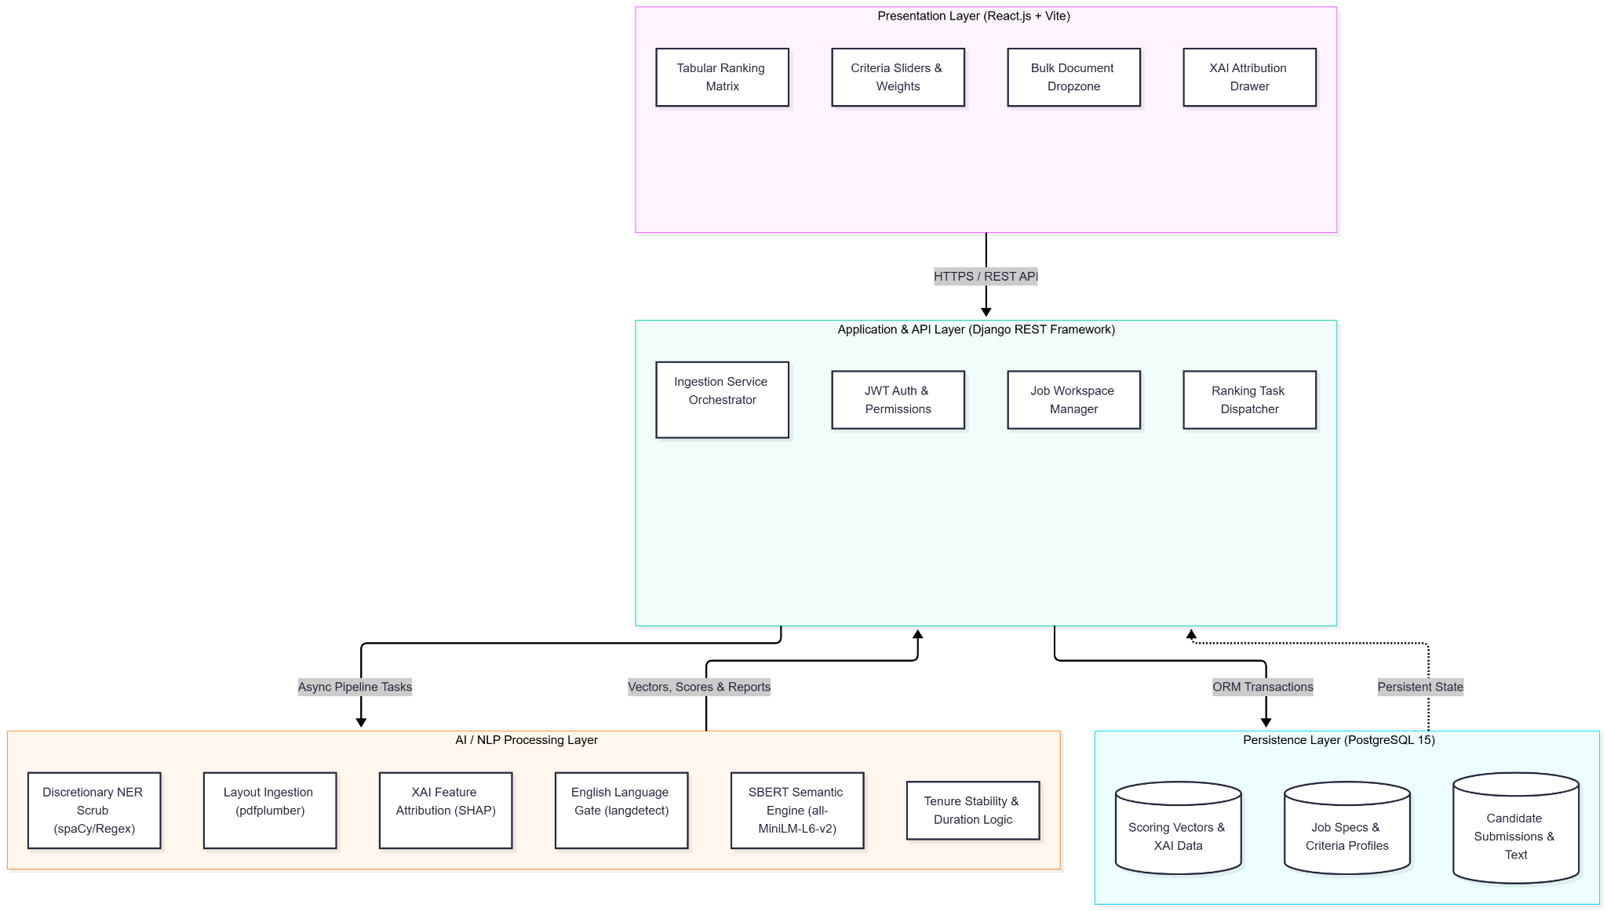
SYSTEM ARCHITECTURE
System Architecture

Slide 10
SYSTEM ARCHITECTURE
System Architecture

Slide 11
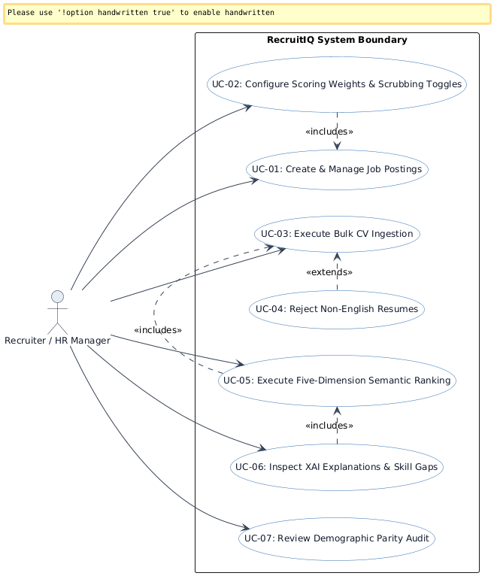
USE CASE DIAGRAM
Use Case Diagram

Slide 12
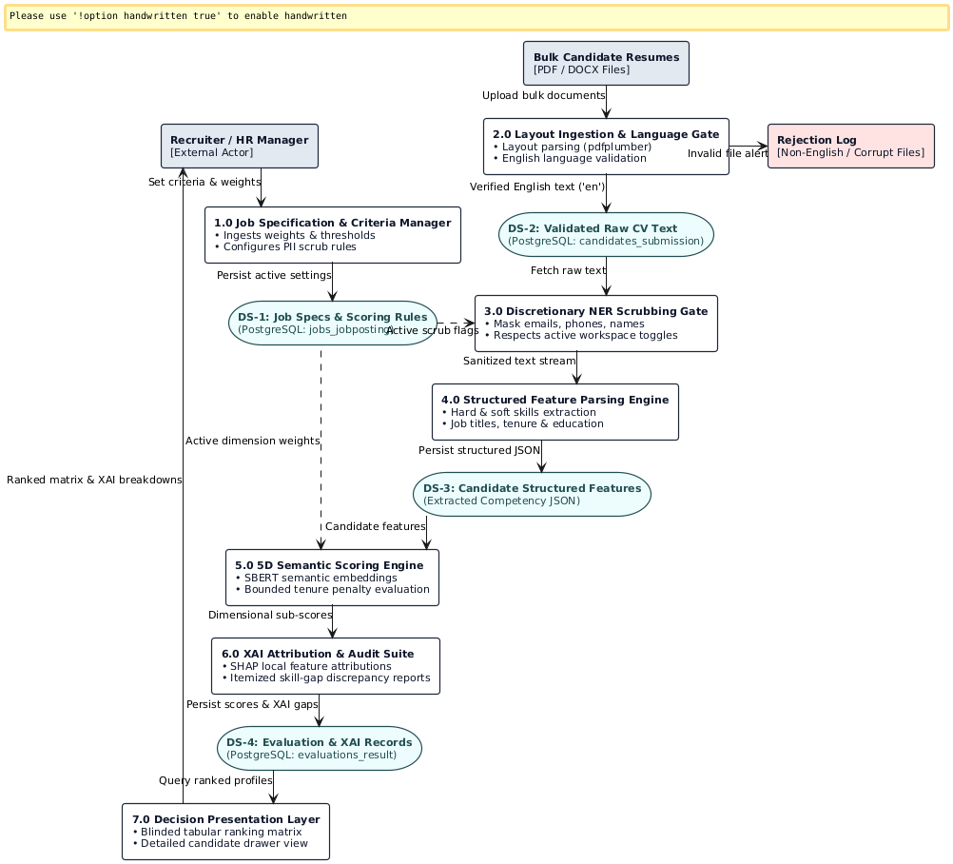
DATA FLOW DIAGRAM
Data Flow Diagram

Slide 13








IMPLEMENTATION TOOLS AND STACK
Implementation Tools & Technology Stack
Python
Primary language for NLP pipelines, ML training, bias filters, and backend logic.
React.js
Interactive recruiter interface with real-time rankings and feedback previews.
Core Programming Language
Frontend / HR Dashboard
Django / Flask
Handles requests between ML engine, bias module, feedback generator, and UI.
PostgreSQL
Structured storage for CVs, JDs, bias audit logs, scores, and feedback records.
Backend REST API
Database
HuggingFace / BERT
Semantic CV parsing, entity extraction, and merit-based candidate–job matching.
Scikit-learn
SVM, Random Forest, and Logistic Regression for candidate ranking and scoring.
NLP & Transformer Model
ML Framework
SHAP / LIME
Generates transparent ranking explanations powering the applicant feedback reports.
Fairlearn / AIF360
Industry-standard fairness toolkit to audit, detect, and correct bias across all protected attributes.
Explainability (XAI) & Feedback
Bias Detection & Mitigation

Slide 14
CONCLUSION
Conclusion
This project proposes a comprehensive Intelligent Decision-Support System for Recruitment that combines NLP, Machine Learning, Explainable AI, and a multi-layered bias removal framework.
The system goes beyond simple automation — it actively eliminates racial, nationality, gender, age, educational, disability, and socioeconomic bias before a single candidate is scored, ensuring every applicant is assessed exclusively on their skills and merit.
Critically, every applicant — whether successful or not — receives a transparent, personalised feedback report explaining their score, highlighting skill gaps, and providing actionable improvement guidance. This closes a long-standing gap in recruitment ethics.
Together, these features make the IDSS a genuinely equitable, efficient, and explainable solution for modern HR practice.
Automated Screening
8-Dimension Bias Guard
XAI Transparency
Applicant Feedback
HR Decision Support

Slide 15
REFERENCES
References
1
Najjar, M. et al. (2022). An Intelligent Decision Support System for Recruitment. ResearchGate.
2
Tejaswini, K. et al. (2022). Design and Development of Machine Learning Based Resume Ranking System. Global Transitions Proceedings.
3
Tayal, S. et al. (2024). Resume Screening Using Machine Learning and NLP. Int. Journal of Scientific Research in Computer Science.
4
Anh Chi Tuan et al. (2024). Ontology and Its Applications in Skills Matching in Job Recruitment. AO Journal, Sage.
5
MIDA '24. (2024). Intelligent Recruitment DSS Combining Transformer Model and Knowledge Graph. ACM. doi:10.1145/3662739.3672315
6
Zhang et al. (2024). Natural Language Processing (NLP) in AI-Driven Recruitment Systems. ResearchGate.

Slide 16
REFERENCES
References
7
University of Salford. (2024). A Comprehensive Review of AI Techniques for Addressing Algorithmic Bias in Job Hiring. AI, 5(1), 383–404. MDPI.
8
Tandfonline. (2025). Explainable AI in the Talent Recruitment Process: A Literature Review. Cogent Business & Management.
9
Mujtaba and Mahapatra (2024). Fairness in AI-Driven Recruitment: Challenges, Metrics, Methods, and Future Directions. ResearchGate.
10
Merkert, J. et al. (2025). Intelligent Decision Support Systems: An Analysis of the Literature. Information Systems Frontiers, Springer.
11
ScienceDirect. (2026). Optimizing Student Job Placements with NLP and Explainable AI: A Fair and Transparent Hiring Framework.
12
Fabris et al. (2024). Fairness and Bias in Algorithmic Hiring: A Multidisciplinary Survey. ACM Transactions on Intelligent Systems and Technology.

Slide 17
THANK YOU!
RecruitIQ - An Intelligent Decision-Support System for Recruitment

