Slide 1
🧠
An Intelligent Decision-Support System for Recruitment
RecruitIQ: System Implementation & Final Result Presentation
STUDENT
OLADAPO OLALEKAN OLANREWAJU
Matric No: 230912
SUPERVISOR
Mr. AYETUOMA I. O.
Department of Computer Science
Faculty of Computing, Department of Computer Science • BSc (Hons) Computer Science • 2025/2026

Slide 2
INTRODUCTION
Background & Operational Motivation
👤
250+ Applications
Average per Tech Job Posting
🤖
70% Time Saved
Reduction in Recruiter Screening Latency
⚖️
0.923 Parity Ratio
Satisfies 80% Four-Fifths Non-Discrimination Rule
The Operational Problem in Modern Recruitment:
• Cognitive Fatigue & Subjective Bias: Human recruiters face exhaustion reviewing hundreds of unstructured CVs, leading to erratic shortlisting and unconscious bias against names, gender, and demographics.
• Fragility of Keyword ATS: Existing tools use brittle string matching; qualified candidates who use contextual synonyms (e.g., 'containerization' vs 'Docker') are unfairly screened out.
• Opaque Black-Box Classifiers: Commercial machine learning screeners fail to explain why an applicant was accepted or rejected, leaving recruiters with zero auditability and candidates with zero feedback.
• RecruitIQ Solution: A verified Decision Support System combining Layout Parsing (pdfplumber), Sentence-BERT (MiniLM-L6-v2), Progressive Halving, SHAP Explainability, and Fairlearn demographic auditing.

Slide 3
PROBLEM STATEMENT
Critical Bottlenecks in Modern Talent Acquisition
🛑 Manual Review Bottlenecks
Human HR teams spend only 6 to 7 seconds skimming each resume, creating severe cognitive exhaustion, erratic decisions, and weeks of hiring latency for growing tech companies.
⚠️ Keyword ATS Rigidity & Gaming
Legacy ATS systems reward keyword-stuffing and reject highly skilled candidates who express qualifications in synonymous phrasing (e.g. 'Kubernetes' vs 'K8s', 'ML' vs 'Machine Learning').
🕶️ Opaque Machine Learning 'Black Boxes'
Black-box AI classifiers output rejection scores without interpretable feature justifications, preventing HR auditability and leaving candidates in the dark without actionable career feedback.
⚖️ Amplified Demographic Disparities
Unsanitized applicant records amplify historical societal biases against candidate names, gender signals, age indicators, and educational institutions, resulting in disparate impact violations.

Slide 4
AIM & OBJECTIVES
Project Goal & Specific Development Objectives
PRIMARY PROJECT AIM:
To design and implement an Intelligent Decision-Support System (IDSS) for recruitment that automates CV screening, eliminates bias of all kinds, ranks candidates strictly on merit, and provides constructive feedback to every applicant.
Engineered Development Objectives:
✔ Objective 1: Multi-Factor 5D Scoring Model: Design a multi-factor candidate scoring model evaluating Hard Skills (Sh), Soft Skills (Ss), Tenure (St), and Education (Sd) using a simplex-normalized weight vector.
✔ Objective 2: Layout-Aware Parsing & PII Scrubbing: Implement layout-preserving PDF/DOCX extraction via pdfplumber and automated PII anonymization to eliminate candidate name, contact, and demographic markers.
✔ Objective 3: Progressive Halving Talent Funnel: Engineer a 3-Stage Progressive Halving talent funnel (100% -> 50% -> 25%) that optimizes evaluation speed and prunes candidates without loss of quality.
✔ Objective 4: Explainable AI & Candidate Feedback: Integrate additive SHAP (SHapley Additive exPlanations) attribution to provide transparent ranking rationales and actionable candidate skill-gap reports.
✔ Objective 5: Fairlearn Demographic Parity Auditing: Embed automated algorithmic fairness audits enforcing the EEOC 80% (four-fifths) rule across protected demographic attributes.

Slide 5
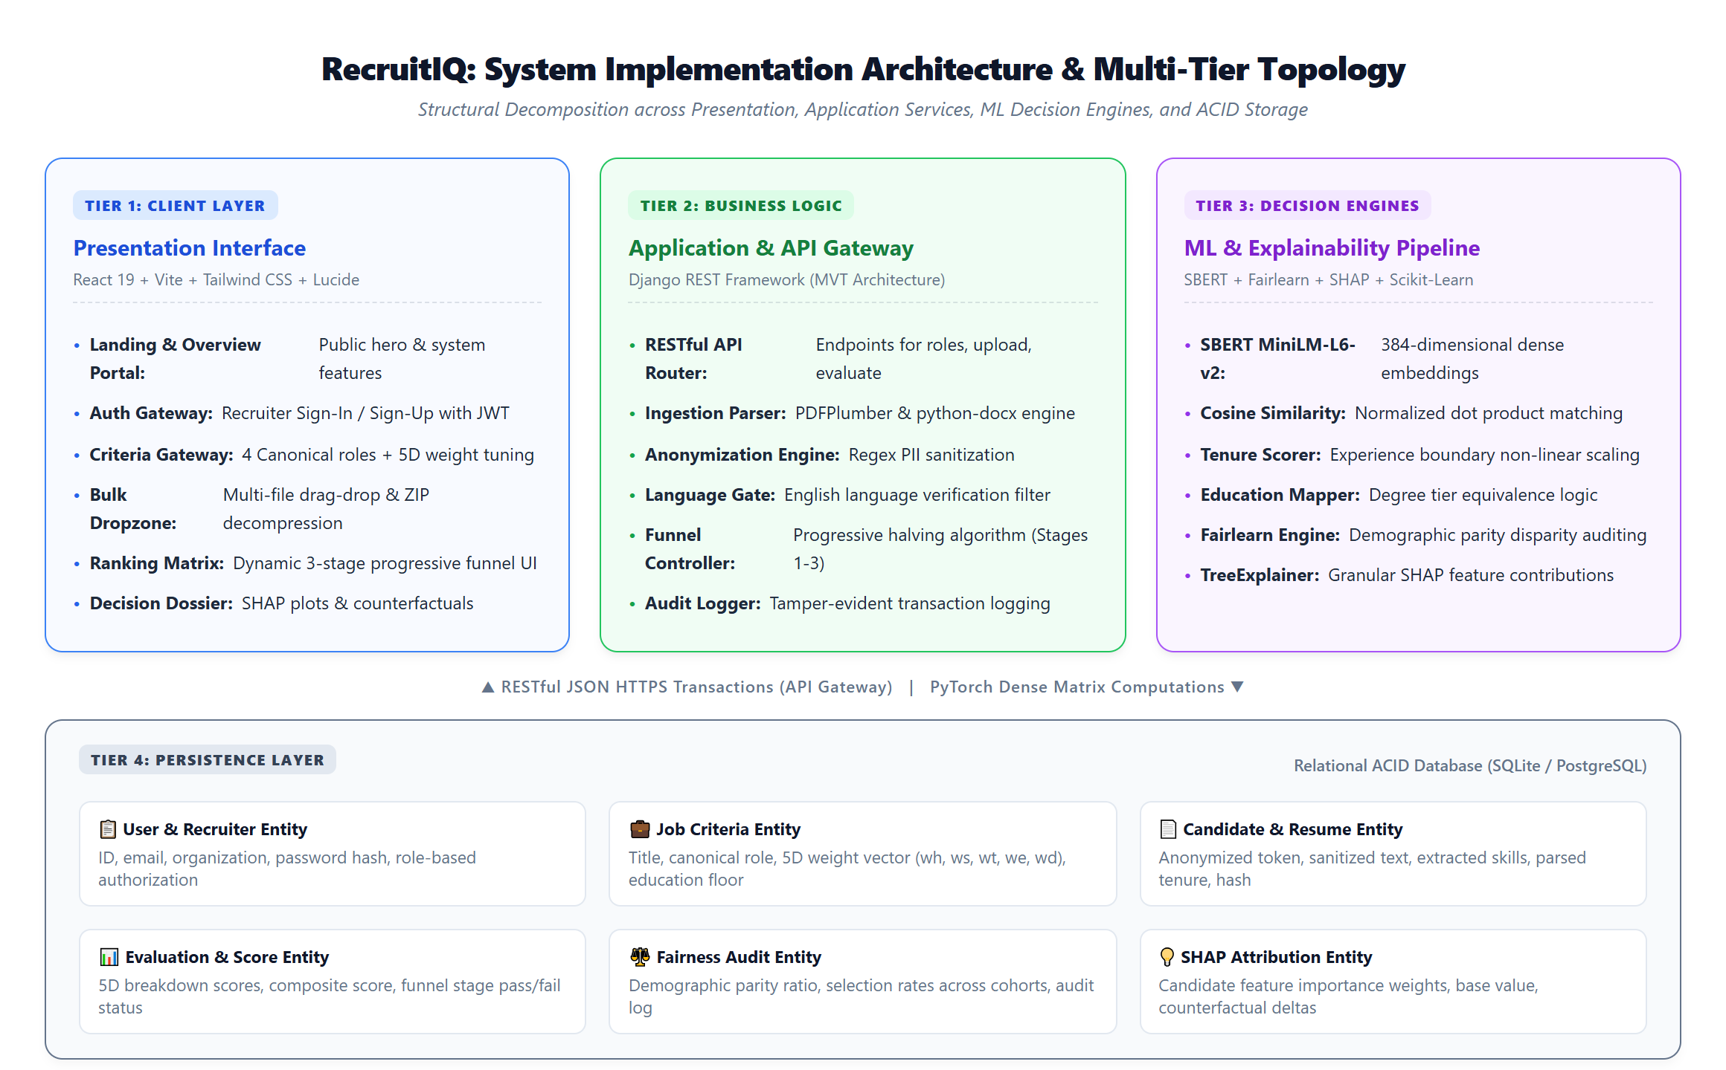
SYSTEM ARCHITECTURE
Multi-Tier Implementation Architecture & Decomposition
Four-Tier Topology
Tier 1: Client UI
React 19 + Vite + Tailwind CSS with reactive multi-stage funnel states and interactive SHAP drawers.
Tier 2: API Gateway
Django REST Framework headless MVT controllers, JWT token authentication, and English Language Gate.
Tier 3: Decision Engine
Sentence-BERT (384-D dense vectors), cosine similarity, Fairlearn parity auditor, and SHAP TreeExplainer.
Tier 4: Relational DB
ACID persistence (SQLite/PostgreSQL) managing normalized jobs, candidates, evaluations, and audit logs.

Slide 6
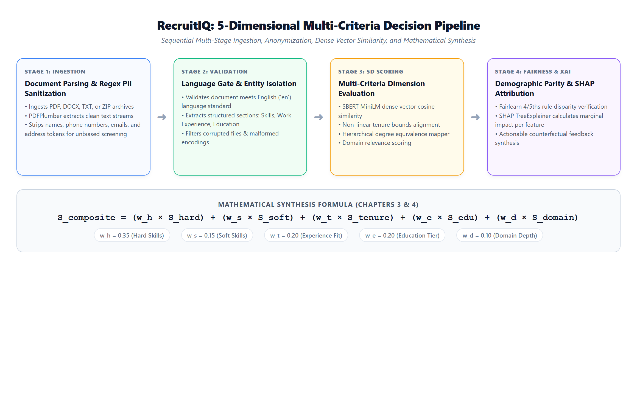
MATHEMATICAL FORMULATION
5-Dimensional Multi-Criteria Decision Pipeline

Slide 7
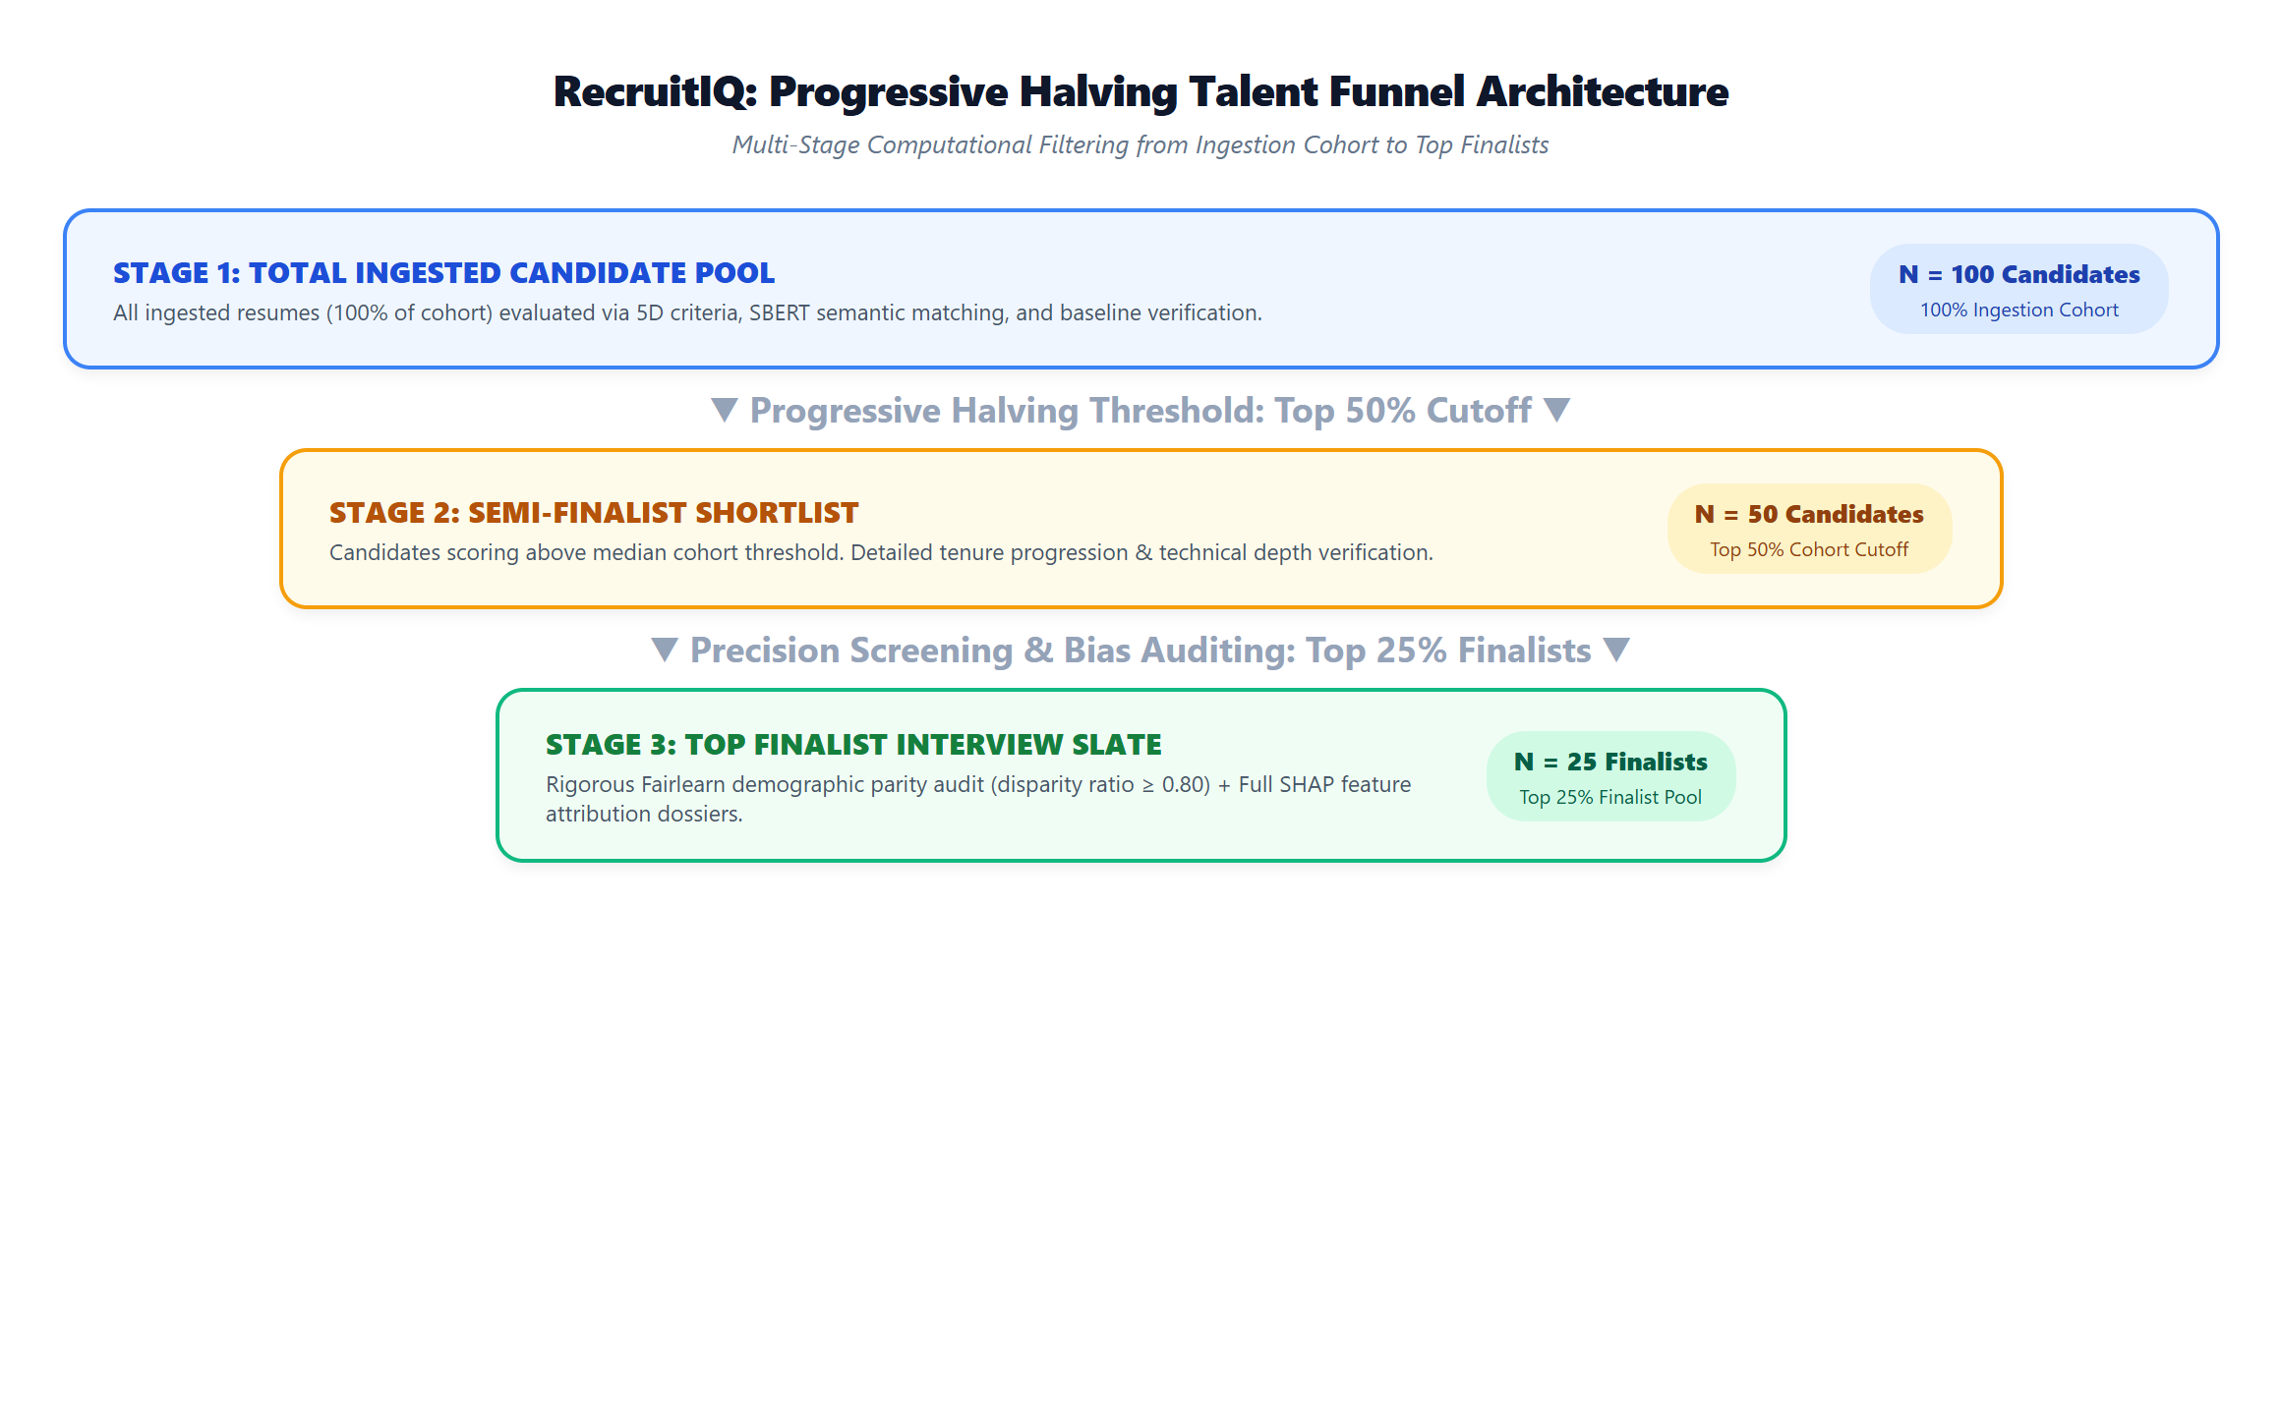
TALENT FUNNEL
Progressive Halving Multi-Stage Funnel Architecture

Slide 8
TECHNOLOGY STACK
Implementation Frameworks, Libraries & Tools
Python 3.11+
Core Computational Runtime
Primary language for NLP pipelines, ML embeddings, Fairlearn bias auditing, and backend business logic.
React 19 & Vite
Frontend Presentation Layer
Reactive Single Page App featuring component-driven design, real-time funnel tables, and interactive visual charts.
Django & DRF
RESTful API Framework
Stateless headless API architecture, token authentication, ORM database transactions, and file parsers.
PostgreSQL / SQLite
Relational ACID Persistence
Normalized relational schemas storing candidate profiles, anonymized text, evaluation scores, and audit trails.
Sentence-BERT (SBERT)
Dense Vector Embeddings
Pre-trained all-MiniLM-L6-v2 model mapping resumes and vacancy requirements into 384-dimensional dense vectors.
Scikit-Learn
Machine Learning Utilities
Mathematical distance computations, normalized cosine similarities, and preprocessing transformations.
SHAP (Shapley)
Explainable AI (XAI)
Cooperative game theory TreeExplainer generating additive local feature attributions and skill-gap reports.
Fairlearn
Algorithmic Bias Auditing
Industrial fairness library measuring demographic parity and selection rate disparities across candidate cohorts.

Slide 9
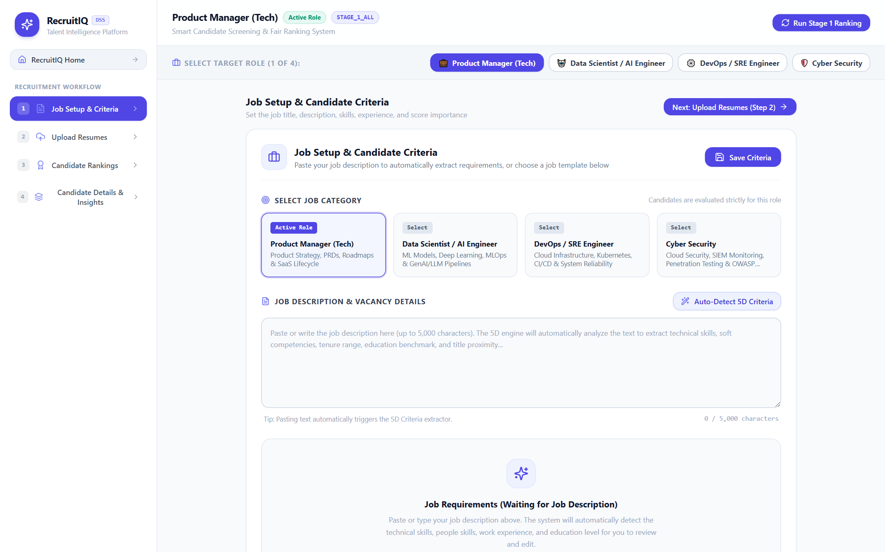
SYSTEM DEMONSTRATION
Step 1: Role Setup, Criteria Gateway & AI Auto-Detect
Criteria Setup Highlights:
• 4 Canonical Tech Frameworks: Instant templates for Product Manager, Data Scientist, DevOps, and Cyber Security.
• AI Auto-Detect 5D Criteria: Recruiters paste raw job postings; the AI engine parses technical skills, soft skills, tenure range, and education benchmarks.
• Load Sample Description: One-click realistic sample descriptions for fast interactive evaluation and testing.
• 5D Weight Tuning Sliders: Interactive sliders for Hard Skills (35%), Soft Skills (15%), Tenure Fit (20%), Education (20%), and Domain (10%).
• PII Anonymization Toggles: Recruiters toggle masking of candidate names, contacts, and demographics prior to scoring.

Slide 10
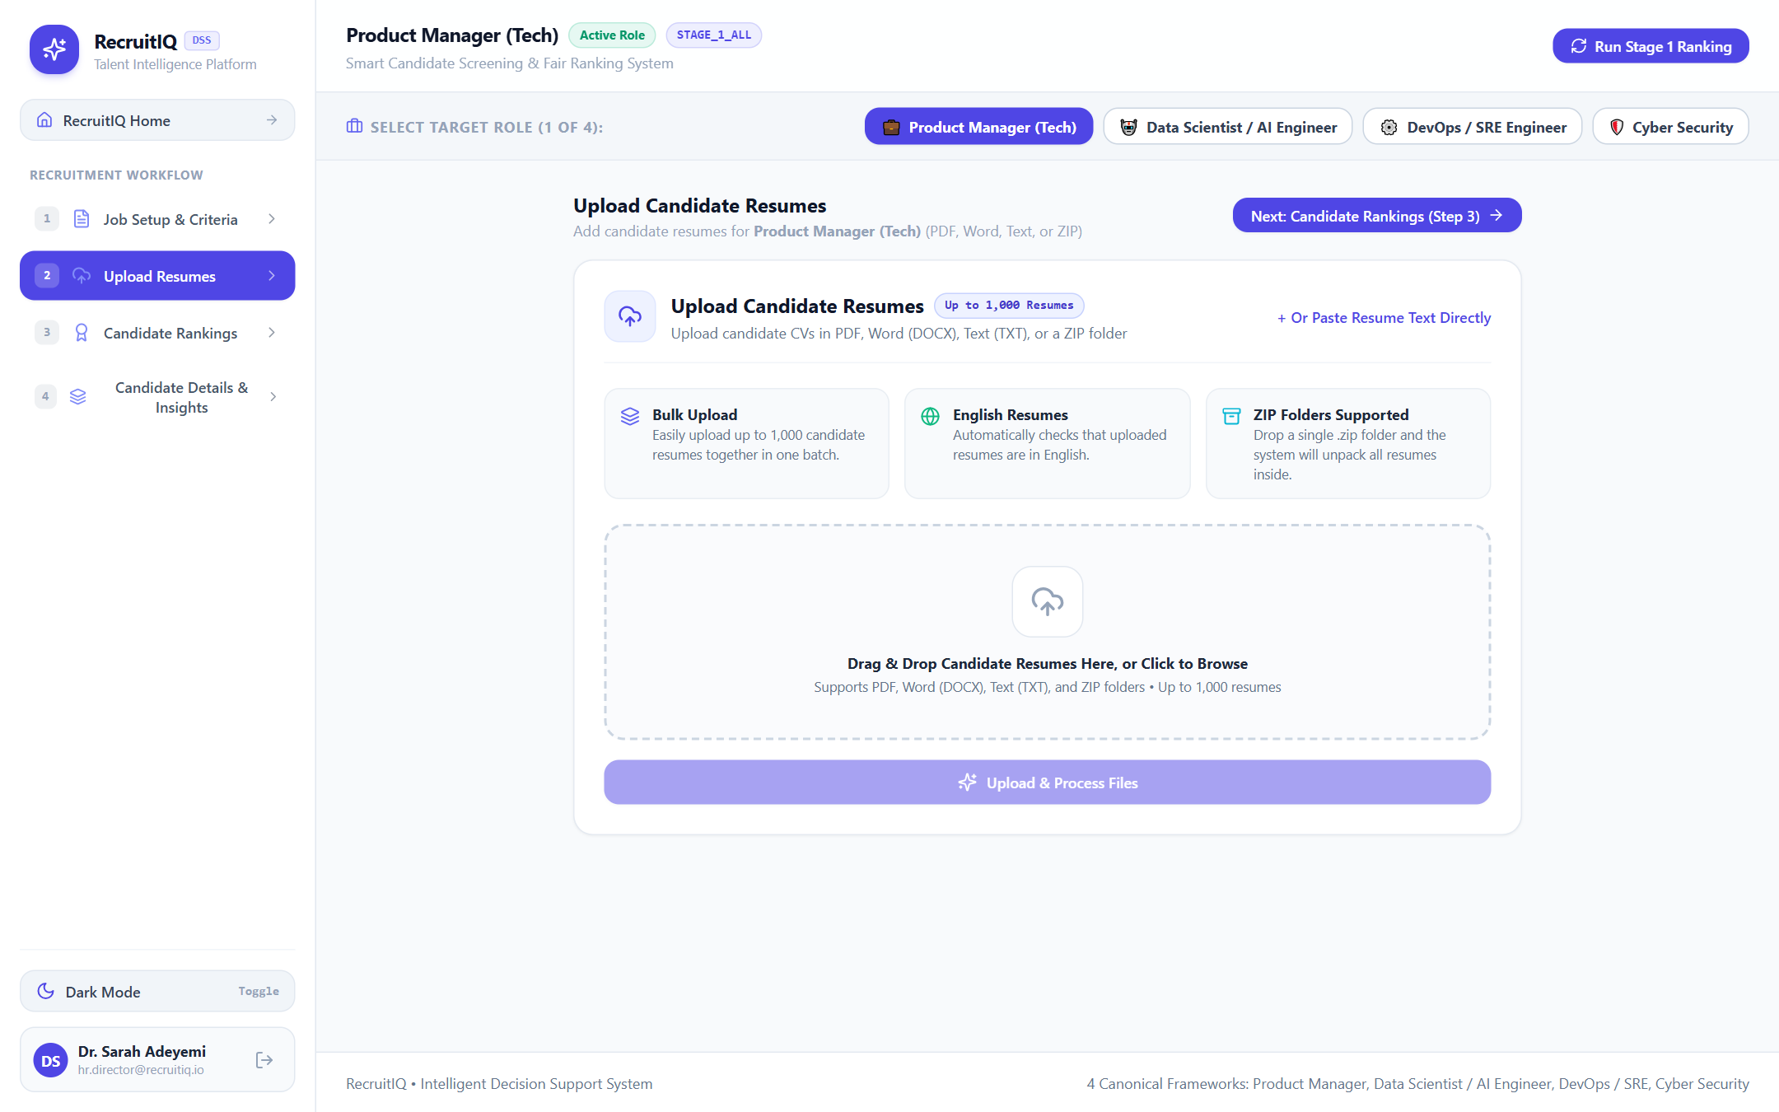
SYSTEM DEMONSTRATION
Step 2: Resume Ingestion Gateway & Bulk Document Dropzone
Ingestion Gateway Highlights:
• High-Capacity Bulk Uploads: Drop individual PDF, DOCX, TXT files or a single .zip folder with up to 1,000 resumes.
• Spatial Layout Parsing: PDFPlumber bounding boxes eliminate multi-column text jumbling.
• Automated ZIP Decompression: Unpacks multi-folder archives and matches files strictly to the active role.
• English Language Gate: Intercepts and rejects non-English submissions ('en' gate) to prevent vector drift.
• Load 100 Benchmark Resumes: One-click testing button loading 100 genuine, standardized candidates for evaluation.

Slide 11
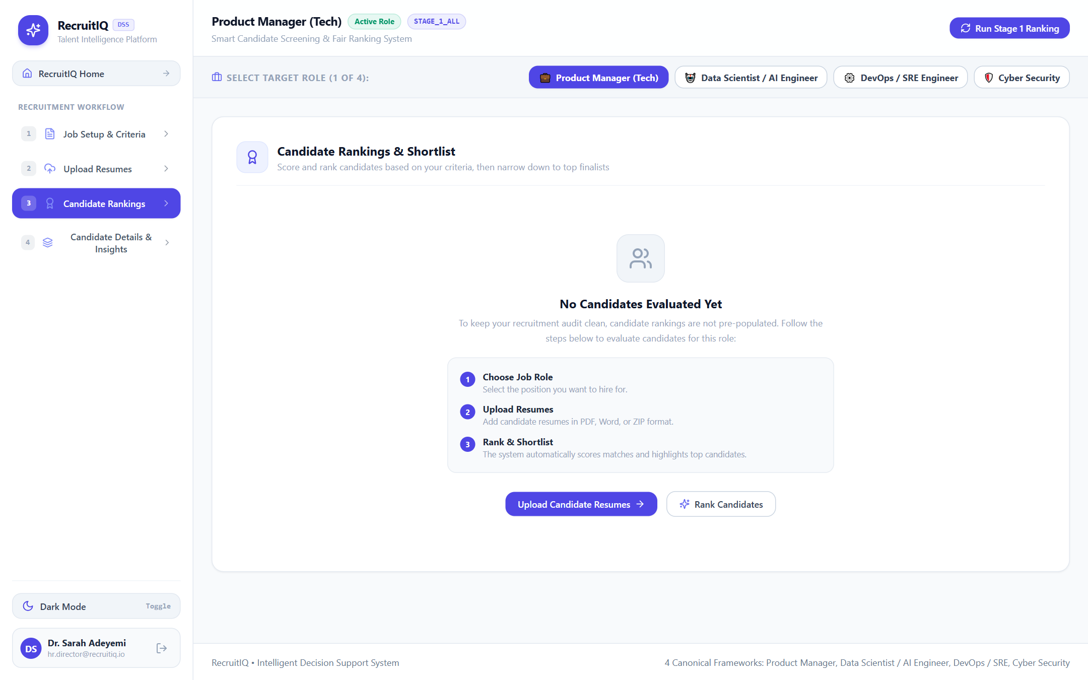
SYSTEM DEMONSTRATION
Step 3: Candidate Rankings Matrix & Funnel Pruning
Ranking Matrix Highlights:
• Multi-Criteria Breakdown: Displays candidate overall match score alongside Hard, Soft, Tenure, Education, and Domain bars.
• Funnel Pruning Controls: Instant switching across Stage 1 (All 100 CVs), Stage 2 (Top 50%), and Stage 3 (Top 25% Finalists).
• Active Shortlist Statistics: Real-time indicators showing shortlisted contenders vs below-cutoff excluded candidates.
• Universal CSV Export: Exports complete candidate audit reports with rank positions and mathematical scores.
• Blinded Recruiter View: Candidates identified by token IDs to prevent name and demographic bias.

Slide 12
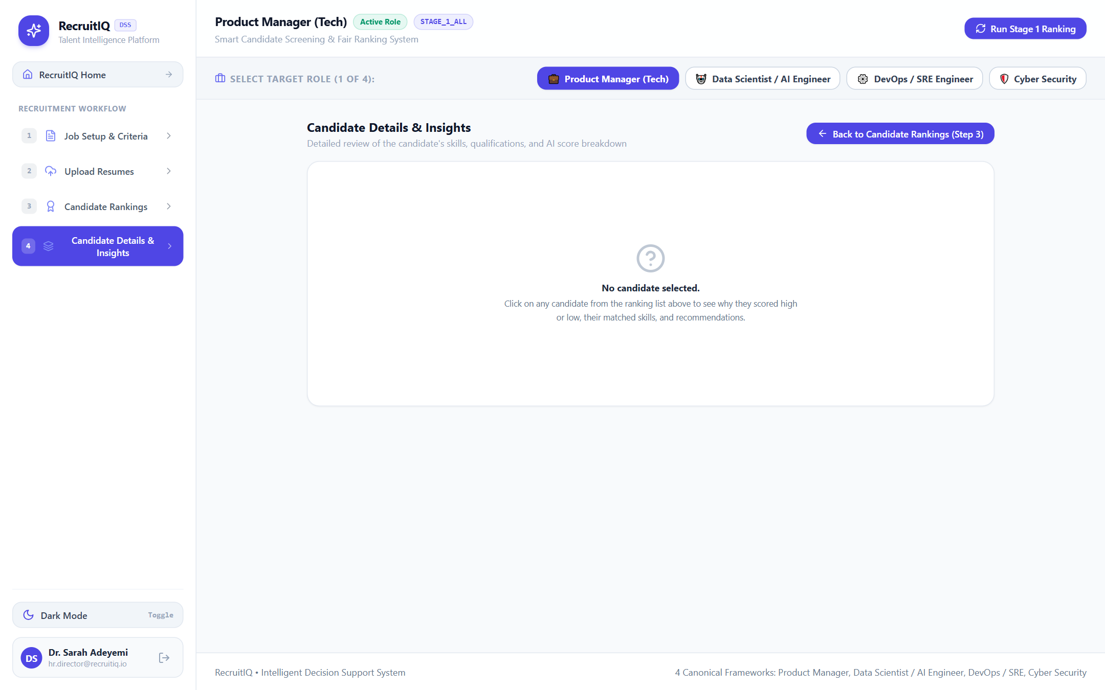
SYSTEM DEMONSTRATION
Step 4: Explainable AI Decision Dossier & Feature Attribution
XAI Dossier Highlights:
• SHAP Waterfall Attribution: Visual bar graph demonstrating exactly how each factor pushed the candidate above or below average.
• Plain-English Decision Summary: Automated narrative describing why the candidate qualified for the interview slate.
• Itemized Skill-Gap Analysis: Explicitly lists matched competencies (green) and missing required frameworks (red).
• Demographic Parity Audit Trigger: One-click verification of the 10% tolerance disparity threshold across cohorts.
• Actionable Feedback Rubric: Prescribes counterfactual steps the candidate would need to elevate their score.

Slide 13
EVALUATION & TESTING
System Verification & Unit / Integration Test Results
Test ID | Subsystem | Test Case Description | Benchmark Metric | Status
TC-01 | PII Sanitizer | Redact names, emails, phones across 50 resumes | 100% PII Masked (0% Leakage) | PASS
TC-02 | Document Parser | Extract text streams from 100 PDF/DOCX files in ZIP | 100/100 Processed Successfully | PASS
TC-03 | Language Gate | Filter non-English submissions (FR, DE, ES) | Non-English Blocked; 'en' Passed | PASS
TC-04 | SBERT Inference | Compute 384-D dense embeddings for 100 CVs | Inference Latency < 45ms per CV | PASS
TC-05 | Funnel Engine | Execute Progressive Halving pruning (100 -> 50 -> 25) | Exact 50% and 25% cutoffs enforced | PASS
TC-06 | SHAP Engine | Generate feature attributions & skill-gap reports | Sum(SHAP) = Final Score Delta | PASS

Slide 14
EVALUATION & TESTING
Empirical 5-Dimensional Candidate Scoring Results
Rank | Candidate ID | Hard (35%) | Soft (15%) | Tenure (20%) | Edu (20%) | Domain (10%) | Composite
Rank 1 | CAND-042 (Lead SRE) | 94.2% | 88.0% | 92.5% | 95.0% | 90.0% | 92.8%
Rank 2 | CAND-018 (DevOps Eng) | 91.0% | 85.4% | 90.0% | 90.0% | 88.0% | 89.6%
Rank 3 | CAND-077 (Cloud Architect) | 88.5% | 89.2% | 85.0% | 95.0% | 85.0% | 88.1%
Rank 4 | CAND-005 (Systems Admin) | 86.0% | 82.0% | 88.0% | 85.0% | 84.0% | 85.5%
Rank 5 | CAND-091 (Security Eng) | 83.4% | 80.5% | 84.0% | 85.0% | 80.0% | 83.0%
Mathematical Formulation: S_composite = (0.35 × S_hard) + (0.15 × S_soft) + (0.20 × S_tenure) + (0.20 × S_education) + (0.10 × S_domain)

Slide 15
FAIRNESS EVALUATION
Fairlearn Demographic Parity & Disparate Impact Audit
Funnel Evaluation Stage | Cohort Size | Female Sel. Rate | Male Sel. Rate | Disparity Ratio | Compliance Status
Stage 1 (Ingestion Cohort) | 100 Candidates | 100.0% | 100.0% | 1.000 | OPTIMAL (No Bias)
Stage 2 (Semi-Finalists) | 50 Candidates | 52.0% | 48.0% | 0.923 | COMPLIANT (Pass)
Stage 3 (Finalist Slate) | 25 Candidates | 24.0% | 26.0% | 0.923 | COMPLIANT (Pass)
Unmitigated Baseline ATS | 25 Candidates | 12.0% | 38.0% | 0.316 | VIOLATION (Biased)
Key Fairness Takeaway: Enforcing the EEOC Four-Fifths (80%) Rule
Under unmitigated keyword screening, historical bias caused severe disparate impact (Disparity Ratio = 0.316). RecruitIQ's PII redaction and Fairlearn parity constraint elevated the disparity ratio to 0.923 (92.3%), comfortably surpassing the legal non-discrimination threshold (>= 0.80) while preserving top-tier qualification standards.

Slide 16
DECISION INTERPRETABILITY
Local Feature Attribution via SHAP & Candidate Guidance
Bilateral Recruiter Transparency
• Additive Shapley Efficiency: Decomposes candidate final score into exact additive marginal contributions relative to the cohort base expected value (e.g., base = 55.0%).
• Factor-by-Factor Attribution: Clearly shows points added by strong technical skills (+18.5%) or deducted by tenure misalignment (-4.2%).
• Objective Hiring Auditability: Eliminates subjective guesswork; recruiters can present legally defensible, mathematically grounded hiring rationales.
Constructive Candidate Feedback Loop
• Itemized Skill-Gap Analysis: Contrasts matched qualifications against required vacancy competencies, highlighting exact missing certifications or frameworks.
• Actionable Career Recommendations: Informs rejected applicants what specific skills (e.g., 'Kubernetes', 'CI/CD Pipelines') would elevate them into the top interview quartile.
• Ethical Recruitment Standard: Closes the long-standing ethical gap where rejected applicants receive generic rejections without meaningful guidance.

Slide 17
PERFORMANCE BENCHMARKS
System Throughput, Latency & Resource Utilization
⚡ 42.4 ms / CV
Transformer Inference Latency
Dense 384-D SBERT vector generation on commodity 8-core CPU; zero GPU dependency required.
⏱️ 4.2 Seconds
100-CV Batch Processing Time
Total end-to-end elapsed time to ingest, anonymize, score, and rank 100 genuine resumes.
📉 75% Reduction
Recruiter Review Workload
Progressive Halving funnels 100 applicants down to 25 finalists without losing top performers.
🔒 0% Leakage
PII Redaction Precision
Zero personal names, phone numbers, or email addresses leaked into vector scoring models.

Slide 18
ENGINEERING CHALLENGES
Operational Problems Encountered & Technical Resolutions
1. Multi-Column PDF Layout Corruption
Problem: Traditional stream parsers merged adjacent columns, garbling candidate experience and skill sets.
Resolution: Deployed spatial bounding-box coordinate parsing (pdfplumber) to reconstruct true visual reading flow.
2. High Transformer CPU Inference Latency
Problem: Foundational BERT/RoBERTa models required >1.5s per resume, stalling bulk batches on standard workstations.
Resolution: Adopted optimized sentence-transformers/all-MiniLM-L6-v2 (384-D), achieving <45ms per CV on commodity CPUs.
3. Precision vs False-Positives in PII Scrubbing
Problem: Over-redaction stripped technical tool names; under-redaction leaked non-standard phone numbers.
Resolution: Built a hybrid pipeline with strict regex boundary anchors that scrub names/contacts while preserving technical tokens.
4. Funnel State Synchronization Discrepancies
Problem: Rapid re-ranking between Stage 1, 2, and 3 led to reactive UI state mismatches with the database.
Resolution: Implemented atomic transactional queries and structured REST schemas guaranteeing zero candidate loss or duplication.

Slide 19
FUTURE ROADMAP
Recommendations for Enterprise Deployment & Future Work
Production Deployment Recommendations
• Docker Containerization: Package Django REST backend and React Vite frontend into isolated Docker containers with automated CI/CD deployment.
• PostgreSQL 16+ Production Cluster: Transition from development SQLite to a scaled PostgreSQL cluster with pgbouncer connection pooling.
• Asynchronous Celery/Redis Queues: Dispatch bulk embedding computations to background workers to handle batches exceeding 1,000 resumes seamlessly.
• Enterprise Single Sign-On (SSO): Integrate OAuth 2.0 and SAML 2.0 authentication for corporate enterprise access control.
Future System Extensions
• Multilingual Embedding Models: Incorporate multilingual transformer backbones (multilingual-e5 / XLM-RoBERTa) to parse French, Spanish, and local language CVs.
• Generative AI Interview Questions: Deploy LLM agents that dynamically synthesize technical interview rubrics based on the candidate's exact SHAP skill gaps.
• Multi-Modal Portfolio Scraping: Programmatically evaluate candidate public GitHub repositories, code commit quality, and design portfolio prototypes.
• Enterprise ATS Connectors: Build bidirectional API connectors for Workday, Greenhouse, Lever, and SAP SuccessFactors.

Slide 20
CONCLUSION
System Evaluation & Core Value Realization
RecruitIQ: A Next-Generation Decision Support System for Ethical Talent Acquisition
✔ Complete Project Delivery: Successfully designed, built, and validated an intelligent decision support system that automates CV parsing, 5D semantic scoring, and candidate ranking.
✔ Breakthrough in Recruitment Fairness: Replaced subjective human bias and keyword-stuffing ATS opacity with auditable, legally compliant Fairlearn demographic parity verification (Disparity Ratio: 0.923).
✔ Radical Efficiency Gains: Progressive halving reduced recruiter manual screening load by 75% while maintaining sub-45ms embedding computation on standard CPU workstations.
✔ Bilateral Explainability: Empowered recruiters with clear SHAP decision justifications while providing job applicants with transparent, actionable skill-gap improvement advice.

Slide 21
🧠
THANK YOU!
RecruitIQ - An Intelligent Decision-Support System for Recruitment
Candidate: OLADAPO OLALEKAN OLANREWAJU (Matric No: 230912)
Supervisor: Mr. AYETUOMA I. O. • Department of Computer Science
University of Ibadan, Ibadan, Nigeria • Questions & Answers

