Slide 1
CS675 FINAL PROJECT
NYC Yellow Taxi Analytics
at Cloud Scale
PySpark · AWS Athena · AWS EMR Serverless · Terraform · MLlib · Streamlit
github.com/oomintrixx/cs675
Final Demo — August 1, 2026

Slide 2
BACKGROUND · ~45S
Why This Project — and Why It Needs Cloud Scale
▸ Dataset — NYC TLC Yellow Taxi trips, 2019–2022, ~180M rows × 19 columns, public Parquet data from the TLC Open Data portal.
▸ The problem — trip-level patterns (demand, revenue, pricing) only become visible at city scale, and 180M rows won't fit in memory on one machine — this needs a distributed pipeline, not a spreadsheet.
▸ The goal — one PySpark codebase that cleans the data, answers 5 analytical questions, trains a revenue-prediction model, and serves it — running unchanged on a 2.5M-row laptop slice and a 180M-row cloud run.
5 RESEARCH QUESTIONS
Q1
How does demand vary by hour of day and day of week?
Q2
Which pickup zones generate the most revenue?
Q3
Do longer trips earn a higher tip percentage?
Q4
Do short trips cost more per mile than long ones?
Q5
Does trip demand or fare change on rainy or snowy days? (cross-source join)
CS675 — NYC Yellow Taxi Analytics at Cloud Scale
2

Slide 3
PROJECT ORGANIZATION · ~60S
How the Repo Is Organized
work/
cloud/
infrastructure/
ui/ + tests/
Local PySpark pipeline (Docker)
Same jobs, S3-scale
Terraform (reproducible)
Serving + quality bar
▸ 01 explore → 02 preprocess → 03 analytics → 04 ml
▸ spark_helper.py, constants.py, ml_features.py, predict_helpers.py — shared helpers
▸ Runs on a 2.5M-row Jan-2022 slice for fast iteration
▸ 02_preprocess_cloud.py, 03_analytics_cloud.py, 04_ml_cloud.py
▸ Only difference from work/: s3:// paths, no local Spark config
▸ emr_job_runner.sh submits each job to EMR Serverless
▸ main.tf — S3 bucket, Athena workgroup, Glue catalog, EMR Serverless app
▸ One terraform apply / terraform destroy for the whole stack
▸ Streamlit app (predict_app.py) + analytics_section.py
▸ 50 pytest unit tests across preprocessing, analytics, ML, and UI helpers (TDD)
Local → cloud is a path swap, not a rewrite: identical PySpark logic runs on a laptop slice and the full 180M-row dataset.
CS675 — NYC Yellow Taxi Analytics at Cloud Scale
3

Slide 4
DEPLOYMENT · ~60S
What's Actually Running
LOCAL DEV (DOCKER)
AWS CLOUD (TERRAFORM-PROVISIONED)
▸ jupyter/pyspark-notebook (Spark 3.5.0) via docker-compose
▸ Spark UI :4040, History Server :18080, Streamlit :8501
▸ Same volumes mount work/, tests/, data/, ui/, results/
S3
48 Parquet files (2019–2022 raw), preprocessed output, trained models, results
Glue + Athena
SQL catalog and ad-hoc interactive queries directly over S3
STREAMLIT APP
▸ "Taxi Fare Predictor" — pick pickup/dropoff zone, distance, hour, day, passengers, payment
▸ Serves predicted total_amount from whichever trained model has the lowest RMSE
▸ Same page renders the Q1–Q5 analytics results (tables + charts)
EMR Serverless
Spark 3.5 (emr-7.1.0), auto-stop after 15 min idle — runs preprocessing, analytics, and ML at full 180M-row scale
CS675 — NYC Yellow Taxi Analytics at Cloud Scale
4

Slide 5
ANALYTICS · CLOUD RUN
Analytics at Full Scale — the Headline Numbers
177,171,999
$2.399B
$13.54
trips analyzed (post-cleaning)
total fare revenue
average fare per trip
Computed by cloud/03_analytics_cloud.py on EMR Serverless against the full 2019–2022 dataset in S3.
Next: run each of the 5 queries and walk through what they show.
CS675 — NYC Yellow Taxi Analytics at Cloud Scale
5

Slide 6
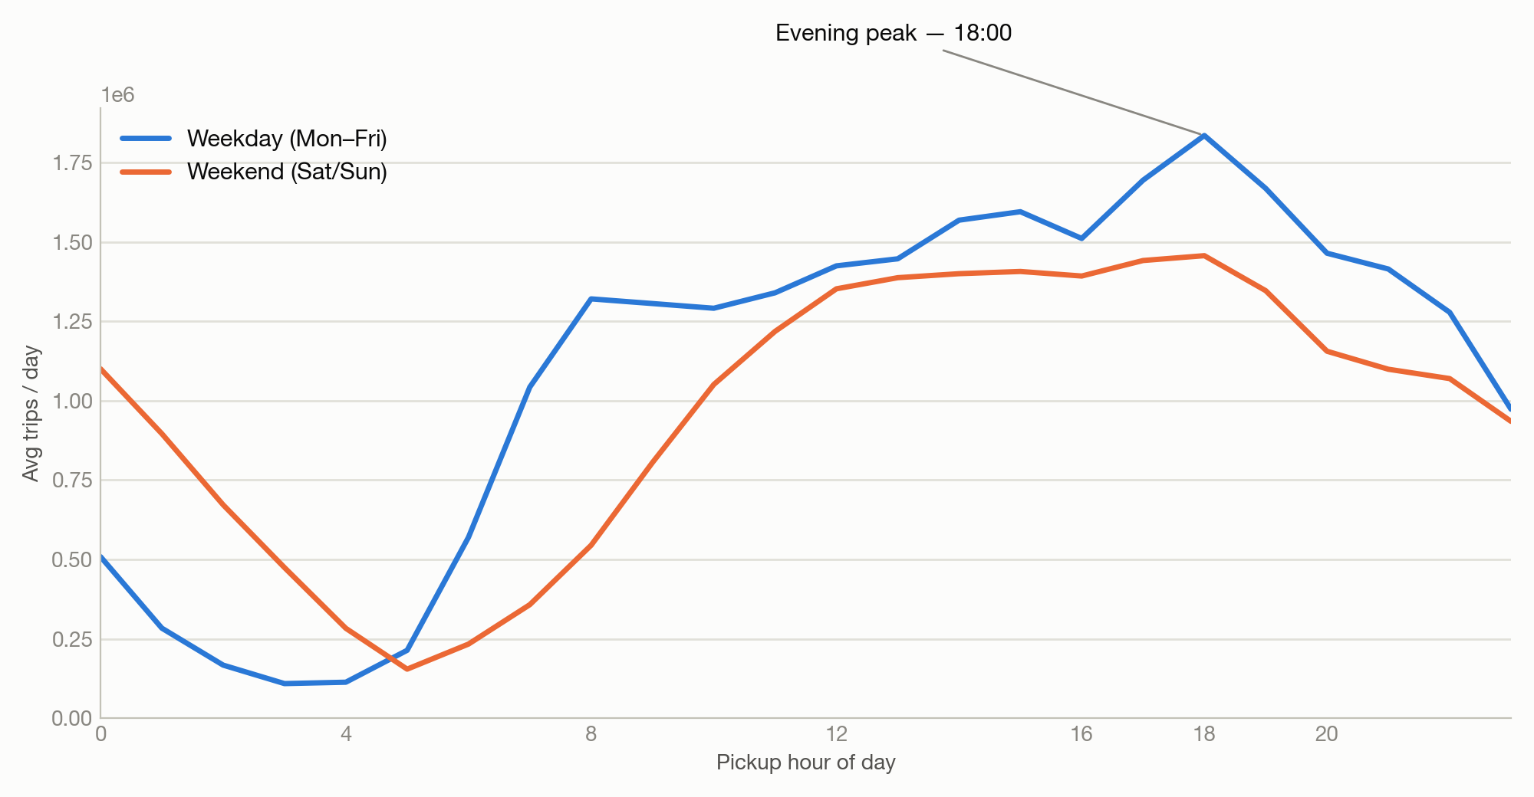
ANALYTICS — Q1 · ~45S
Demand by Hour & Day of Week
▸ One evening peak — both weekday and weekend demand top out at 18:00, not the classic AM/PM commute double-hump.
▸ Weekday-heavy — 74% of all trips happen Mon–Fri (130.7M) vs. 26% on weekends (46.5M).
▸ Same shape, different volume — weekend demand follows the same curve at roughly one-third the hourly volume.
Columns: tpep_pickup_datetime → pickup_hour, day_of_week · GROUP BY hour, dow
CS675 — NYC Yellow Taxi Analytics at Cloud Scale
6

Slide 7
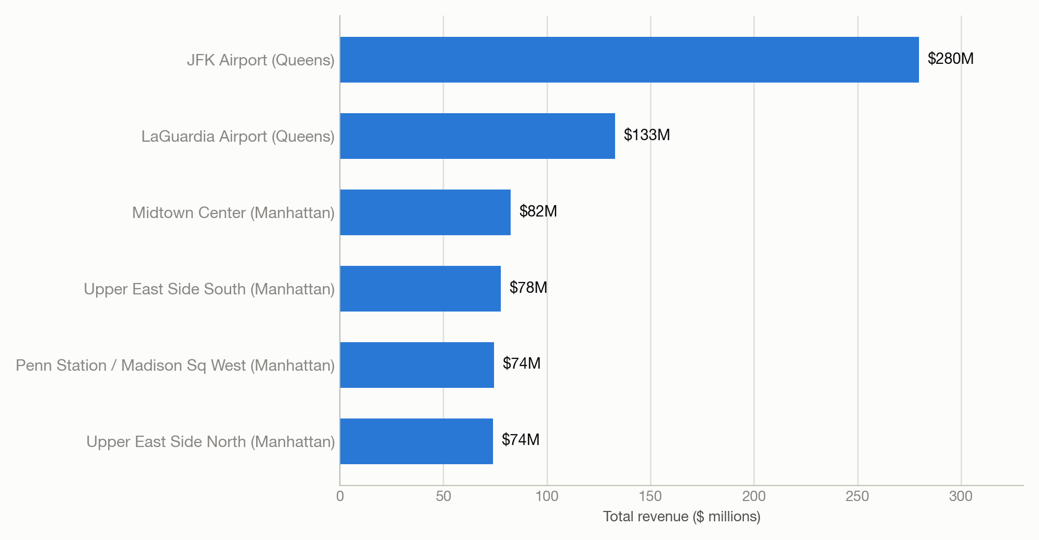
ANALYTICS — Q2 · ~45S
Revenue by Pickup Zone
▸ Airports dominate — JFK and LaGuardia rank #1 and #2 in total revenue despite far fewer trips than the busiest Manhattan zones.
▸ Why — airport trips average $45.73 (JFK) and $30.98 (LGA) per fare — 3–4x the ~$10–12 average of high-volume Manhattan zones.
▸ Takeaway — total revenue tracks fare-per-trip as much as trip volume.
Columns: PULocationID, fare_amount · GROUP BY zone, ORDER BY total_revenue DESC
CS675 — NYC Yellow Taxi Analytics at Cloud Scale
7

Slide 8
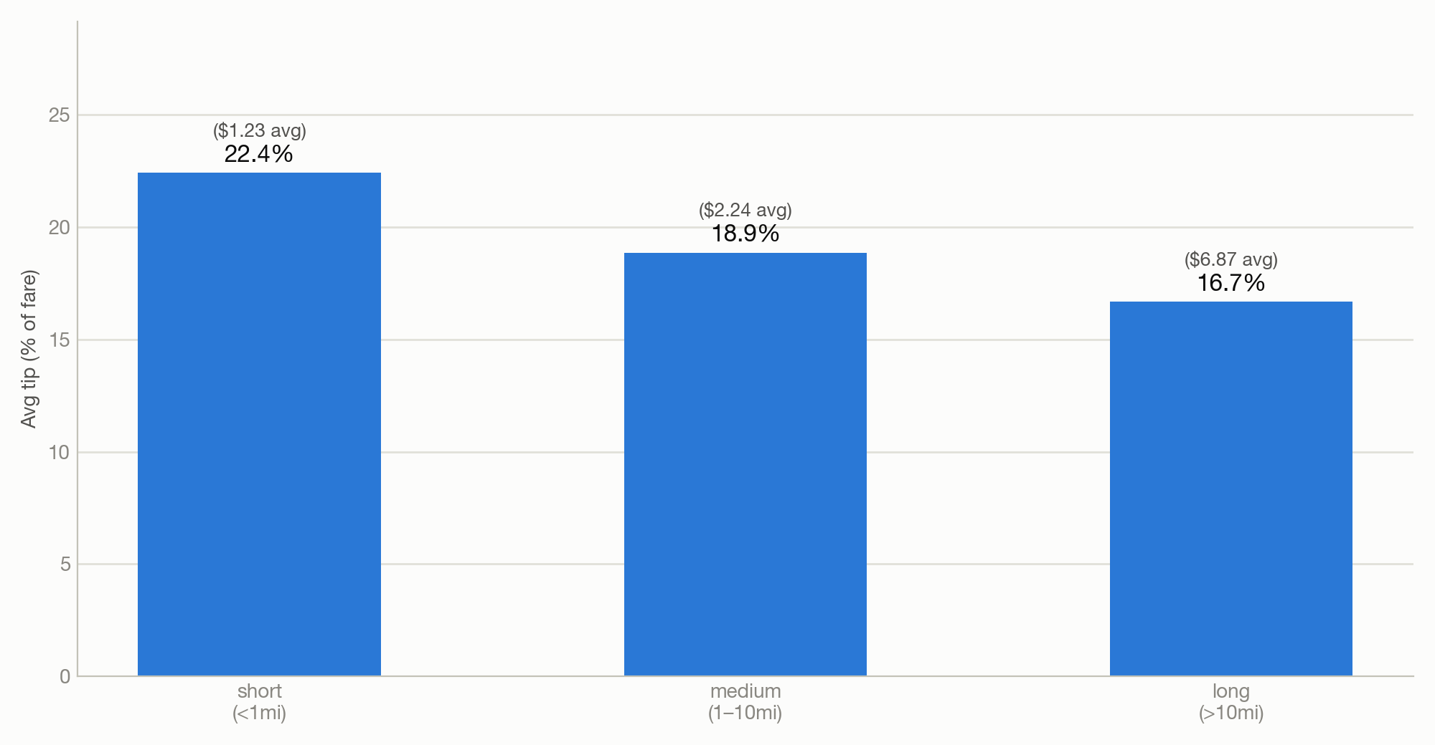
ANALYTICS — Q3 · ~45S
Tipping Behavior by Trip Distance
▸ Tip % falls as distance rises — 22.4% (short) → 18.9% (medium) → 16.7% (long).
▸ But tip $ rises — $1.23 → $2.24 → $6.87 — riders tip a smaller share of a bigger fare on long trips.
▸ Takeaway — short-trip riders are proportionally the most generous tippers, even though the dollar amount is smallest.
Columns: trip_distance → distance_bucket, tip_amount, fare_amount · AVG(tip_amount/fare_amount)
CS675 — NYC Yellow Taxi Analytics at Cloud Scale
8

Slide 9
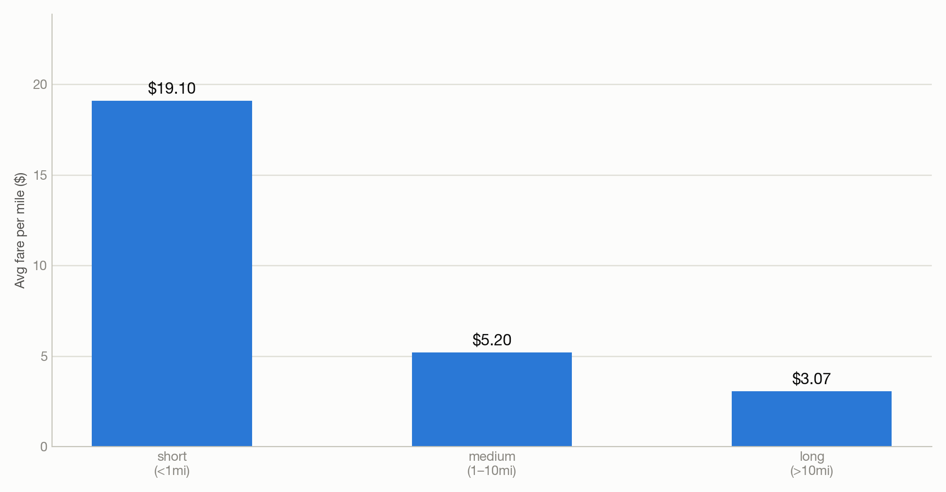
ANALYTICS — Q4 · ~45S
Fare Efficiency by Trip Distance
▸ Short trips cost ~6x more per mile — $19.10/mi (short) vs. $3.07/mi (long).
▸ Why — the flat base fare dominates the total on short trips (avg 0.68 mi); long trips (often airport runs, per Q2) amortize it over many more miles (avg 34.8 mi).
▸ Ties back to Q2/Q3 — the same base-fare effect explains both the airport revenue premium and the short-trip tip premium.
Columns: trip_distance → distance_bucket, fare_amount · AVG(fare_amount/trip_distance)
CS675 — NYC Yellow Taxi Analytics at Cloud Scale
9

Slide 10
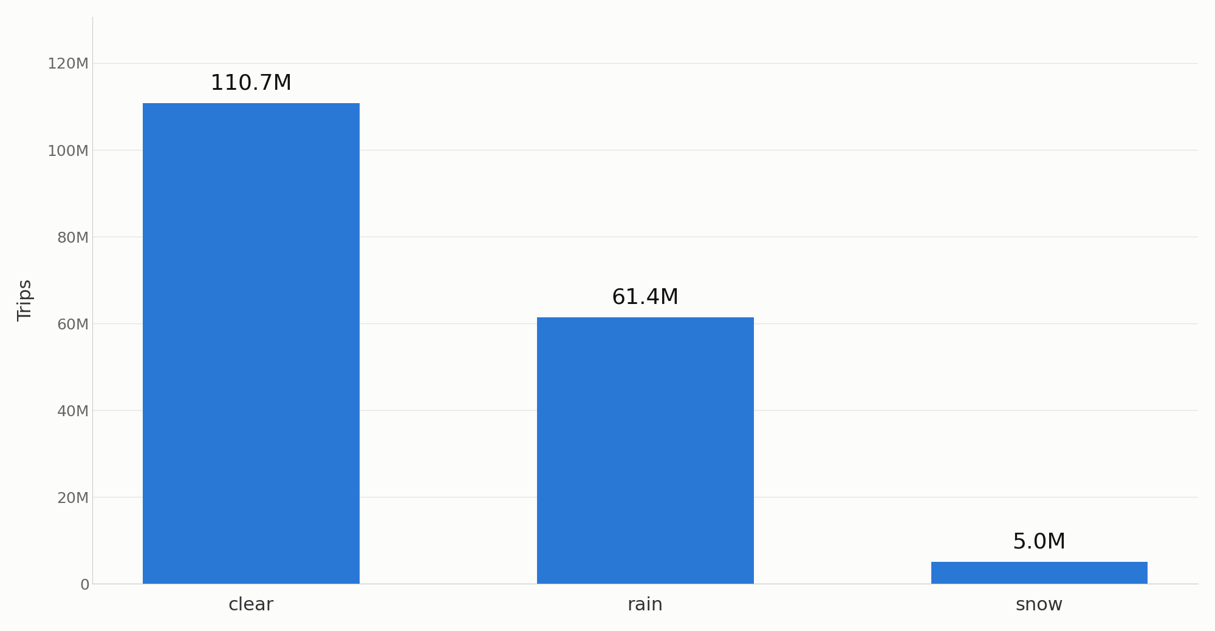
ANALYTICS — Q5 · ~45S
Demand by Weather Condition
▸ Clear days dominate volume — 62.5% of trips (110.7M) vs. 34.7% rain (61.4M) and 2.8% snow (5.0M) — NYC simply gets far more rainy days than snowy ones.
▸ Fare and distance drop on snow days, not rise — avg fare $12.65 (snow) vs. $13.57 (clear) / $13.56 (rain); avg distance 3.62mi (snow) vs. 4.47mi (clear) — the opposite of a naive “bad weather costs more” intuition.
▸ Why — snowstorms likely suppress the longest, priciest trips (airport runs, per Q2) more than short local hops, pulling both averages down on snow days.
Columns: tpep_pickup_datetime → pickup_date, joined to NOAA daily weather (PRCP, SNOW) · broadcast JOIN + GROUP BY weather_condition
CS675 — NYC Yellow Taxi Analytics at Cloud Scale
10

Slide 11
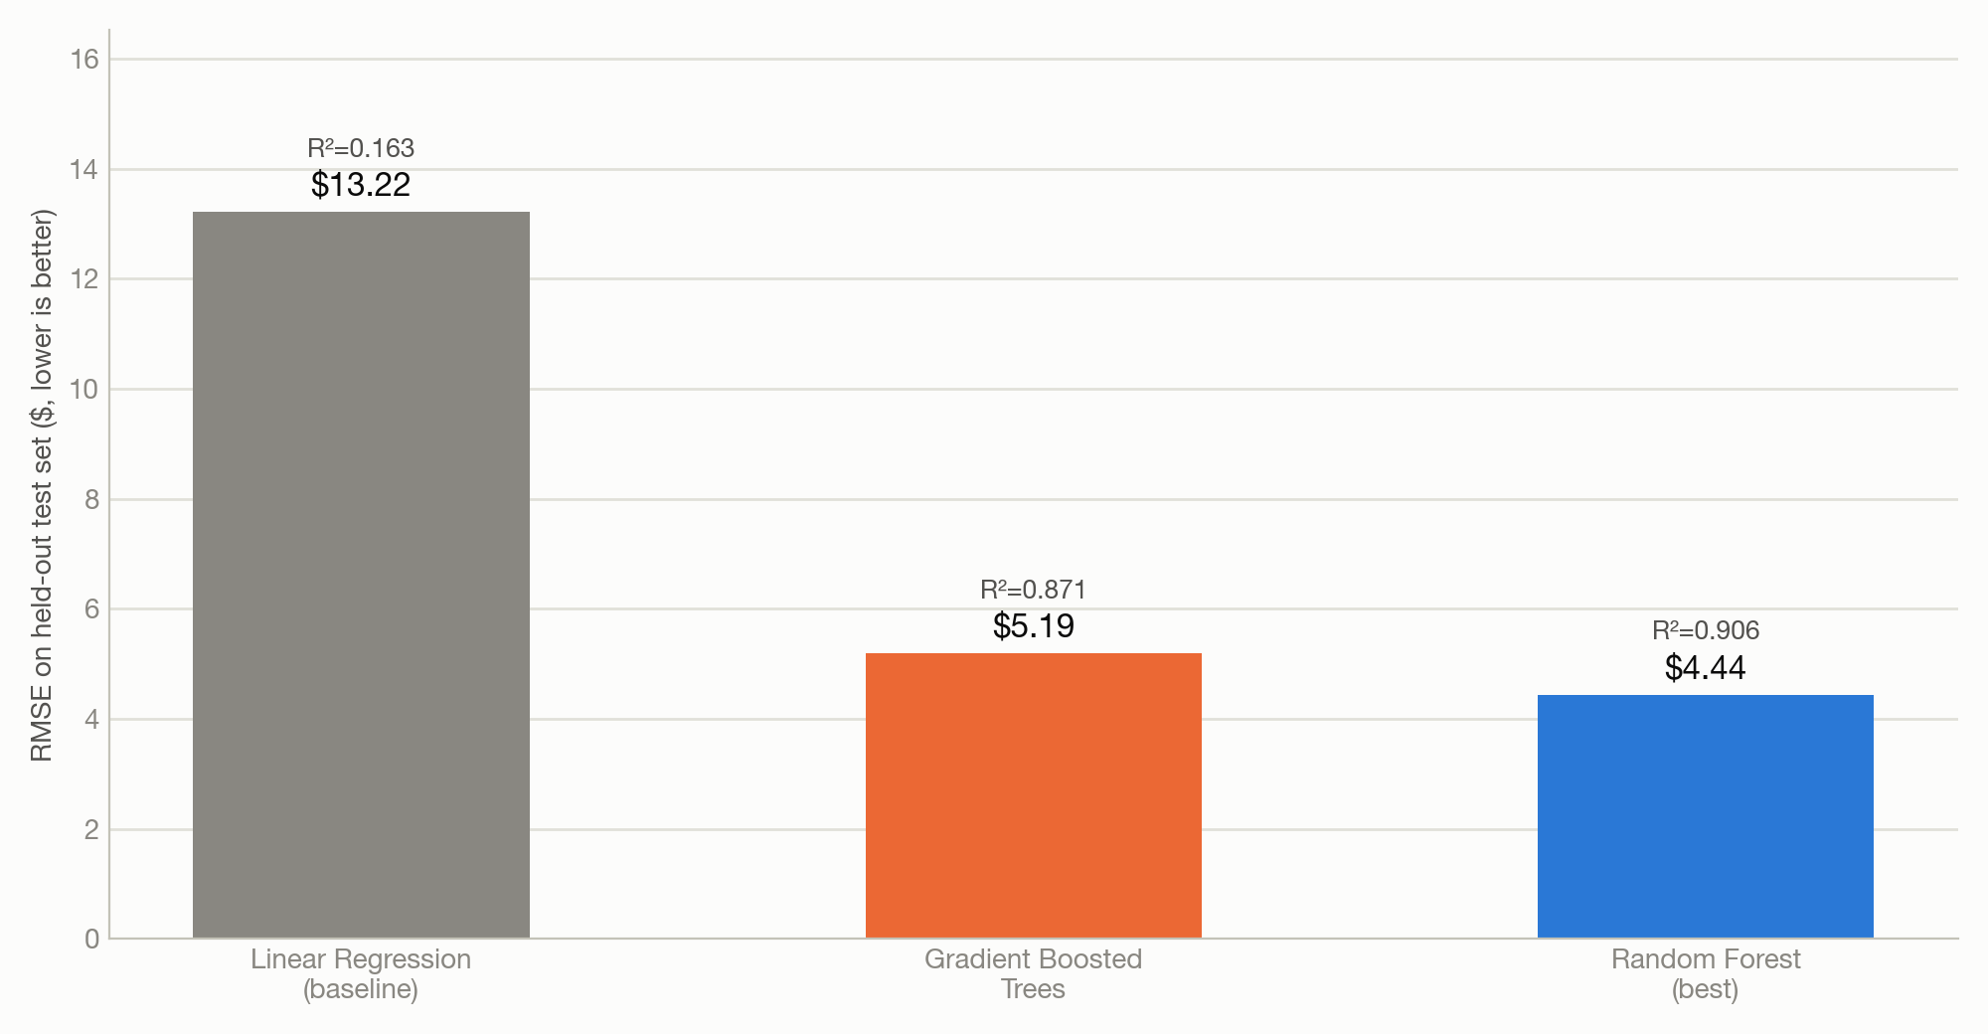
ML EXTENSION · +10 BONUS · ~30S
Predicting Trip Revenue
SETUP
▸ Target — total_amount (fare + tip + tolls + surcharges) per trip
▸ 8 features — trip_distance, pickup_hour, day_of_week, passenger_count, pickup/dropoff zone (StringIndexer), pay_credit_card, pay_cash
▸ 3 models compared — Linear Regression (baseline), Gradient Boosted Trees, Random Forest — all trained on an 80/20 split, evaluated with RMSE + R²
Winner: Random Forest — RMSE $4.44, R² 0.906 (66% lower RMSE than the linear baseline). The Streamlit UI auto-loads whichever model has the lowest saved RMSE.
CS675 — NYC Yellow Taxi Analytics at Cloud Scale
11

Slide 12
WRAP-UP
Summary & Key Takeaways
▸ Full pipeline, proven at two scales — raw Parquet → cleaned data → 5 analytics queries → ML model → served prediction UI, unchanged between a 2.5M-row laptop run and a 180M-row EMR Serverless run.
▸ Demand is evening-shaped, not commute-shaped — one peak at 18:00 on both weekdays and weekends.
▸ Airport trips drive revenue, not volume — JFK/LGA rank #1/#2 in total revenue on far fewer trips, purely on fare-per-trip.
▸ The flat base fare explains two patterns at once — why short trips tip the highest % and cost the most per mile.
▸ Random Forest cut prediction error by 66% over the linear baseline (RMSE $13.22 → $4.44) and is what actually serves the UI.
▸ ≥ 2 course tools satisfied — PySpark, AWS Athena, AWS EMR Serverless, Terraform.
▸ Weather barely moves the needle at full scale — the cross-source join (Q5) shows avg fare/distance flat-to-lower on snow days, not higher, once you have all 177M trips instead of one snowy month.
CS675 — NYC Yellow Taxi Analytics at Cloud Scale
13

Slide 13
Q&A
github.com/oomintrixx/cs675
CS675 — NYC Yellow Taxi Analytics at Cloud Scale
14

