Slide 1
Lab 1:
Google Colab &LLM Using
(AIE1901)

Slide 2
Course Overview:
Introduction to the registration and basic operation of Google Colab.
Registration process and fundamental usage of large language models (LLMs).
You will gain hands-on experience in navigating these tools and executing simple tasks.

Slide 3
Learning Objectives:
By the end of this session, you will be able to:
Register for and effectively navigate Google Colab’s interface.
Set up and interact with large language models for basic tasks.
Apply these tools to enhance efficiency and creativity in problem-solving.
Build a foundation for future exploration into more advanced computational and AI-driven workflows.

Slide 4
What is Google Colab?
Google Colab, or “Google Colaboratory,” allows you to write and execute Python in your browser, with:
No setup required – runs entirely in the cloud.
Free access to computing resources.
Seamless integration with Google Drive for saving and sharing notebooks.
Support for popular Python libraries used in data science, machine learning, and AI.
An interactive environment combining code, text, equations, and visualizations in one document.

Slide 5
Chapter 1.
Creating a Google Account (Gmail)

Slide 6
Before starting
Please connect to the CUHKSZ Wi-Fi while on campus,
Please use the school VPN when off campus
For more details: https://itso.cuhk.edu.cn/node/169
Step 1 – Open the Sign-Up Page
In your browser, go to: https://accounts.google.com/signup
You can use Chrome, Firefox, Edge, or any application that behaves like a web browser.
💡 Tip: Using Google Chrome may provide the smoothest experience when accessing other Google services later.

Slide 7
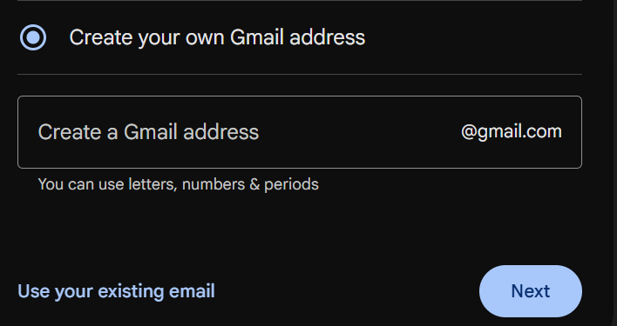
Step 2 – Enter Basic Information
Fill in your name, gender, and other required details as prompted.
Username: This will become your Gmail address (e.g., name@gmail.com).
Choose a unique username that is unlikely to be already taken.
Avoid overly complicated or hard-to-remember names.
💡 Tip: Your Gmail address will also serve as your login for all Google services, so pick one you are comfortable using professionally and academically.

Slide 8
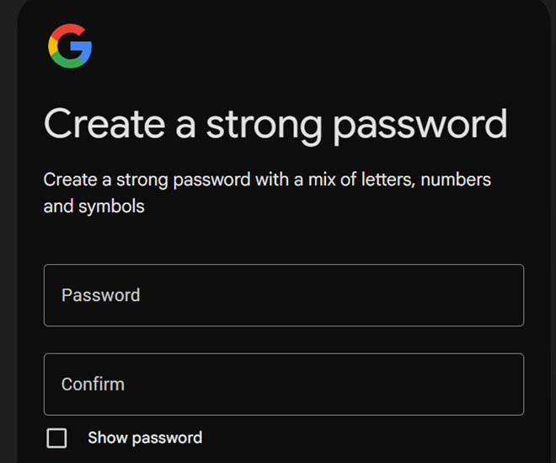
💡Password:
Must be at least 8 characters long.
Recommended format: a mix of uppercase letters, lowercase letters, numbers, and symbols.
Keep a secure record of your password in a safe place.

Slide 9
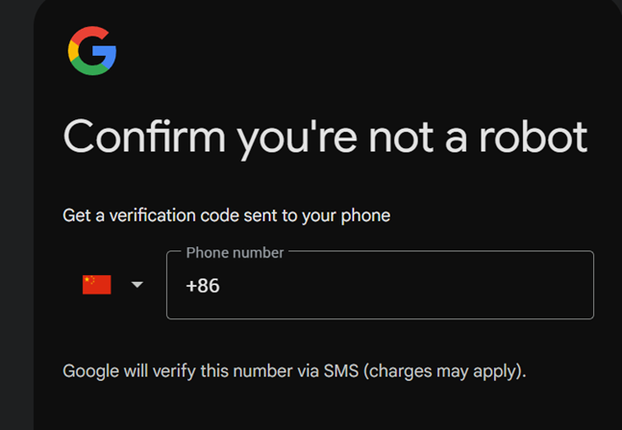
Step 3 – Verify Your Phone
Select +86 China (or your country code if different).
Enter your mobile phone number as prompted to receive a verification code.
Check your phone for the 6-digit verification code and enter it to complete verification.
💡 Tip: Linking your phone number helps with account recovery and enhances account security through two-step verification.

Slide 10
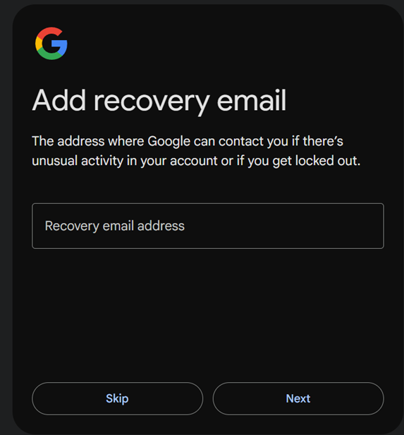
Step 4 – Add a Recovery Email (Optional but Recommended)
You may enter a recovery email address to help regain access to your account if you forget your password or lose access.
If you do not have another email address, you can skip this step.
💡 Tip: Using a recovery email from a different provider (e.g., Outlook, 163, QQ) can make your account recovery process more reliable.

Slide 11
Step 5 – Read and Agree to the Terms of Service
Click “I Agree” to proceed with account creation.
Once your account is created, you will automatically have access to the entire suite of Google services — including Gmail, Google Drive, and Google Colab — with a single sign-in.

Slide 12

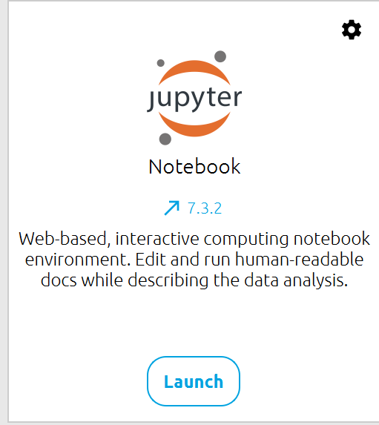
*Alternative Access Method
If repeated registration attempts are unsuccessful, please turn on the desktop computer in front of you (log in using your student ID number).
Then click the Anaconda shortcut on the desktop.
Launch Jupyter Notebook to enjoy an experience identical to Google Colab!

Slide 13
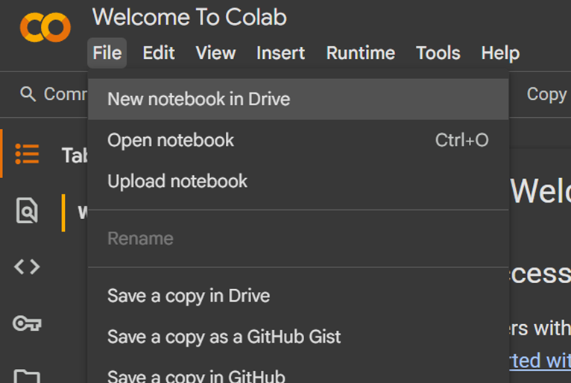
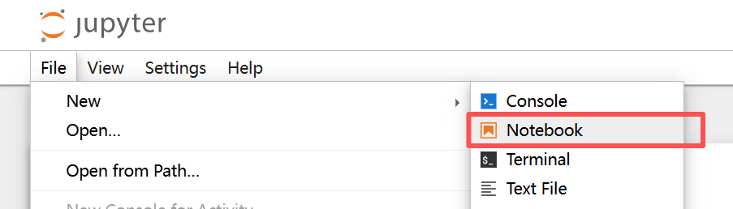
2. Open Google Colab
In your browser, go to: https://colab.research.google.com/
Click “New Notebook” to create a fresh Colab workspace.
💡 Tip: Make sure you are signed in to your Google account before opening Colab, so your notebook can be automatically saved to Google Drive.

Slide 14

3. Getting to Know the Colab Interface
File Name (top left): Click to rename (default is something like Untitled0.ipynb).
Common Menu Options:
File: Create a new notebook, save, save to GitHub, download as .ipynb or .py.
Edit: Find & replace, notebook settings.
View: Toggle side panels, show/hide line numbers, etc.
Insert: Add text cells or code cells.
Runtime: Connect/disconnect, restart, change runtime type (CPU/GPU/TPU).
Tools: Settings, manage extensions.

Slide 15
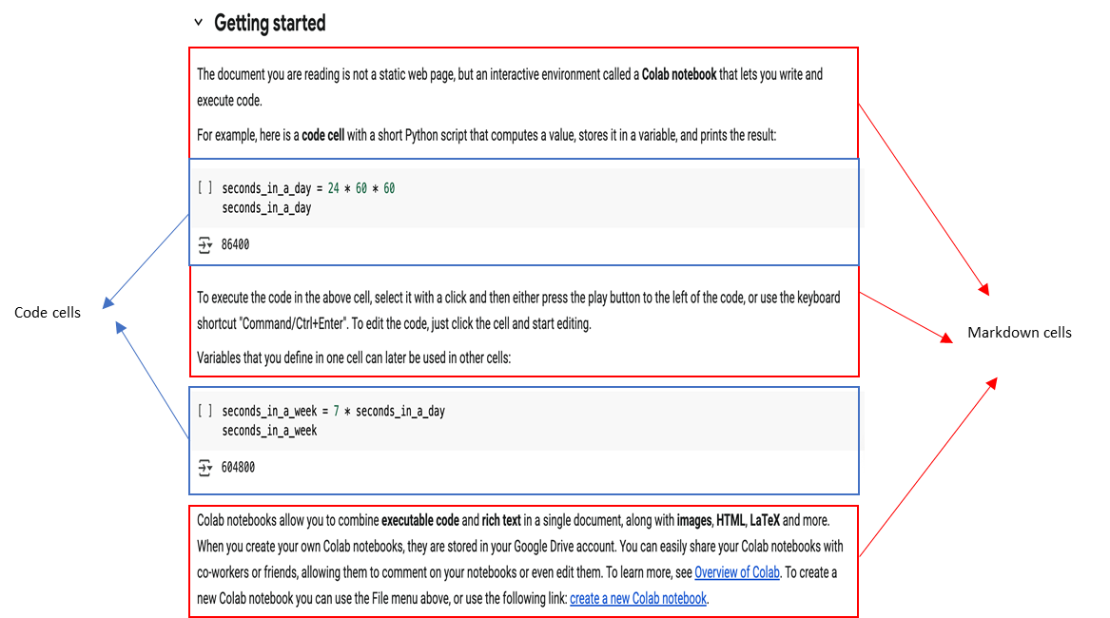
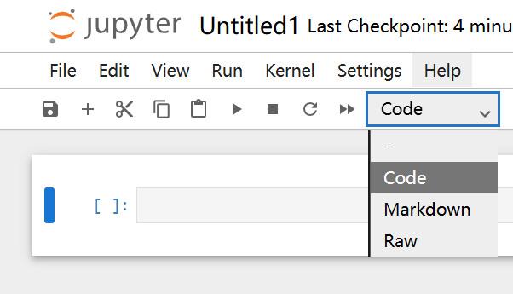
4. Cells:
+ Code / + Text buttons: Add new cells.
A colab notebook consists of two kinds of cells:
Code Cells: Contain executable Python code. Click the ▶️ button on the left to run.
Text Cells: For writing explanations using Markdown.

Slide 16
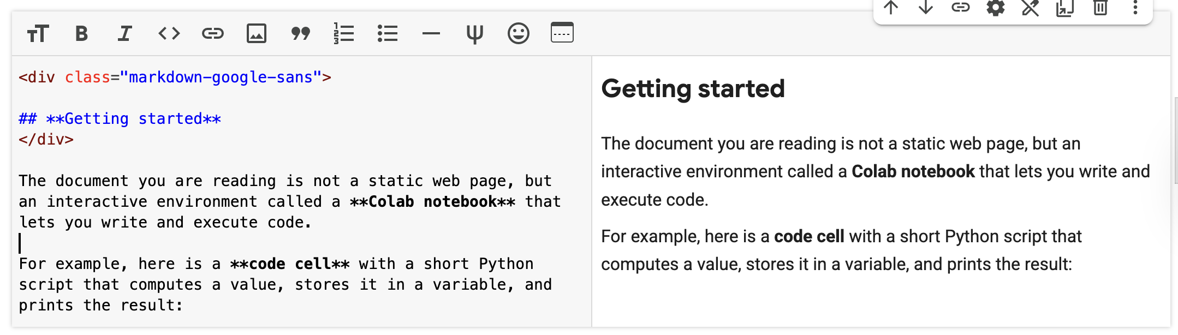
4. Cells:
Double-click a Markdown cell to edit its content.
When you’re done editing, press Shift + Enter to render the content, or simply click outside the cell (for Colab notebooks only).

Slide 17
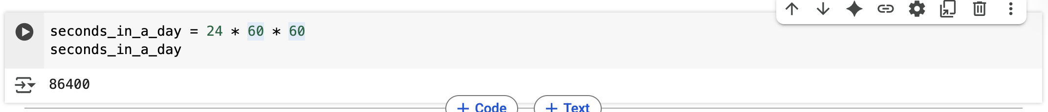
5. Running Your First Python Code
Step 1: In an empty code cell, type:
print("Hello, Colab!“)
Step 2: Click the ▶️ Run button on the left.
or use the keyboard shortcut "Command/Ctrl+Enter".
Step 3: Once execution finishes, you should see the output
Hello, Colab!
displayed directly below the cell — this means you’ve run your first Python program successfully.
💡 Tip: Every cell in Colab is independent. You can run them in any order, but variables and imports only exist in the current runtime session.
play button
output

Slide 18
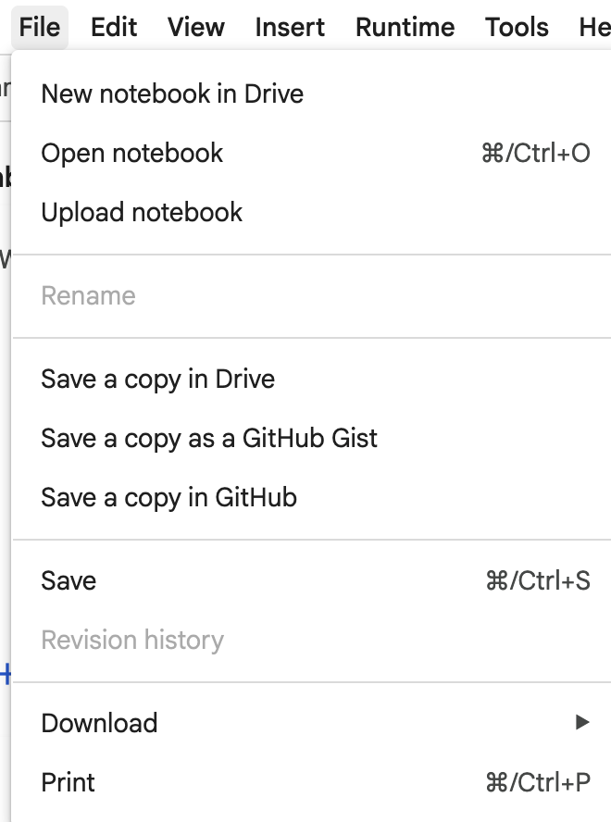
6. Saving, Sharing, and Exporting
Auto-Save: Colab automatically saves your notebook to Google Drive (file name shown in the top-left corner).
Manually Save a Copy:
  File → Save a copy in Drive
Download to Local Machine:
  File → Download
Share:
  Click the “Share” button in the top-right corner.
  Add collaborator emails or generate a shareable link.
  Set permissions: Viewer / Commenter / Editor.

Slide 19
Cpter 2.
Registration and Use of LLM

Slide 20
1. Register a DeepSeek Account
Step 1: Open the official website and chat portal
  Main website: deepseek.com (links to both the chat interface and platform)
  Web chat: chat.deepseek.com (recommended to use on desktop or mobile browser)
💡 Tip: Bookmark both links for quick access. The main site is great for exploring all DeepSeek services, while the chat page takes you directly into conversations.

Slide 21
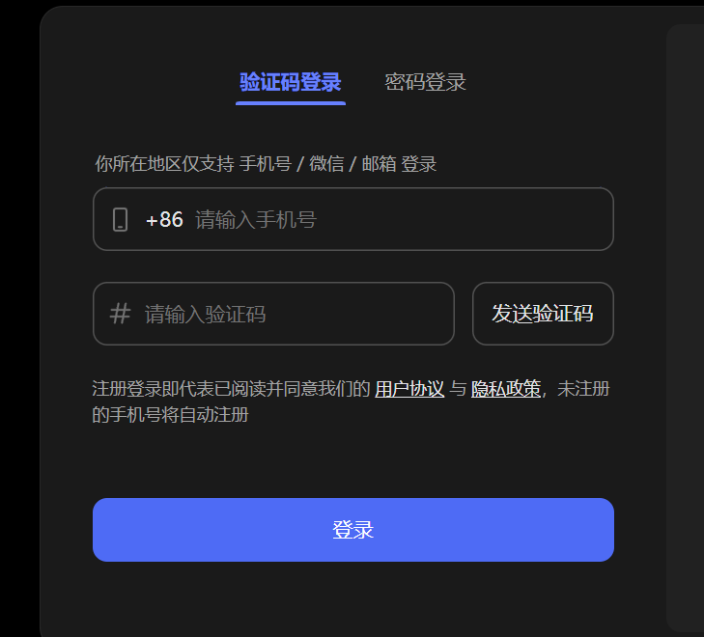
Step 2 – Sign Up Using Your Phone
Enter your mobile number: Use a +86 phone number to log in or register.
Alternative method: Scan the QR code on the right using WeChat to log in or register.
💡 Tip: If you do not receive the verification code, check your spam folder, wait 1–2 minutes, or try using a different active email address.

Slide 22
2. Open and Basic Usage
Interface Overview:
Left panel: Conversation list.
Right panel: Input box for typing prompts or questions.
Mobile users can install the DeepSeek App (iOS/Android) to chat anytime, anywhere.
Model Selection (know the names):
DeepSeek-V3 (deepseek-chat): Suitable for general conversation, writing, coding, and summarizing.
DeepSeek-R1 (deepseek-reasoner): Focused on enhanced reasoning and problem-solving.

Slide 23
3. Basic Operations
Type your question or task directly into the input box.
For long text, paste it in sections.
Remember to copy and save important results.
You can manage or delete your chat history in Privacy Settings.

Slide 24
4. Use Cases for LLMs
Content creation
Summarization
Classification
Extraction
Editing
Problem-solving
Translation

Slide 25
5. Prompting Best Practices
Prompting is an essential skill for getting the most out of generative AI.
To get the best results from an AI tool, you need to craft a good prompt.
A good prompt follows a simple framework: Task, Context, References, Evaluate, and Iterate.

Slide 26
Step 1: Specify the task
Specifying your task is the foundation of every prompt. Describe in detail what you want the AI tool to do, be clear and avoid ambiguity.
Task: What action do you want the tool to help you with?
Format: How do you want the output to be formatted?

Slide 27
Step 1: Specify the task: Example
Here's an example of a prompt that includes a specific task and a format:
“Annotate the following Python code for absolute beginners. Explain each line clearly, avoid technical jargon, and use friendly, easy-to-understand language. Add inline comments starting with # above or beside the relevant code.”

Slide 28
Step 2: Provide necessary context
Including detailed context in your prompts can narrow an AI tool's focus, enabling it to produce more tailored and effective output. Contextual information in your prompts might include:
Reasons and objectives for performing the task
Rules or guidelines that the output must follow
Relevant background information the tool should consider

Slide 29
Step 2: Provide necessary context: Example
Here's an example of a prompt that provides necessary context
“Annotate the following Python code for absolute beginners. Explain each line clearly, avoid technical jargon, and use friendly, easy-to-understand language. Add inline comments starting with # above or beside the relevant code. The annotated code will be used in an introductory programming class to help students understand both what the code does and why each step is necessary.”

Slide 30
Step 3: Include references as examples
References provide examples or resources that illustrate what you want an AI tool to produce. They specify details about your desired output, such as the style, tone, and format.
Example:
# This is a simple program that prints "Hello, World!"
# print() is a function that displays text on the screen
print("Hello, World!")

Slide 31
Here‘s an example of a prompt that includes specific task, context and references：
Annotate the following Python code for absolute beginners. Explain each line clearly, avoid technical jargon, and use friendly, easy-to-understand language. Add inline comments starting with # above or beside the relevant code. The annotated code will be used in an introductory programming class to help students understand both what the code does and why each step is necessary.
Reference:
# This is a simple program that prints "Hello, World!"
# print() is a function that displays text on the screen
print("Hello, World!")

Slide 32
Step 4: Evaluate your output
AI tools vary in their training and capabilities. Each tool has unique strengths and limitations, which can influence the quality of their output.
After receiving a response from an AI tool, it's essential to carefully evaluate the quality and effectiveness of the AI-generated content before using it or sharing the output with others.

Slide 33
Step 5: Iterate for better results
Even well-crafted prompts may not produce ideal results on the first try. This is where iteration comes in—the process of refining your prompt based on the AI's output. Think of iteration like having a back-and-forth conversation with an AI tool.
The exchange typically flows like this:
You provide an initial prompt.➡The AI tool responds with an output. ➡You evaluate the AI-generated response. ➡You refine your request. ➡The cycle repeats until you produce the desired results.

Slide 34
💡Pro Tip:
When you've arrived at an effective prompt for a particular task, save it!
You can use your most effective prompts as templates for different use cases and needs. This can help you replicate successful AI-output consistently—without starting from scratch each time.

Slide 35
Let's try!

Slide 36
Thank You!
Thank you for your attention and participation.
📬 Contact Information:
zhanzhanzhao@cuhk.edu.cn (Dr. Zhao Zhanzhan)
225080011@link.cuhk.edu.cn (Jia Xiao )

Slide 37
