Slide 1
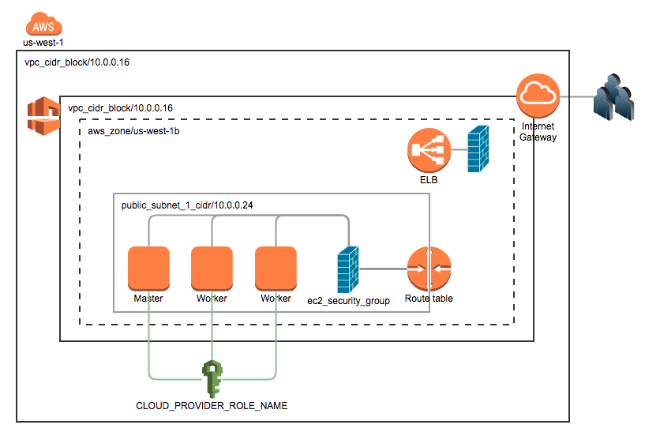

To be created by a K8S service (Load Balancer type) via AWS cloud provider for applications
K8S cluster
IAM Policy required for AWS cloud provider attached

Slide 2
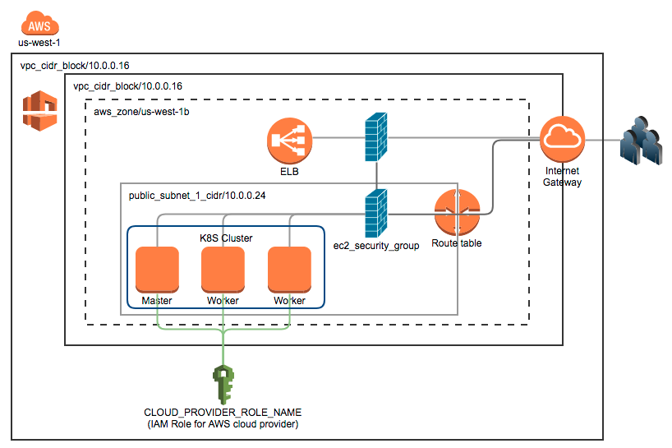
To be created by a K8S service (Load Balancer type) via AWS cloud provider for applications

