Slide 1


ANDROID APPLICATION FOR KEEPING UP WITH LATEST HEADLINES
SPEED FLASH

Slide 2


Description:
The NewsHeadlinesApp is a mobile application designed to help users stay updated with the latest news and headlines from around the world. The app aggregates news articles from various reliable sources, providing users with real-time updates, category-based news filtering, and a seamless reading experience. The primary goal is to deliver a user-friendly, responsive, and visually appealing app that ensures users are always informed about current events
Key Features:
1. Real-Time News Updates:
Fetches the latest headlines using a news API (e.g., NewsAPI, NYTimes, etc.).
Displays news articles in a clean, card-based layout for easy reading

Slide 3
2. Category-Based News:
Users can filter news by categories such as Technology, Sports, Health, Entertainment, Business, etc.
Provides a tailored news experience based on user preferences.
3. Search Functionality:
Integrated search feature to find news articles by keywords.
Users can quickly locate specific topics of interest.
4. Bookmarking and Favorites:
Allows users to save or bookmark articles for offline reading.
Users can access saved articles in a dedicated "Favorites" section.
5. Responsive UI with Material Design:
Uses modern design principles (Material Design) for an intuitive user interface.
Supports both light and dark themes for better readability.

Slide 4
6. In-App Browser for Full Articles:
Provides the ability to open full news articles within the app using an in-app browser.
Ensures users stay within the app while exploring detailed content.
7. Push Notifications:
Users receive notifications for breaking news and top headlines.
Configurable notification settings to control the frequency of alerts.
8. Offline Mode:
Caches news articles for offline reading when there's no internet connection.
Automatically updates articles once the device reconnects to the internet.

Slide 5
Instrumented test:
package com.example.newsheadlines
import androidx.test.platform.app.InstrumentationRegistry
import androidx.test.ext.junit.runners.AndroidJUnit4
import org.junit.Test
import org.junit.runner.RunWith
import org.junit.Assert.*
/**
* Instrumented test, which will execute on an Android device.
*
* See [testing documentation](http://d.android.com/tools/testing).
*/
@RunWith(AndroidJUnit4::class)
class ExampleInstrumentedTest {
@Test
fun useAppContext() {
// Context of the app under test.
val appContext = InstrumentationRegistry.getInstrumentation().targetContext
assertEquals("com.example.newsheadlines", appContext.packageName)
}
}

Slide 6
Color:
package com.example.newsheadlines.ui.theme
import androidx.compose.ui.graphics.Color
val Purple200 = Color(0xFFBB86FC)
val Purple500 = Color(0xFF6200EE)
val Purple700 = Color(0xFF3700B3)
val Teal200 = Color(0xFF03DAC5)
Shape:
package com.example.newsheadlines.ui.theme
import androidx.compose.foundation.shape.RoundedCornerShape
import androidx.compose.material.Shapes
import androidx.compose.ui.unit.dp
val Shapes = Shapes(
small = RoundedCornerShape(4.dp),
medium = RoundedCornerShape(4.dp),
large = RoundedCornerShape(0.dp)
)

Slide 7
Theme:
package com.example.newsheadlines.ui.theme
import androidx.compose.foundation.isSystemInDarkTheme
import androidx.compose.material.MaterialTheme
import androidx.compose.material.darkColors
import androidx.compose.material.lightColors
import androidx.compose.runtime.Composable
private val DarkColorPalette = darkColors(
primary = Purple200,
primaryVariant = Purple700,
secondary = Teal200
)
private val LightColorPalette = lightColors(
primary = Purple500,
primaryVariant = Purple700,
secondary = Teal200
/* Other default colors to override
background = Color.White,
surface = Color.White,
onPrimary = Color.White,
onSecondary = Color.Black,
onBackground = Color.Black,
onSurface = Color.Black,
*/
)
@Composable
fun NewsHeadlinesTheme(
darkTheme: Boolean = isSystemInDarkTheme(),
content: @Composable () -> Unit
) {
val colors = if (darkTheme) {
DarkColorPalette
} else {
LightColorPalette
}
MaterialTheme(
colors = colors,
typography = Typography,
shapes = Shapes,
content = content
)
}

Slide 8
Type:
package com.example.newsheadlines.ui.theme
import androidx.compose.material.Typography
import androidx.compose.ui.text.TextStyle
import androidx.compose.ui.text.font.FontFamily
import androidx.compose.ui.text.font.FontWeight
import androidx.compose.ui.unit.sp
// Set of Material typography styles to start with
val Typography = Typography(
body1 = TextStyle(
fontFamily = FontFamily.Default,
fontWeight = FontWeight.Normal,
fontSize = 16.sp
)
/* Other default text styles to override
button = TextStyle(
fontFamily = FontFamily.Default,
fontWeight = FontWeight.W500,
fontSize = 14.sp
),
caption = TextStyle(
fontFamily = FontFamily.Default,
fontWeight = FontWeight.Normal,
fontSize = 12.sp
)
*/
)

Slide 9
Backup rules:
<?xml version="1.0" encoding="utf-8"?><!--
Sample backup rules file; uncomment and customize as necessary.
See https://developer.android.com/guide/topics/data/autobackup
for details.
Note: This file is ignored for devices older that API 31
See https://developer.android.com/about/versions/12/backup-restore
-->
<full-backup-content>
<!--
<include domain="sharedpref" path="."/>
<exclude domain="sharedpref" path="device.xml"/>
-->
</full-backup-content>
Settings Gradle:
pluginManagement {
repositories {
google()
mavenCentral()
gradlePluginPortal()
}
}
dependencyResolutionManagement {
repositoriesMode.set(RepositoriesMode.FAIL_ON_PROJECT_REPOS)
repositories {
google()
mavenCentral()
}
}
rootProject.name = "News Headlines"
include ':app'

Slide 10
Local Properties:
## This file must *NOT* be checked into Version Control Systems,
# as it contains information specific to your local configuration.
#
# Location of the SDK. This is only used by Gradle.
# For customization when using a Version Control System, please read the
# header note.
#Mon Mar 13 10:00:07 IST 2023
sdk.dir=C\:\\Users\\KEERTHI\\AppData\\Local\\Android\\Sdk
Example unit test:
package com.example.newsheadlines
import org.junit.Test
import org.junit.Assert.*
/**
* Example local unit test, which will execute on the development machine (host).
*
* See [testing documentation](http://d.android.com/tools/testing).
*/
class ExampleUnitTest {
@Test
fun addition_isCorrect() {
assertEquals(4, 2 + 2)
}
}

Slide 11
Android manifest:
<?xml version="1.0" encoding="utf-8"?>
<manifest xmlns:android="http://schemas.android.com/apk/res/android"
xmlns:tools="http://schemas.android.com/tools">
<uses-permission android:name="android.permission.INTERNET"/>
<uses-permission android:name="android.permission.ACCESS_WIFI_STATE"/>
<application
android:allowBackup="true"
android:dataExtractionRules="@xml/data_extraction_rules"
android:fullBackupContent="@xml/backup_rules"
android:icon="@drawable/news_app_icon"
android:label="@string/app_name"
android:supportsRtl="true"
android:theme="@style/Theme.NewsHeadlines"
tools:targetApi="31">
<activity
android:name=".DisplayNews"
android:exported="false"
android:label="@string/title_activity_display_news"
android:theme="@style/Theme.NewsHeadlines" />

Slide 12
<activity
android:name=".RegistrationActivity"
android:exported="false"
android:label="@string/title_activity_registration"
android:theme="@style/Theme.NewsHeadlines" />
<activity
android:name=".MainPage"
android:exported="false"
android:label="@string/title_activity_main_page"
android:theme="@style/Theme.NewsHeadlines" />
<activity
android:name=".LoginActivity"
android:exported="true"
android:label="@string/app_name"
android:theme="@style/Theme.NewsHeadlines">
<intent-filter>
<action android:name="android.intent.action.MAIN" />
<category android:name="android.intent.category.LAUNCHER" />
</intent-filter>
</activity>
</application>
</manifest>

Slide 13
Main page:
package com.example.newsheadlines
import android.content.Context
import android.content.Intent
import android.content.Intent.FLAG_ACTIVITY_NEW_TASK
import android.os.Bundle
import android.util.Log
import android.widget.TextView
import androidx.activity.ComponentActivity
import androidx.activity.compose.setContent
import androidx.activity.viewModels
import androidx.compose.foundation.Image
import androidx.compose.foundation.background
import androidx.compose.foundation.clickable
import androidx.compose.foundation.layout.*
import androidx.compose.foundation.lazy.LazyColumn
import androidx.compose.foundation.lazy.itemsIndexed
import androidx.compose.foundation.selection.selectable
import androidx.compose.foundation.shape.RoundedCornerShape
import androidx.compose.material.Card
import androidx.compose.material.MaterialTheme
import androidx.compose.material.Surface
import androidx.compose.material.Text
import androidx.compose.runtime.*

Slide 14
import androidx.compose.ui.Modifier
import androidx.compose.ui.graphics.Color
import androidx.compose.ui.text.font.FontWeight
import androidx.compose.ui.text.style.TextAlign
import androidx.compose.ui.unit.dp
import androidx.compose.ui.unit.sp
import androidx.compose.ui.viewinterop.AndroidView
import androidx.core.text.HtmlCompat
import coil.compose.rememberImagePainter
import coil.size.Scale
import coil.transform.CircleCropTransformation
import com.example.example.Articles
import com.example.newsheadlines.ui.theme.NewsHeadlinesTheme
class MainPage : ComponentActivity() {
val mainViewModel by viewModels<MainViewModel>()
override fun onCreate(savedInstanceState: Bundle?) {
super.onCreate(savedInstanceState)
setContent {
NewsHeadlinesTheme {
// A surface container using the 'background' color from the theme
Surface(color = MaterialTheme.colors.background) {
Column() {

Slide 15
Text(text = "Latest NEWS", fontSize = 32.sp, modifier = Modifier.fillMaxWidth(), textAlign = TextAlign.Center)
MovieList(applicationContext, movieList = mainViewModel.movieListResponse)
mainViewModel.getMovieList()
}
}
}
}
}
}
@Composable
fun MovieList(context: Context, movieList: List<Articles>) {
var selectedIndex by remember { mutableStateOf(-1) }
LazyColumn {
itemsIndexed(items = movieList) {
index, item ->
MovieItem(context,movie = item, index, selectedIndex) { i ->
selectedIndex = i
}
}
}
}

Slide 16
@Composable
fun MovieItem(context: Context) {
val movie = Articles(
"Coco",
"",
" articl"
)
MovieItem(context,movie = movie, 0, 0) { i ->
Log.i("wertytest123abc", "MovieItem: "
+i)
}
}
@Composable
fun MovieItem(context: Context, movie: Articles, index: Int, selectedIndex: Int,
onClick: (Int) -> Unit)
{
val backgroundColor = if (index == selectedIndex) MaterialTheme.colors.primary else MaterialTheme.colors.background
Card(
modifier = Modifier
.padding(8.dp, 4.dp)
.fillMaxSize()
.selectable(true, true, null,
onClick = {
Log.i("test123abc", "MovieItem: $index/n$selectedIndex")
})

Slide 17
.clickable { onClick(index) }
.height(180.dp), shape = RoundedCornerShape(8.dp), elevation = 4.dp
) {
Surface(color = Color.White) {
Row(
Modifier
.padding(4.dp)
.fillMaxSize()
)
{
Image(
painter = rememberImagePainter(
data = movie.urlToImage,
builder = {
scale(Scale.FILL)
placeholder(R.drawable.placeholder)
transformations(CircleCropTransformation())
}
),
contentDescription = movie.description,
modifier = Modifier
.fillMaxHeight()
.weight(0.3f)
)

Slide 18
Column(
verticalArrangement = Arrangement.Center,
modifier = Modifier
.padding(4.dp)
.fillMaxHeight()
.weight(0.8f)
.background(Color.Gray)
.padding(20.dp)
.selectable(true, true, null,
onClick = {
Log.i("test123abc", "MovieItem: $index/n${movie.description}")
context.startActivity(
Intent(context, DisplayNews::class.java)
.setFlags(Intent.FLAG_ACTIVITY_NEW_TASK)
.putExtra("desk", movie.description.toString())
.putExtra("urlToImage", movie.urlToImage)
.putExtra("title", movie.title)
)
})
) {
Text(
text = movie.title.toString(),
style = MaterialTheme.typography.subtitle1,
fontWeight = FontWeight.Bold
)

Slide 19
HtmlText(html = movie.description.toString())
}
}
}
}
@Composable
fun HtmlText(html: String, modifier: Modifier = Modifier) {
AndroidView(
modifier = modifier
.fillMaxSize()
.size(33.dp),
factory = { context -> TextView(context) },
update = { it.text = HtmlCompat.fromHtml(html, HtmlCompat.FROM_HTML_MODE_COMPACT) }
)
}
}

Slide 20
Conclusion:
The NewsHeadlinesApp project is a comprehensive solution for users who want a fast, efficient, and organized way to stay informed. The app leverages modern Android development practices, offering a scalable and feature-rich experience. By focusing on user experience and performance, this project aims to provide a one-stop platform for all news needs.
This project plan provides a detailed overview to help you get started with developing your news application on Android Studio. If you have any specific questions or need further guidance, feel free to ask!

Slide 21
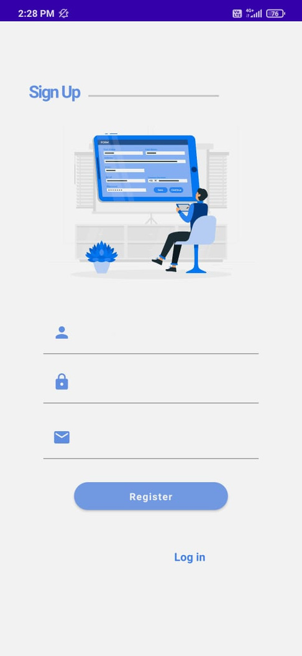
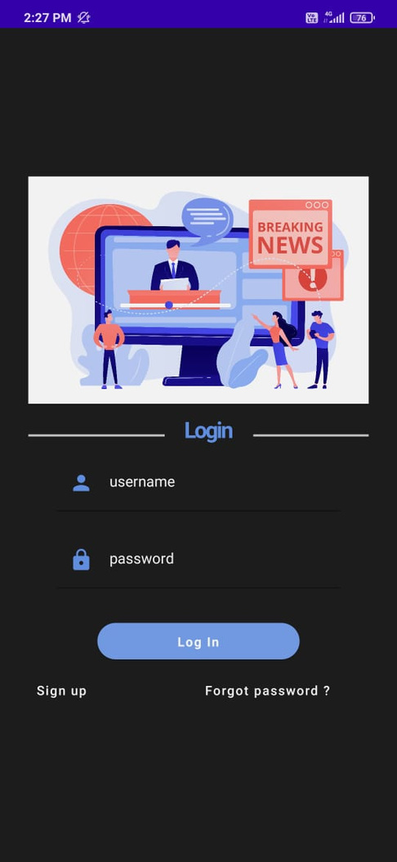
Output:

Slide 22
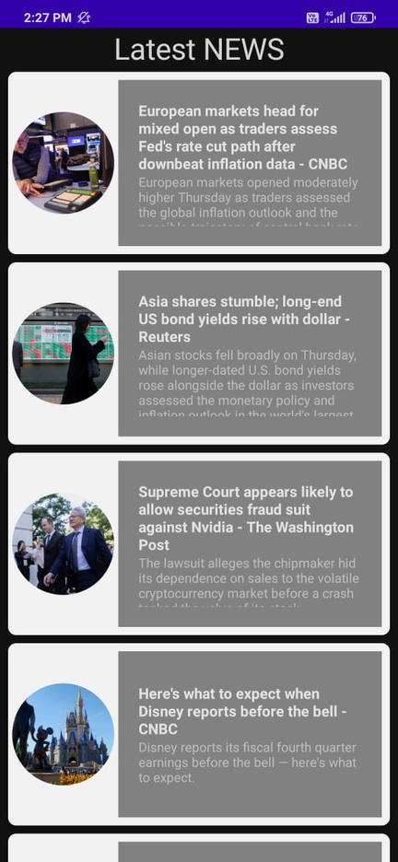
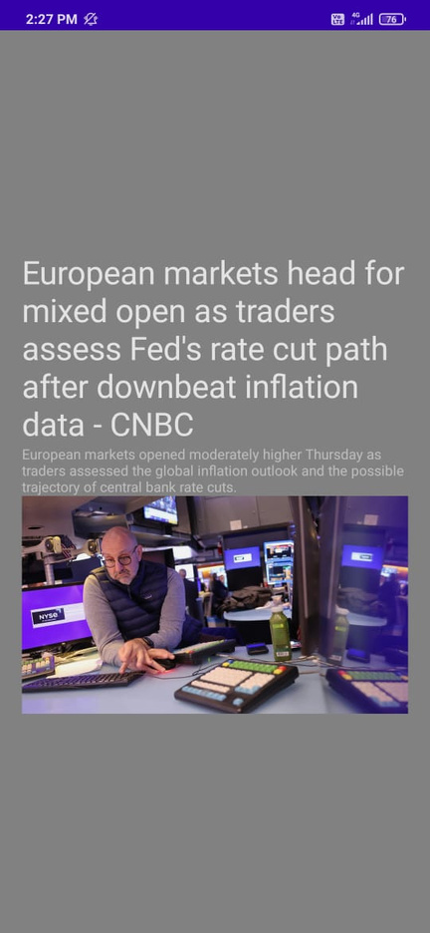

Slide 23
THANK YOU

