Slide 1

U.S. DOT GIS Strategic Plan 2022-2024
An analysis, by Harrison DeFord
GES 678: GIS Project Leadership and Management in the Enterprise

Slide 2
About the plan
U.S. Department of Transportation (DOT) GIS Strategic Plan 2022-2024
As a federal agency, the organization covers the United States
Responsibility over all modes of transportation
“DOT’s mission is to deliver the world’s leading transportation system, serving the American people and economy through the safe, efficient, sustainable, and equitable movement of people and goods”

Slide 3
Common Elements: Executive Summary
Many strategic plans contain an executive summary:
Why GIS is important (and, further why a strategic plan is important)
Vision statement, mission statement, and/or goals of the organization
How the strategic plan will be implemented
“…to formalize governance processes related to geospatial data, provide policy and requirements to empower the use of geospatial data and technology, and require Federal agencies to cooperate between the public and private sector”

Slide 4
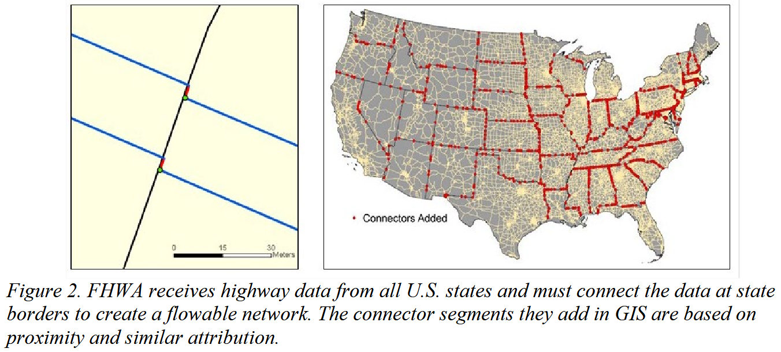
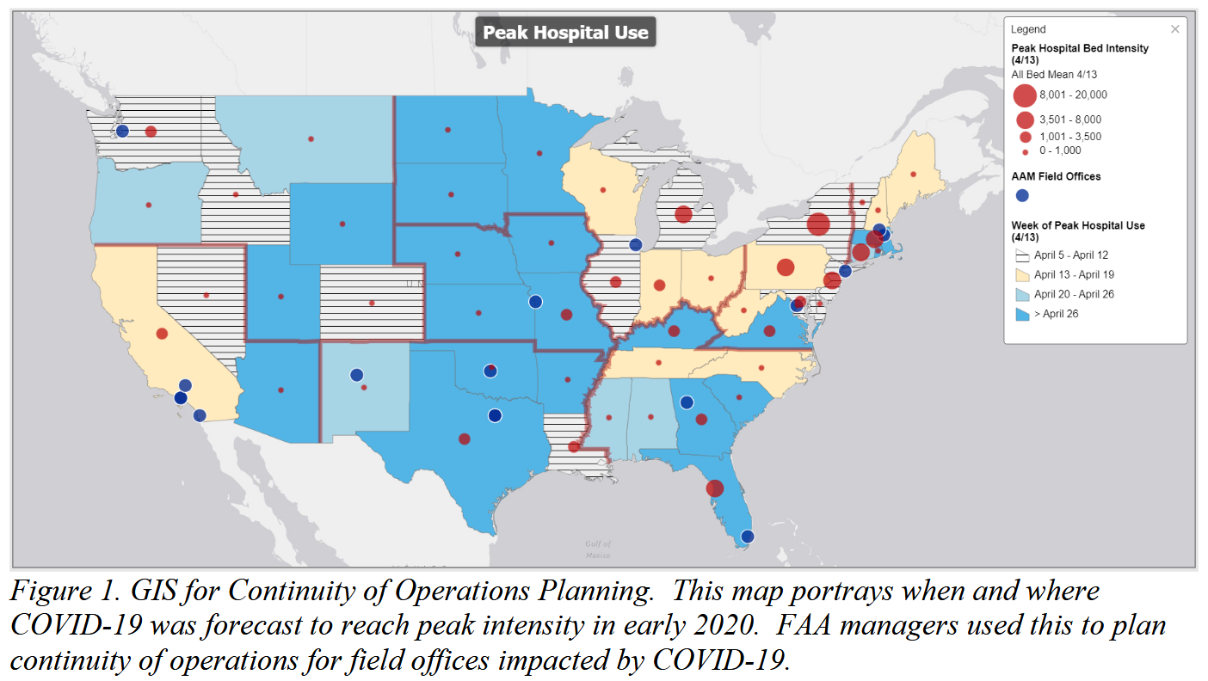
Common Elements: Introduction
Sometimes called “Background”, the introduction:
Provides a lower-level explanation of how GIS is important
Provides examples of internal and external GIS products, including maps, links, and descriptions
Is more technical, to demonstrate the value of a GIS

Slide 5
Common Elements: Current Conditions
An inventory of existing conditions, including:
Number of employees and staffing goals per business unit
Hardware and software systems which make up the GIS
Relevant legislation and organizational policy
Relationships with external partners (such as FGDC)
“Users appreciate the flexibility offered by the ELA with ESRI. They believe that GIS is recognized as a key tool for visualization across DOT, and that spatial potential is considered in the requirements phase of new data projects. DOT has raised awareness of GIS among senior leadership by proving that GIS provides impactful visualizations of important datasets”

Slide 6
Common Elements: Challenges and Opportunities
Sometimes called a “Needs assessment”, this section:
Lays out the main, specific needs that the strategic plan is meant to address
In DOT’s case, this is staffing and hardware constraints
Generally involves interviews of users and stakeholders
Can be a SWOT analysis or other needs assessment
“Funding and FTEs were near-universal concerns. The current level of funding for geospatial programs does not provide for optimal data procurement, application upgrades, tool development, training, and hiring […] users reported that their scripts and models take days to run, and often end in errors”

Slide 7
Common Elements: Implementation Plan
The implementation plan lays out:
Estimates of resources, budget, and continued training
Who will be responsible and accountable for tasks, and how
A communication plan between stakeholders
The “reporting” section describes mandatory reporting requirements
“This Implementation Plan provides resource estimates, responsible parties and high-level tasks, a communication plan, timelines, and performance metrics for actions needed to implement the strategic goals and Objectives”

Slide 8
Common Elements: Implementation Plan
Requirement | Deadline/Frequency | Status
Covered Agency Report (GDA, Section 759(b)(1) ) | Annually in January or as determined by the FGDC | Reports filed on time in January 2021 and 2022
Lead Covered Agency Report (GDA, Section 756(b)(3)) for the Transportation Theme | Annually in January or as determined by the FGDC | Reports filed on time in January 2021 and 2022
GIS Strategic Plan (GDA, Section 759(a)(1)) | When NSDI Strategic Plan is updated | NSDI plan adopted in November 2020; this plan was finalized in 2022 due to administration change
Geospatial Budget and Data Inventory (GDA, Section 759(b)(2)) | Annually, but first due date TBD by OMB | Gathering information through the IT Spend Plan and DOT’s Data Inventory
OIG Audit recommendations | By 9/30/21 | Requested closure or set completion dates for all recommendations

Slide 9
Missing Elements: Risk/Threat Assessment
While the DOT Strategic Plan had a “challenges and opportunities” section, there was no assessment of risks or threats during implementation
What happens if a system goes down due to implementation?
What is the disaster recovery process? Does it need to be updated with the recommendations listed in the strategic plan?
Many other strategic plans explicitly contain this information
Wilmington, N.C.: “One concern with this model is that there is a risk of not allowing the GIS Division to serve all departments equally resulting in stifled GIS growth enterprise-wide”

Slide 10
Guide towards implementation
The DOT Strategic Plan did an excellent job demonstrating the importance of GIS to the organization
It contains 8(!) different examples of GIS products across multiple business units
However, the missing threat analysis makes it more difficult to implement
No understanding of how implementing the changes could break existing systems or processes
“Although senior leadership appreciates impactful geospatial data visualizations (such as the maps provided to the Secretary’s team during disasters), many employees do not realize the full power of geospatial data analysis”

Slide 11
First actions
Given this plan to implement, my first steps would be to commission a risk analysis of some of the changes mentioned:
One of the goals listed is to increase in-house data creation and storage capabilities
What is the existing on-prem server and database infrastructure? What happens if one of these goes offline?
Otherwise, I would start assembling a team to begin dealing with the opportunities identified
How can we get more FTEs? Users are generally happy with the ELA; how can we procure better hardware?

