Slide 1
Assignment 2:
Statistical Machine Translation
CSC401/2511 Tutorial, Winter 2019
Charlie Chenyu Zhang
Based on slides by Mohamed Abdalla, Patricia Thaine, Jackie Cheung, Alex Fraser and Frank Rudzicz
Notes:
My name is Charlie
Marking first two parts of A2
You may have other assignments due or midterms this week
Cover all materials and try to finish today’s TUT earlier
I will take questions after the TUT
I will ask the professor to post those slides on the website after the TUT

Slide 2
Today’s Schedule
History of Machine Translation
A2: the big picture
Task 1: Preprocess Inputs
Task 2: Compute n-gram counts
Marking: How each tasks are evaluated
}
Focus
Notes:
Before we dive in, let's take a look of today's schedule
History of MT won’t be on the test
We will focus on Task 1 and Task 2 today

Slide 3
Today’s Schedule
History of Machine Translation
A2: the big picture
Task 1: Preprocess Inputs
Task 2: Compute n-gram counts
Marking: How each tasks are evaluated
Notes:
Without further ado, let's get started with the History

Slide 4
Rough History of Machine Translation Research
When I look at an article in Russian, I say: "This is really written in English, but has been coded in some strange symbols. I will now proceed to decode."
[Warren Weaver, 1947]
The early years of MT
1940
1950
1960
1970
1980
1990
2000
2010
2020
Cromieres, Fabien, Toshiaki Nakazawa, and Raj Dabre. "Neural Machine Translation: Basics, Practical Aspects and Recent Trends." Proceedings of the IJCNLP 2017
Notes:
The first ideas of statistical machine translation were introduced by Warren Weaver in 1949
These proposals were based on information theory.
They were very successful in code breaking during the Second World War

Slide 5
Rough History of Machine Translation Research
It turns out MT is difficult
Beginning of MT
1940
1950
1960
1970
1980
1990
2000
2010
2020
Cromieres, Fabien, Toshiaki Nakazawa, and Raj Dabre. "Neural Machine Translation: Basics, Practical Aspects and Recent Trends." Proceedings of the IJCNLP 2017
Notes:
In A2, IBM-1 to learn the alignment between English and French words automatically.
However, early systems used large bilingual dictionaries and hand-coded rules for fixing the word order in the final output which was eventually considered too restrictive in linguistic developments at the time.
We realized that MT is hard because of semantic ambiguity. At the time, this type of semantic ambiguity could only be solved by writing source texts for machine translation in a controlled language that uses a vocabulary in which each word has exactly one meaning.

Slide 6
Rough History of Machine Translation Research
It turns out MT is difficult
Disinterest in MT research
(esp. in USA after ALPAC report)
Beginning of MT
1940
1950
1960
1970
1980
1990
2000
2010
2020
Cromieres, Fabien, Toshiaki Nakazawa, and Raj Dabre. "Neural Machine Translation: Basics, Practical Aspects and Recent Trends." Proceedings of the IJCNLP 2017
Notes:
ALPAC, the Automatic Language Processing Advisory Committee
After this ALPAC report, research in the US was almost completely abandoned for over a decade. In Canada, however, research continued.

Slide 7
Rough History of Machine Translation Research
It turns out MT is difficult
Diversity and the number of installed systems for MT had increased
Disinterest in MT research
(esp. in USA after ALPAC report)
Beginning of MT
1940
1950
1960
1970
1980
1990
2000
2010
2020
Cromieres, Fabien, Toshiaki Nakazawa, and Raj Dabre. "Neural Machine Translation: Basics, Practical Aspects and Recent Trends." Proceedings of the IJCNLP 2017
Notes:
Between 1980s and early 1990s, as a result of the improved availability of microcomputers, there was a large surge in a number of novel methods for machine translation.

Slide 8
Rough History of Machine Translation Research
Example-based Machine Translation (EBMT) [Nagao, 1981]
1940
1950
1960
1970
1980
1990
2000
2010
2020
Cromieres, Fabien, Toshiaki Nakazawa, and Raj Dabre. "Neural Machine Translation: Basics, Practical Aspects and Recent Trends." Proceedings of the IJCNLP 2017
Notes:
In 1981, Makoto Nagao and his group used methods based on large numbers of translation examples, a technique that is now termed example-based machine translation

Slide 9
Rough History of Machine Translation Research
Example-based Machine Translation (EBMT) [Nagao, 1981]
Statistical Machine Translation (SMT) [Brown et al., 1993]
1940
1950
1960
1970
1980
1990
2000
2010
2020
Cromieres, Fabien, Toshiaki Nakazawa, and Raj Dabre. "Neural Machine Translation: Basics, Practical Aspects and Recent Trends." Proceedings of the IJCNLP 2017
Notes:
IBM Model 1 that we will use in A2 was introduced by Brown et al. in 1993

Slide 10
Rough History of Machine Translation Research
Phrase-based SMT [Koehn et al., 2003]
Example-based Machine Translation (EBMT) [Nagao, 1981]
Statistical Machine Translation (SMT) [Brown et al., 1993]
1940
1950
1960
1970
1980
1990
2000
2010
2020
Cromieres, Fabien, Toshiaki Nakazawa, and Raj Dabre. "Neural Machine Translation: Basics, Practical Aspects and Recent Trends." Proceedings of the IJCNLP 2017
Notes:
The statistical translation models were initially word based (Models 1-6 from IBM Hidden Markov model), but significant advances were made with the introduction of phrase based models in 2003.

Slide 11
Rough History of Machine Translation Research
Phrase-based SMT [Koehn et al., 2003]
Neural Machine Translation (NMT) [Sutskever et al., 2014]
Example-based Machine Translation (EBMT) [Nagao, 1981]
Statistical Machine Translation (SMT) [Brown et al., 1993]
1940
1950
1960
1970
1980
1990
2000
2010
2020
Cromieres, Fabien, Toshiaki Nakazawa, and Raj Dabre. "Neural Machine Translation: Basics, Practical Aspects and Recent Trends." Proceedings of the IJCNLP 2017
Notes:
If you are interested in the Neural Network, the first scientific paper on using neural networks in machine translation appeared in 2014.
Neural machine translation (NMT) is an approach to machine translation that uses a large artificial neural network to predict the likelihood of a sequence of words, typically modeling entire sentences in a single integrated model.

Slide 12
Rough History of Machine Translation Research
Phrase-based SMT [Koehn et al., 2003]
Neural Machine Translation (NMT) [Sutskever et al., 2014]
Example-based Machine Translation (EBMT) [Nagao, 1981]
Statistical Machine Translation (SMT) [Brown et al., 1993]
1940
1950
1960
1970
1980
1990
2000
2010
2020
Cromieres, Fabien, Toshiaki Nakazawa, and Raj Dabre. "Neural Machine Translation: Basics, Practical Aspects and Recent Trends." Proceedings of the IJCNLP 2017
Notes:
In A2, we will focus on the statistical machine translation

Slide 13
Today’s Schedule
History of Machine Translation
A2: the big picture
Task 1: Preprocess Inputs
Task 2: Compute n-gram counts
Marking: How each tasks are evaluated
Notes:
Now you know the brief history of the Machine Translation, let's take a look of the big picture of A2

Slide 14
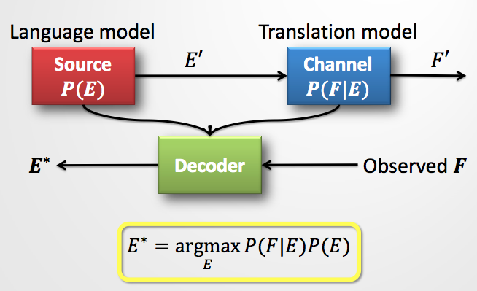
A2 – The big picture
Noisy Channel Model
We need a language model, a translation model, and a decoder.
your tasks!
Notes:
Task 2. Language Model
Task 4. You will implement IBM-1 as the translation model. P(A, F | E) where A is an alignment
Task 5. Implement BLUE score to evaluate each translation

Slide 15
Today’s Schedule
History of Machine Translation
A2: the big picture
Task 1: Preprocess Inputs
Task 2: Compute n-gram counts
Marking: How each tasks are evaluated
Notes:
Now, let's talk about the most important part of today's TUT
Task 1: preprocess inputs

Slide 16
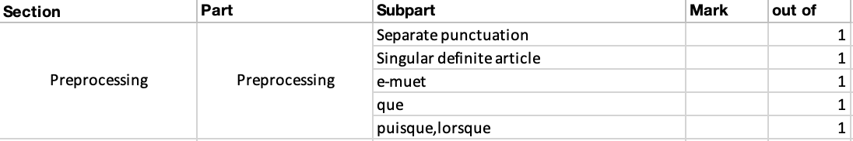
Task 1. Preprocess input text
[5 marks]
Do not modify the header of the function
Do only what is asked on the handout
Submission should work on teach.cs
Marking rubric
Notes:
You already know the first three points [read them]
Regarding the marking rubric, we won’t test you on the corner cases. As long as your code passed all the examples in the handout, you should get the perfect mark for this task.
Oh, I almost forget, there is one more thing

Slide 17
Task 1: One More Thing
In addition to all the rules, you need to add “SENTSTART” and “SENTEND” tags for all English and French sentences
For example:
l’election.
=> SENTSTART l’ election . SENTEND
Notes:
Also notice that the space between the sentence-final punctuation

Slide 18
Punctuation and Preprocessing
Q: The preprocessing rules in the handout don't handle/mention this particular case. What do I do? Can I fix it?
A: Yes, as long as it is reasonable and doesn’t interfere with anything which is explicitly specified in the handout.
- No bonus marks for extra work on this part.
- You are not required to do anything beyond what is described in the handout.
- Do not spend too much time on this part!

Slide 19
Today’s Schedule
History of Machine Translation
A2: the big picture
Task 1: Preprocess Inputs
Task 2: Compute n-gram counts
Marking: How each tasks are evaluated

Slide 20
Task 2: Compute n-gram counts
Implement the function lm_train
Train two models using lm_train, one for English and one for French. You can save the files with the names you want.
Marking Rubric
Notes:
[read the first two points]
Regarding the marking rubric, If you pass all the test cases, I will give you 15 marks.
If you fail partial test cases or all test cases, I will look into your implementation and give you partial marks for the “general correctness of the code”
So, I won't give you 0 on this part unless you did something crazy or you didn't implement the function at all
Oh, there are two more things

Slide 21
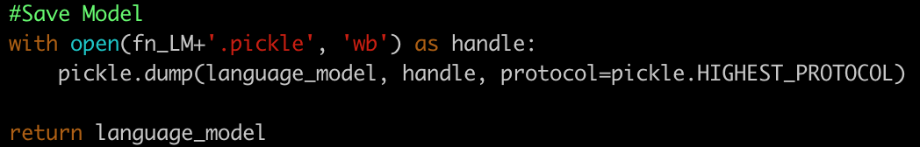
Task 2: Two More Things
Don’t change those lines
This is what we expect
language_model_uni = {string : int} # single dictionaries
language_model_bigram = {string : dict(string : int)} # nested dictionaries
language_model = {'uni': language_model_uni, "bi": language_model_bigram}
Notes:
We use pickle for Python object serialization

Slide 22
Today’s Schedule
History of Machine Translation
A2: the big picture
Task 1: Preprocess Inputs
Task 2: Compute n-gram counts
Marking: How each tasks are evaluated

Slide 23
Marking
(A large) Portion of it will be auto-marked.
Your code will be tested individually (by file).
Your code must adhere to the specifications for function calls to work.
Do NOT hardcode any paths.
It must work on CDF (test your code).

Slide 24
Marking (Cont)
Initially:
Correct Code:
A
B
C
D
Your Code:
A
B
C
D

Slide 25
Marking (Cont)
If we are testing “A”:
Correct Code:
A
B
C
D
Your Code:
A
B
C
D
Notes:
Feed the inputs to both files, then compare the result

Slide 26
Marking (Cont)
If we are testing “B”:
Correct Code:
A
B
C
D
Your Code:
A
B
C
D

Slide 27
Today’s Schedule
History of Machine Translation
A2: the big picture
Task 1: Preprocess Inputs
Task 2: Compute n-gram counts
Marking: How each tasks are evaluated
Notes:
Now, you have a basic understanding of the history of Machine Translation and understand the big picture of A2.

Slide 28
Thank you!
Enjoy your reading week!
Notes:
That’s it everyone!
Good luck with the midterms and other assignments.

