Slide 1
Storing 1 Bit (cont.)
Bistable Element
q
Q+
!q
Q–
q = 0 or 1
Stable 1
V_{in} = V₂
V₂
V₂
Metastable
V_{in}
V_{in}
V₁
V₁
Stable 0

Slide 2
Physical Analogy
Stable 1
Metastable
Stable 0
Metastable
.
Stable left
Stable right
.
.

Slide 3
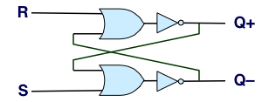
Storing and Accessing 1 Bit
Bistable Element
R-S Latch
q
R
Q+
Q+
!q
Q–
Q–
S
q = 0 or 1
Resetting
Setting
Storing
1
1
0
0
0
1
0
!q
q
0
0
1
1
1
0
0
q
!q

Slide 4
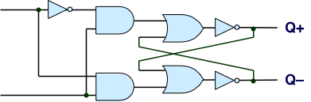
1-Bit Latch
D Latch
D
R
Data
Q+
C
Q–
Clock
S
Latching
Storing
d
!d
!d
!d
d
d
!d
0
!q
q
1
0
!q
d
d
!d
0
q

Slide 5
Transparent 1-Bit Latch
Latching
Changing D
d
!d
!d
!d
d
C
D
1
Q+
d
d
!d
Time
When in latching mode, combinational propogation from D to Q+ and Q–
Value latched depends on value of D as C falls

Slide 6
Edge-Triggered Latch
D
R
Data
Q+
Q–
C
S
T
Clock
Trigger
Only in latching mode for brief period
Rising clock edge
Value latched depends on data as clock rises
Output remains stable at all other times
C
T
D
Q+
Time

