Slide 1
CBIO204 — FUNDAMENTALS OF DATABASES
Biobank & Biospecimen
Management System
A Relational Database for Managing Donors, Samples, Storage,
and Research Activity
Mohamed Rateb
Student ID: 231002599
August 2026
Biobank & Biospecimen Management System
1

Slide 2
INTRODUCTION
Problem & Objectives
!
The Problem
✓
Project Objectives
Biobanks manage large volumes of information about donors, biological samples, storage locations, researchers, and lab activity. Tracking this manually makes it hard to trace samples, identify donors, locate storage, and monitor how samples are requested and used.
Design a relational database covering the full biobank workflow
Store donors, consent, samples, storage, and research requests
Track aliquots, sample usage, and laboratory test requests
Normalize the schema to 3NF and enforce business rules
Implement in MySQL with views, a trigger, and tested queries
Biobank & Biospecimen Management System
2

Slide 3
SCOPE
Database Scope & Business Rules
Project Scope
Key Business Rules
Donor information & consent
Sample collection events
Each donor has a unique donor code; each sample belongs to one collection event
Each aliquot belongs to one sample and one storage location
A sample can be requested by multiple researchers
Storage position (freezer + rack + box + position) must be unique
Sample and aliquot volumes must be greater than zero
Only anonymized donor identifiers are used
Sample types & tracking
Storage locations & aliquots
Researchers & sample requests
Sample usage & lab test requests
Focus: database management only — no GUI is included in the core system.
Biobank & Biospecimen Management System
3

Slide 4
DESIGN
Entities & Relationships
11 core entities model the full sample lifecycle — from donor consent through storage, request, and use.
Donor
Consent
Collection Event
Sample Type
Sample
Storage Location
Aliquot
Researcher
Sample Request
Sample Usage
Test Request
Relationship highlights: Donor →(1:N) Consent & Collection_Event · Collection_Event →(1:N) Sample · Sample →(1:N) Aliquot · Researcher ↔ Sample (M:N) via Sample_Request · Sample_Request →(1:N) Sample_Usage
Biobank & Biospecimen Management System
4

Slide 5
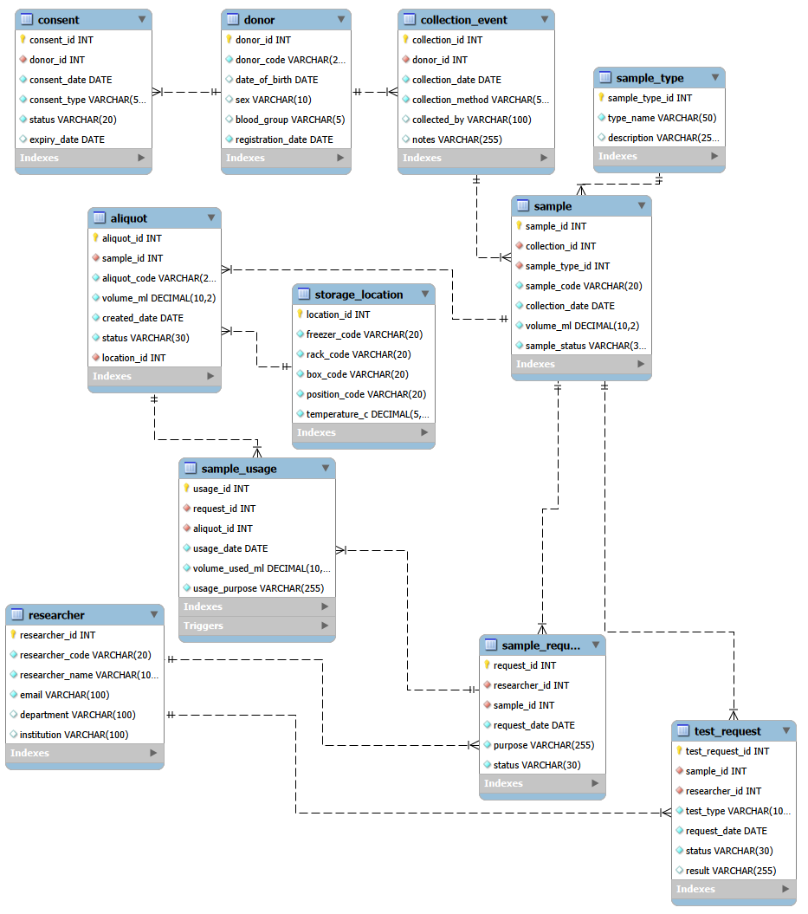
CONCEPTUAL DESIGN
Entity Relationship Diagram
Built in MySQL Workbench — 11 entities with primary keys, foreign keys, cardinality, and participation constraints.
Biobank & Biospecimen Management System
5

Slide 6
NORMALIZATION
Relational Schema & 3NF
1NF
2NF
3NF
Every column holds a single atomic value; no repeating groups. Each table has a defined primary key.
Tables use single-column primary keys (donor_id, sample_id...), so no partial dependency exists on part of a key.
Independent data is split into its own table — Sample_Type, Storage_Location, and Researcher are referenced by FK, not repeated.
Result: reduced duplication, easier maintenance, and consistent referential integrity across all 11 tables.
Constraints enforced in the schema
PK / FK on every relationship · UNIQUE on donor_code, sample_code, aliquot_code, researcher_code, email · CHECK volume_ml > 0 · UNIQUE (freezer, rack, box, position) on Storage_Location
Biobank & Biospecimen Management System
6

Slide 7
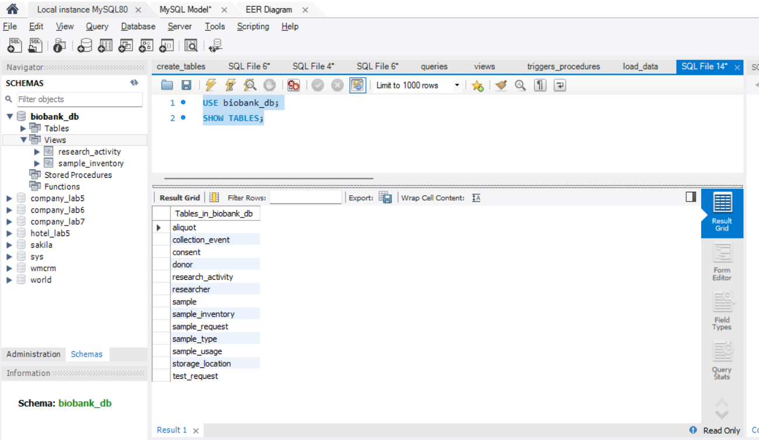
BUILD
Database Implementation
T
Tables
11 tables implemented in MySQL, one per core entity
K
PK / FK
Primary keys uniquely identify rows; foreign keys preserve referential integrity
C
Constraints
UNIQUE and CHECK constraints enforce codes, emails, and positive volumes
Organized into separate scripts: create_tables.sql · load_data.sql · queries.sql · views.sql · triggers_procedures.sql
All 11 tables successfully created in MySQL Workbench (SHOW TABLES).
Biobank & Biospecimen Management System
7

Slide 8
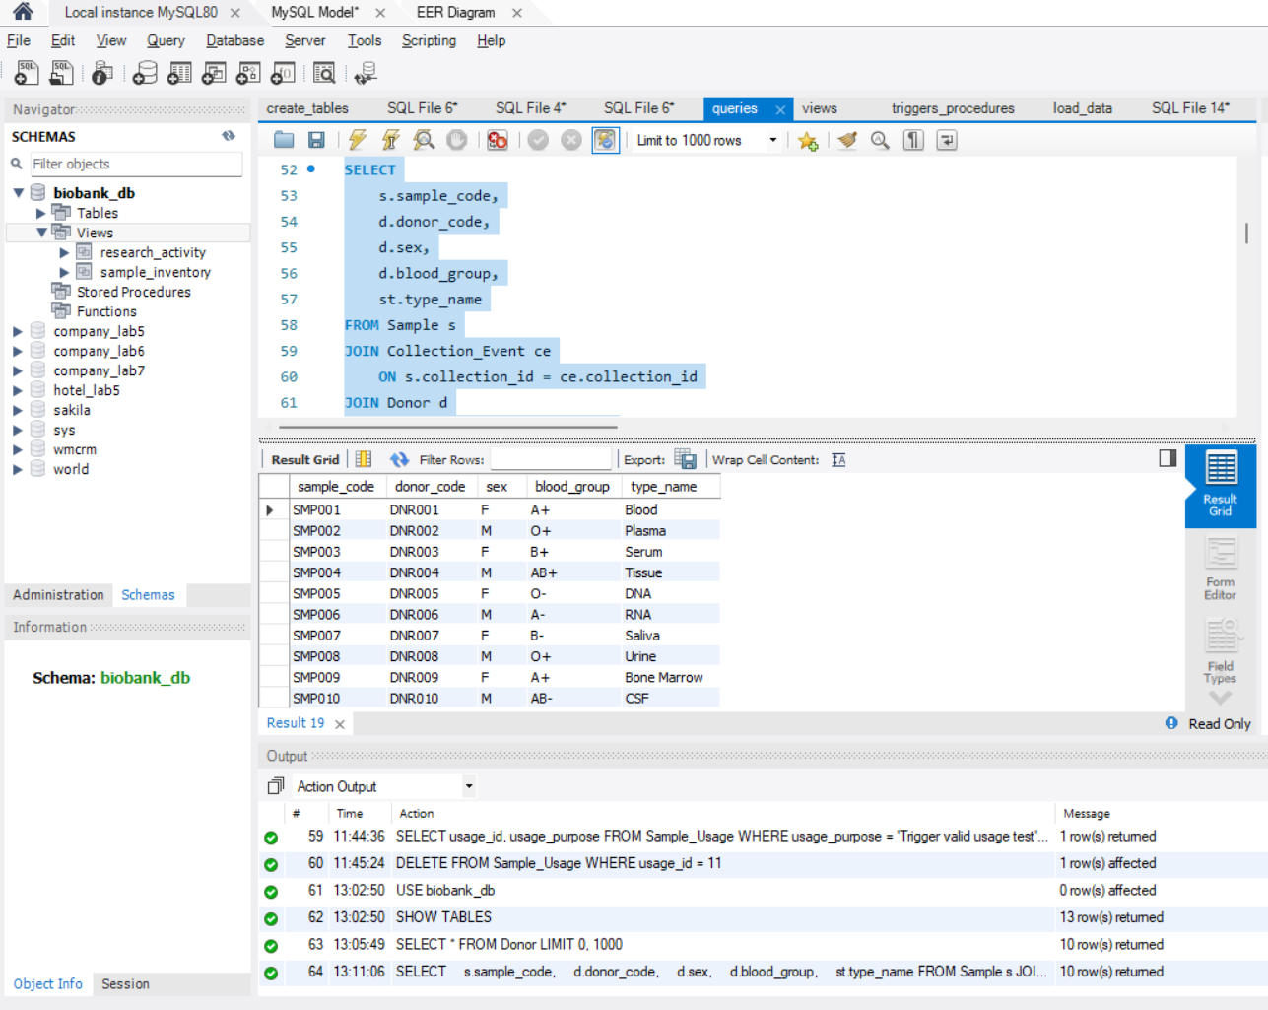
QUERYING
SQL Queries
SELECT
JOIN
Retrieval of donors by sex, blood group, or registration date
Combine Sample, Donor, and Sample_Type across tables
Aggregation
Subqueries
Count donors by blood group; average sample volume
Samples above average volume; researchers with approved requests
Plus tested INSERT, UPDATE, and DELETE operations
Multi-table JOIN — Sample, Collection_Event, and Donor combined
Biobank & Biospecimen Management System
8

Slide 9
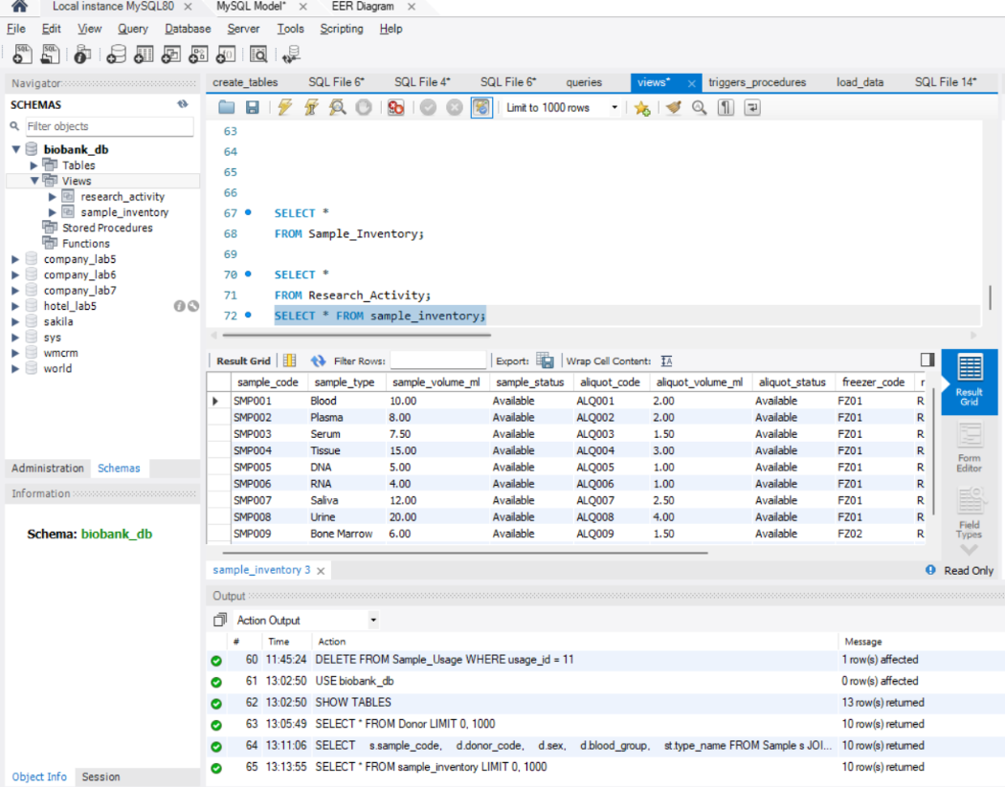
SIMPLIFYING ACCESS
Database Views
sample_inventory
Combines sample records with their current storage location for a single, ready-to-query inventory view.
research_activity
Summarizes researchers together with their sample requests and activity, avoiding repeated joins.
Successful execution of the sample_inventory view
Biobank & Biospecimen Management System
9

Slide 10
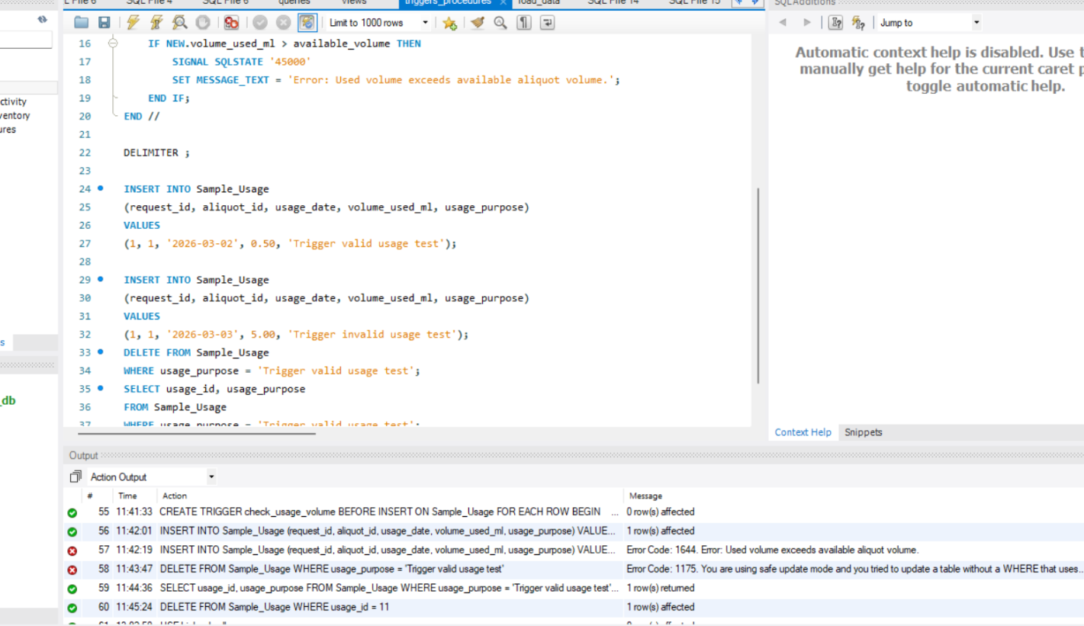
BUSINESS RULE ENFORCEMENT
Trigger — check_usage_volume
What it does
Fires BEFORE INSERT on Sample_Usage. It checks the requested volume_used_ml against the aliquot's available volume — if the request exceeds what's available, the insert is rejected with a clear error message.
VALID
INVALID
0.50 mL usage
inserted successfully
5.00 mL requested from a 2.00 mL aliquot — rejected
Error returned: "Used volume exceeds available aliquot volume."
Biobank & Biospecimen Management System
10

Slide 11
VERIFICATION
Testing & Results
Test | Action | Result
Valid usage | Insert 0.50 mL usage against available aliquot | Inserted successfully
Invalid usage | Insert 5.00 mL against a 2.00 mL aliquot | Rejected by trigger with error
Views | Query sample_inventory & research_activity | Correct combined results returned
Joins & aggregation | Multi-table joins, counts, averages | Executed successfully
Data modification | INSERT / UPDATE / DELETE operations | All applied and verified
Test
Action
Result
All business rules and SQL operations — queries, joins, aggregation, subqueries, views, and the trigger — were verified with real test data.
Biobank & Biospecimen Management System
11

Slide 12
CONCLUSION
A Complete Database Development Lifecycle
This project delivered a fully normalized (3NF) relational database of 11 tables for managing a biobank — from requirements and ER modeling through implementation, querying, views, a business-rule trigger, and full testing in MySQL.
Thank You
Questions & Live Database
Demonstration
11
3NF
2
1
Tables
Normalized
Views
Trigger
Limitation: focused on database management — no GUI is included in the core system (optional bonus scope).
Mohamed Rateb
Student ID: 231002599
Biobank & Biospecimen Management System
12

