Slide 1
Diabetes Diagnosis and Wine Review Data Analysis
CSSE 290 Machine Learning Summer Quarter
Bill Yu, Lory Wang
08/15/2019

Slide 2
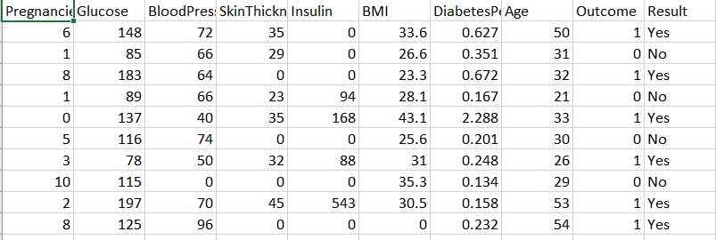
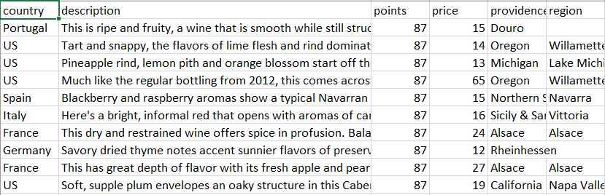
Two Sets of Data for Numerical and Textual Algorithm
Diabetes Diagnosis (Numerical)
Wine Review (textual)

Slide 3
Different Algorithms and Results
Diabetes.csv
Wine Review.csv
Lazy Learning Using KNN()
Accuracy ~ 68.5%
C5.0()
Accuracy ~ 74.4%
Decision Tree
Accuracy ~83.2%
Regression
Doesn’t apply to both data
Neural Network
Error: 0.95596
K-Clustering
BMI is an important factor
Naïve Bayes
Accuracy ~82.3%
Market Basket Analysis
interesting relationship between wine age and cigar flavor

Slide 4
Summary
Decision tree and C5.0 have the best result for numerical data
Naïve Bayes method is successful for textual data
Market Basket method shows interesting result

Slide 5
Thank you!

