Slide 1
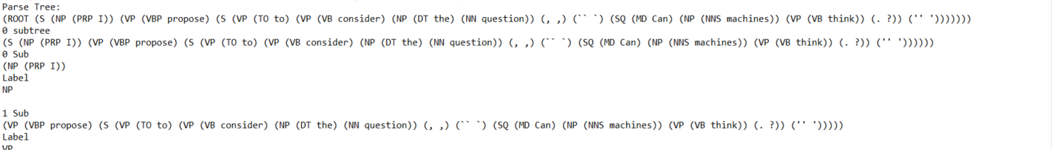
I propose to consider the question, 'Can machines think?'
Subject: I
Predicate: propose
Object: to consider the question

