Slide 1
Consensus on Replicated Logs
Assignments of Distributed System Course
Based on the Raft paper and Michael Freedman’s slides

Slide 2
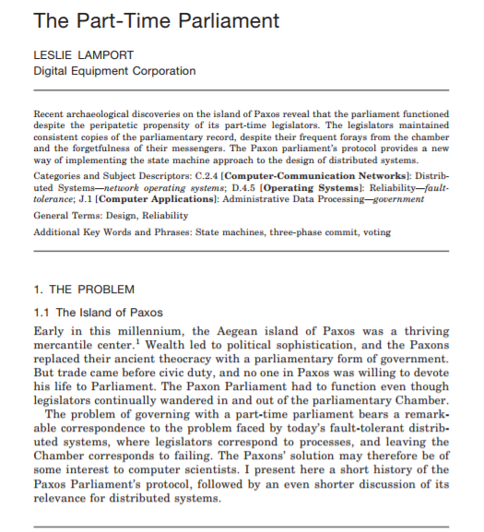
The Raft Paper
Diego Ongaro, John K. Ousterhout. In search of an understandable consensus algorithm. USENIX ATC 2014. [Best Paper Award]
Compared with Paxos

Slide 3

Goal: Replicated Log
Clients
shl
Consensus Module
State Machine
Consensus Module
State Machine
Consensus Module
State Machine
Servers
Log
Log
Log
add
jmp
mov
shl
add
jmp
mov
shl
add
jmp
mov
shl
Replicated log => replicated state machine
All servers execute same commands in same order
Consensus module ensures proper log replication

Slide 4
Raft Overview
Leader election
Normal operation (basic log replication)
Safety and consistency after leader changes
Neutralizing old leaders
Client interactions

Slide 5
Server States
At any given time, each server is either:
Leader: handles all client interactions, log replication
Follower: completely passive
Candidate: used to elect a new leader
Normal operation: 1 leader, N-1 followers
Follower
Candidate
Leader

Slide 6
Liveness Validation
Servers start as followers
Leaders send heartbeats (empty AppendEntries RPCs) to maintain authority
If electionTimeout elapses with no RPCs (100-500ms), follower assumes leader has crashed and starts new election
timeout, new election
timeout, start election
receive votes from majority of servers
start
Follower
Candidate
Leader
“step down”
discover server with higher term
discover current leader or higher term

Slide 7
Terms (aka epochs)
Term 1
Term 2
Term 3
Term 4
Term 5
time
Elections
Split Vote
Normal Operation
Time divided into terms
Election (either failed or resulted in 1 leader)
Normal operation under a single leader
Each server maintains current term value
Key role of terms: identify obsolete information

Slide 8
Elections
Start election:
Increment current term, change to candidate state, vote for self
Send RequestVote to all other servers, retry until either:
Receive votes from majority of servers:
Become leader
Send AppendEntries heartbeats to all other servers
Receive RPC from valid leader:
Return to follower state
No-one wins election (election timeout elapses):
Increment term, start new election

Slide 9
Elections
Safety: allow at most one winner per term
Each server votes only once per term (persists on disk)
Two different candidates can’t get majorities in same term
Liveness: some candidate must eventually win
Each choose election timeouts randomly in [T, 2T]
One usually initiates and wins election before others start
Works well if T >> network RTT
B can’t also get majority
Voted for candidate A
Servers
Notes:
分布式系统中需要有证明它有safety和liveness property: safefy指的是“坏事情不发生”；liveness指的是“好事情最终会发生”

Slide 10
Log Structure
term
1
2
3
4
5
6
7
8
log index
1 add
1 cmp
1 ret
2 mov
3 jmp
3 div
3 shl
3 sub
leader
command
1 add
1 cmp
1 ret
2 mov
3 jmp
1 add
1 cmp
1 ret
2 mov
3 jmp
3 div
3 shl
3 sub
followers
1 add
1 cmp
1 add
1 cmp
1 ret
2 mov
3 jmp
3 div
3 shl
committed entries
Log entry = < index, term, command >
Log stored on stable storage (disk); survives crashes
Entry committed if known to be stored on majority of servers
Durable / stable, will eventually be executed by state machines

Slide 11
Normal operation
shl
Consensus Module
State Machine
Consensus Module
State Machine
Consensus Module
State Machine
Log
Log
Log
add
jmp
mov
shl
add
jmp
mov
shl
add
jmp
mov
shl
Client sends command to leader
Leader appends command to its log
Leader sends AppendEntries RPCs to followers
Once new entry committed:
Leader passes command to its state machine, sends result to client
Leader piggybacks commitment to followers in later AppendEntries
Followers pass committed commands to their state machines

Slide 12
Normal operation
shl
Consensus Module
State Machine
Consensus Module
State Machine
Consensus Module
State Machine
Log
Log
Log
add
jmp
mov
shl
add
jmp
mov
shl
add
jmp
mov
shl
Crashed / slow followers?
Leader retries RPCs until they succeed
Performance is optimal in common case:
One successful RPC to any majority of servers

Slide 13
Log Operation: Consistency Check
1
2
3
4
5
leader
1 add
1 cmp
1 ret
2 mov
3 jmp
AppendEntries succeeds:
matching entry
follower
1 add
1 cmp
1 ret
2 mov
leader
1 add
1 cmp
1 ret
2 mov
3 jmp
AppendEntries fails:
mismatch
follower
1 add
1 cmp
1 ret
1 shl
AppendEntries has <index, term> of entry preceding new ones
Follower must contain matching entry; otherwise it rejects
Implements an induction step, ensures coherency

Slide 14
Safety Requirement
Once log entry applied to a state machine, no other state machine must apply a different value for that log entry
Raft safety property: If leader has decided log entry is committed, entry will be present in logs of all future leaders
Why does this guarantee higher-level goal?
Leaders never overwrite entries in their logs
Only entries in leader’s log can be committed
Entries must be committed before applying to state machine
Committed → Present in future leaders’ logs
Restrictions on commitment
Restrictions on leader election

Slide 15
Picking the Best Leader
1
2
3
4
5
s₁
1
1
1
2
2
Committed?
Can’t tell which entries committed!
s₂
1
1
1
2
1
1
1
2
2
Unavailable during leader transition
Elect candidate most likely to contain all committed entries
In RequestVote, candidates incl. index + term of last log entry
Voter V denies vote if its log is “more complete”: (newer term) or (entry in higher index of same term)
Leader will have “most complete” log among electing majority

Slide 16
Repairing Follower Logs
nextIndex
1
2
3
4
5
6
7
8
9
10
11
12
Leader for term 7
1
1
1
4
4
5
5
6
6
6
(a)
1
1
1
4
Followers
(b)
1
1
1
2
2
2
3
3
3
3
3
New leader must make follower logs consistent with its own
Delete extraneous entries
Fill in missing entries
Leader keeps nextIndex for each follower:
Index of next log entry to send to that follower
Initialized to (1 + leader’s last index)
If AppendEntries consistency check fails, decrement nextIndex, try again

Slide 17
Repairing Follower Logs
nextIndex
1
2
3
4
5
6
7
8
9
10
11
12
Leader for term 7
1
1
1
4
4
5
5
6
6
6
(a)
1
1
1
4
Before repair
(f)
1
1
1
2
2
2
3
3
3
3
3
After repair
(f)
1
1
1
4

Slide 18
Neutralizing Old Leaders
Leader temporarily disconnected
→ other servers elect new leader
→ old leader reconnected
→ old leader attempts to commit log entries
Terms used to detect stale leaders (and candidates)
Every RPC contains term of sender
Sender’s term < receiver:
Receiver: Rejects RPC (via ACK which sender processes…)
Receiver’s term < sender:
Receiver reverts to follower, updates term, processes RPC
Election updates terms of majority of servers
Deposed server cannot commit new log entries

Slide 19
Client Protocol
Send commands to leader
If leader unknown, contact any server, which redirects client to leader
Leader only responds after command logged, committed, and executed by leader
If request times out (e.g., leader crashes):
Client reissues command to new leader (after possible redirect)
Ensure exactly-once semantics even with leader failures
E.g., Leader can execute command then crash before responding
Client should embed unique ID in each command
This client ID included in log entry
Before accepting request, leader checks log for entry with same id

Slide 20
Assignment Setup
Programming in Go
We will do all of our assignments in Go, a language developed at Google, but now part of an open source project.
We believe that Go is an especially suitable language for writing distributed systems for the following reasons:
The language is type-safe and garbage collected, avoiding many of the pitfalls of lower-level languages, such as C and C++.
Many useful data structures are built into the language, such as resizable arrays and dictionaries.
There is a large collection of packages providing access to useful system resources.
Go supports a model of concurrency that is cleaner and more abstract than traditional mechanisms, such as Pthreads and Java threads.

Slide 21
Assignment Setup
Go installation
You need the Go environment for the assignments. The version should be at least Go 1.5.
There are instructions to install: golang.org
Tools
Three useful tools in the Go ecosystem: Go fmt (https://golang.org/cmd/gofmt/) , Go vet (https://golang.org/cmd/vet ), and Golint (https://github.com/golang/lint ).
Go tutorial
https://tour.golang.org , go through it!

Slide 22
Assignment Setup
Resources
Raft paper
Conference version: https://www.usenix.org/system/files/conference/atc14/atc14-paper-ongaro.pdf
Full version: https://raft.github.io/raft.pdf
illustrated Raft guide: http://thesecretlivesofdata.com/raft/
Software
https://github.com/Zhang-Xiaoda/NJU-DisSys-2017
Focus primary on the code and tests for the Raft implementation in src/raft and simple RPC-like system in src/labrpc, (read the code in these packages first)

Slide 23
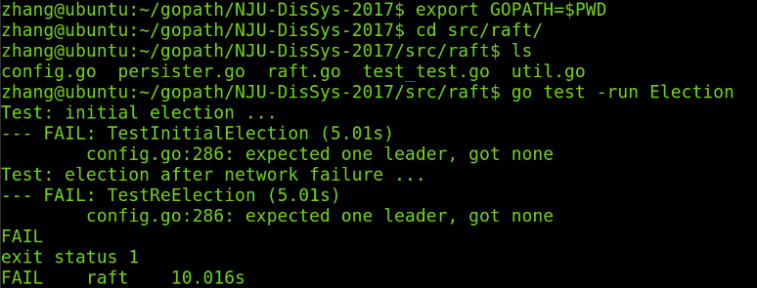
Assignment Part I
At the beginning:
Implement Raft by adding code to raft/raft.go (only)
find some example code of how to send and receive RPC
Your task: Leader election:
First task is to fill the RequestVoteArgs and RequestVoteReply structs

Slide 24
Assignment Part I
Modify Make() to create a background goroutine that starts an election by sending out RequestVote RPC when it hasn’t heard from another peer for a while
You need to implement RequestVote RPC handler so that servers will vote for one another
To implement heartbeats, you will need to define AppendEntries struct (though you will not need any real payload yet), and have the leader send them out periodically
Also need to implement AppendEntries RPC handler
make sure the election timeouts don't always fire at the same time

Slide 25
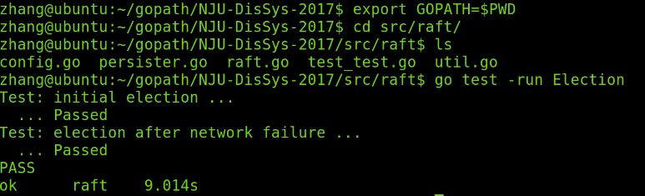
Assignment Part I
At the end:
Advice:
Remember field names of any structures you will be sending over RPC must start with capital letters
Read and understand the paper before you start. Figure 2 in the paper may provide a good guideline.
Start early!

Slide 26
Assignment Part II
Software as the above
Your task in this part:
Implement the leader and follower code to append new log entries
implementing Start(), completing the AppendEntries RPC structs, sending them, and completing the AppendEntry RPC handler
pass the TestBasicAgree() test, try to pass all test before “Persist”

Slide 27
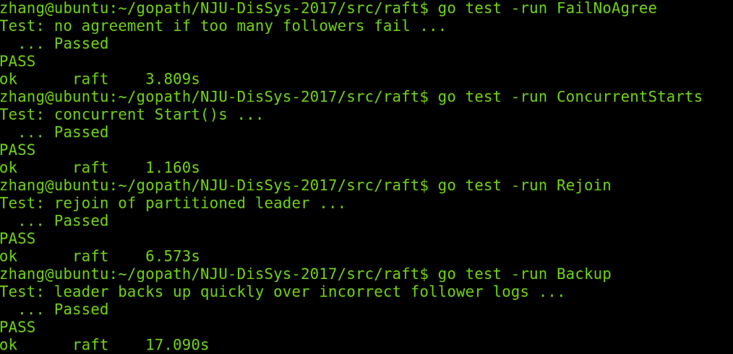
Assignment Part II
The results should be like follows:

Slide 28
Assignment Part III (Optional)
This part is optional. There are bonus points for completing this part, and no point will be deducted if it is not completed.
Handle the fault tolerant aspects of the Raft protocol
require that Raft keep persistent state that survives a reboot (see Figure 2 for which states should be persistent)
won't use the disk; instead, it will save and restore persistent state from a Persister (see persister.go)
initialize its state from that Persister, and should use it to save its persistent state each time the state changes.
You should determine at what points in the Raft protocol your servers are required to persist their state, and insert calls to persist() in those places

Slide 29
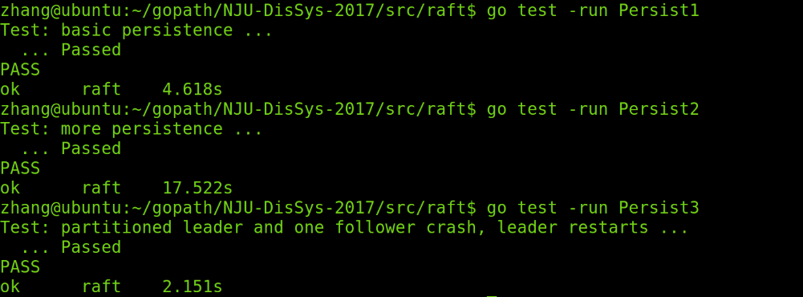
Assignment Part III (Optional)
Pass the Persist test:
Try to pass the further challenging tests towards the end
need to implement the optimization to allow a follower to back up the leader's nextIndex by more than one entry at a time

Slide 30
作业说明
1）邮件标题格式
DZ/MG/MF123WXYZ+姓名+DisEX
2）附件格式
报告为pdf，代码rar（报告与代码不必打包）
文件名： DZ/MG/MF123WXYZ +姓名+DisEX
3）报告内容与格式
详细说明如何达到目标：简述分析与设计、实现演示、总结；
4）杜绝任何形式的代码拷贝与报告抄袭，遵循学术规范。
5）作业占总成绩30分，其中第一部分20分，第二部分10分。第三部分选做，最多10分的加分计入总评。
6）格式要求
未按照1、2、3中格式要求的，每项扣2分；
未遵守4的，取消本课程成绩。

Slide 31
作业说明
7）提交邮箱：nju_dissys@126.com
8）截止日期：2020.12.30 23:59:59

