Slide 1
2023 Convergent Capstone Design
Untact Order and Waiting System
Using QR code
201820962 JONGGUK KIM
201820925 DAEMIN KIM

Slide 2
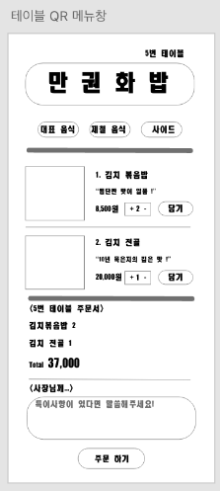
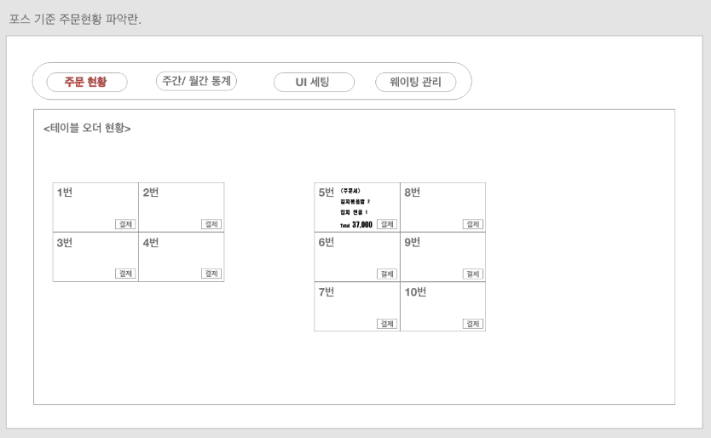


Toy project goal
“Client can order and owner can check a menu on webpage.”

Slide 3



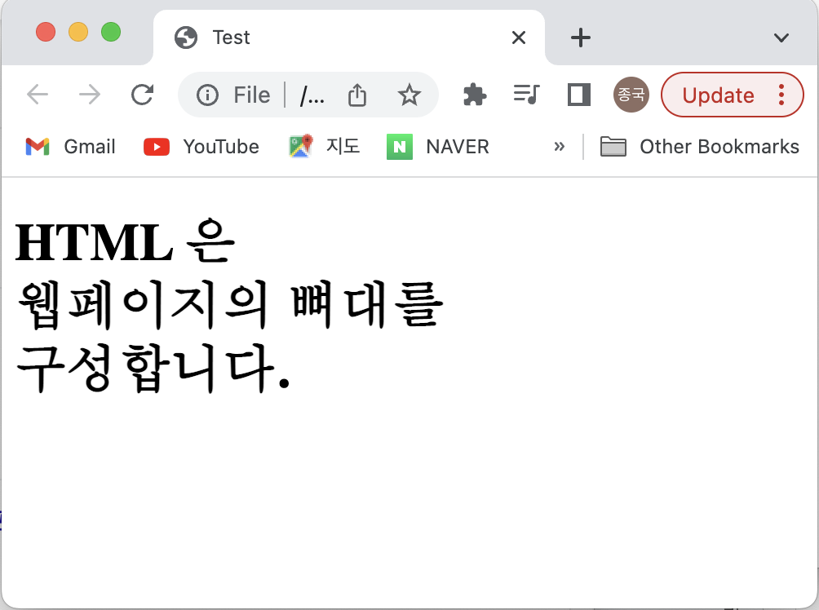
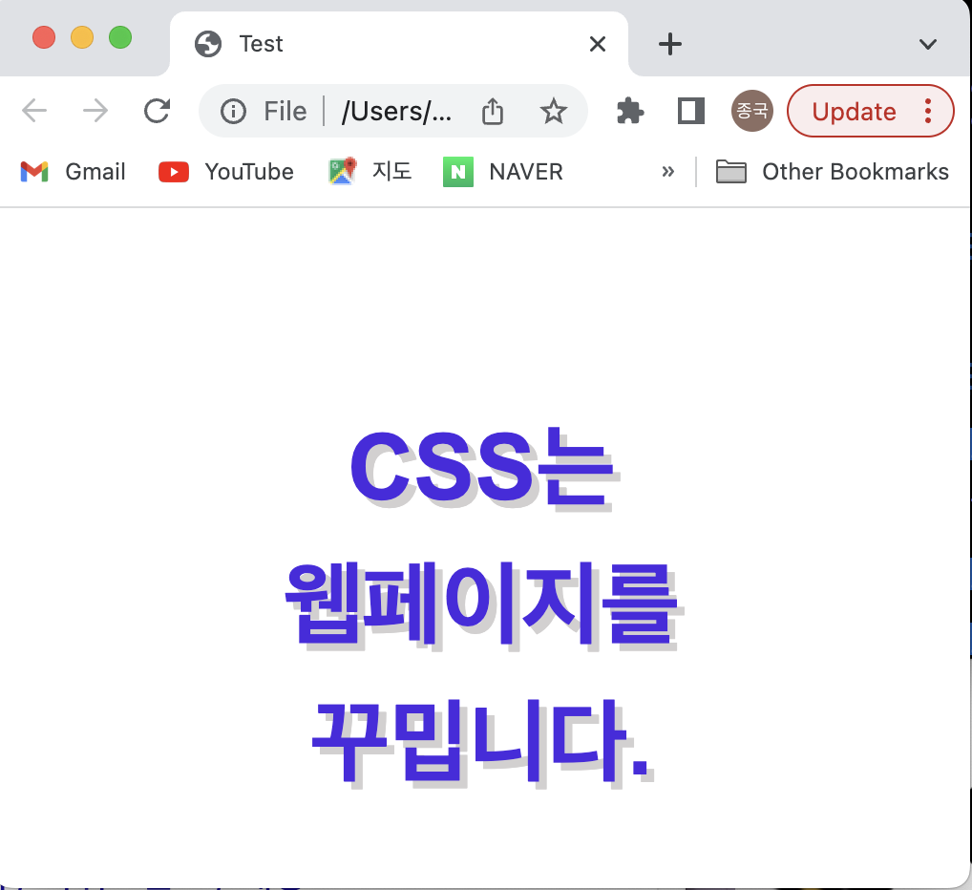
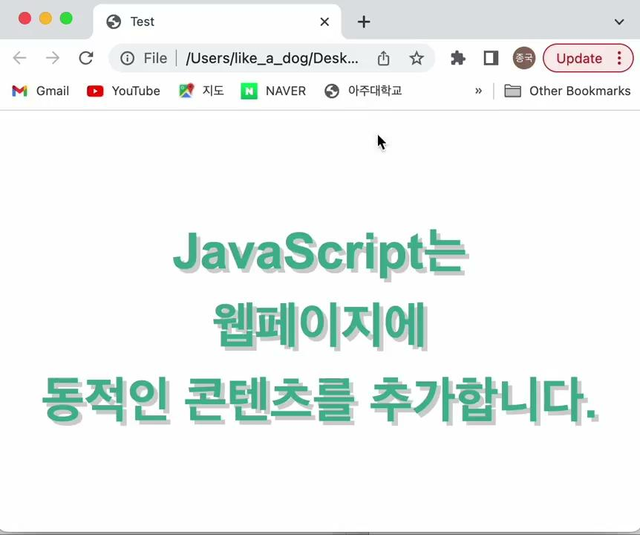

Slide 4

: JavaScript library for building user interfaces, Not framework
Why many developers choose React ?
1. Readability and maintainability
2. Virtual-DOM

Slide 5
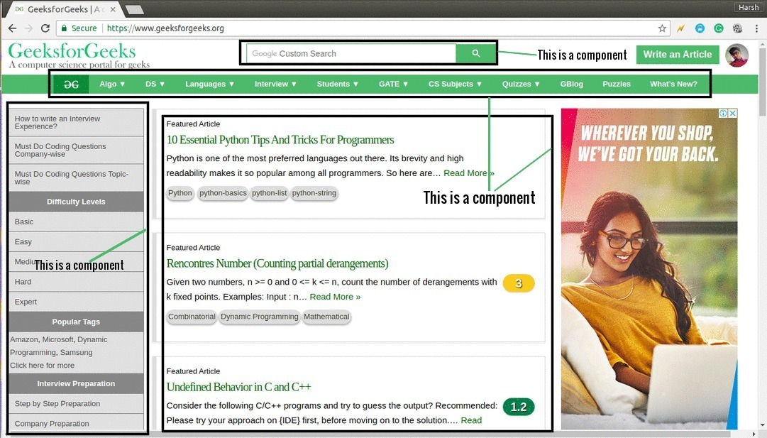
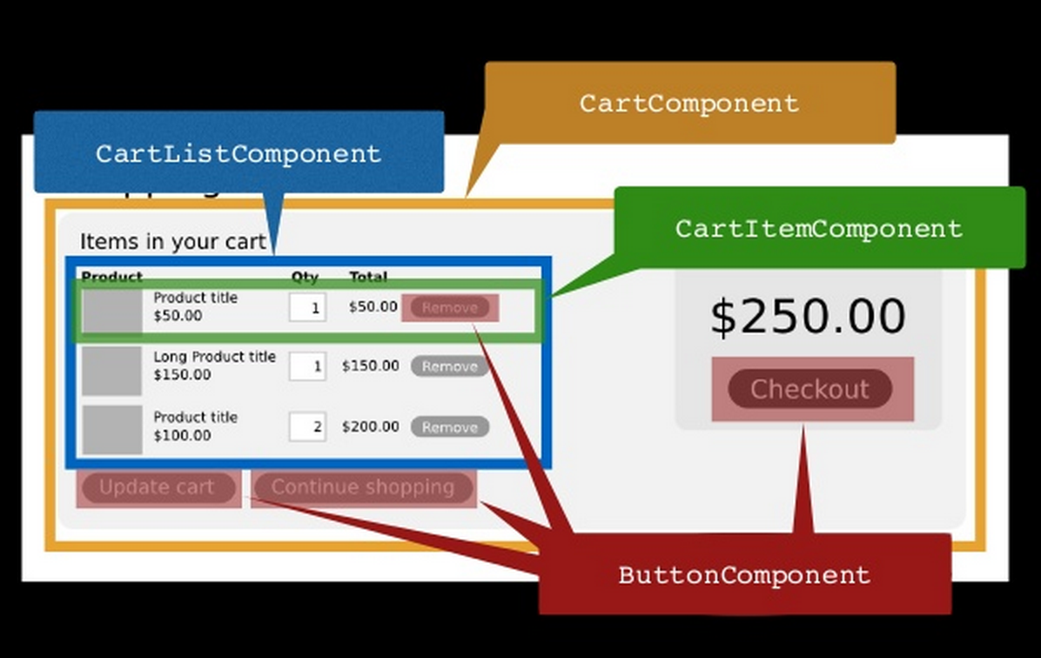
What is component?
Component
: independent and reusable piece of code that represents a part of a user interface.

Slide 6
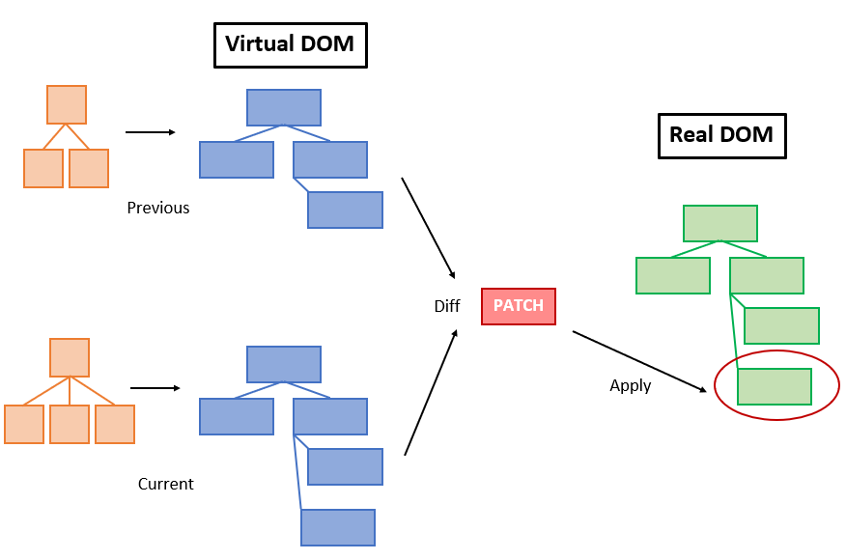
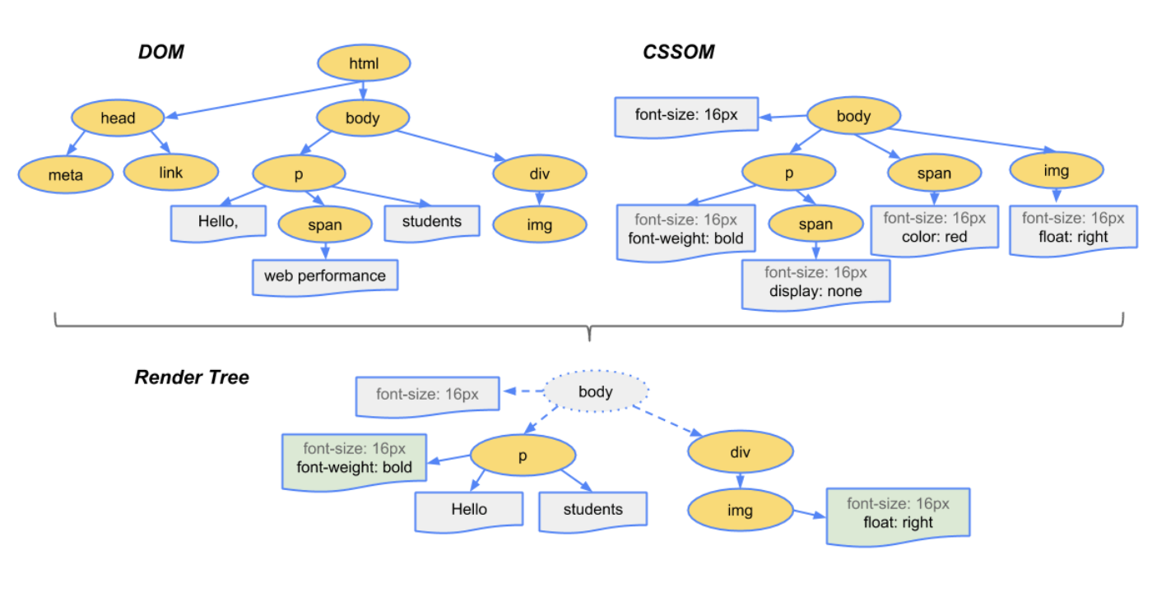
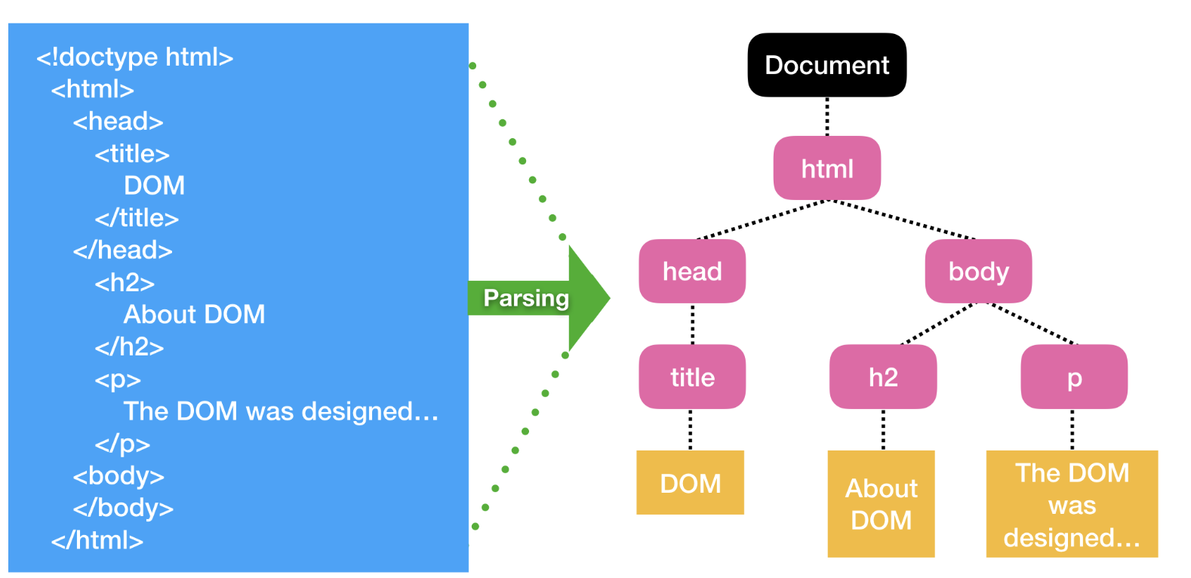
What is virtual-DOM?
Virtual-DOM
: Lightweight copy of the actual DOM(Document Object Model) of a web page.

Slide 7
Why Spring?
AOP(Aspect-Oriented Programming) : The function can be separated and managed by multiple modules. So, Spring calls the codes you made if it needs.
Inversion of Control(IoC) : The control is in the framework, not the user.
DI(Dependency Injection) : When a dependent object is needed in a certain object, Spring directly injects it. So, an object don’t need to make its own dependent object what it needs.

Slide 8
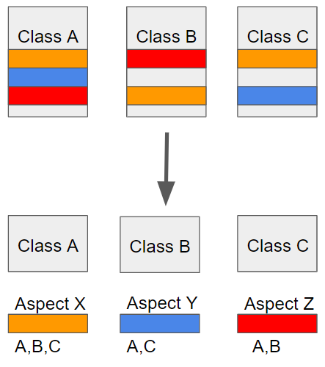
Why Spring?
AOP(Aspect-Oriented Programming) : The function can be separated and managed by multiple modules. So, Spring calls the codes you made if it needs.

Slide 9
Why Spring?
Inversion of Control(IoC) : The control is in the framework, not the user.
@Service
public class TestService {
TestRepository testRepository = new TestRepository();
}
@Repository
public class TestRepository {
}

Slide 10
Why Spring?
Inversion of Control(IoC) : The control is in the framework, not the user.
@Service
public class TestService {
TestRepository testRepository;
@Autowired
public TestService(TestRepository testRepository){
this.testRepository = testRepository;
}
}
@Repository
public class TestRepository {
}

Slide 11
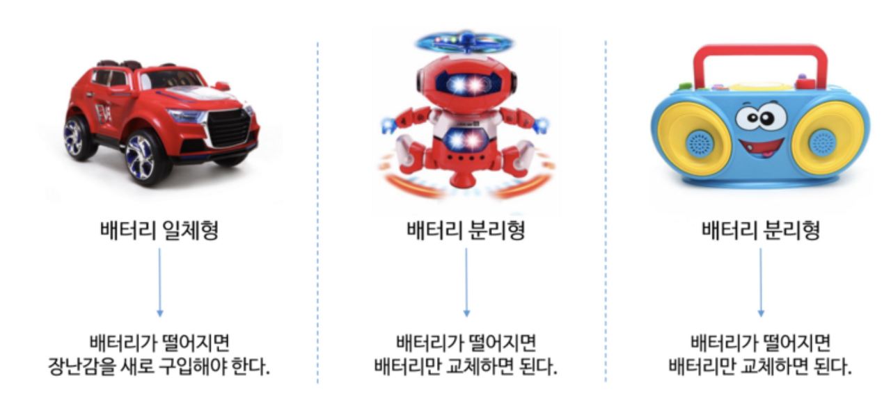
Why Spring?
DI(Dependency Injection) : When a dependent object is needed in a certain object, Spring directly injects it. So, an object don’t need to make its own dependent object what it needs.

Slide 12
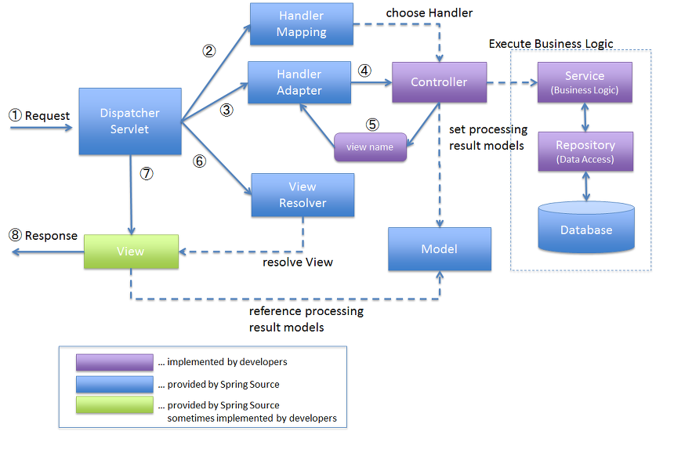
Spring MVC?

Slide 13
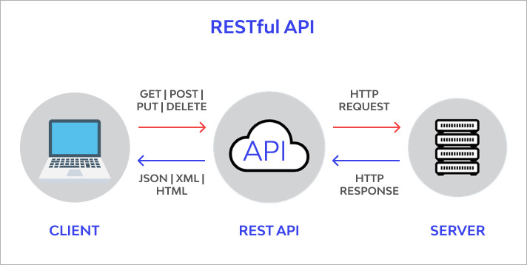
Use API!

Slide 14
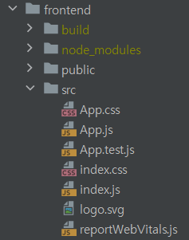


What we did

Slide 15

What we did

Slide 16
Current Problem (Next Task)
Build error in React
Where is the problem?? << This problem demands too much time.
Is it React problem?
Is it a method problem?
Is it a library problem?
Is it a version problem?
…
Is it Spring problem?
Is it a dependency problem?
Is it a version problem?
It is a library problem?
…

