Slide 1
2023 Convergent Capstone Design
Untact Order and Waiting System
Using QR code
201820962 JONGGUK KIM
201820925 DAEMIN KIM

Slide 2
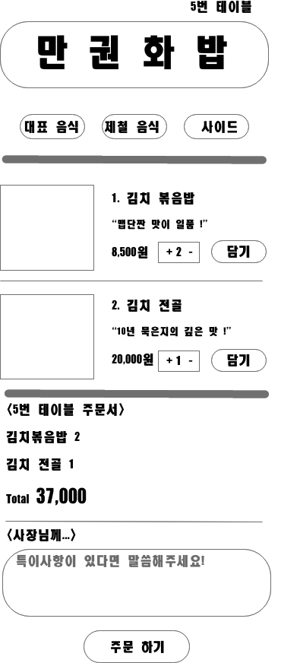
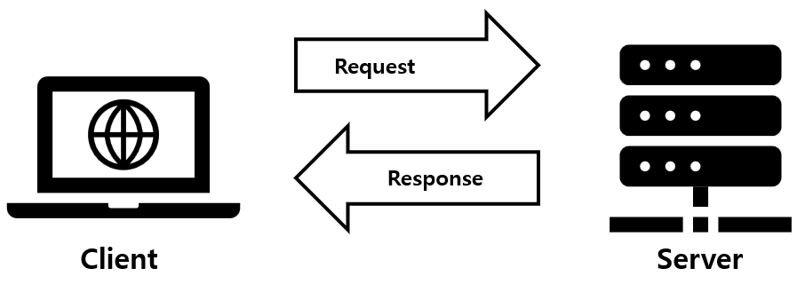
Development Goal
“Let’s make a menu board”
Toy project (~3.23)
Client - Client can see the menu on web
Owner - Owner can edit the menu on web
First Collaboration

Slide 3



Development process : Front-end
HTML : A markup language that describes the structure and content of web pages
CSS : A style sheet language that specifies the style and
layout of web pages.
JavaScript : A scripting language for adding interactivity
to web pages.

Slide 4
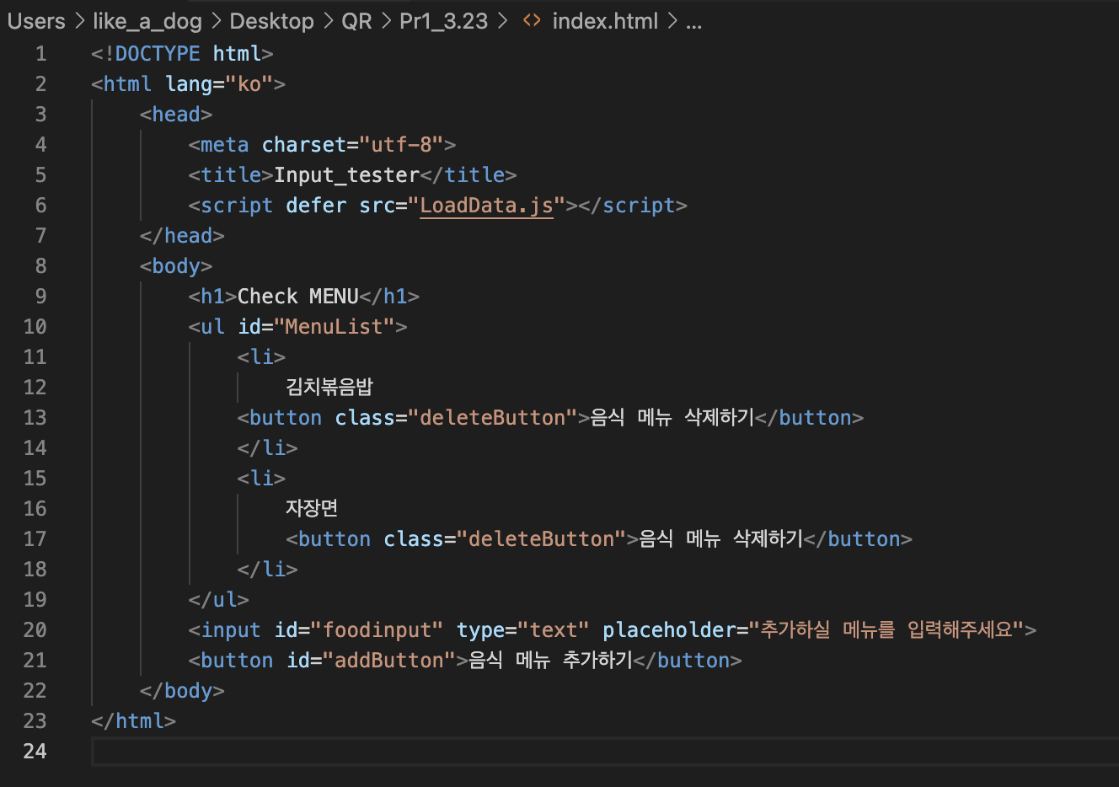
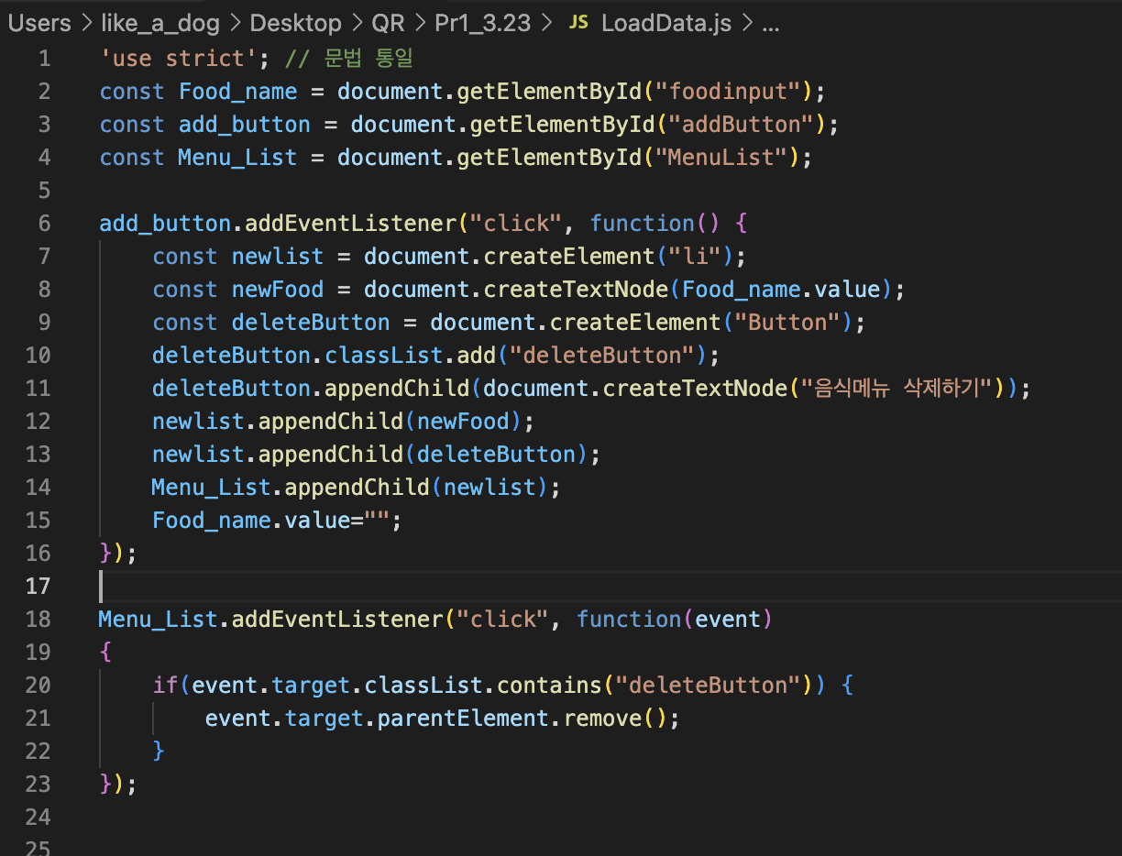
Code
HTML JavaScrpt

Slide 5
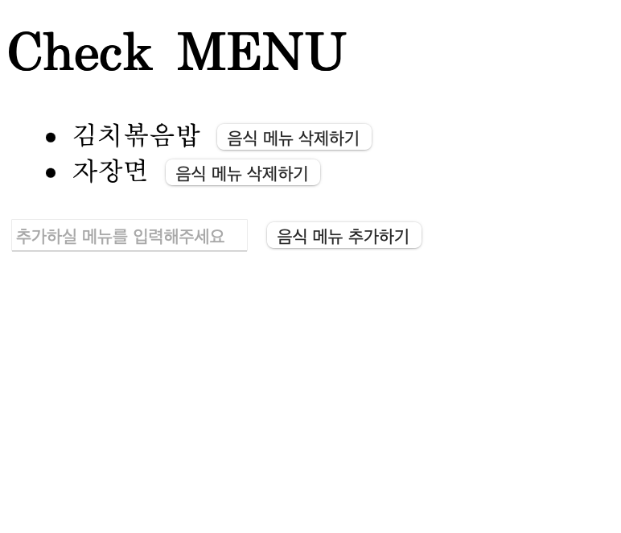
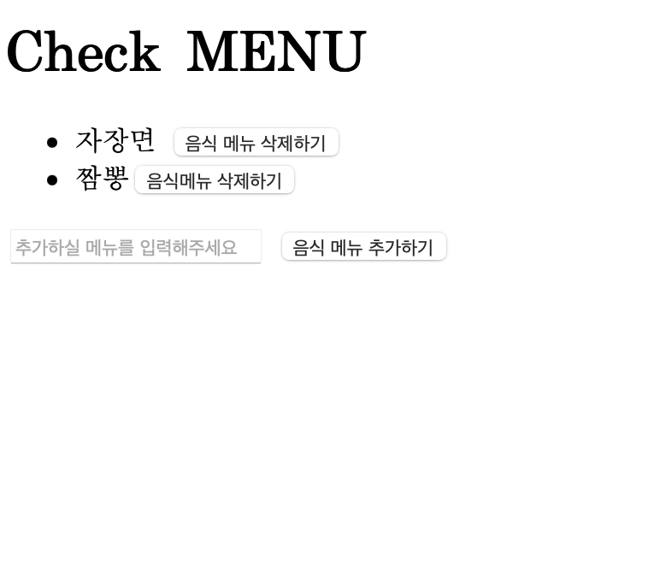
Practice
Before After

Slide 6


Development process : Back-end
JAVA : optimized for object-oriented programming.
Spring : Light Weight, Quick and Safe Development Environment

Slide 7
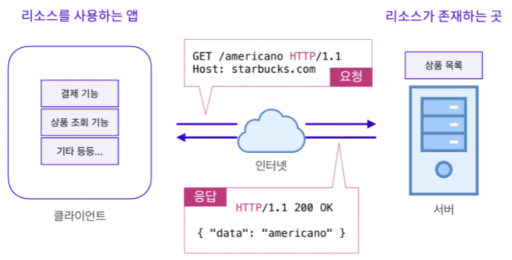


Slide 8
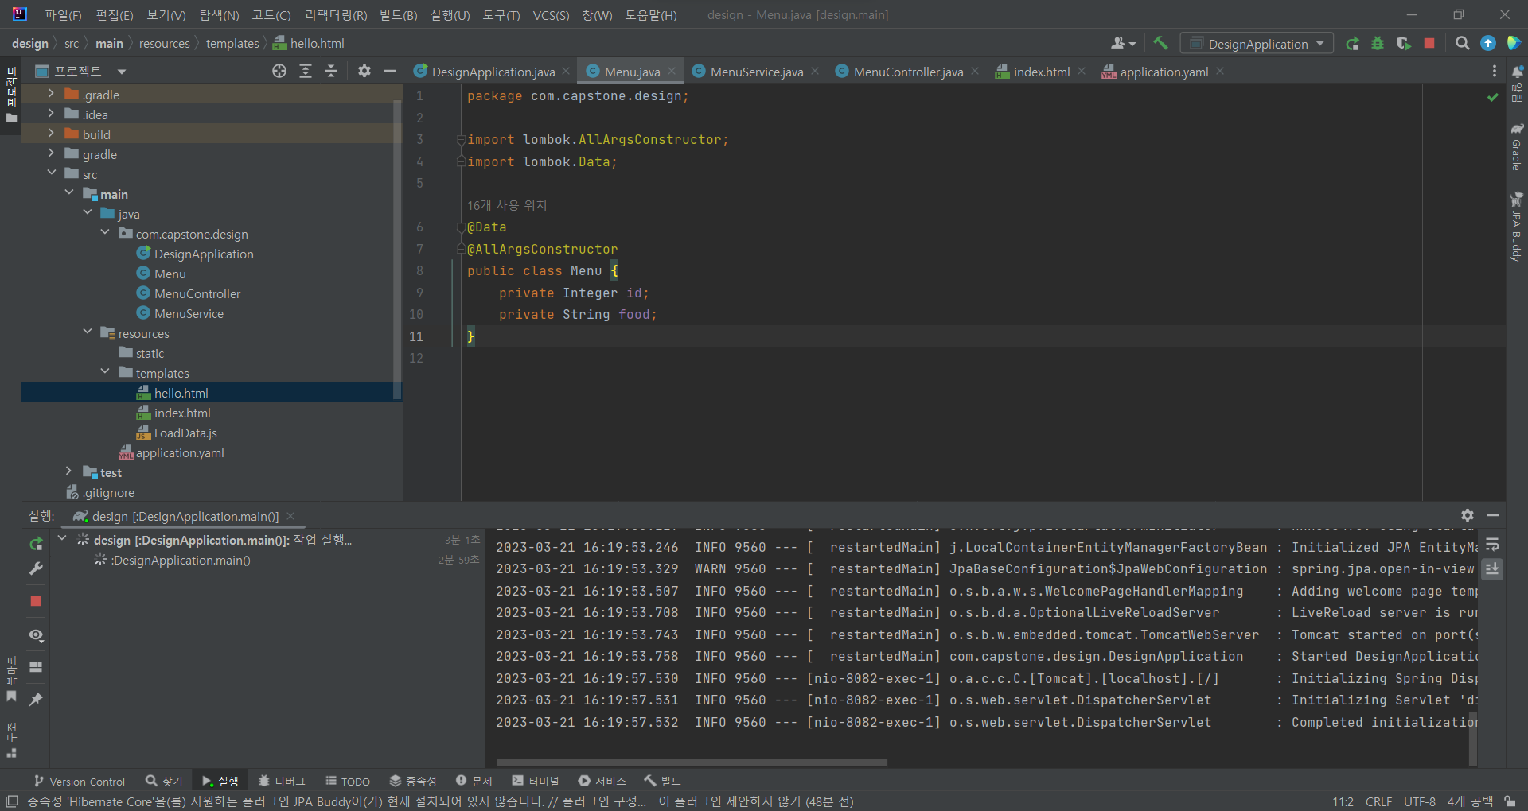
WorkSpace

Slide 9
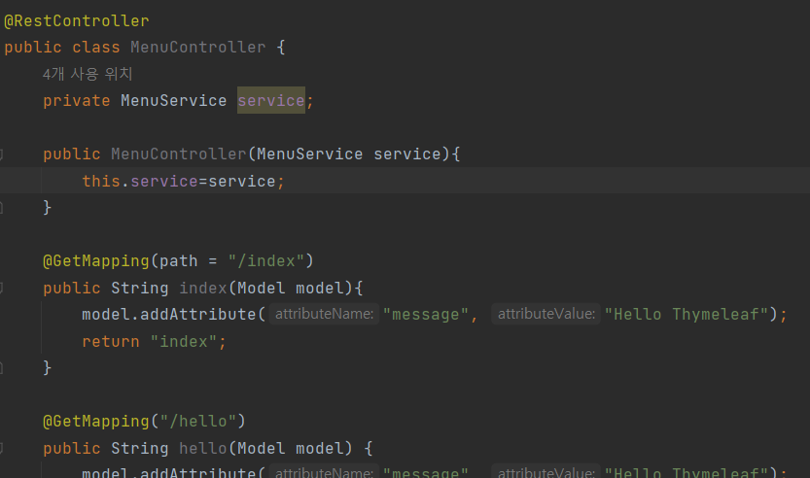
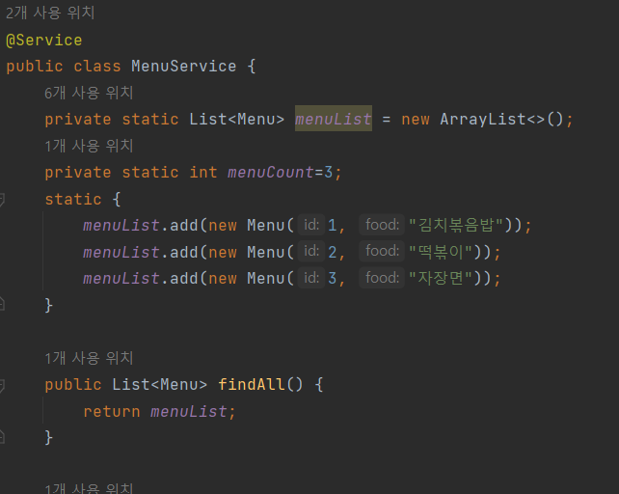
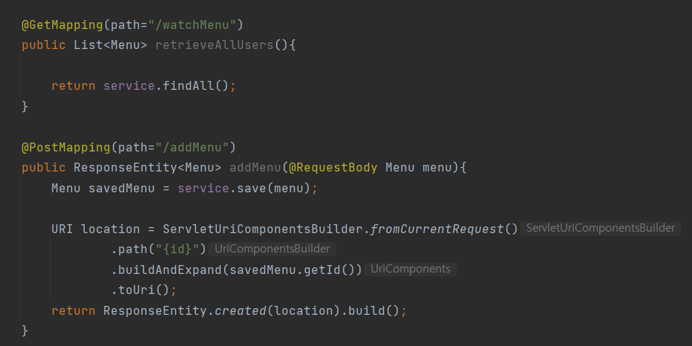
Code

Slide 10
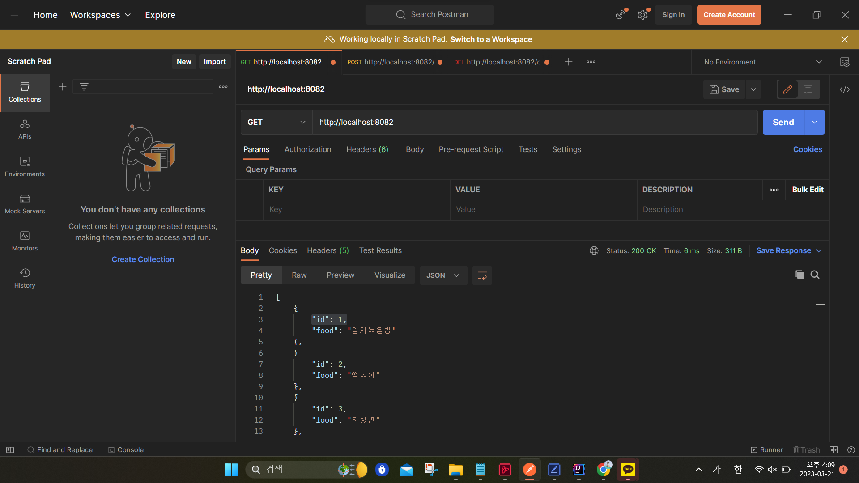
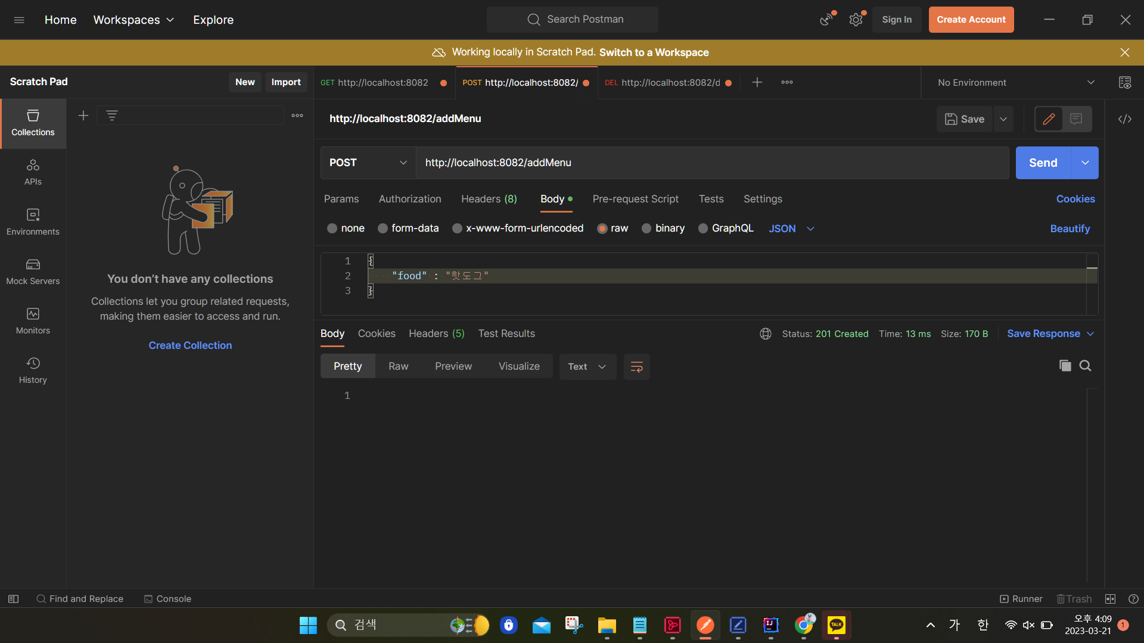
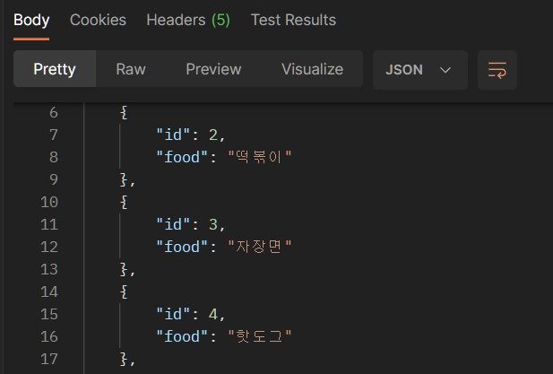
Practice

Slide 11
Development Limits
1. Low proficiency (ex. React, Spring ...)
2. lack of experience
First collaboration in front-end and back-end development

