Slide 1

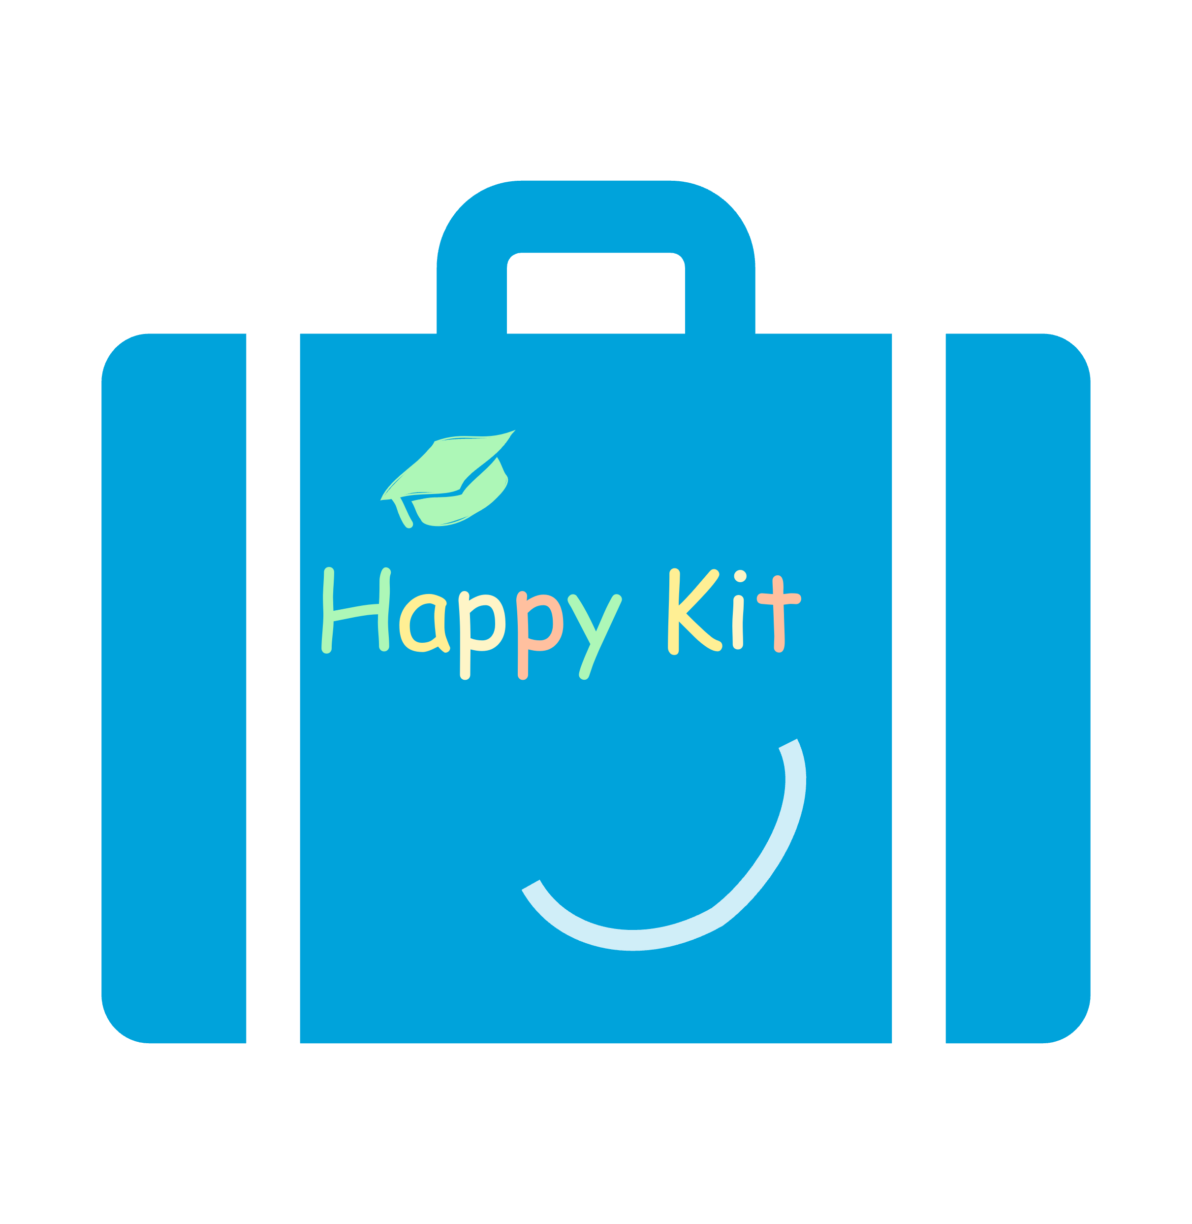

Best Possible Self: Vision of an ideal future
Instruction:
Ideal vision of the future (approx. 5 minutes): Create a positive vision of the future in which everything has gone well or ideally at the end of your studies and you start your career with an ideal job. Use the prompt questions in the reflection portfolio to help you.
Link to course content (approx. 5 minutes): Then note down how the course content contributes to achieving your vision of the future or how it can be applied in your ideal future.
Concrete steps (approx. 5 minutes): Formulate concrete steps that will bring you closer to your ideal vision of the future, also with regard to the course.
This material was developed as part of the Happy Kit project. The project was funded from October 2024 to October 2026 through internal quality improvement funds for academic programs and teaching at Ruhr West University of Applied Sciences.
Notes:
“I would like to go through another tool from the Happy Kit with you. Today, we will be doing the ”Best Possible Self" exercise, which will take about 15 minutes. This is a reflection task that you will do individually and do not need to share with anyone. The exercise is divided into three parts: In the first part, you create a positive vision of the future for yourself and imagine how everything will have gone well at the end of your studies. You can use the prompt questions in the reflection portfolio for this. Roughly speaking, think about what you are like, what you have achieved, what skills/knowledge you have acquired if your studies are going ideally, and perhaps also what your ideal professional future looks like.
In the second part, consider how the content of this course will help you achieve your ideal vision of the future or how the course content can be applied to your vision of the future. What do you need to achieve your ideal vision of the future? Which content is particularly relevant to you?
In the third part, formulate concrete steps in relation to your vision for the future and how you can get closer to it. Which course content do you want to focus on in particular? How do you want to learn throughout the semester in order to achieve the desired skills at the end?
You will now find the reflection portfolio in our Moodle course, which you can download and fill out. Have fun!

