Slide 1

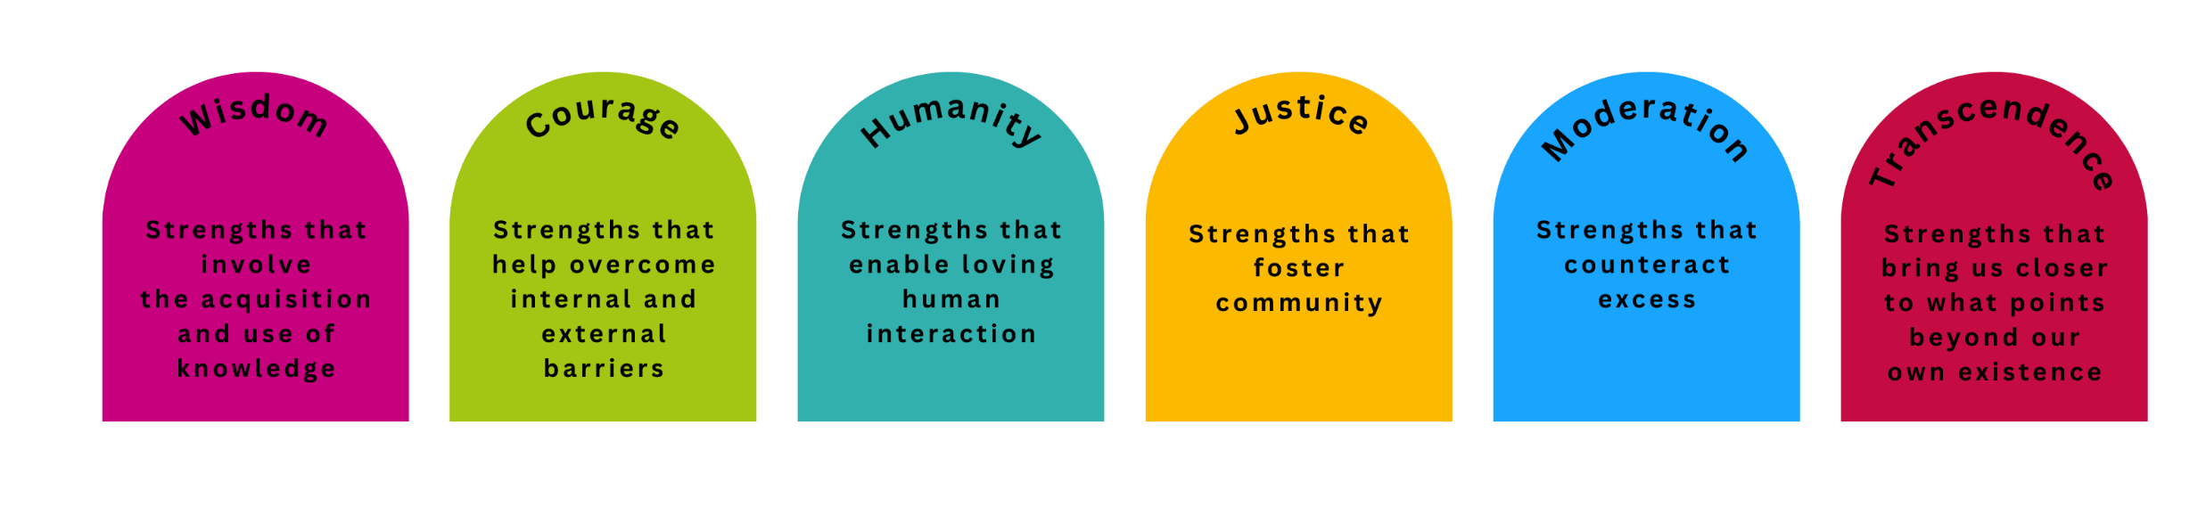


Character Strengths
A definition of terms:
Character strengths are relatively stable positive traits that form the core of our being, are personally fulfilling and energizing, are valued across cultures, and do not diminish others.
Identifying and applying these strengths is associated with a higher level of subjective well-being.
There are 24 character strengths grouped into 6 virtues:
This material was developed as part of the Happy Kit project. The project was funded from October 2024 to October 2026 through internal quality improvement funds for academic programs and teaching at Ruhr West University of Applied Sciences.
Notes:
"With the help of this tool, you can explore your character strengths and learn something about yourself. To explain:
Character strengths are relatively stable positive traits that form the core of our being, are personally fulfilling and energizing, are valued across cultures, and do not diminish other people.
Identifying and applying these traits is associated with a higher level of subjective well-being.
Scientific research in the field of positive psychology has identified 24 character strengths and summarized them into 6 virtues, which you can see listed in the figure below.
The top five strengths are considered signature strengths, i.e., those that are particularly pronounced
To learn about your character strengths, you need to complete a questionnaire, and you will find instructions on the next slides.

Slide 2
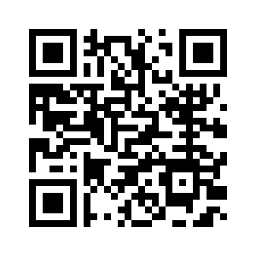
Character Strengths
Instruction:
Registration: Go to https://www.viacharacter.org/account/register or scan the QR-Code and register to take the test. Select “English” under Language to get the English version of the test.
Selecting the test: After successfully registering, you will be taken to your dashboard. Click on “Take the Survey” at the top right or center left and select the VIA Adult Survey (on the right-hand side).
This material was developed as part of the Happy Kit project. The project was funded from October 2024 to October 2026 through internal quality improvement funds for academic programs and teaching at Ruhr West University of Applied Sciences.
Notes:
„Here is a brief guide on how to proceed. Go to the website provided here. You must register in order to take the test. Then select the VIA Adult Survey and complete it.”
[continues on the next slide]

Slide 3
Character Strengths
Instruction:
Test administration (approx. 10 minutes): Take your time to answer the items honestly. Once completed, your Top Strengths will be displayed immediately. Scroll down to get your Free Results. Click on “Access Now” to see your 5 Top Strengths, Middle Strengths, and Lesser Strengths.
Reflection (approx. 10 minutes): After you have received your results, reflect on them using the questions in the reflection portfolio.
This material was developed as part of the Happy Kit project. The project was funded from October 2024 to October 2026 through internal quality improvement funds for academic programs and teaching at Ruhr West University of Applied Sciences.
Notes:
“The test takes about 10 minutes and provides you with information about your character and five signature strengths, i.e., those that are particularly pronounced. Once you have received the results, save them and continue working with the reflection portfolio for about 10 more minutes. You are invited to think about how you can use your signature strengths in a university context to increase your energy, motivation, and well-being here as well. If you like, you are welcome to share your thoughts with the group afterwards!"

