Slide 1
Databricks Intro
Train models in C#. Deploy at scale in Spark. Without rewriting your data pipeline.
+ AiDotNet → ONNX integration
Internal team training
Backend devs · 60-90 min · v1 2026

Slide 2
A · Why we're here
2 / 22
Your stack is .NET. Your data is in Databricks.
How do you ship a model trained in C# to a cluster that runs Python on JVM?
Today (without this session)
After this session
• Train in .NET • Hit a wall when ops asks where the model runs • Rewrite preprocessing in Python • Rewrite the model in PyTorch / TensorFlow • Hope it scores the same as the .NET original • Ship months late
• Train in .NET (unchanged) • AiDotNet → .onnx file (one method call) • Upload .onnx to Databricks • Load + score in a notebook (today's demo) • Spark scales it across millions of rows • Ship this week
Databricks intro + AiDotNet → ONNX · internal team session

Slide 3
A · Why we're here
3 / 22
By the end of this session you'll be able to:
1
Sign up for Databricks Free Edition
5-minute signup, no credit card
2
Navigate the workspace
find Catalog, Compute, Workflows, Experiments
3
Import a notebook
Workspace → Import (model + data embedded)
4
Run a notebook end-to-end
%pip install + Spark + pandas_udf + MLflow
5
Score an ONNX model at Spark scale
the headline demo
6
Know what comes next
Workflows, MLflow Registry, Unity Catalog
Databricks intro + AiDotNet → ONNX · internal team session

Slide 4
B · What is Databricks?
4 / 22
One-sentence answer
"Databricks is a managed workspace that runs Spark + Delta + MLflow."
Translation: • Spark — the engine that splits computation across a cluster • Delta — the storage format that makes a cloud bucket act like a database • MLflow — the model-lifecycle tracker (experiments, runs, registry) • Databricks — the UI + cluster manager wrapping all of the above
Databricks intro + AiDotNet → ONNX · internal team session

Slide 5
B · What is Databricks?
5 / 22
What it isn't
Three things people often conflate with Databricks — they're related but separate.
Snowflake
Data warehouse. Stores + queries data. Doesn't train models. Doesn't run Spark.
(not Databricks)
AWS SageMaker / Azure ML
Managed ML platforms. Compete with Databricks for the ML workflow specifically.
(not Databricks)
Vanilla Apache Spark
What's underneath. Free + open source. Lacks the UI, Delta, MLflow, governance.
(not Databricks)
Databricks intro + AiDotNet → ONNX · internal team session

Slide 6
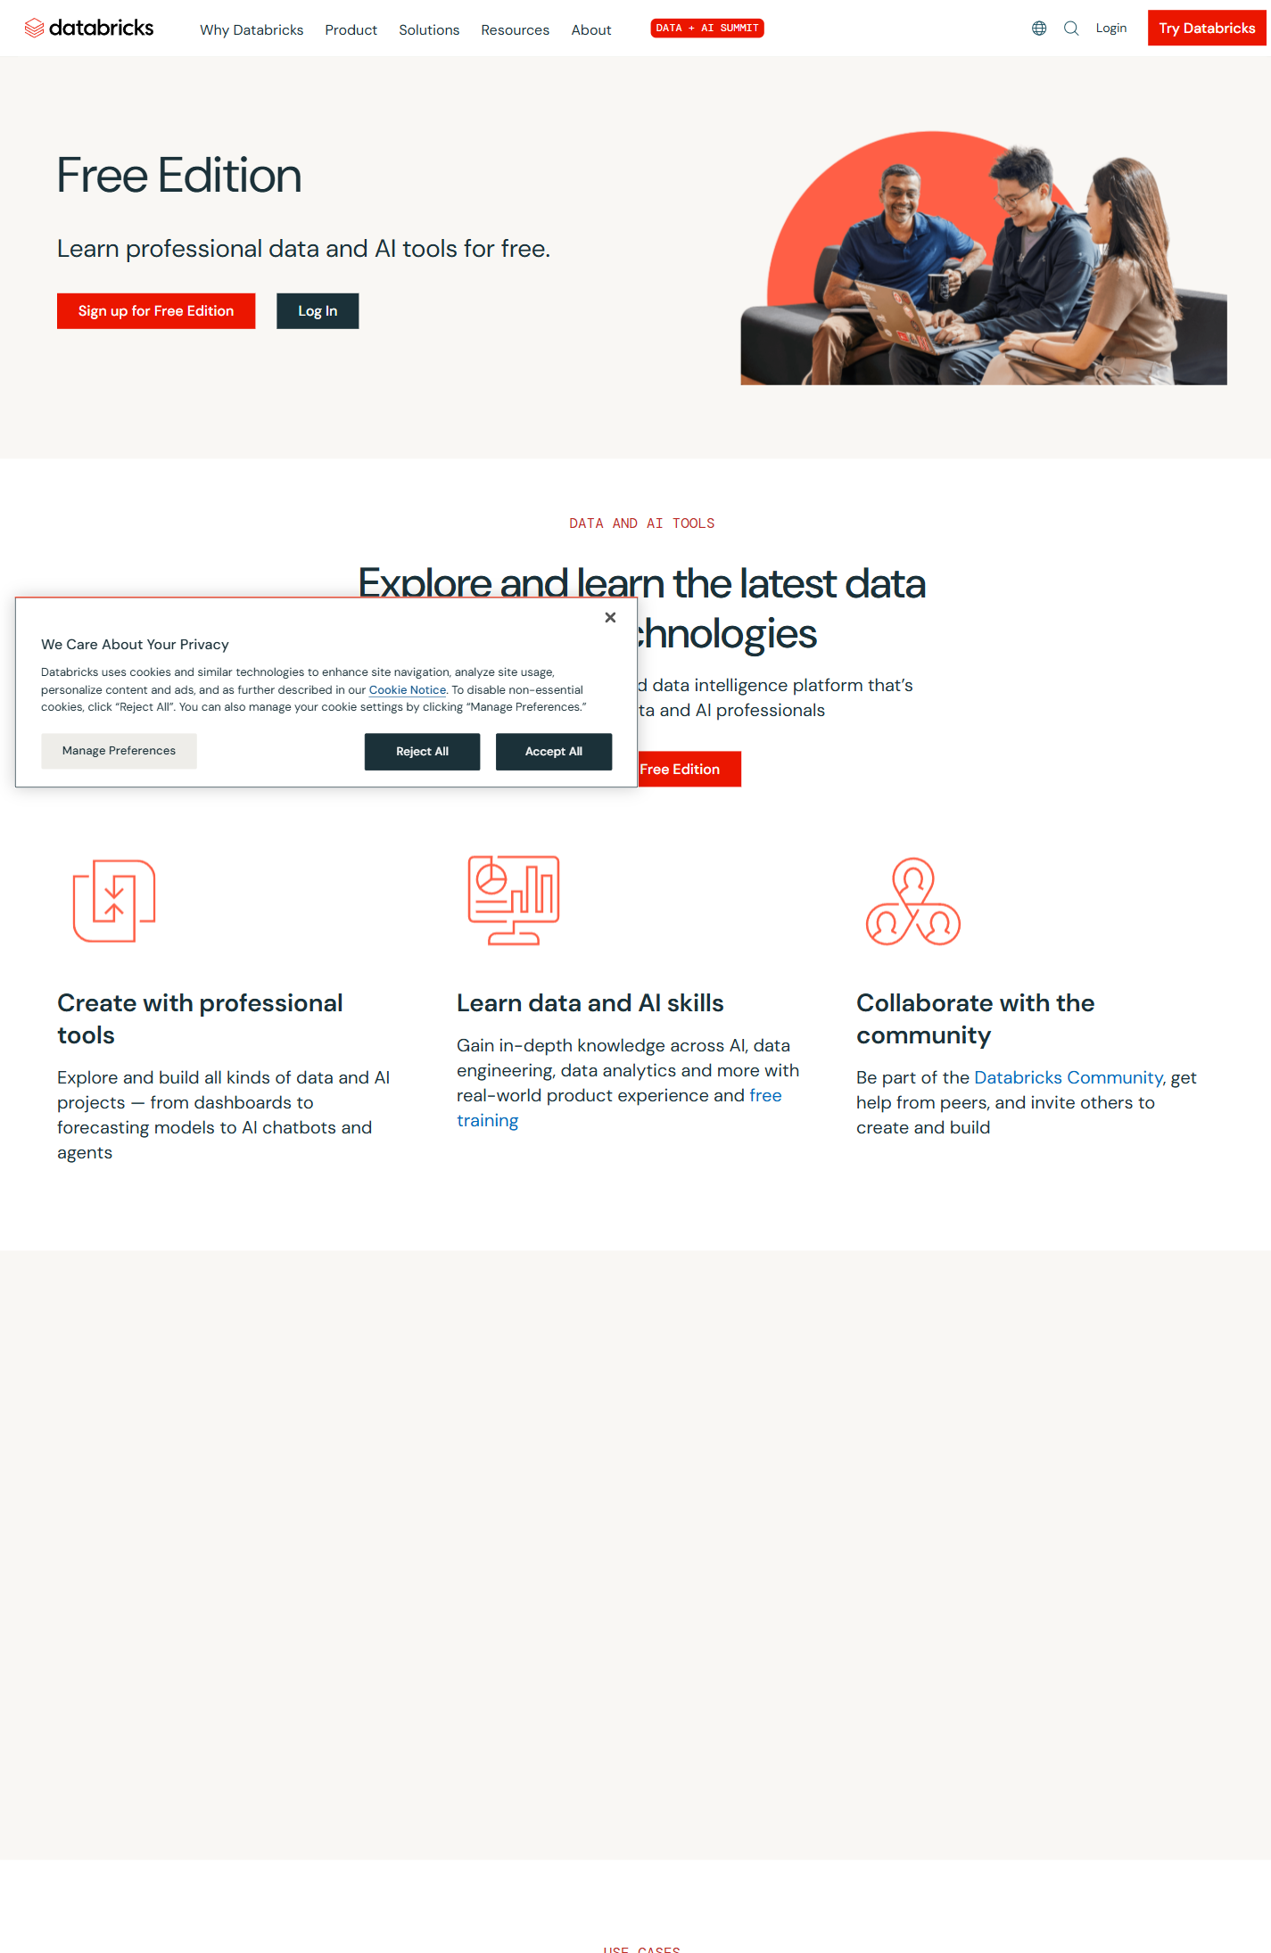
B · What is Databricks?
6 / 22
Free Edition — the no-credit-card on-ramp
What you get
• Full workspace UI • Notebooks (Python / SQL / Scala / R) • Serverless cluster (shared, on-demand) • Delta tables • MLflow • No credit card; no time limit
Databricks renamed Community Edition to Free Edition in 2025. Same idea, slightly different UI.
Databricks intro + AiDotNet → ONNX · internal team session

Slide 7
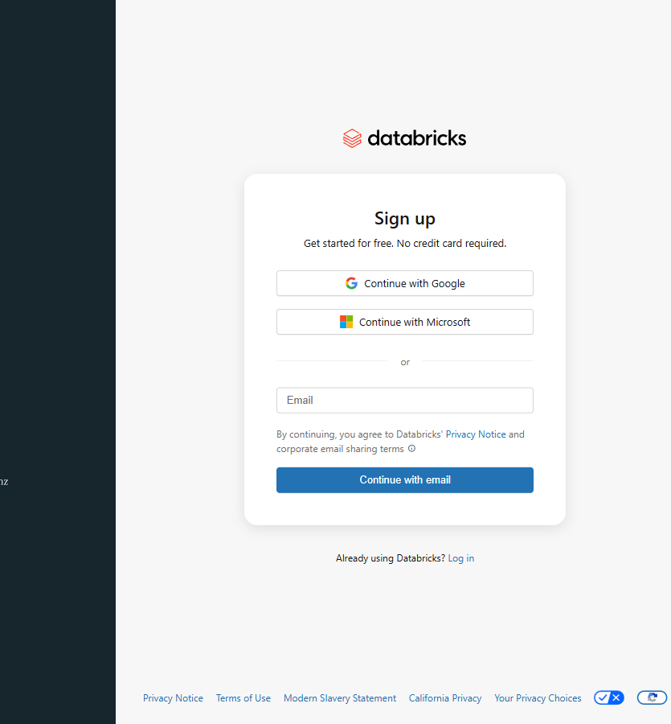
B · What is Databricks?
7 / 22
Signing up
Three ways to sign in
1. Continue with Google 2. Continue with Microsoft 3. Email + password Email verification follows. Then a few profile fields (name, role). Then a workspace gets provisioned. Total: ~5 minutes.
Databricks intro + AiDotNet → ONNX · internal team session

Slide 8
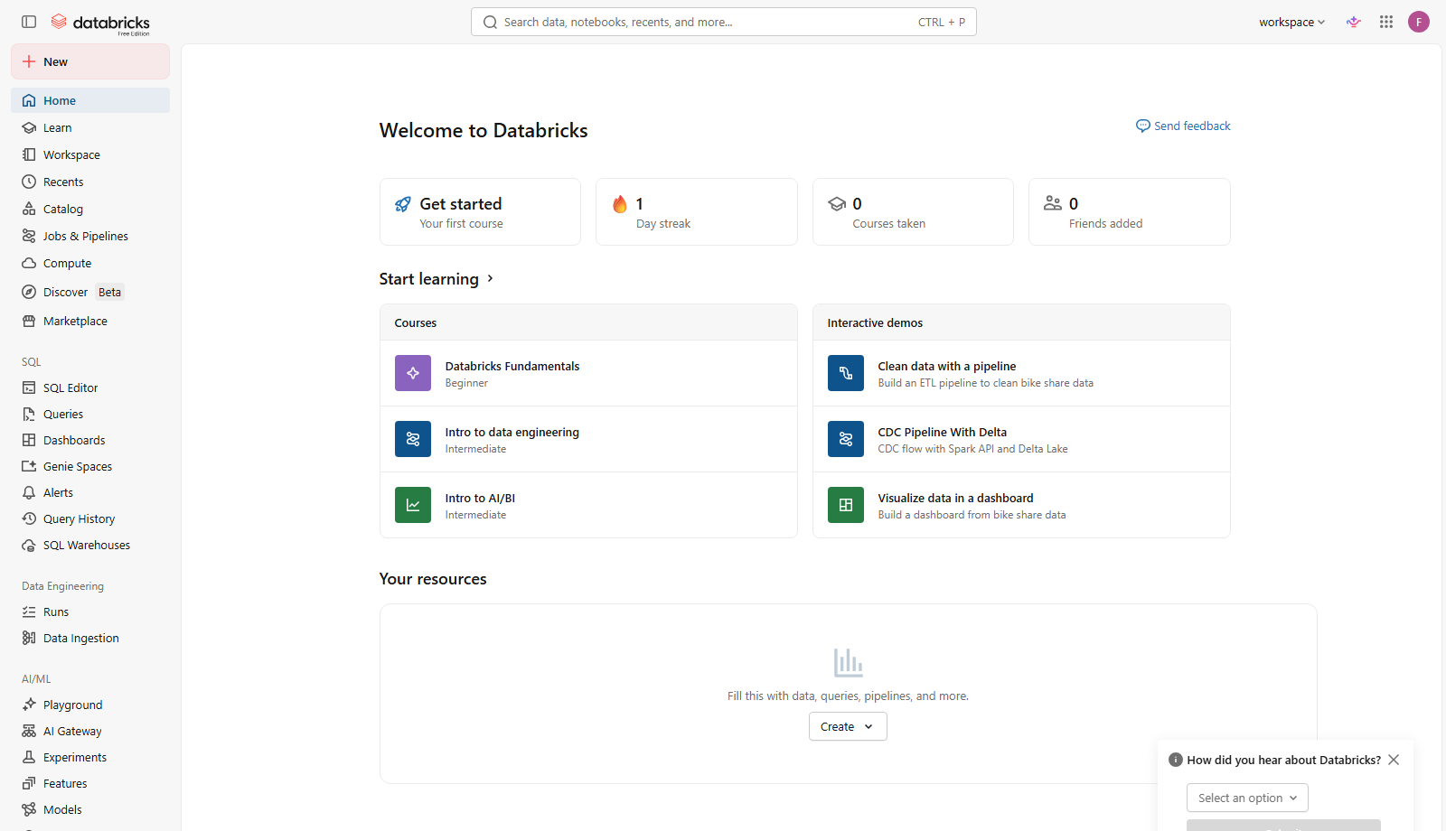
C · Hello, workspace
8 / 22
The workspace — your home base
Left sidebar: Catalog (data) · Workspace (notebooks) · Compute (clusters) · Workflows · Experiments
Databricks intro + AiDotNet → ONNX · internal team session

Slide 9
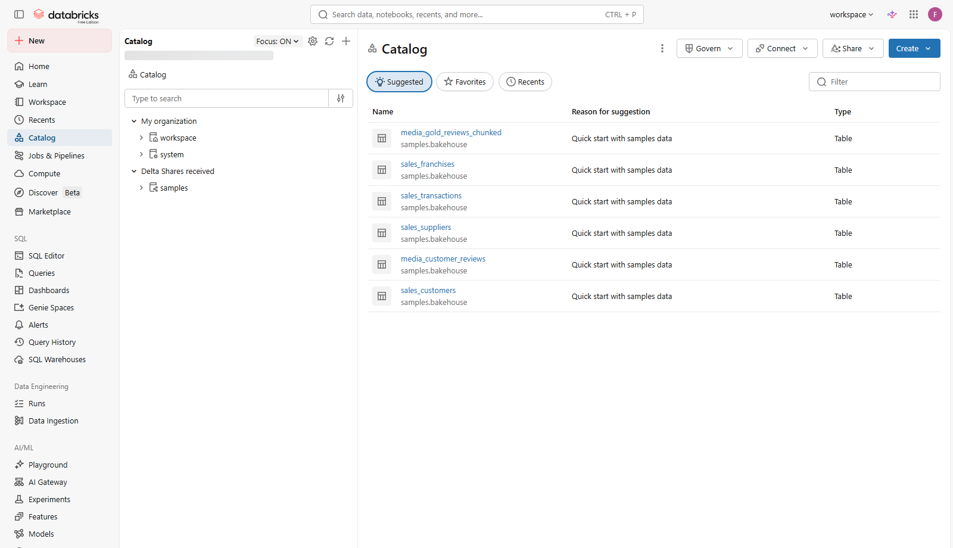
C · Hello, workspace
9 / 22
Catalog — your data
Schemas · Tables (Delta + non-Delta) · Volumes · Uploaded files (paid). Today's demo embeds the .onnx + .csv in the notebook — FE disables /FileStore.
Databricks intro + AiDotNet → ONNX · internal team session

Slide 10
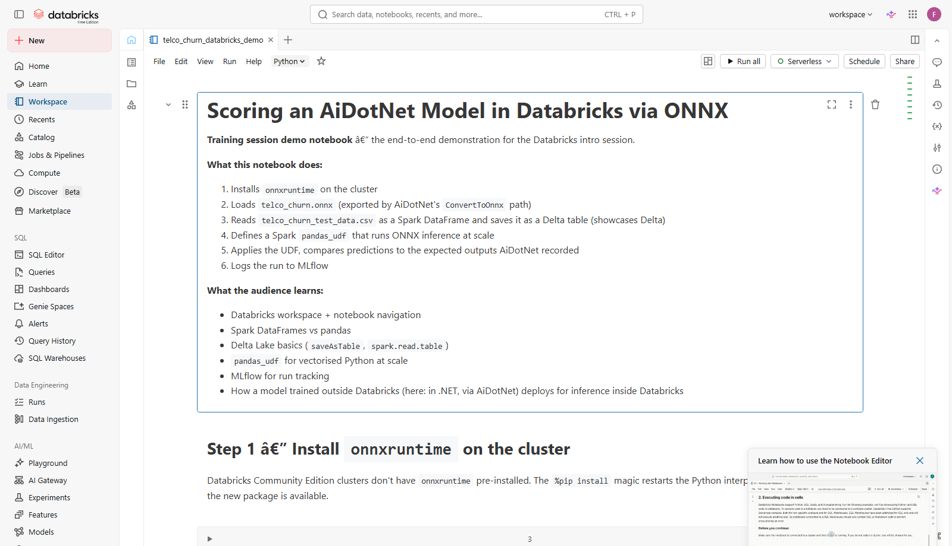
C · Hello, workspace
10 / 22
The notebook — your IDE
Cell-by-cell execution. Mix languages: Python, SQL, Scala, R, markdown. Each cell shares state with prior cells.
Databricks intro + AiDotNet → ONNX · internal team session

Slide 11
C · Hello, workspace
11 / 22
Spark DataFrames: pandas at cluster scale
Familiar API; distributed compute behind the scenes.
pandas (one machine)
PySpark (whole cluster)
import pandas as pd df = pd.read_csv('data.csv') df.head() (df[df.churn == 1] .groupby('contract') .monthly.mean())
from pyspark.sql.functions import * df = spark.read.csv('data.csv', header=True) df.show(5) (df.filter(col('churn') == 1) .groupBy('contract') .agg(avg('monthly').alias('avg_m'))).show()
Databricks intro + AiDotNet → ONNX · internal team session

Slide 12
C · Hello, workspace
12 / 22
Delta Lake: a database that lives in cloud storage
Save a DataFrame once; query it with SQL forever.
# write df.write.format('delta').saveAsTable('telco_churn_test') # read back with SQL spark.sql('SELECT COUNT(*) FROM telco_churn_test').show()
ACID transactions + time travel + schema enforcement. Free, open source, included with Databricks.
Databricks intro + AiDotNet → ONNX · internal team session

Slide 13
D · The headline demo
13 / 22
The flow
AiDotNet
ONNX
DBFS
Spark
Delta
in .NET (train + export)
model artifact (portable)
upload to Databricks storage
load + score at scale
results table + MLflow
The teaching point: any model that can export to ONNX (PyTorch, scikit-learn, ML.NET, AiDotNet) deploys to Databricks the same way.
Databricks intro + AiDotNet → ONNX · internal team session

Slide 14
D · The headline demo
14 / 22
Step 1: install onnxruntime in the cluster
%pip install onnxruntime
%pip is a Databricks notebook magic. It installs the package on every cluster node AND restarts the Python interpreter for the notebook so subsequent cells see the new package. Without %pip: import onnxruntime fails — the package isn't on the default Free-Edition Python path.
Databricks intro + AiDotNet → ONNX · internal team session

Slide 15
D · The headline demo
15 / 22
Step 2-3: load CSV → Delta table
df = (spark.read .option('header', True) .option('inferSchema', True) .csv('file://' + CSV_PATH)) df.write.format('delta').mode('overwrite').saveAsTable('telco_churn_test')
The CSV is now a queryable, ACID-transactional Delta table. Anyone in the workspace can SELECT from it.
Databricks intro + AiDotNet → ONNX · internal team session

Slide 16
D · The headline demo
16 / 22
Step 4: pandas_udf — ONNX inference at Spark scale
with open('/tmp/telco_churn.onnx', 'rb') as f: model_bytes = f.read() bc_model = spark.sparkContext.broadcast(model_bytes) _cache = {} def _sess(): if 's' not in _cache: import onnxruntime as ort _cache['s'] = ort.InferenceSession(bc_model.value) return _cache['s'] @pandas_udf(FloatType()) def predict(a, b, c, d): X = np.column_stack([a, b, c, d]).astype(np.float32) return pd.Series(_sess().run(None, {'input': X})[0].flatten())
Broadcast the model bytes once; lazily build the session per worker; pandas_udf vectorises the inference loop.
Databricks intro + AiDotNet → ONNX · internal team session

Slide 17
D · The headline demo
17 / 22
Step 5-6: apply + verify parity
scored = ( spark.table('telco_churn_test') .withColumn('onnx_prediction', predict(col('tenure_norm'), col('monthly_norm'), col('total_norm'), col('contract_norm')))) scored.show(10) # assert no mismatches above 1e-3 vs the AiDotNet-recorded predictions
The model behaves identically inside Databricks as it did in .NET. That's the demo.
Databricks intro + AiDotNet → ONNX · internal team session

Slide 18
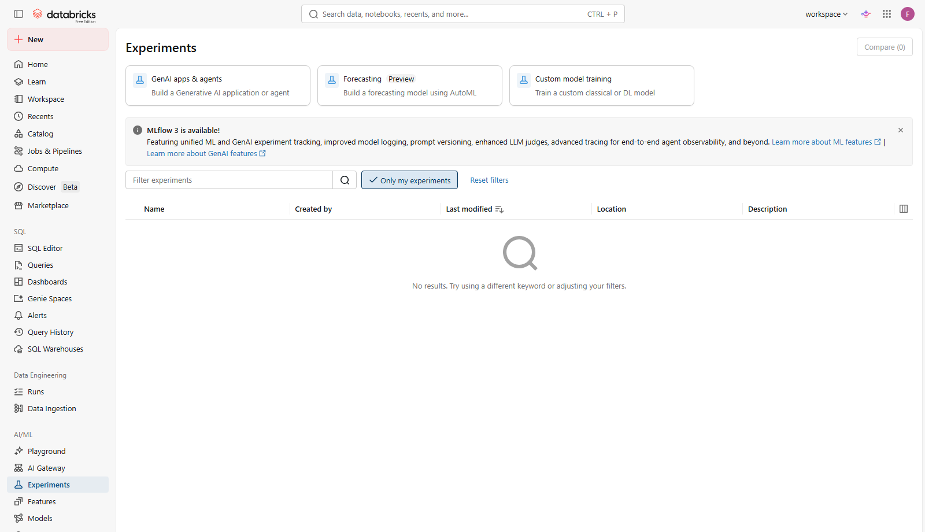
D · The headline demo
18 / 22
Step 7: log to MLflow
Tracks: timestamp · params · metrics · the .onnx artifact · permanent audit trail. Paid tier adds Model Registry for versioning + staging→production promotion.
Databricks intro + AiDotNet → ONNX · internal team session

Slide 19
E · What you'd build next
19 / 22
From demo to production
Workflows
Schedule the notebook nightly or trigger on file arrival.
Paid
Model Registry
Versioned .onnx artifacts; promote staging → production.
Free
Unity Catalog
Per-table / per-column access control across the workspace.
Paid
Auto Loader
Pick up new files from cloud storage as they land.
Paid
Genie / BI
Natural-language queries + dashboards over your Delta tables.
Paid
Databricks intro + AiDotNet → ONNX · internal team session

Slide 20
E · What you'd build next
20 / 22
Homework (next 2-3 weeks)
1
Load a different ONNX model (MNIST) in the same notebook.
2
Replace inferSchema with an explicit Spark StructType.
3
Add a Spark feature-engineering step before the UDF call.
4
Save predictions back to a new Delta table; query with SQL.
5
Train on real data, with whatever .NET stack you prefer.
6
Stretch: schedule the notebook as a Databricks Job.
Databricks intro + AiDotNet → ONNX · internal team session

Slide 21
F · Hand-off
21 / 22
Take-home artifacts
All live in the AiDotNet repo under samples/deployment/TelcoChurnOnnxExport/
dev_cheatsheet.pdf
Single landscape page — PySpark, CLI, ONNX UDF code. Print + pin.
telco_churn_databricks_demo.ipynb
The notebook from today. Re-run it on your own account.
telco_churn.onnx + .csv
Standalone copies of the model + test data (also embedded in the notebook).
verify_locally.py
Sanity-check the .onnx outside Databricks (pure Python + onnxruntime).
HOMEWORK.md
5 exercises + 1 stretch. Bring questions to the next session.
FAQ.md
Questions we didn't have time for live.
Databricks intro + AiDotNet → ONNX · internal team session

Slide 22
Questions?
Drop deeper ones in #training and we'll cover them next session.

