Slide 1
Culture and representation
Lecture 2

Slide 2
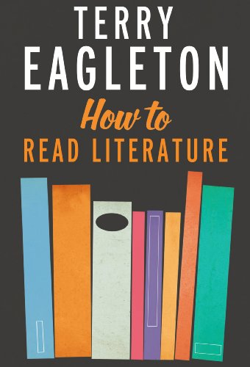
READING 1:
Chapter 1,
“Openings”

Slide 3
“The most common mistake students of literature make is to go straight for what the poem or novel says, setting aside the way that it says it. To read like this is to set aside the ‘literariness’ of the work – the fact that it is a poem or play or novel, rather than an account of the incidence of soil erosion in Nebraska. Literary works are pieces of rhetoric as well as reports. They demand a peculiarly vigilant kind of reading, one which is alert to tone, mood, pace, genre, syntax, grammar, texture, rhythm, narrative structure, punctuation, ambiguity – in fact to everything that comes under the heading of ‘form’” (2).

Slide 4
“Part of what we mean by a ‘literary’ work is one in which what is said is to be taken in terms of how it is said. It is the kind of writing in which the content is inseparable from the language in which it is presented. Language is constitutive of the reality or experience, rather than simply a vehicle for it” (3).

Slide 5
Review
Proper object of inquiry (= study) in HS is the human
What does it mean to be human (… in the age of AI!)
Continuity between HS as an academic area and human society
The HS student/researcher/teacher is implicated/embedded/emerges from human society → no division or distance

Slide 6
Review
As literary scholars, we think critically, interpretively, creatively, imaginatively about literary texts
The meaning of a literary text – the truth it contains about human experience – is incomplete without the reader.
Each reader comes to a text from their own location as an individual, idea, and social-historical-political-economic entity.
Each reader invests a text with meaning.
The strength of an interpretation depends on what is made available/possible by a text.

Slide 7
Haiku – Kynpham Sing Nongkynrih
“fresh green leaves
an orange tree – white atop
my head, also fresh.”

Slide 8
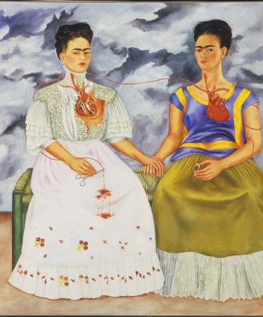
Broken Love – Hoshang Merchant
Is like an intercepted message
It is a feather swirling emptily
in a dusty trough
It is the sun’s broken yolk
at evening
It is this empty room
where I write this poem.
The Two Fridas (1939)
Frida Kahlo
Oil on Canvas
Museo de Arte Moderno, Mexico City

Slide 9
Review
Literature (fiction) is one manifestation of Culture
Two related definitions of culture
Culture is constantly produced and reproduced
All cultural productions and artefacts must be read as emerging from a particular context (social, historical, political, economic).
Or: culture is everywhere. It permeates everything and is implicated in reproducing or challenging existing worldview.
Culture and power mutually construct and reconstruct each other.

Slide 10
Review
So while aesthetics are an important aspect of the study of cultural artefacts, alone they fall short.

Slide 11

Untitled (1969)
Vasudev S. Gaitonde
Sold for USD 110,000
2005

Slide 12
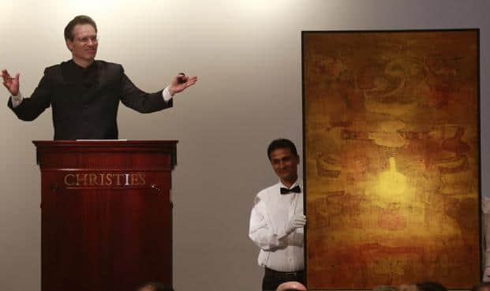
Untitled (1979)
VS. Gaitonde
Sold for USD 3 million
2013

Slide 13
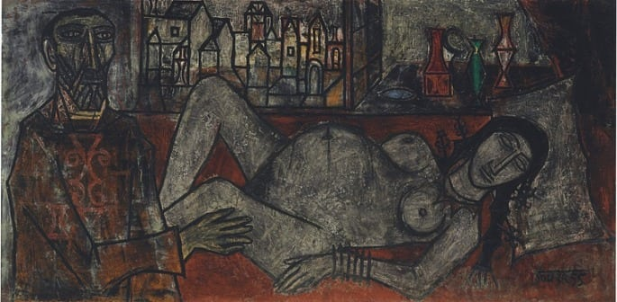
Birth (1955) FN Souza Sold in 2015 for USD 4 million

Slide 14
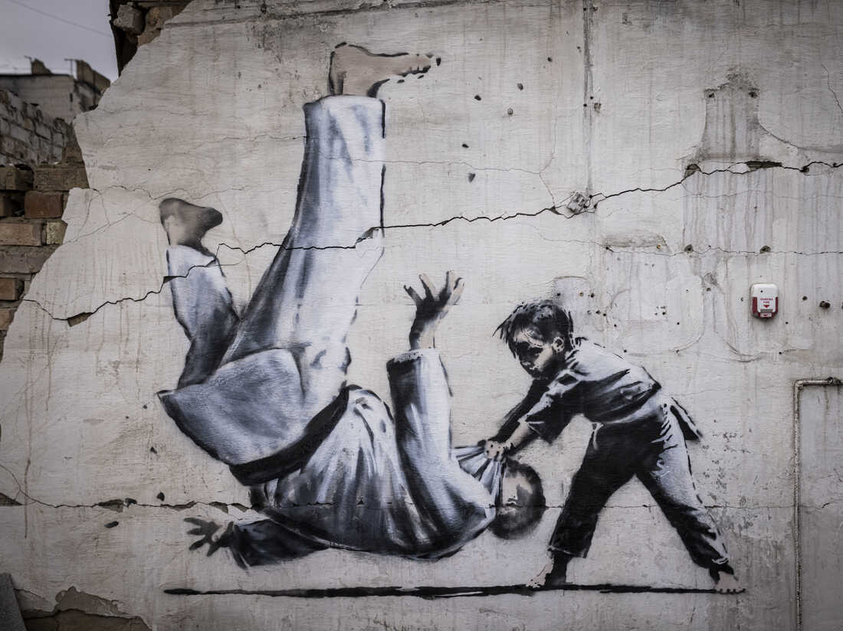

Slide 15


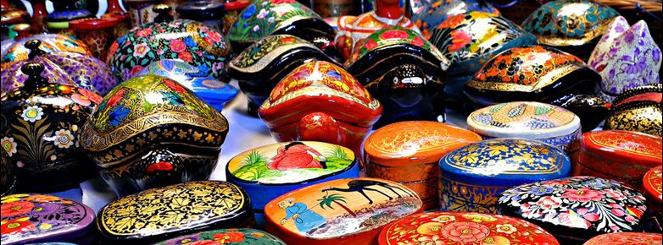

Slide 16
Arts vs. Crafts
Separation between body and mind, the useful and beautiful
People who make useful things and people who make/contemplate beautiful things are separated
The theoretical and the beautiful are suspended away from the concrete and the useful
High culture vs. Low culture
Arts vs. (handi)crafts/Artist vs. artisan/individual (lone) genius vs. communal activity

Slide 17
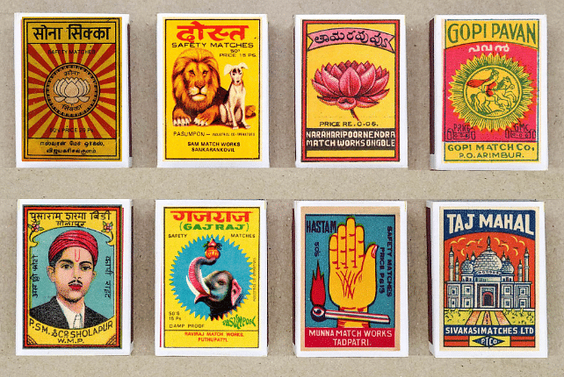

Slide 18
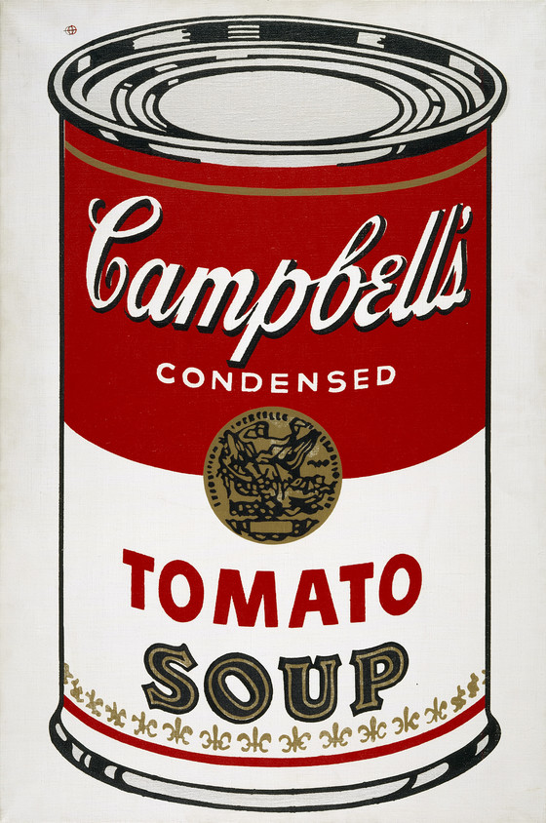
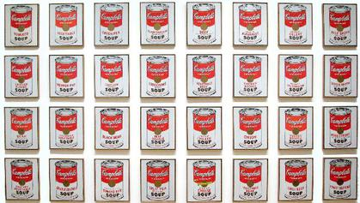

Slide 19
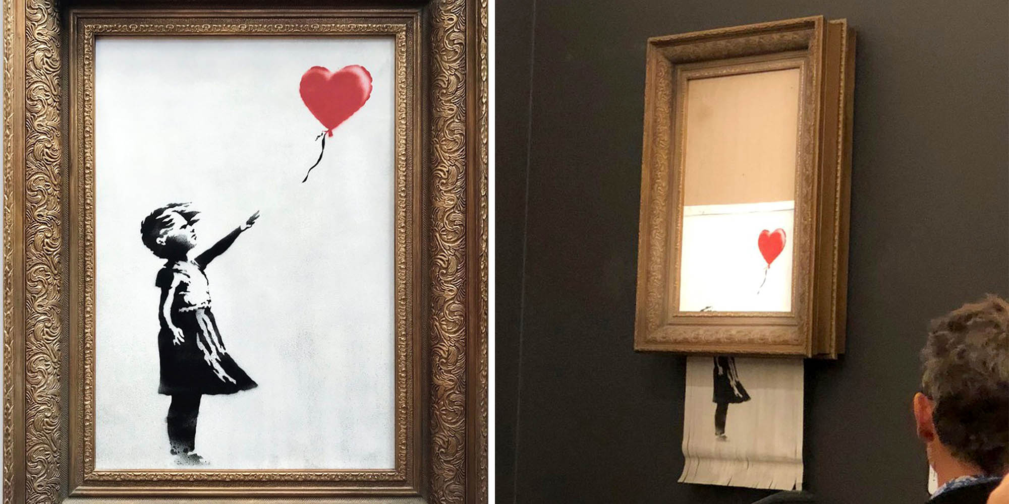

Slide 20
Pop Culture
Popular art incorporates references to advertisements, mass-produced goods, comic books etc. It represents a challenge to “fine art” through the use of irony.

Slide 21
Works Cited
Eagleton, Terry. How to Read Literature. Yale University Press, 2013.

