Slide 1
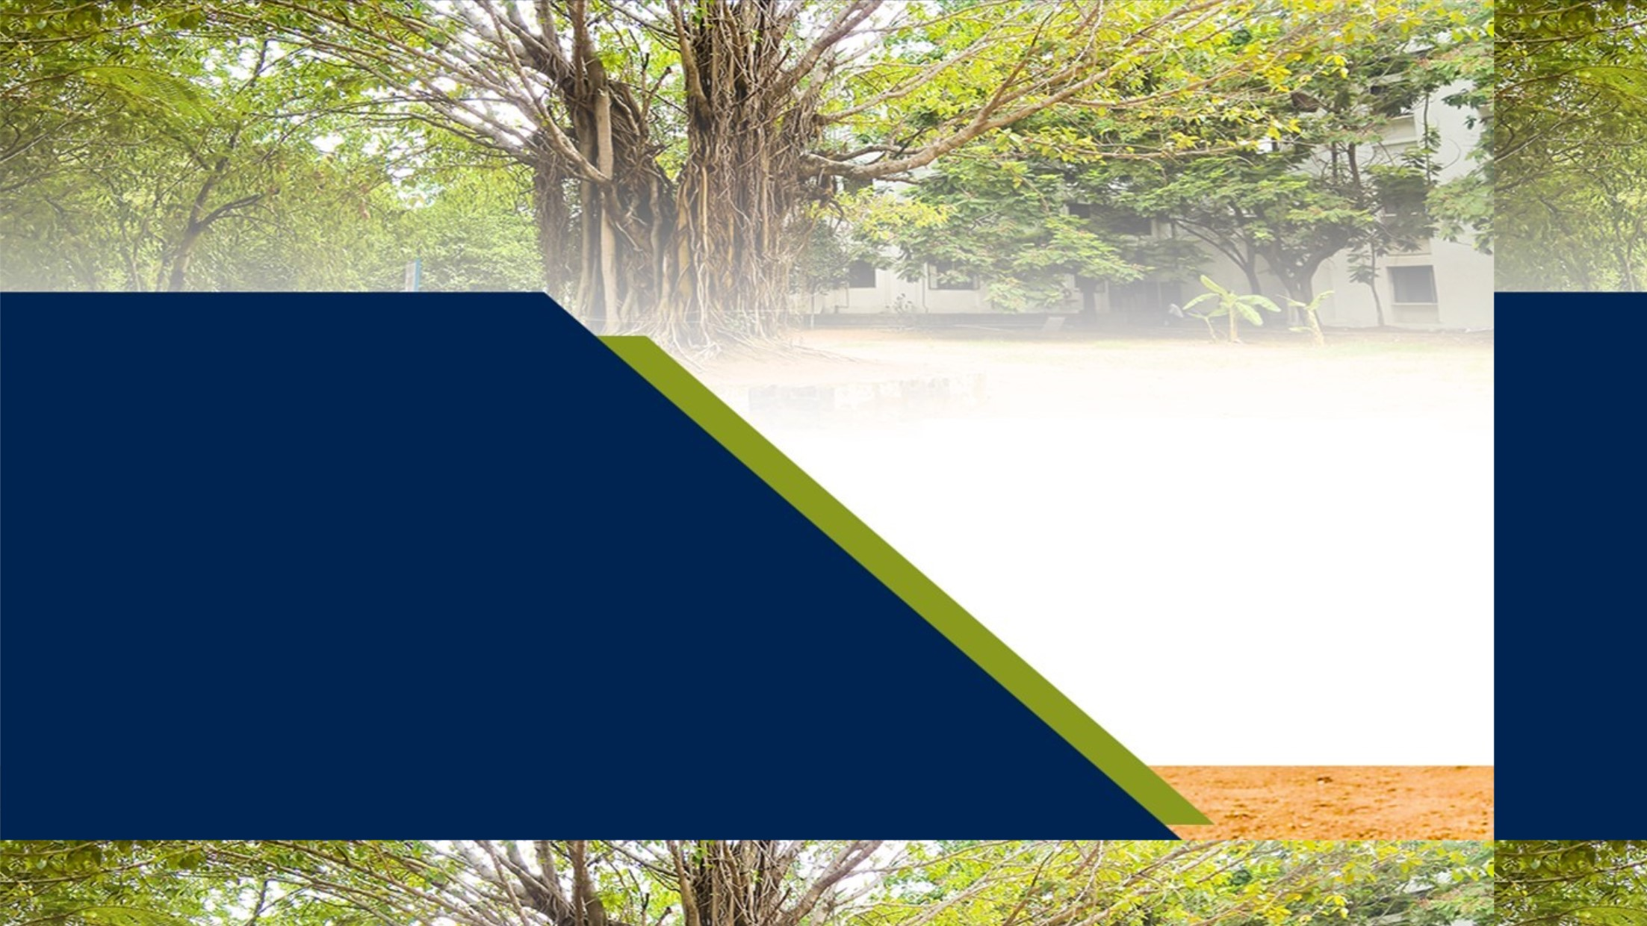
Introduction to SDLC

Slide 2
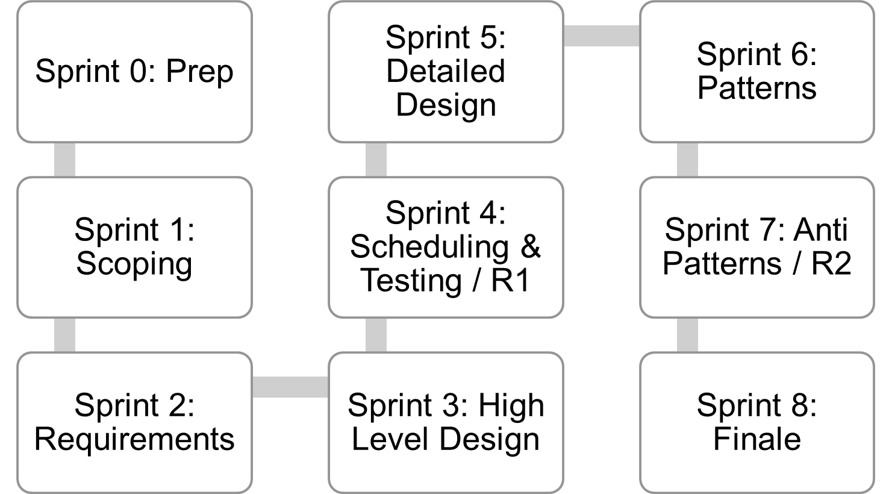
Where are we..
Jan 4
Mar 12
Mar 26
Lecture topics will follow this flow
As the projects tracks these sprints
Submissions due along the way
Guest lectures from startups and Industry leaders
EACH SPRINT IS 2 WEEKS, Friday start.
Jan 15
Feb 26
Apr 9
Jan 29
Feb 12
April 23
April 23+ EVALUATIONS

Slide 3
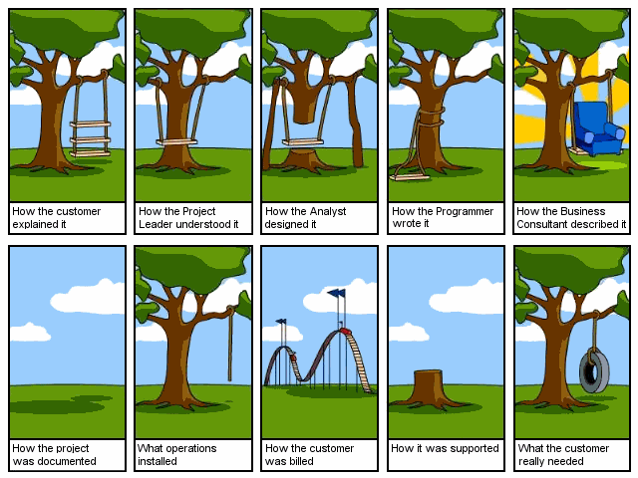

Slide 4
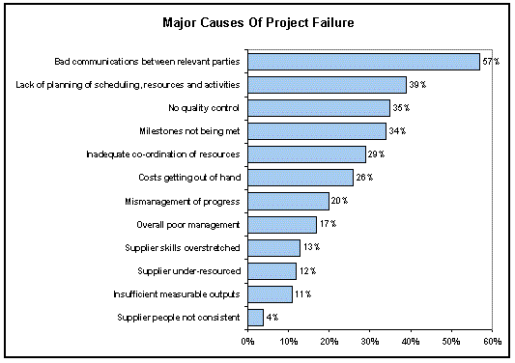

Slide 5
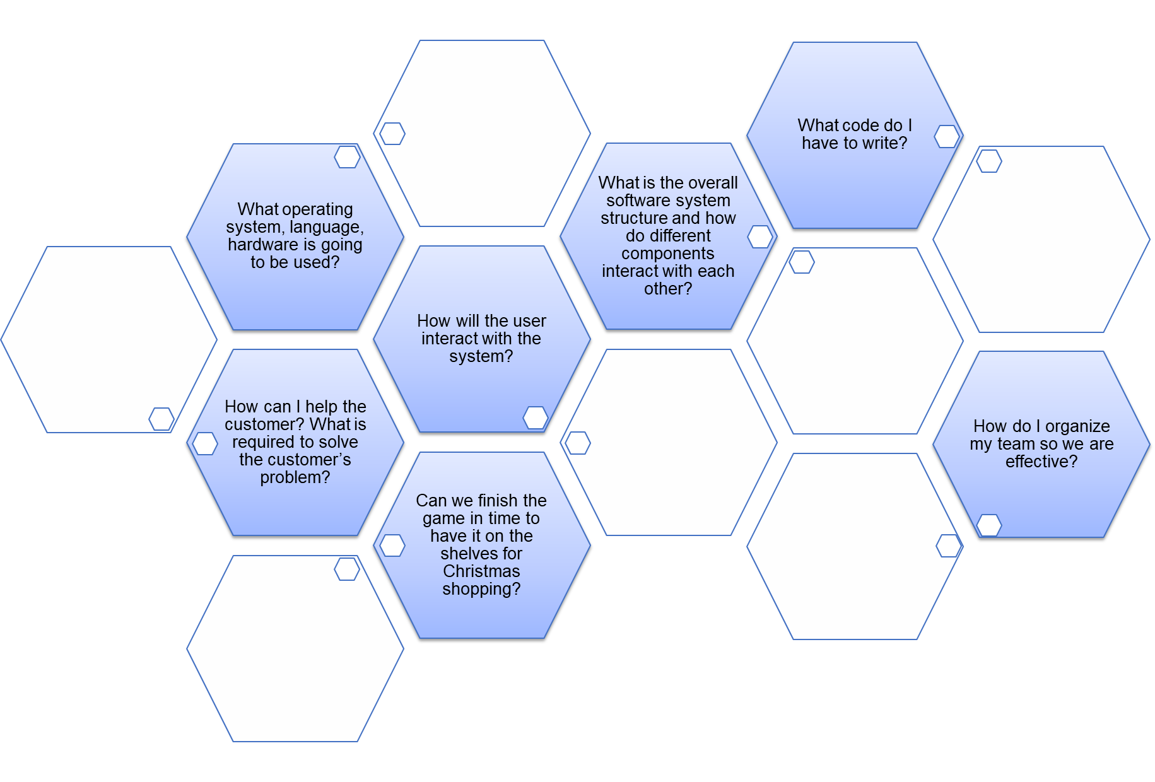
The software engineer’s daily job..
to answer questions about the s/w system

Slide 6
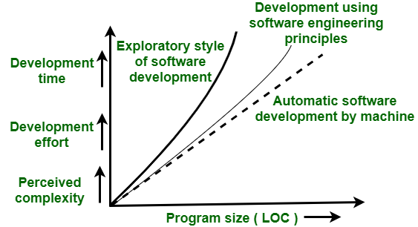
Exploratory Style vs. Software Engineering?
Exploratory..
Build & fix approach
Can successfully be used for very small programs only.

Slide 7
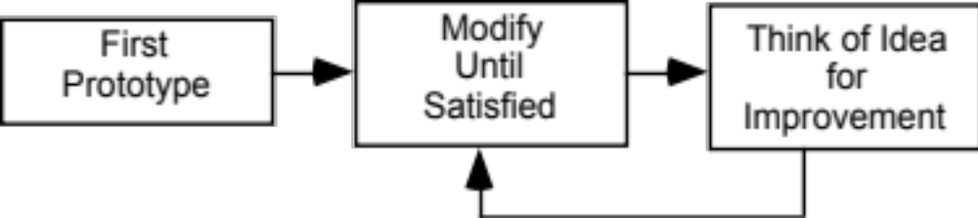
Prototyping model
(The opportunistic approach.. Spray & pray)
OK for small, informal projects
Inappropriate for professional environments/complex software where on-time delivery and high quality are expected
Agile methodology
is a type of project management process,
mainly used for software development,
where demands and solutions evolve
through
the collaborative effort of self-organizing and cross-functional teams and their customers
© Lethbridge/Laganière 2001

Slide 8
Why Life cycle model?
A software project will never succeed if activities are not coordinated:
  one engineer starts writing code,
  another concentrates on writing the test document first,
  yet another engineer first defines the file structure
  another defines the I/O for his portion first
Adherence can lead to accurate status reports
Otherwise, it becomes very difficult to track the progress of the project
    the project manager would have to depend on the guesses of the team members.

Slide 9
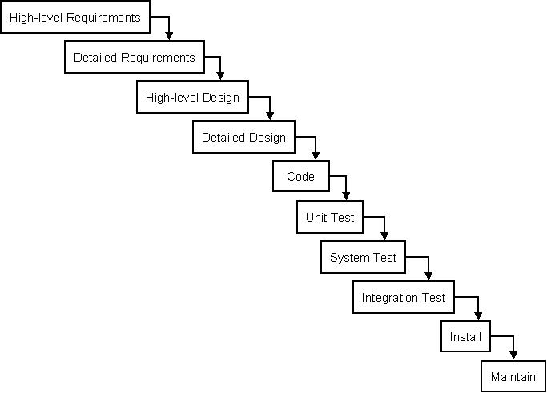
Software Development Life Cycle elements
(SDLC)
Typical software life cycle/process consists of:
Feasibility study (involves business case)
Requirements analysis and specification,
Design
Coding
Testing
Maintenance

Slide 10
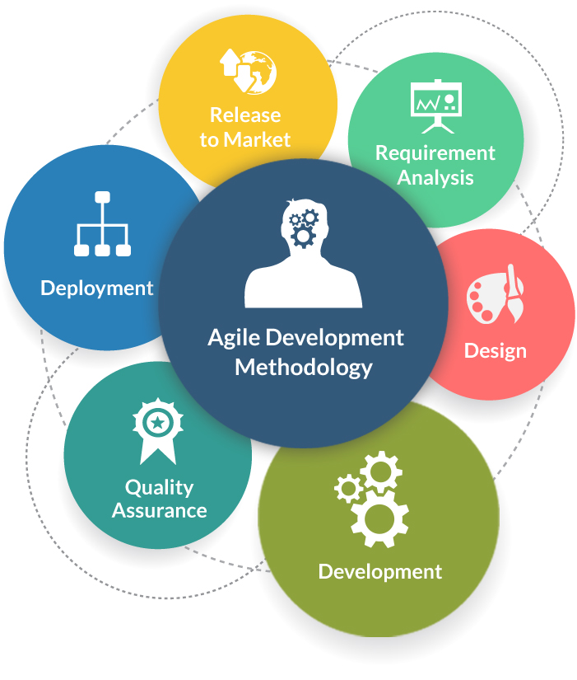
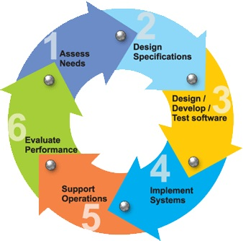
The cycle..

Slide 11
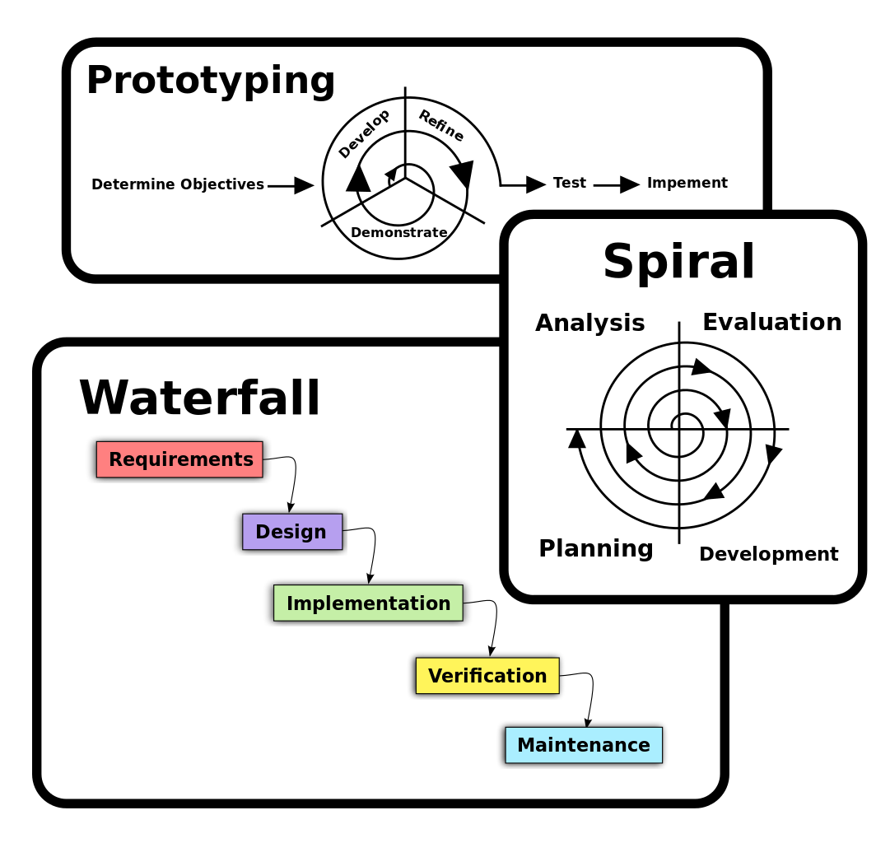
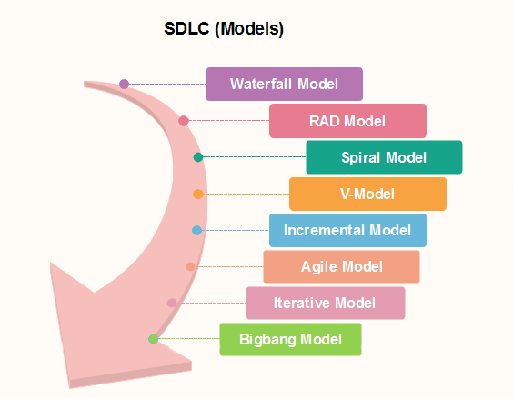

Slide 12
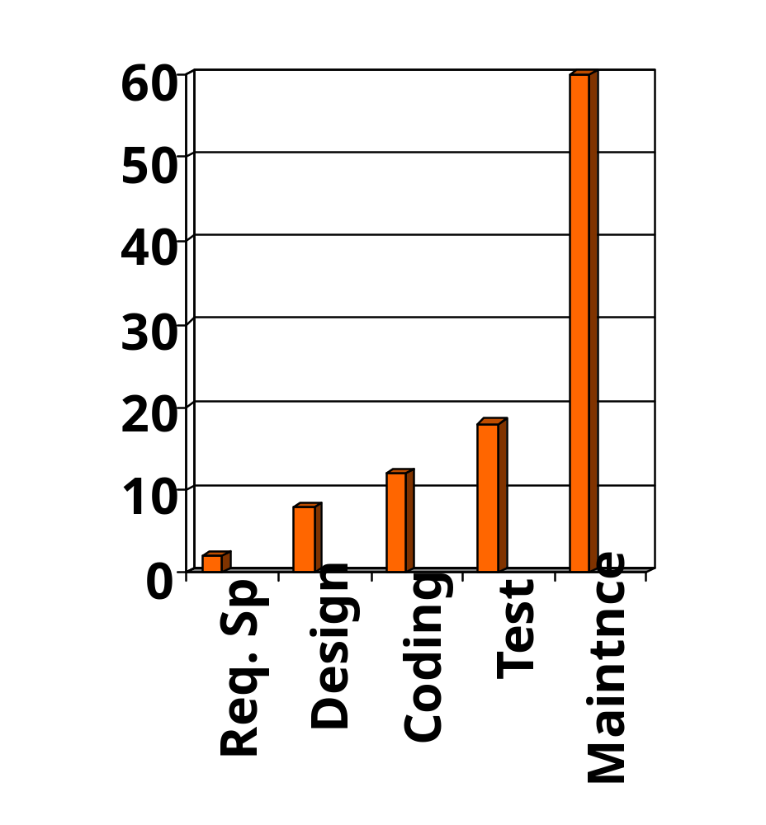
Relative effort for Phases
Phases between feasibility study and testing
  known as development phases.
Among all life cycle phases
  maintenance phase consumes maximum effort.
Relative Effort

Slide 13
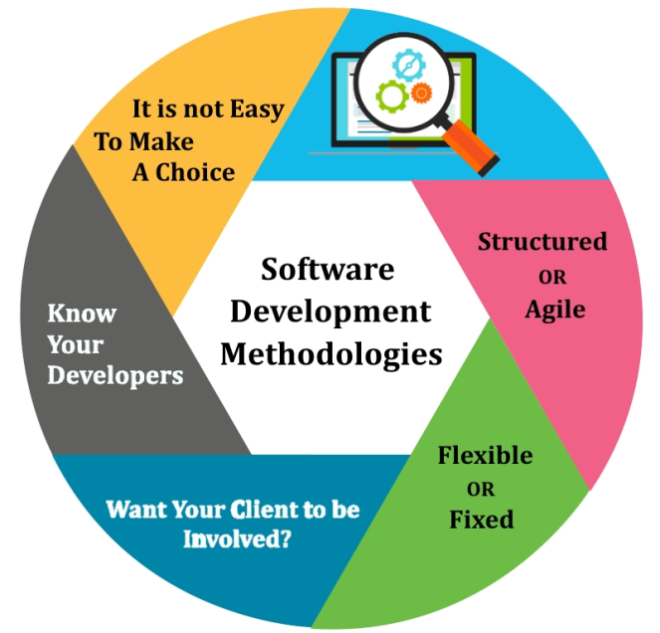
Dev Process Choices to make

Slide 14
Next steps
Pls read course outline
Project teams to be formed (by TAs)
Mentors assigned (TAs)
Meet project sponsor (client)
Understand requirements
Need to make weekly progress on projects
First submission, due in one week

Slide 15
Introdction

Slide 16
From Exploratory programming to Software Engineering
The early programmers used an exploratory (also called build and fix) style.
In the build and fix (exploratory) style, normally a `dirty' program is quickly developed.
The different imperfections that are subsequently noticed are fixed.

Slide 17
What is Wrong with the Exploratory Style?
Can successfully be used for very small programs only.
Effort, time, cost
Software
Engineering
Exploratory
Machine
Program Size

Slide 18
What is Wrong with the Exploratory Style? Contd…
Besides the exponential growth of effort, cost, and time with problem size:
  Exploratory style usually results in unmaintainable code.
  It becomes very difficult to use the exploratory style in a team development environment.
Why does the effort required to develop a product grow exponentially with product size?
  Why does the approach completely break down when the product size becomes large?

Slide 19
Why Study Software Engineering? (1)
To acquire skills to develop large programs.
  Exponential growth in complexity and difficulty level with size.
  The ad hoc approach breaks down when size of software increases.

Slide 20
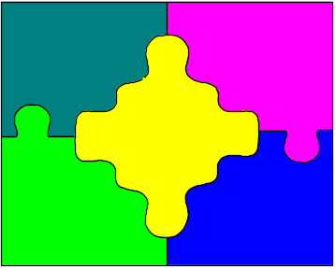
Why Study Software Engineering? (2)
Ability to solve complex programming problems:
  How to break large projects into smaller and manageable parts?
  How to use abstraction?
Also learn techniques of:
  Specification, design, user interface development, testing, project management, etc.

Slide 21
Why Study Software Engineering? (3)
To develop large, high quality software systems:
    Large systems cannot be understood by one person
    Requires team work
    Achieve sufficient quality (e.g. Maintainability, Usability, etc)

Slide 22
PRINCIPLES DEPLOYED BY SOFTWARE ENGINEERING
  Abstraction:
    Simplify a problem by omitting unnecessary details.
    Focus attention on only one aspect of the problem and ignore irrelevant details.
Decomposition:
  Decompose a problem into many small independent parts.
    The small parts are then taken up one by one and solved separately.
    The idea is that each small part would be easy to grasp and can be easily solved.
    The full problem is solved when all the parts are solved.

Slide 23
Programs versus Software Products
Usually small in size
Author himself is sole user
Single developer
Lacks proper user interface
Lacks proper documentation
Ad hoc development.
Large
Large number of users
Team of developers
Well-designed interface
Well documented & user-manual prepared
Systematic development

Slide 24
Types of software
Custom
  For a specific customer
Generic
  COTS (Commercial Off The Shelf)
Embedded
  Build into Hardware

Slide 25
Software Development Life Cycle (SDLC)

Slide 26
The opportunistic approach
OK for small, informal projects
Inappropriate for professional environments/complex software where on-time delivery and high quality are expected
© Lethbridge/Laganière 2001

Slide 28
Why Life cycle model?
A software project will never succeed if activities are not coordinated:
  one engineer starts writing code,
  another concentrates on writing the test document first,
  yet another engineer first defines the file structure
  another defines the I/O for his portion first
Adherence can lead to accurate status reports
Otherwise, it becomes very difficult to track the progress of the project
    the project manager would have to depend on the guesses of the team members.

Slide 29
The cycle..

Slide 30
Software Development Life Cycle (SDLC)
Typical software life cycle or software process consists of following phases:
    Feasibility study (involves business case)
    Requirements analysis and specification,
    Design
    Coding
    Testing
    Maintenance

Slide 31
Relative effort for Phases
Phases between feasibility study and testing
  known as development phases.
Among all life cycle phases
  maintenance phase consumes maximum effort.
Relative Effort

Slide 32
Feasibility Study
Main aim of feasibility study: determine whether developing the product
  financially worthwhile
  technically feasible.
First roughly understand what the customer wants:
  Inputs
  Processing
  Outputs
  various constraints on the behaviour of the system

Slide 33
Activities during Feasibility Study
Work out an overall understanding of the problem
Formulate different solution strategies
Examine alternate solution strategies in terms of:
    resources required
    cost of development
    development time
Perform a cost/benefit analysis:
  you may determine that none of the solutions is feasible due to high cost, resource constraints, technical reasons.

Slide 34
Requirements Analysis and Specification
Aim of this phase:
  understand the exact requirements of the customer,
  document them properly.
Consists of two distinct activities:
  requirements gathering and analysis
  requirements specification.

Slide 35
Goals of Requirements Analysis
Collect all related data from the customer:
  analyze the collected data to clearly understand what the customer wants,
  ensure correctness, consistency and unambiguity.

Slide 36
Requirements Gathering
Gathering relevant data:
  usually collected from the end-users through interviews and discussions.
  For example, for a business accounting software:
    interview all the accountants of the organization to find out their requirements.

Slide 37
Requirements Analysis (CONT.)
The data you initially collect from the users:
  would usually contain several contradictions and ambiguities:
  each user typically has only a partial and incomplete view of the system.
Ambiguities and contradictions:
  must be identified
  resolved by discussions with the customers.
Next, requirements are organized:
  into a Software Requirements Specification (SRS) document

Slide 38
Design
Design phase transforms requirements specification:
  into a form suitable for implementation in some programming language.

Slide 39
Design
High-level design:
  decompose the system into modules,
  represent invocation relationships among the modules.
Detailed design:
  different modules designed in greater detail:
    data structures and algorithms for each module are designed.

Slide 40
Implementation
During the implementation phase:
  each module of the design is coded,
  each module is unit tested
    tested independently as a stand alone unit, and debugged
The purpose of unit testing:
  test if individual modules work correctly.
The end product of implementation phase:
  a set of program modules that have been tested individually

Slide 41
Integration and System Testing
Different modules are integrated in a planned manner:
  modules are almost never integrated in one shot.
  Normally integration is carried out through a number of steps.
During each integration step,
  the partially integrated system is tested.

Slide 42
Integration and System Testing
M1
M2
M8
M5
M7
M3
M4
M6

Slide 43
Maintenenace
Maintenance of any software product:
  requires much more effort than the effort to develop the product itself.
  development effort to maintenance effort is typically 40:60.

Slide 44
Maintenance (CONT.)
Preventive maintenance
  Making appropriate changes to prevent the occurrence of errors
Corrective maintenance
  Correct errors which were not discovered during the product development phases
Perfective maintenance
  Improve implementation of the system
  enhance functionalities of the system
Adaptive maintenance
  Port software to a new environment

Slide 45
Summary
A software life cycle model (or process model):
  a descriptive and diagrammatic model of software life cycle
  identifies all the activities required for product development,
  establishes a precedence ordering among the different activities
  divides life cycle into phases.
A fundamental necessity while developing any large software product:
  Adoption of a software development life cycle model (software process model).

