Slide 1
Greedy Algorithms

Slide 2
Optimization problems
An optimization problem is one in which you want to find, not just a solution, but the best solution
A “greedy algorithm” sometimes works well for optimization problems
A greedy algorithm works in phases. At each phase:
  You take the best you can get right now, without regard for future consequences
  You hope that by choosing a local optimum at each step, you will end up at a global optimum
Notes:
2

Slide 3
Greedy Algorithms
Maximum Independent Set in a tree
Acitivity Selection Problem
Minimum number of processors to run activities
Fractional Kanpsack
Huffman Code
Minimise delay
Min Coin Change

Slide 4
Max independent set in a tree
Given a tree, find the maximum set of independent vertices such that no two nodes in the output set share an edge.

Slide 5
Max independent set in a tree
Given a tree of nodes and connecting edges, find the maximum set of independent vertices such that no two nodes in the output set share an edge.
Iteratively:
Add all leaves and drop their neighbours until no nodes left
Proof: Suppose a leaf is not part of the max independent set then its neighbour should be. For any leaf whose neighbour is in independent set; remove neighbour from IS and add neighbouring leaves to it. In such a case the size of IS wont reduce but can only go up.

Slide 6
An Activity Selection Problem
(Conference Scheduling Problem)
Input: A set of activities S = {a₁,…, a_{n}}
Each activity has start time and a finish time
  a_{i}=(s_{i}, f_{i})
Two activities are compatible if and only if their interval does not overlap
Output: a maximum-size subset of mutually compatible activities

Slide 7
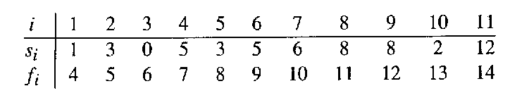
The Activity Selection Problem
Here are a set of start and finish times
What is the maximum number of activities that can be completed?
  {a₃, a₉, a₁₁} can be completed
  But so can {a₁, a₄, a_{8’} a₁₁} which is a larger set
  But it is not unique, consider {a₂, a₄, a_{9’} a₁₁}

Slide 8
Naïve: try all subsets O(2^n)
Dynamic: O(n^2) : For each task store a tuple of (the max length compatible string it can make with earlier tasks, which is the latest task before it with which is was compatible to form the max length).
T(1)=(1,1)
for i=1 to n
{ T(i)=(1,i) //dummy
for j=1 to i-1
{ if j compatible with I
if T(i_1)< T(j_1) +1 then
T(i)= (T(j_1) +1,j)
}
}

Slide 9
Interval Representation

Slide 10
Greedy attempts
Select the activity with the earliest start time
With smallest interval
With minimum overlap

Slide 11
Greedy attempts
Select the activity with the earliest start time
first activity overlaps all other activities where all other activities occur in sequence one starting after other finishes.
With smallest job interval
Activityi StartTime FinishTime Duration Soln derived {1}. Ans:{2,3}
1 3 5 2
2 1 4 3
3 4 7 3

Slide 12
Greedy attempts
With minimum overlap
Activityi StartTime FinishTime # of overlaps
1 3 5 2
2 0 2 2
3 6 8 2
4 2 4 3
5 4 6 3
6 1 3 3
7 1 3 3
8 5 7 3
9 5 7 3
The solution derived from this approach is{1,2,3}, but he optimal solution should be{2,3,4,5}

Slide 13
Early Finish Greedy
Select the activity with the earliest finish
Eliminate the activities that could not be scheduled
Repeat!

Slide 14
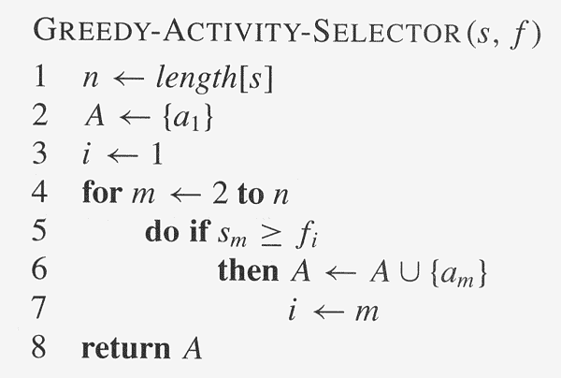
Assuming activities are sorted by finish time

Slide 15
Why it is Greedy?
Greedy in the sense that it leaves as much opportunity as possible for the remaining activities to be scheduled
The greedy choice is the one that maximizes the amount of unscheduled time remaining

Slide 16
activities sorted by finish time gives optimal
Let optimal solution in increasing sorted order of finish time be
O : A1, A2, A3 , …..
And greedy solution output written in sorted order of finish time be
G: A1’, A2’, A3’ , ….
Consider O1=O-{A1}+{A1’}
Since finish(A1’)<finish(A1) so in O we can replace A1 with A1’ (since A1 finishes before A2 starts and hence A1’ finishes before A2 starts). O1 is more similar to G than O and is optimal as has same number of jobs.
Keep doing this where
O2=O1-{A2}+{A2’}
Since finish(A2’)<finish(A2) so in O1 we can replace A2 with A2’. O2 is more similar to G than O1.
Iteratively On=G and hence G is optimal.
G cannot have lesser jobs than O. Suppose G had k jobs and O had n jobs where k<n then
Consider O with first k jobs replaced with that of G. the k+1th job of O is compatible with kth job of G as it starts after kth job of G. the greedy algorithm looks for the next job with minimal finish time that starts after its kth job. If such a job exists then it would have found it. So such a job did not exist. Hence p>kth job can not exist in O

Slide 17
activities sorted by decreasing start time gives optimal (same proof as inc finish time
Let optimal solution output printed in increasing sorted order of start time be
O : A1, A2, A3 , …..
And greedy solution output written in increasing sorted order of start time be
G: A1’, A2’, A3’ , ….
Consider O1=O-{An}+{An’}
Since start(An’)>start(An) so in O we can replace An with An’. O1 is more similar to G than O and is optimal as has same number of jobs and has set of non conflicting jobs.
Keep doing this where
O2=O1-{A_(n-1)}+{A_(n-1)’}
Iteratively O1=G and hence G is optimal.
G cannot have lesser jobs than O. Suppose G had k jobs and O had n jobs where k<n then
Consider O with last k jobs replaced with that of G. the k+1th last job of O is compatible with kth job of O and hence G as it starts and ends before kth job of O and hence G. the greedy algorithm looks for the next job with max start time that finishes before its kth job. If such a job exists then it would have found it. So such a job did not exist. Hence optimal cant have more than k jobs

Slide 18
Fractional Knapsack Problem
One wants to pack n items in a luggage
  The ith item is worth v_{i} dollars and weighs w_{i} pounds
  Maximize the value but cannot exceed W pounds
  v_{i} , w_{i}, W are integers
0-1 knapsack → each item is taken or not taken
Fractional knapsack → fractions of items can be taken
Both exhibit the optimal-substructure property
  0-1: If item j is removed from an optimal packing, the remaining packing is an optimal packing with weight at most W-w_{j}
  Fractional: If w pounds of item j is removed from an optimal packing, the remaining packing is an optimal packing with weight at most W-w that can be taken from other n-1 items plus w_{j} – w of item j

Slide 19
Greedy Algorithm for Fractional Knapsack problem
Fractional knapsack can be solvable by the greedy strategy
  Compute the value per pound v_{i}/w_{i} for each item
  Obeying a greedy strategy, take as much as possible of the item with the greatest value per pound.
  If the supply of that item is exhausted and there is still more room, take as much as possible of the item with the next value per pound, and so forth until there is no more room
  O(n lg n) (we need to sort the items by value per pound)
  Greedy Algorithm?
  Correctness?

Slide 20
O-1 knapsack is harder!
0-1 knapsack cannot be solved by the greedy strategy
  Unable to fill the knapsack to capacity, and the empty space lowers the effective value per pound of the packing
  We must compare the solution to the sub-problem in which the item is included with the solution to the sub-problem in which the item is excluded before we can make the choice
  Dynamic Programming

Slide 21
Task Scheduling
Suppose we are given a set T of n tasks, s.t., each task i has a start time s_{i} and a completion time f_{i}.
Each task has to be performed on a machine and each machine can execute only one task at a time.
Two tasks i and j are non-conflicting if fi ≤ sj or fj ≤ si.
Two tasks can be executed on the same machine only if they are non-conflicting.
The task scheduling problem is to schedule all the tasks in T on the fewest machines possible in a non-conflicting way

Slide 22
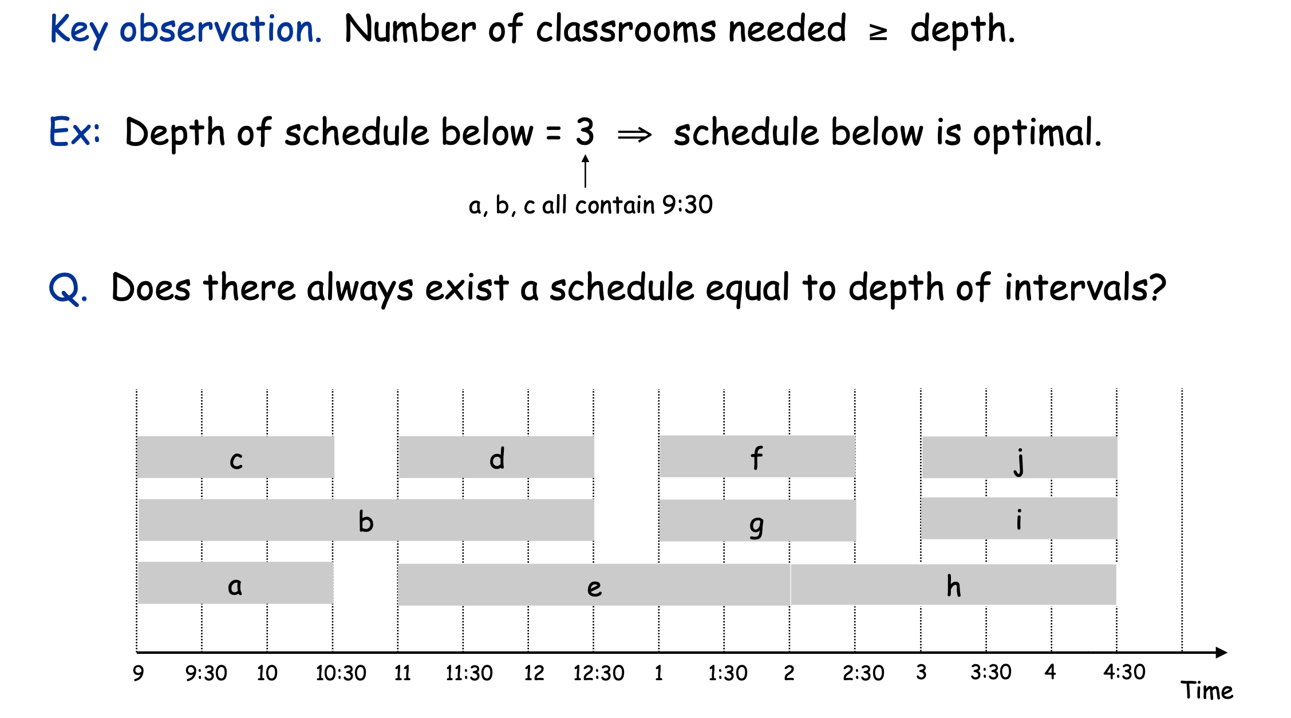

Slide 23
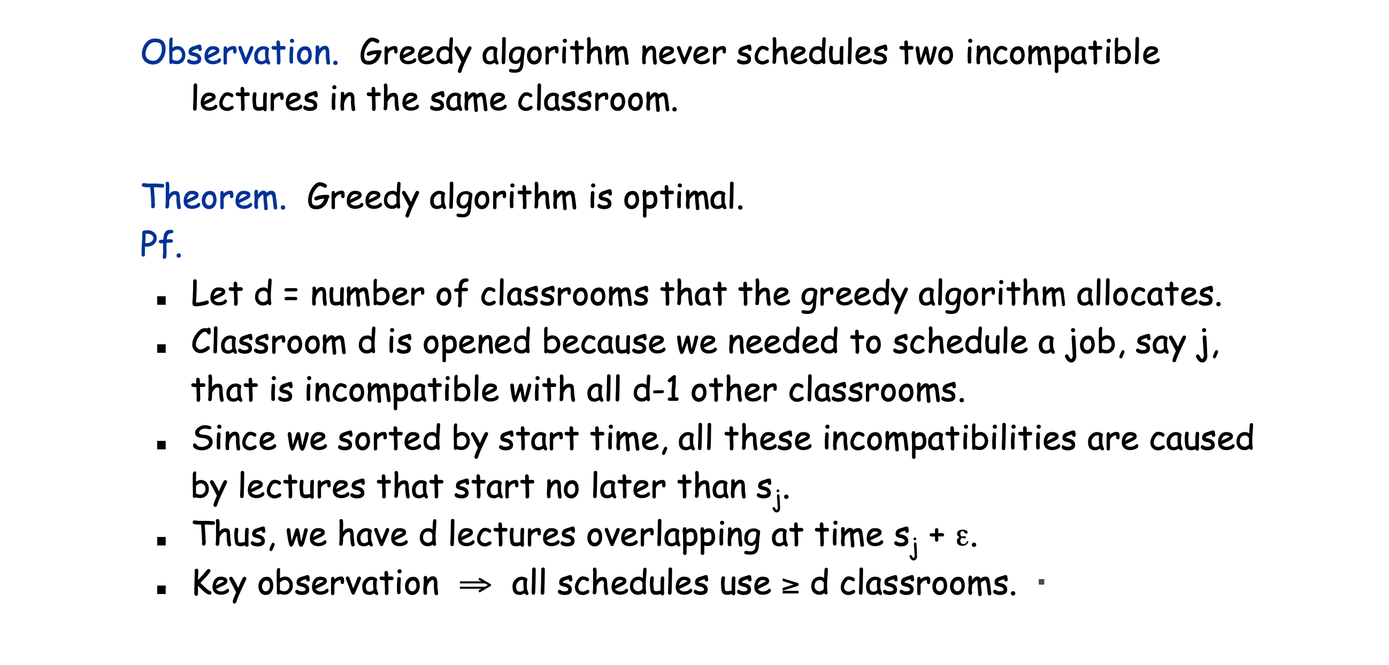
Sorting by start time gives optimal
Notes:
The job say j had a time that conflicts with d-1 other jobs and hence required the opening of a classroom d. That means depth is d so d classrooms

Slide 24
Min Coin Change
The greedy choice: max{di in denominations|di<=A}
Subproblem: c(A-di}
A=12: S={1,5,10}
A=12: S={1,6,10}
Notes:
12

Slide 25
Min Coin Change
The greedy choice: max{di in denominations|di<=A}
Subproblem: c(A-di}
A=12: S={1,5,10}
Let O(A)be optimal and O(A) does not follow greedy
Strategy. Then;
For A>=10: 10 not in O(A). In each of the below case we show that
O(A) is not optimal
A) O(A) has only 1’s: Contradiction. Replace 10 1’s with 10
B) O(A) has one 5. Contradiction. Replace 5 1’s with a 5
C)O(A) has multiple 5’s. Contradiction. Replace 2 5’s with a 10.
For 5<=A<10
Only 1’s: Contradiction . Replace 5 1’s with 5
Thus Optimal has to be following greedy.
Notes:
12

Slide 26
Huffman Coding

Slide 27
Huffman Coding
Huffman codes can be used to compress information
  Like WinZip – although WinZip doesn’t use the Huffman algorithm
  JPEGs do use Huffman as part of their compression process
The basic idea is that instead of storing each character in a file as an 8-bit ASCII value, we will instead store the more frequently occurring characters using fewer bits and less frequently occurring characters using more bits
  On average this should decrease the filesize (usually ½)

Slide 28
Huffman Coding
As an example, lets take the string:
  “duke blue devils”
We first to a frequency count of the characters:
    e:3, d:2, u:2, l:2, space:2, k:1, b:1, v:1, i:1, s:1
Next we use a Greedy algorithm to build up a Huffman Tree
  We start with nodes for each character
e,3
d,2
u,2
l,2
sp,2
k,1
b,1
v,1
i,1
s,1

Slide 29
Huffman Coding
We then pick the nodes with the smallest frequency and combine them together to form a new node
  The selection of these nodes is the Greedy part
The two selected nodes are removed from the set, but replace by the combined node
This continues until we have only 1 node left in the set

Slide 30
Huffman Coding
e,3
d,2
u,2
l,2
sp,2
k,1
b,1
v,1
i,1
s,1

Slide 31
Huffman Coding
e,3
d,2
u,2
l,2
sp,2
k,1
b,1
v,1
2
i,1
s,1

Slide 32
Huffman Coding
e,3
d,2
u,2
l,2
sp,2
k,1
2
2
b,1
v,1
i,1
s,1

Slide 33
Huffman Coding
e,3
d,2
u,2
l,2
sp,2
3
2
k,1
2
i,1
s,1
b,1
v,1

Slide 34
Huffman Coding
e,3
d,2
u,2
4
3
2
l,2
sp,2
k,1
2
i,1
s,1
b,1
v,1

Slide 35
Huffman Coding
e,3
4
4
3
2
d,2
u,2
l,2
sp,2
k,1
2
i,1
s,1
b,1
v,1

Slide 36
Huffman Coding
e,3
4
4
5
d,2
u,2
l,2
sp,2
2
3
i,1
s,1
k,1
2
b,1
v,1

Slide 37
Huffman Coding
7
4
5
e,3
4
l,2
sp,2
2
3
d,2
u,2
i,1
s,1
k,1
2
b,1
v,1

Slide 38
Huffman Coding
7
9
e,3
4
4
5
d,2
u,2
l,2
sp,2
2
3
i,1
s,1
k,1
2
b,1
v,1

Slide 39
Huffman Coding
16
7
9
e,3
4
4
5
d,2
u,2
l,2
sp,2
2
3
i,1
s,1
k,1
2
b,1
v,1

Slide 40
Huffman Coding
Now we assign codes to the tree by placing a 0 on every left branch and a 1 on every right branch
A traversal of the tree from root to leaf give the Huffman code for that particular leaf character
Note that no code is the prefix of another code

Slide 41
Huffman Coding
e | 00
d | 010
u | 011
l | 100
sp | 101
i | 1100
s | 1101
k | 1110
b | 11110
v | 11111
16
0
1
7
9
0
1
0
1
e,3
4
4
5
0
1
0
1
0
1
d,2
u,2
l,2
sp,2
2
3
0
1
0
1
i,1
s,1
k,1
2
0
1
b,1
v,1

Slide 42
Huffman Coding
These codes are then used to encode the string
Thus, “duke blue devils” turns into:
010 011 1110 00 101 11110 100 011 00 101 010 00 11111 1100 100 1101
When grouped into 8-bit bytes:
01001111 10001011 11101000 11001010 10001111 11100100 1101xxxx
Thus it takes 7 bytes of space compared to 16 characters * 1 byte/char = 16 bytes uncompressed

Slide 43
Huffman Coding
Uncompressing works by reading in the file bit by bit
  Start at the root of the tree
  If a 0 is read, head left
  If a 1 is read, head right
  When a leaf is reached decode that character and start over again at the root of the tree
Thus, we need to save Huffman table information as a header in the compressed file
  Doesn’t add a significant amount of size to the file for large files (which are the ones you want to compress anyway)
  Or we could use a fixed universal set of codes/freqencies

Slide 44
Other greedy algorithms
Dijkstra’s algorithm for finding the shortest path in a graph
  Always takes the shortest edge connecting a known node to an unknown node
Kruskal’s algorithm for finding a minimum-cost spanning tree
  Always tries the lowest-cost remaining edge
Prim’s algorithm for finding a minimum-cost spanning tree
  Always takes the lowest-cost edge between nodes in the spanning tree and nodes not yet in the spanning tree

Slide 45
Dijkstra’s shortest-path algorithm
Dijkstra’s algorithm finds the shortest paths from a given node to all other nodes in a graph
  Initially,
    Mark the given node as known (path length is zero)
    For each out-edge, set the distance in each neighboring node equal to the cost (length) of the out-edge, and set its predecessor to the initially given node
  Repeatedly (until all nodes are known),
    Find an unknown node containing the smallest distance
    Mark the new node as known
    For each node adjacent to the new node, examine its neighbors to see whether their estimated distance can be reduced (distance to known node plus cost of out-edge)
      If so, also reset the predecessor of the new node

Slide 46
Analysis of Dijkstra’s algorithm I
Assume that the average out-degree of a node is some constant k
  Initially,
    Mark the given node as known (path length is zero)
      This takes O(1) (constant) time
    For each out-edge, set the distance in each neighboring node equal to the cost (length) of the out-edge, and set its predecessor to the initially given node
      If each node refers to a list of k adjacent node/edge pairs, this takes O(k) = O(1) time, that is, constant time
      Notice that this operation takes longer if we have to extract a list of names from a hash table

Slide 47
Analysis of Dijkstra’s algorithm II
Repeatedly (until all nodes are known), (n times)
  Find an unknown node containing the smallest distance
    Probably the best way to do this is to put the unknown nodes into a priority queue; this takes k * O(log n) time each time a new node is marked “known” (and this happens n times)
  Mark the new node as known -- O(1) time
  For each node adjacent to the new node, examine its neighbors to see whether their estimated distance can be reduced (distance to known node plus cost of out-edge)
    If so, also reset the predecessor of the new node
    There are k adjacent nodes (on average), operation requires constant time at each, therefore O(k) (constant) time
  Combining all the parts, we get:
  O(1) + n*(k*O(log n)+O(k)), that is, O(nk log n) time

Slide 48
Minimum spanning tree
A minimum spanning tree is a least-cost subset of the edges of a graph that connects all the nodes
  Start by picking any node and adding it to the tree
  Repeatedly: Pick any least-cost edge from a node in the tree to a node not in the tree, and add the edge and new node to the tree
  Stop when all nodes have been added to the tree
6
The result is a least-cost (3+3+2+2+2=12) spanning tree
If you think some other edge should be in the spanning tree:
  Try adding that edge
  Note that the edge is part of a cycle
  To break the cycle, you must remove the edge with the greatest cost
    This will be the edge you just added
4
2
1
4
5
3
2
3
3
2
3
3
2
4
4
Notes:
9

