Slide 1
Readers-Writers Problem
A data set is shared among a number of concurrent processes
  Readers – only read the data set; they do not perform any updates
  Writers – can both read and write.
Problem – allow multiple readers to read at the same time. Only one single writer can access the shared data at the same time.
http://www.cis.upenn.edu/~lee/03cse380/lectures/ln2-ipc-v2.pdf

Slide 2
Constraints
Only one writer writes at a time
If even one reader is reading then, no writing should happen
Multiple readers can read at the same time

Slide 3
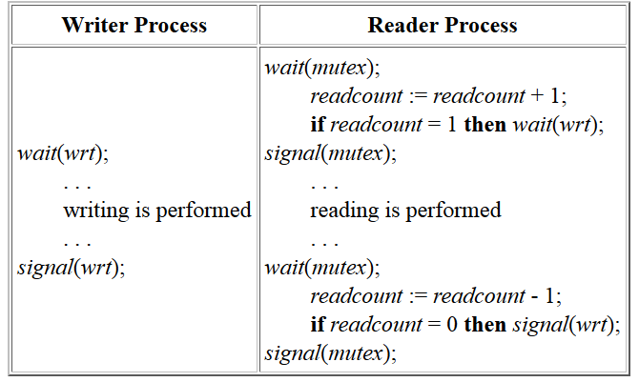
Readers-Writers Problem (Cont.)

Slide 4
Second Readers-Writers Problem
First-readers-writers-problem : Gives preference to readers –no readers will be kept waiting unless writer has got access
Second-readers-writers-problem: Requires writers to be given priority where writers should not be kept waiting. That is, no new reader can gain access if a writer is waiting

Slide 5
Second readers writers
Make sure multiple readers can read
-You hence cant lock the reading part as it restricts another reader reading simultaneously
Make sure more readers don’t join the reading group if a writer expressed interest in writing
-When writer interested lock readers from entering
When a writer writes, no one reads/writes.
-lock while writing
If both reader and writer is waiting, give preference to writer
A)writer should not release lock to reader if another writer is waiting.
B)If first writer is writing, restrict the number of readers who can even show interest so that if a writer enters after first writer relinquishes lock then he does not have to wait for a queue of waiting readers to finish.

Slide 6
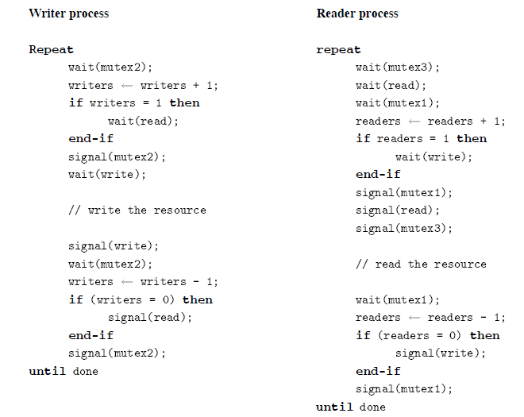
Second Readers-Writers Problem

