Slide 1

CS7.505: Computer Vision
Spring 2025: Object Detection with DL
CAT, DOG, DUCK
Makarand Tapaswi, Ravi Kiran Sarvadevabhatla
CVIT, IIIT Hyderabad

Slide 2
R-CNN Problems
Slow at test-time: Need to run full forward pass of CNN for each region proposal
SVMs and Regressors are Post-hoc: CNN features are not updated in response to SVMs and regressors
Complex multistage training pipeline

Slide 3
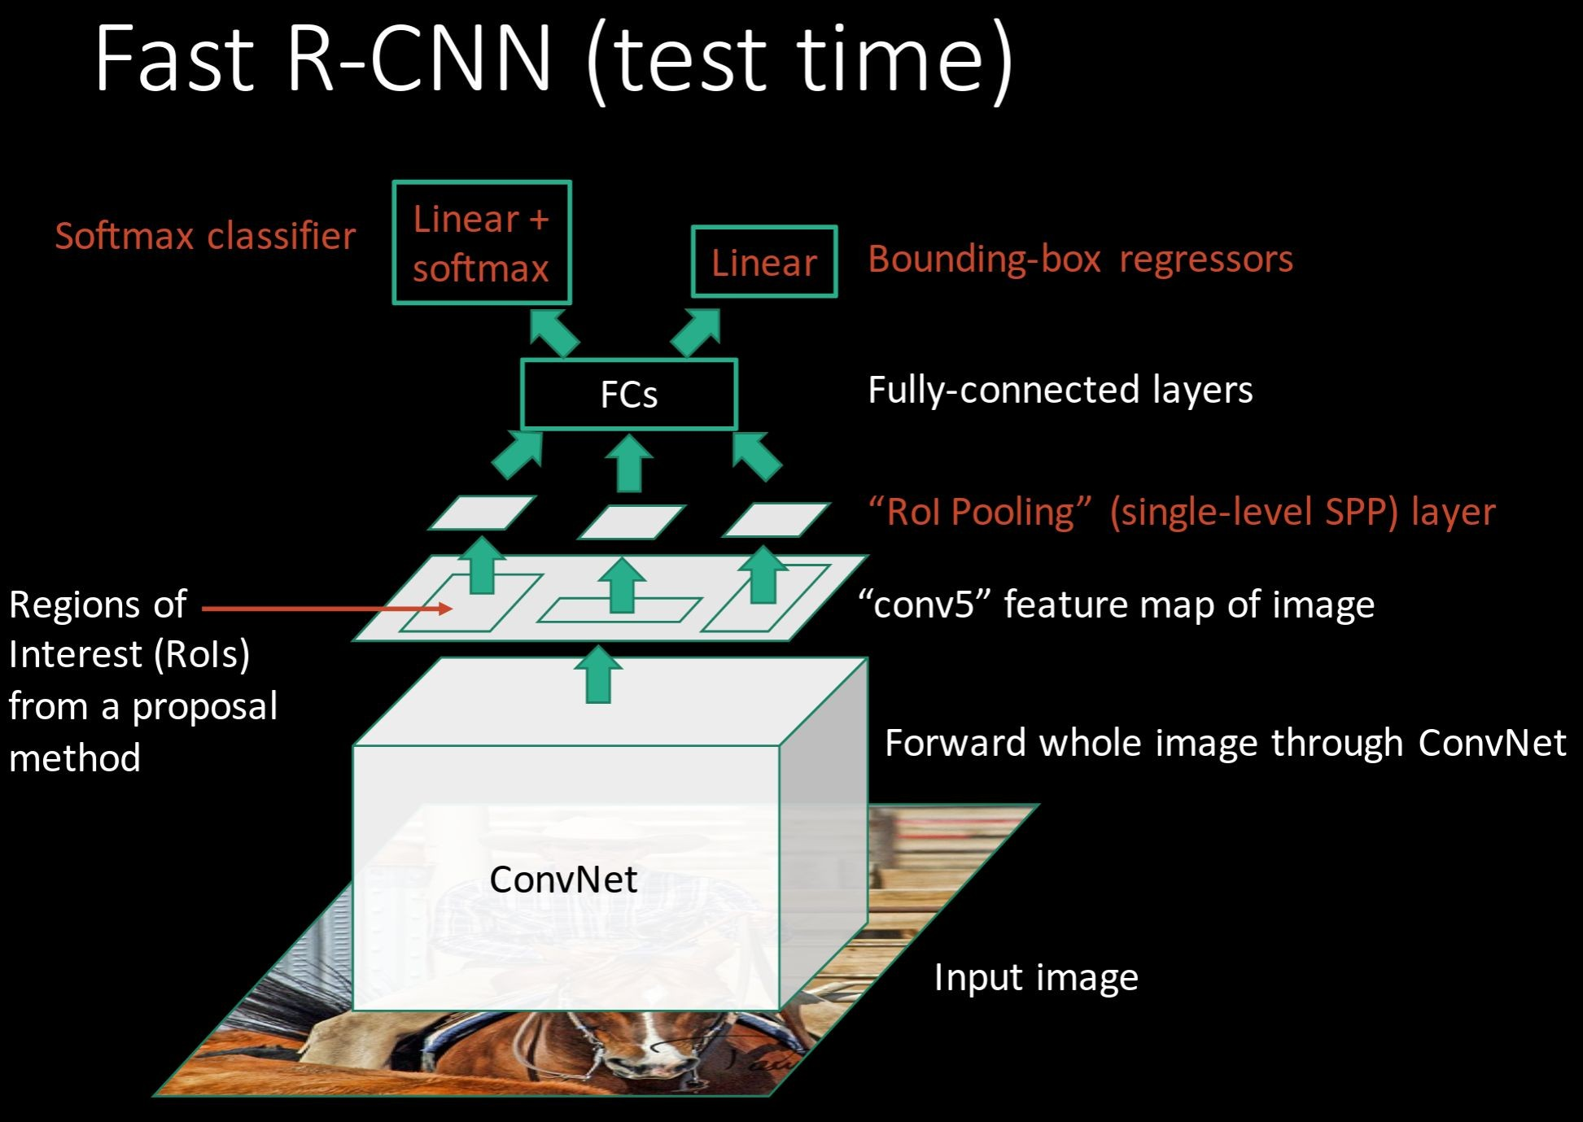
Girschick, “Fast R-CNN”, ICCV 2015

Slide 4

R-CNN Problem #1: Slow at test-time due to independent forward passes of the CNN
Solution:
Share computation of convolutional layers between proposals for an image
Girschick, “Fast R-CNN”, ICCV 2015

Slide 5
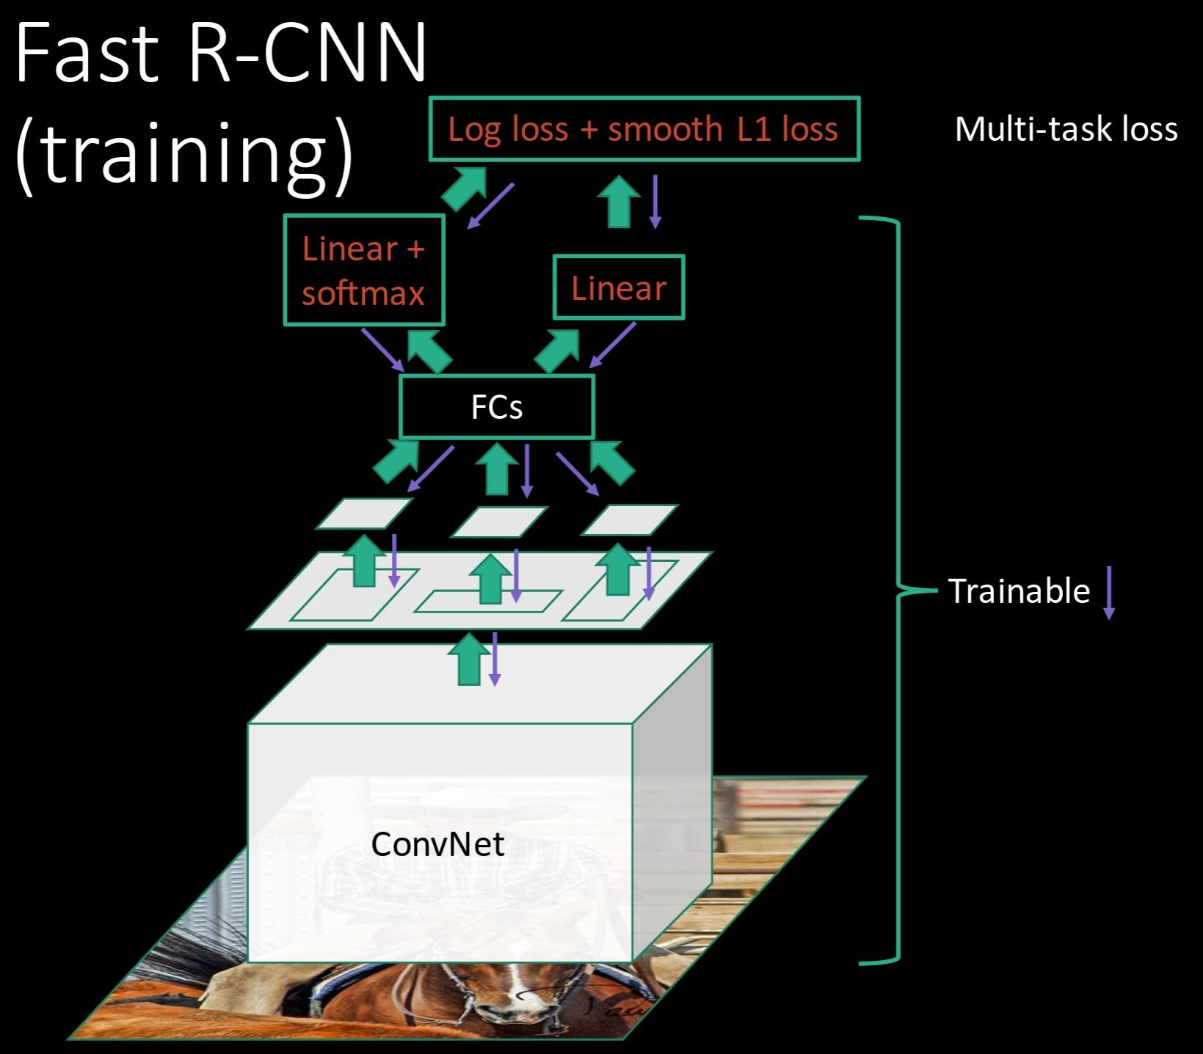
R-CNN Problem #2:
Post-hoc training: CNN not updated in response to final classifiers and regressors
R-CNN Problem #3:
Complex training pipeline
Solution:
Just train the whole system end-to-end all at once!
Slide credit: Ross Girschick

Slide 6

Fast R-CNN: Region of Interest Pooling
Convolution and Pooling
Fully-connected layers
Hi-res input image: 3 x 800 x 600
with region proposal
Hi-res conv features:
C x H x W
with region proposal
Problem: Fully-connected layers expect low-res conv features: C x h x w

Slide 7
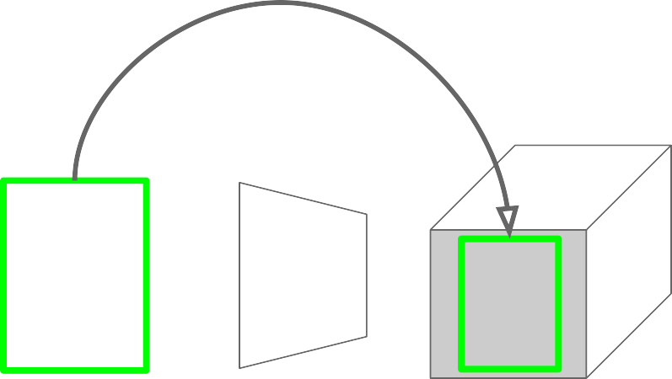
Fast R-CNN: Region of Interest Pooling
Project region proposal onto conv feature map
Convolution and Pooling
Fully-connected layers
Hi-res input image: 3 x 800 x 600
with region proposal
Hi-res conv features:
C x H x W
with region proposal
Problem: Fully-connected layers expect low-res conv features: C x h x w

Slide 8
Fast R-CNN: Region of Interest Pooling
Convolution and Pooling
Divide projected region into h x w grid
Fully-connected layers
Hi-res input image: 3 x 800 x 600
with region proposal
Hi-res conv features:
C x H x W
with region proposal
Problem: Fully-connected layers expect low-res conv features: C x h x w

Slide 9
Fast R-CNN: Region of Interest Pooling
Max-pool within
Convolution and Pooling
each grid cell
Fully-connected layers
Hi-res input image: 3 x 800 x 600
with region proposal
Hi-res conv features:
C x H x W
with region proposal
RoI conv features:
C x h x w
for region proposal
Problem: Fully-connected layers expect low-res conv features: C x h x w

Slide 10
Fast R-CNN: Region of Interest Pooling
Can back propagate
similar to max pooling
Convolution and Pooling
Fully-connected layers
Hi-res input image: 3 x 800 x 600
with region proposal
Hi-res conv features:
C x H x W
with region proposal
RoI conv features:
C x h x w
for region proposal
Problem: Fully-connected layers expect low-res conv features: C x h x w

Slide 11
RoI in more detail
https://web.eecs.umich.edu/~justincj/slides/eecs498/WI2022/598_WI2022_lecture14.pdf
slides 23 – 31 about projecting boxes across CNN layers
slides 32 – 38 about Region of Interest (RoI) Pooling
slides 39 – 47 about Region of Interest (RoI) Align

Slide 12
Fast R-CNN Results
 | R-CNN | Fast R-CNN
Training Time: | 84 hours | 9.5 hours
(Speedup) | 1x | 8.8x
Faster!
Using VGG-16 CNN on Pascal VOC 2007 dataset

Slide 13
Fast R-CNN Results
 | R-CNN | Fast R-CNN
Training Time: | 84 hours | 9.5 hours
(Speedup) | 1x | 8.8x
Test time per image | 47 seconds | 0.32 seconds
(Speedup) | 1x | 146x
Faster!
FASTER!
Using VGG-16 CNN on Pascal VOC 2007 dataset

Slide 14
Fast R-CNN Results
 | R-CNN | Fast R-CNN
Training Time: | 84 hours | 9.5 hours
(Speedup) | 1x | 8.8x
Test time per image | 47 seconds | 0.32 seconds
(Speedup) | 1x | 146x
mAP (VOC 2007) | 66.0 | 66.9
Faster!
FASTER!
Better!
Using VGG-16 CNN on Pascal VOC 2007 dataset

Slide 15
Fast R-CNN Problem:
Test-time speeds don’t include region proposals
 | R-CNN | Fast R-CNN
Test time per image | 47 seconds | 0.32 seconds
(Speedup) | 1x | 146x
Test time per image with Selective Search | 50 seconds | 2 seconds
(Speedup) | 1x | 25x

Slide 16
Fast R-CNN Problem: Solution
Test-time speeds don’t include region proposals Just make the CNN do region proposals too!
 | R-CNN | Fast R-CNN
Test time per image | 47 seconds | 0.32 seconds
(Speedup) | 1x | 146x
Test time per image with Selective Search | 50 seconds | 2 seconds
(Speedup) | 1x | 25x

Slide 17
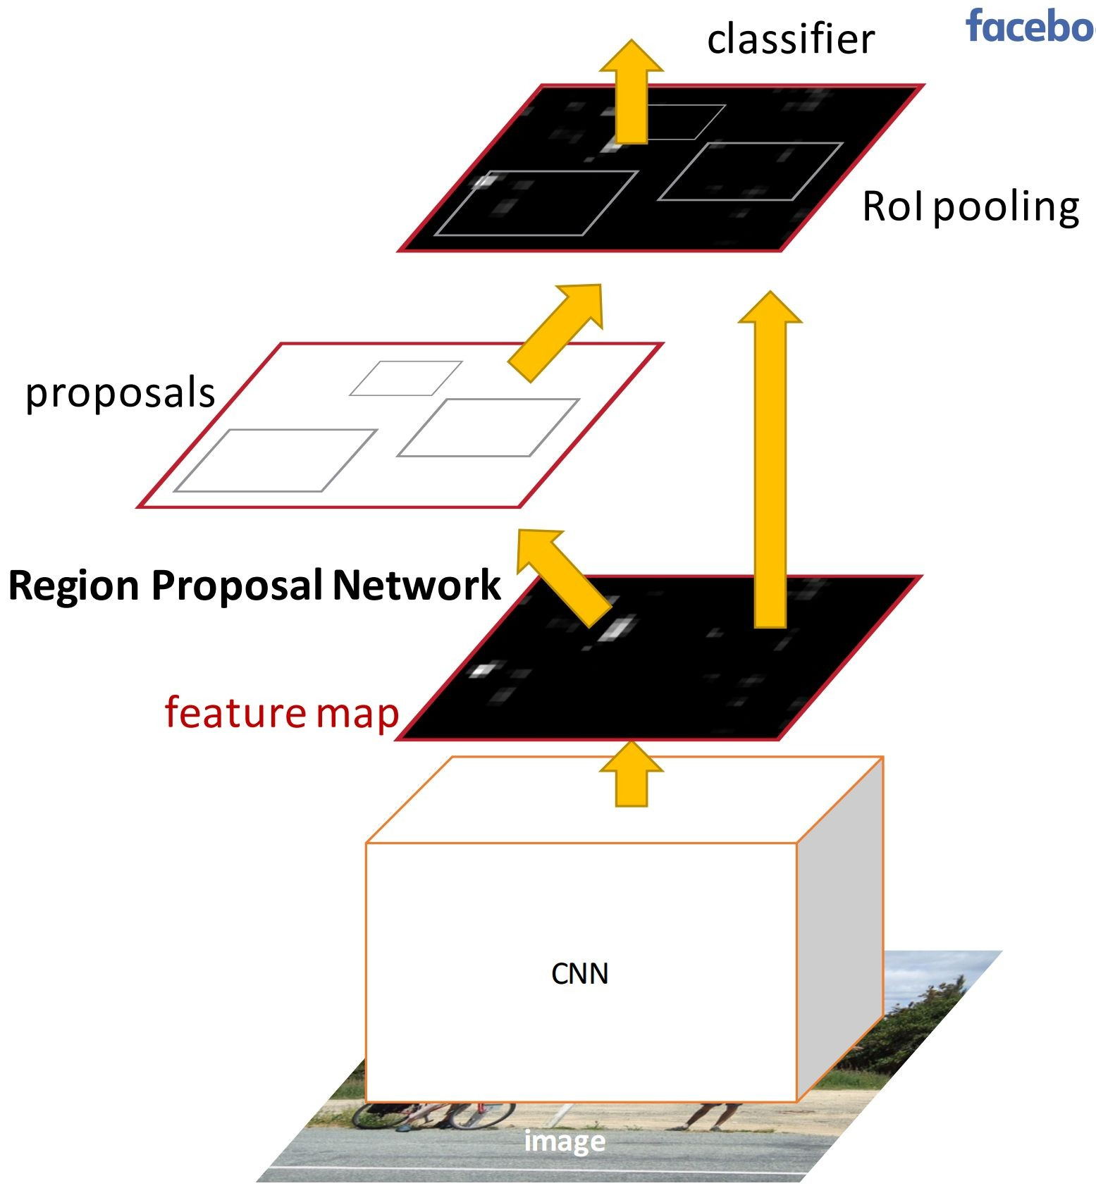
Faster R-CNN:
Insert a Region Proposal Network (RPN) after the last convolutional layer
RPN trained to produce region proposals directly; no need for external region proposals!
After RPN, use RoI Pooling and an upstream classifier and bbox regressor just like Fast R-CNN
Ren et al, “Faster R-CNN: Towards Real-Time Object Detection with Region Proposal Networks”, NIPS 2015
Slide credit: Ross Girschick

Slide 18
Region Proposal Network
Explained nicely with an example here:
https://web.eecs.umich.edu/~justincj/slides/eecs498/WI2022/598_WI2022_lecture14.pdf
Slides 52 – 72

Slide 19
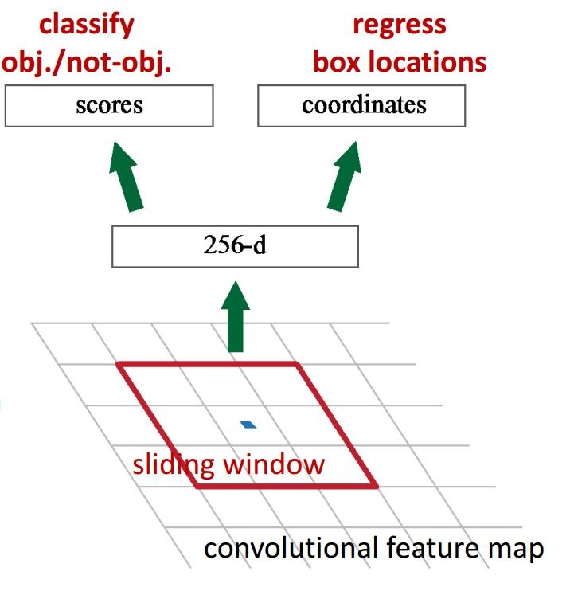
Faster R-CNN: Region Proposal Network
Slide a small window on the feature map
Build a small network for:
classifying object or not-object, and
regressing bbox locations
1 x 1 conv
1 x 1 conv
3 x 3 conv
Position of the sliding window provides localization information with reference to the image
Box regression provides finer localization information with reference to this sliding window
Slide credit: Kaiming He

Slide 20
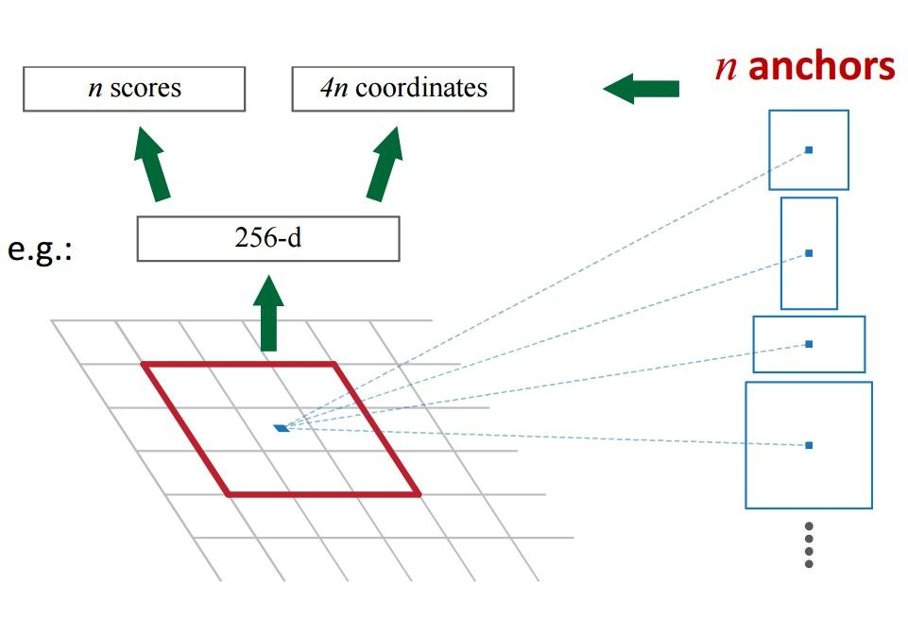
Faster R-CNN: Region Proposal Network
Use N anchor boxes at each location
Anchors are translation invariant: use the same ones at every location
Regression gives offsets from anchor boxes
Classification gives the probability that each (regressed) anchor shows an object

Slide 21
Faster R-CNN: Results
 | R-CNN | Fast R-CNN | Faster R-CNN
Test time per image (with proposals) | 50 seconds | 2 seconds | 0.2 seconds
(Speedup) | 1x | 25x | 250x
mAP (VOC 2007) | 66.0 | 66.9 | 66.9

Slide 22
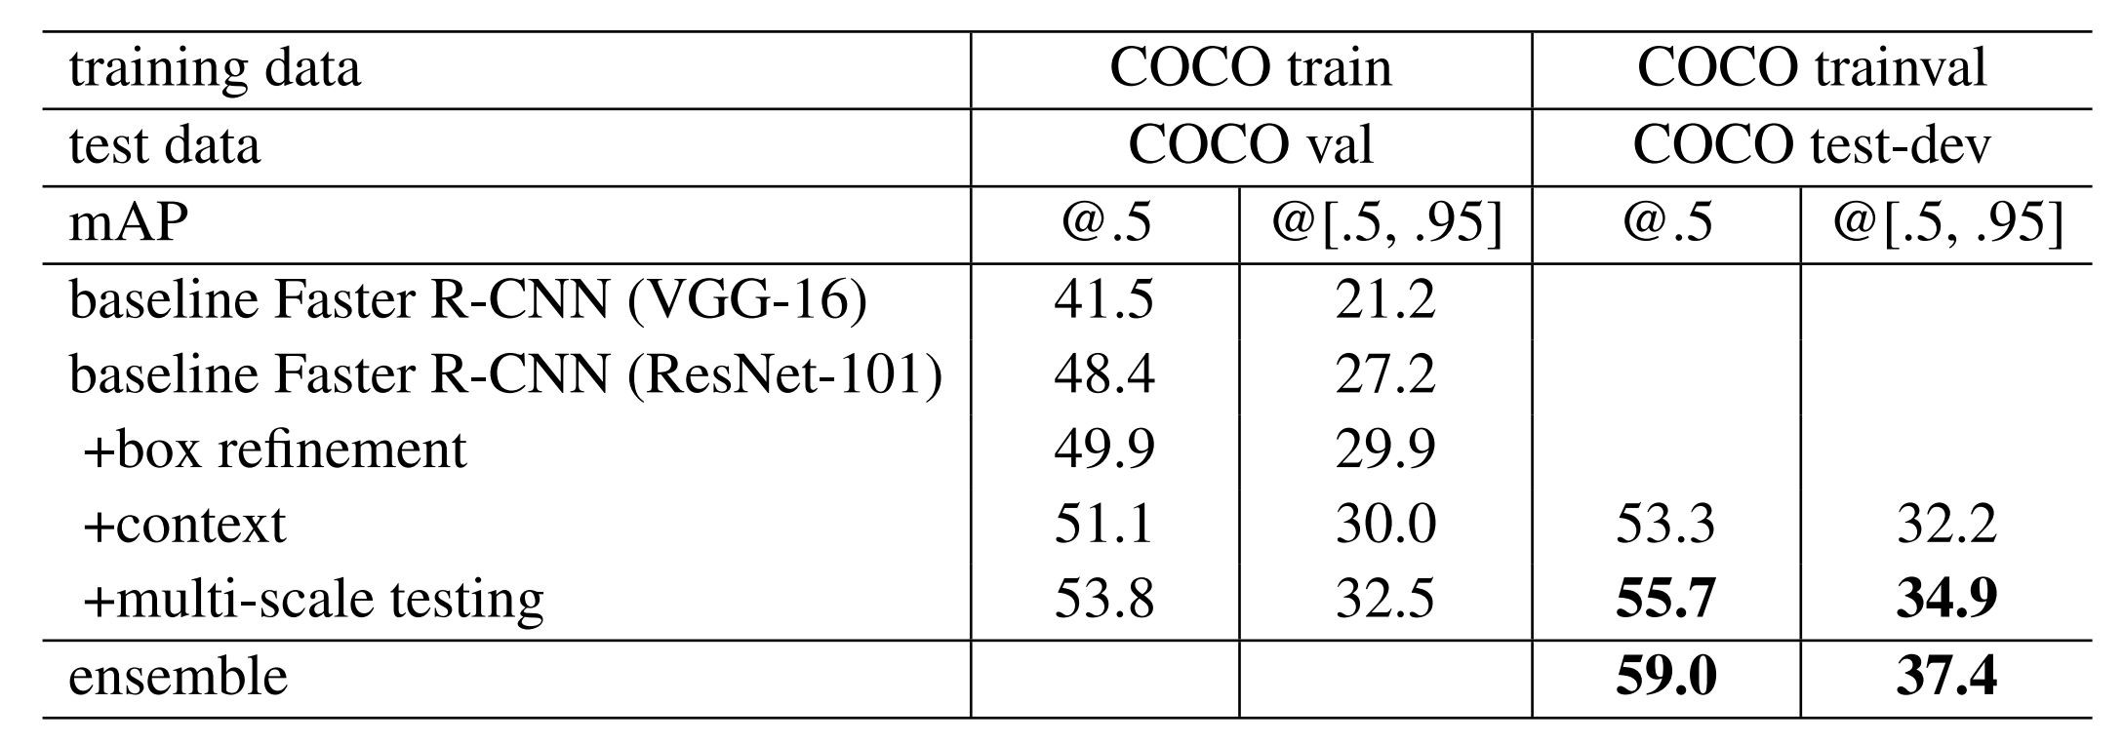
ResNet 101 + Faster R-CNN + extras
He et. al, “Deep Residual Learning for Image Recognition”, arXiv 2015

Slide 23
Feature Pyramid Network
In practice, what is used is something like:
FasterRCNN (ResNet-101) + FPN
https://web.eecs.umich.edu/~justincj/slides/eecs498/WI2022/598_WI2022_lecture14.pdf
Slides 73 – 83

Slide 24
Deep Learning based Detection
Use deep Learnt features for detection
  Cannot afford to do for every window
Classify select windows (Region Proposals)
  RCNN, Fast RCNN, Faster RCNN, Mask RCNN
Directly predict bounding boxes
  YOLO V1, V2, V3
Detection Transformer

Slide 25
Questions?

