Slide 1
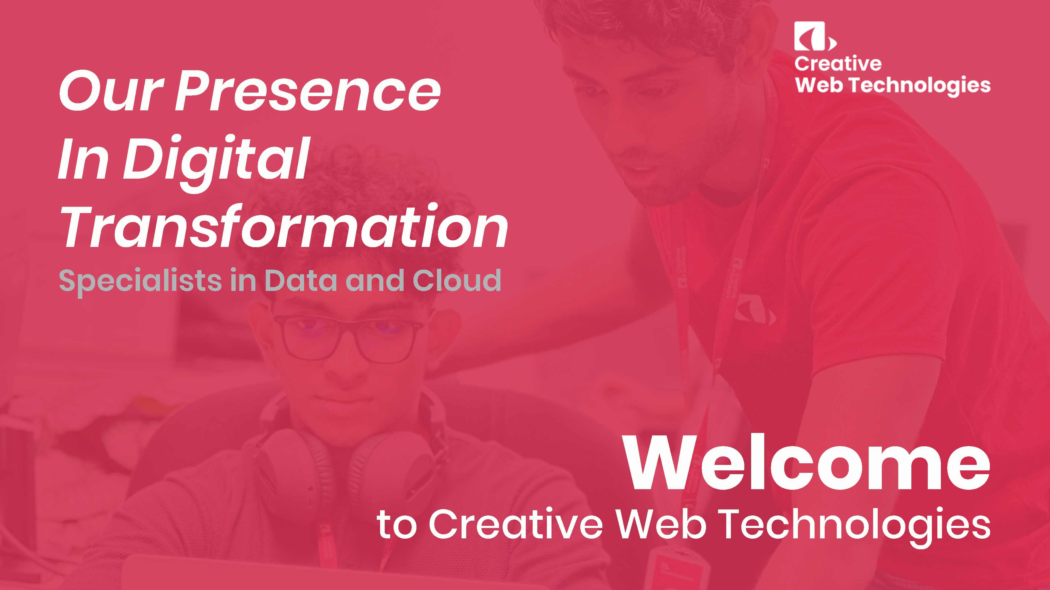

Slide 2




Creative Software’s Leadership​
Sushena Ranatunga
Jonas Bridgwater
Co-Founder Director - Creative Software
Co-Founder /Director - Creative Software
Sushena has been a director of Creative Software since its inception.
He co-founded Four Corners Lanka (Pvt) Ltd, Four Corners Leisure (Pvt) Ltd, Creative eLearning and serves as a Director of Cambio Software Engineering Pvt Ltd., the leading E-Healthcare solutions provider in Sweden.
He has been working in the IT Industry in Sri Lanka and overseas since 1989.
He is currently the Rotary District Governor 2024-25 of the Rotary District 3220. Sushena holds a B.Sc. (Hons) in Information Technology/ Information Systems from Manchester Metropolitan University (UK) and an M.Sc. in Information Technology from Keele University (UK).
Jonas has been a director of Creative Software since its inception.
He has been working in Sri Lanka’s IT Industry since 1998 when he arrived as the Managing Director of IFS' first R&D centre in Colombo.
Prior to moving to Sri Lanka, Jonas worked as a software engineer and programme manager in Sweden.
He holds a BSc in Information Technology from Chalmers Tekniska Högskola in Sweden.

Slide 3
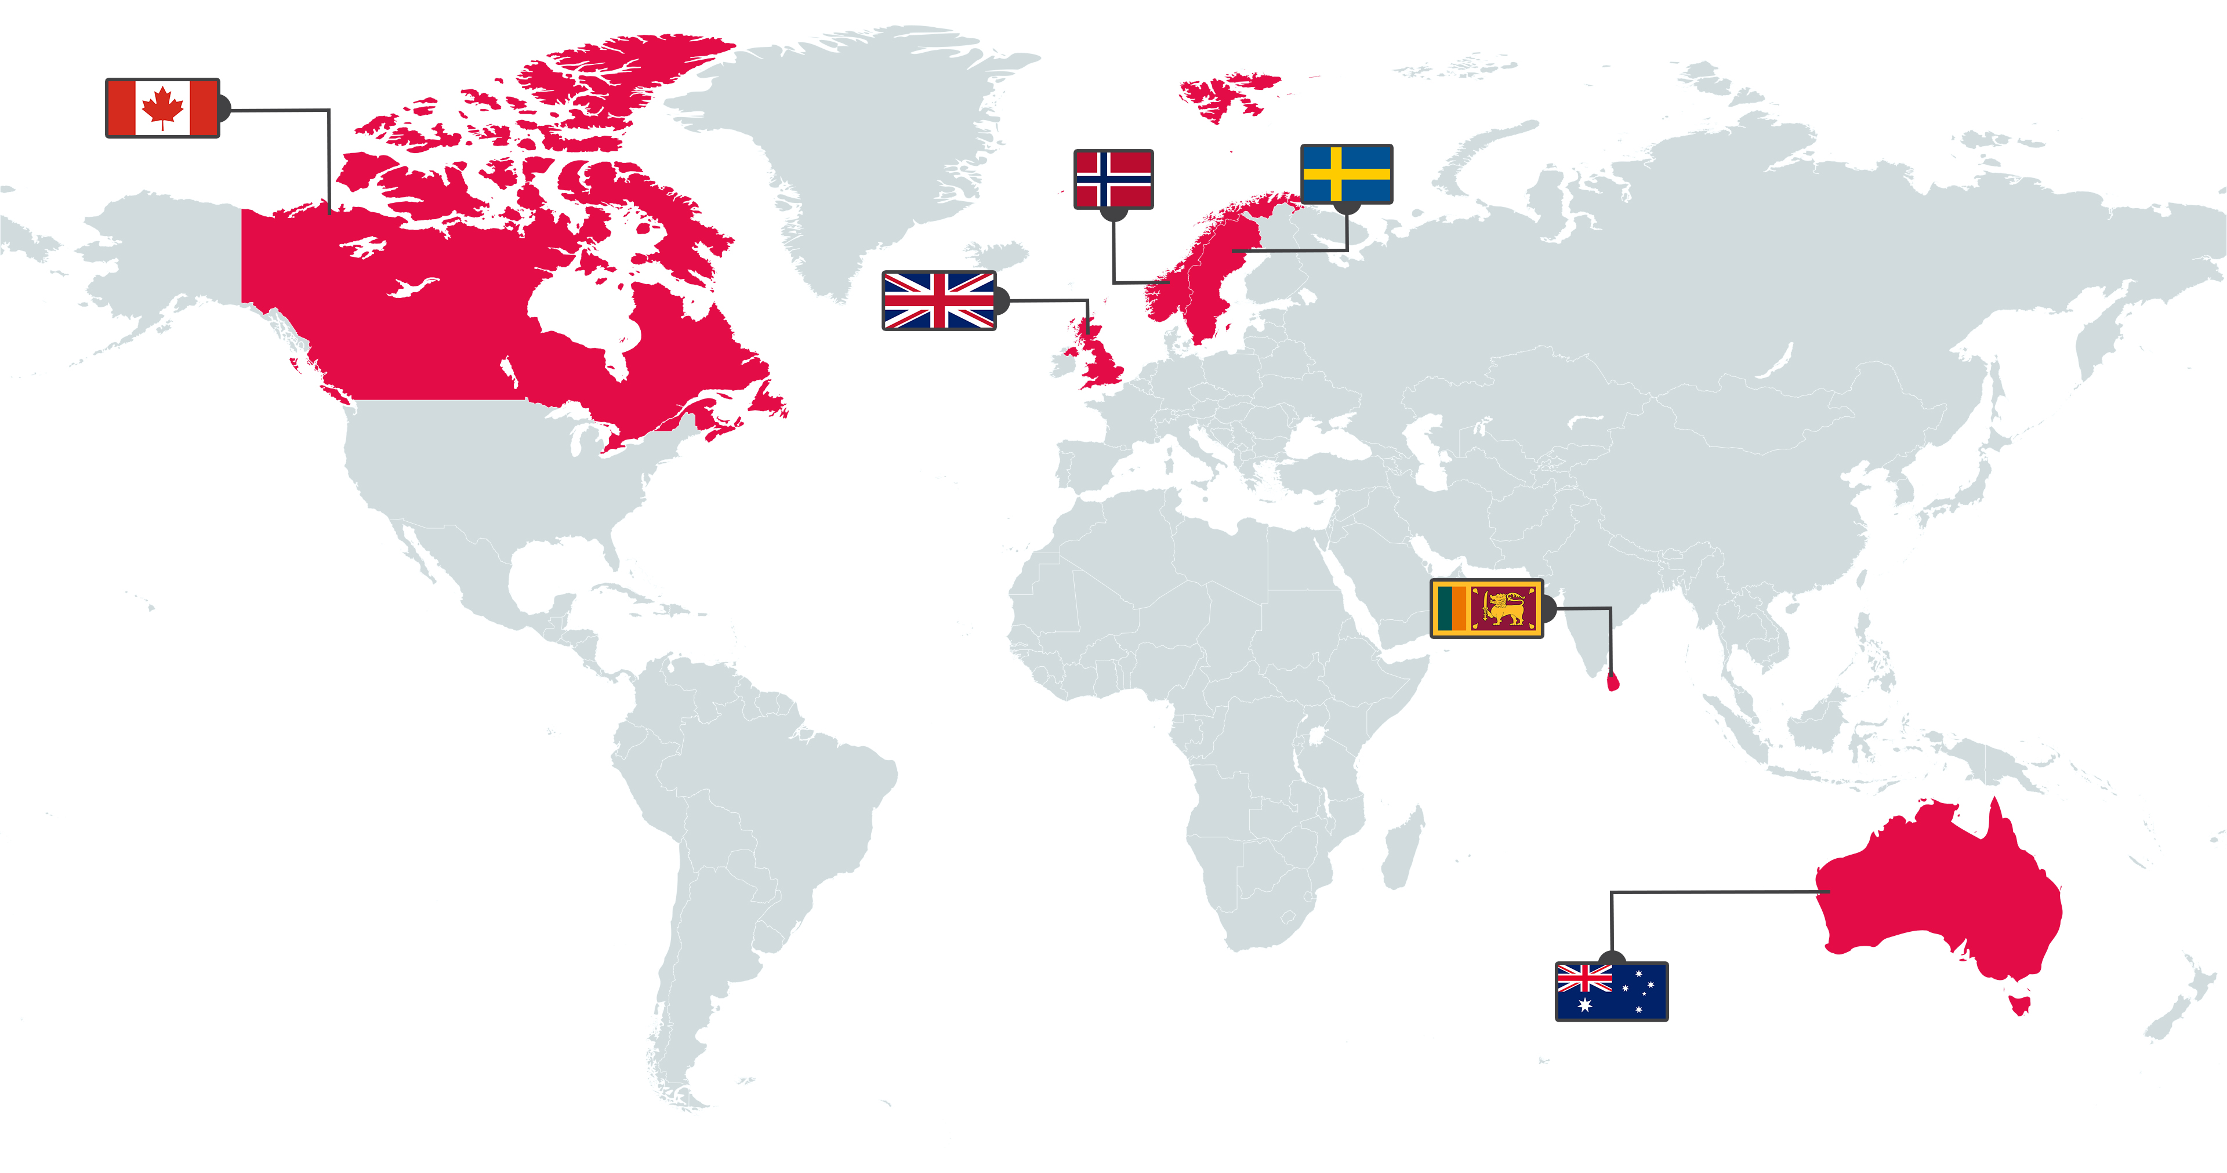




Creative Software at a Glance​
Founded in 1999
700 employed and under
management
Customers world-wide
With the biggest footprint
In Scandinavia
20+ years experience working
With geographically dispersed
teams
Scandinavia is our home market, but today we have customers all over the world. ​Our success comes from a relentless focus on quality and customer satisfaction, and most of our new business comes from customer referrals​

Slide 4
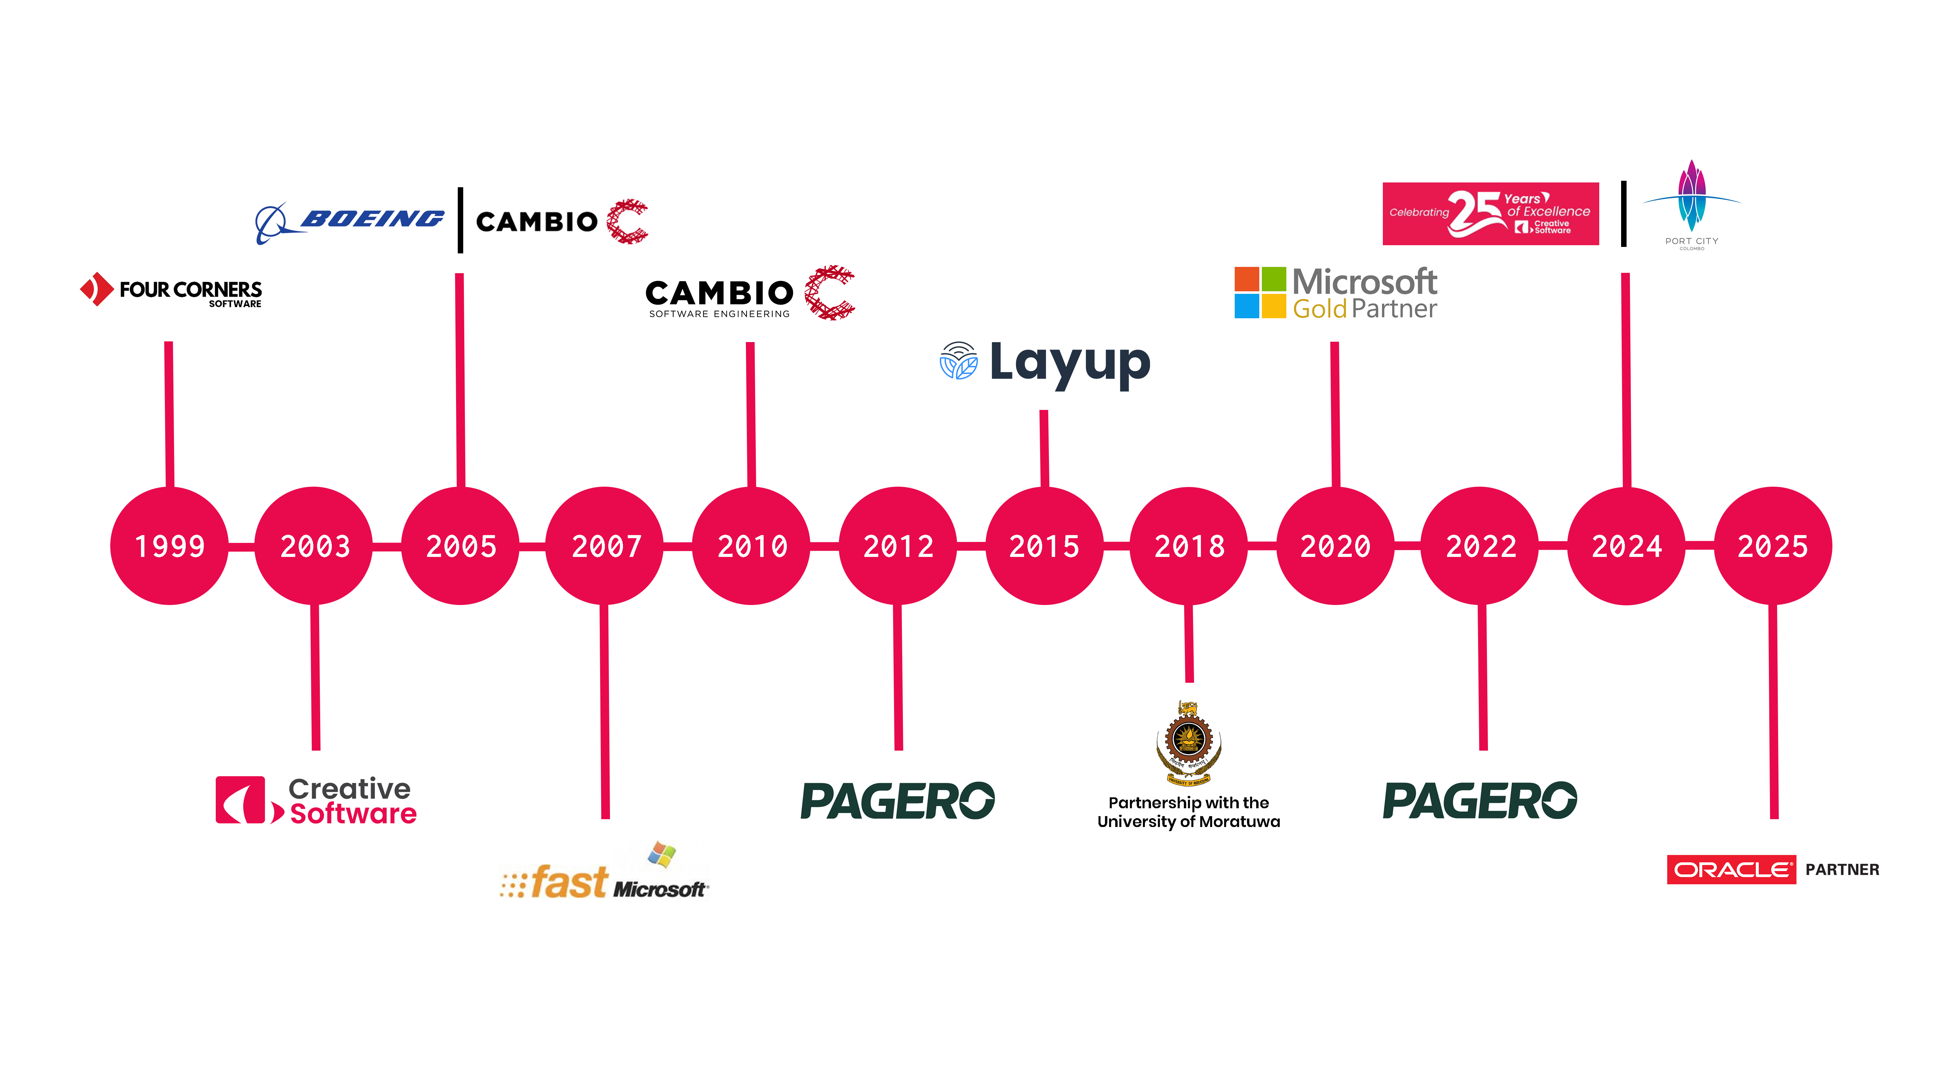
The Journey​
Notes:
Our story begins in 1999 with the founding of Four Corners Software, which laid the groundwork for our engineering culture. Just four years later, in 2003, Creative Software was officially established.
From the very beginning, we targeted complex, high-compliance industries. By 2005, we had secured landmark relationships, stepping up to build software solutions for global giants like Boeing and anchoring our footprint in the specialized Nordic e-healthcare space with Cambio.
As we entered the late 2000s, our technical capabilities expanded rapidly. In 2007, we deepened our alignment with the Microsoft ecosystem, getting involved with their fast search engine. In 2010, we formalized our presence in healthcare engineering by establishing Cambio Software Engineering in Sri Lanka, which has since grown to house hundreds of specialized healthcare IT professionals.
By 2012, Pagero was formed and joined our umbrella, a leader in automated e-invoicing and e-order processing. To ensure a continuous pipeline of world-class engineering talent, 2015 marked the launch of our strategic partnership with the University of Moratuwa, alongside the rollout of Layup, our proprietary SaaS corporate learning platform.
The last several years have been defined by rapid cloud modernization and formal industry accolades. By 2018, our enterprise footprint grew to handle massive international projects. In 2020, our engineering excellence was officially recognized when we achieved Microsoft Gold Partner status.
In 2022, our dedication to cutting-edge cloud architectures earned us the prestigious Microsoft Special Recognition for 'App Innovation for Sri Lanka' and the 'Best App Modernisation Award'.
Bringing us to 2024 and 2025, we celebrated a quarter-century of operations, officially establishing ourselves as a premier Oracle Partner and solidifying our status as the go-to regional specialist for Public, Hybrid, and Multi-Cloud Data Platforms.

Slide 5
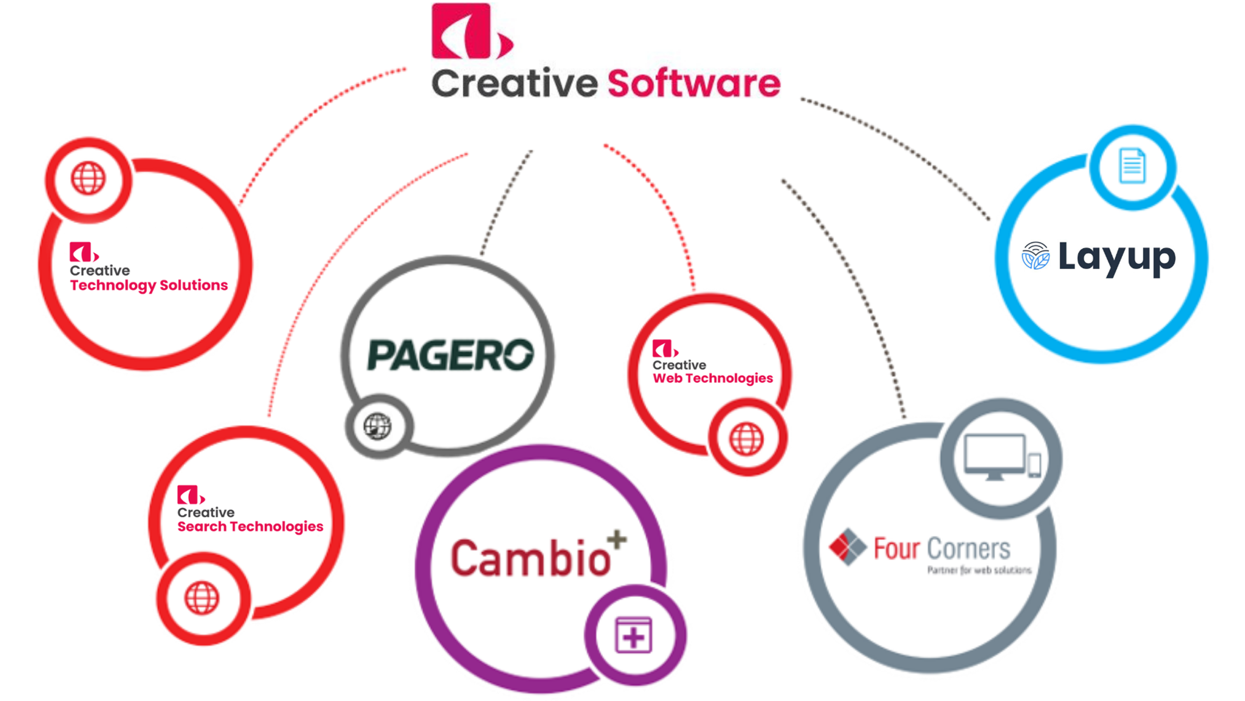
Notes:
Pagero – Invoicing with millions of customers
Four Corners – Fast (Bought by Microsoft)
CWT - Data

Slide 6

Our Associates
CAMBIO
The e-healthcare market leader in the Nordic regions,
Cambio Software Engineering, backed by the strength of its parent company Cambio Healthcare Systems
AB, is at the forefront of designing and developing cutting-edge healthcare solutions using state-of-the-art
technologies. Cambio’s e-health solutions support healthcare professionals in their daily work and offer
patients safer and more accessible care. Operating in Sri Lanka for over 15 years, Cambio currently employs
over 300 skilled software professionals in the island, leveraging the country’s development expertise.
Headquartered in Stockholm, Sweden, Cambio is the e-healthcare market leader in the Nordic regions,
delivering comprehensive IT solutions to healthcare providers in Sweden, Denmark, and the UK. As a
subsidiary of Creative Software, the team in Sri Lanka manages the entire R&D operations for Cambio,
ensuring the delivery of innovative and effective healthcare solutions
Notes:
Swedish
Developed the Software

Slide 7

Our Partners
DIPS
Leading supplier of e-health software intended for Norwegian hospitals, municipal health services, radiology, and laboratories
DIPS addresses the needs for administration and documentation of patient treatment through electronic patient records systems and interaction between healthcare organizations and collaborating businesses. This enables clients with structured information processing for optimal patient care. DIPS was founded in 1987 and has grown to become the largest provider of electronic patient record systems to hospitals in Norway. The company has contracts with three of Norway’s four regional health trusts, including five of the six university hospitals in Norway. The DIPS solutions have more than 100,000 daily users and are thus one of Norway’s most used computer systems. DIPS has around 400 employees in offices located in 5 cities in Norway and is headquartered in Bodø. DIPS, conducts its Research and Development (R&D) operations in Sri Lanka through a strategic partnership with Creative Software.

Slide 8

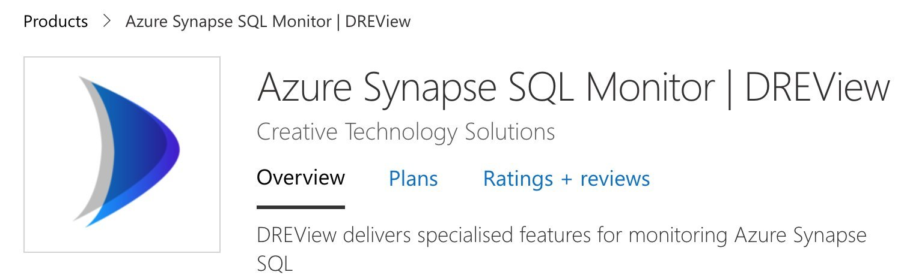


Our Products
Dreview
Kuha
Layup
DREView gives you a comprehensive insight into your workloads and end-to-end visibility into the performance of your SQL data warehouse, helping you to dramatically reduce the time it takes to isolate and fix data warehouse issues. ​​
​​
The monitor provides an intuitive interface on a single pane of glass that visualizes data warehouses and server activity so you can see immediately where problem areas are.​​
In today's fast-paced business landscape, organizations encounter a common challenge - efficiently accessing and managing critical information within their extensive document repositories. ​​
​​
This affects various departments, such as Legal, HR, and Finance, making quick access to crucial documents a struggle due to the complexity of existing search solutions. kuha is here to revolutionize the way you access and utilize your data and documents, all while keeping your data highly secure.​
Layup revolutionizes corporate training with its cutting-edge platform featuring a multi-tenant cloud architecture for seamless scalability and rapid deployment. Offering frequent iterative updates and multiple integrations to streamline operations, Layup fosters an active learning culture by reimagining corporate learning. ​
​
Enhance training effectiveness and engagement with Layup's gamified, social-driven Learning Management System, designed to optimize learning experiences within your organization.​
Notes:
Kuha – Chat-GPT like for Internal Data

Slide 9
Creative
Web Technologies

Slide 10
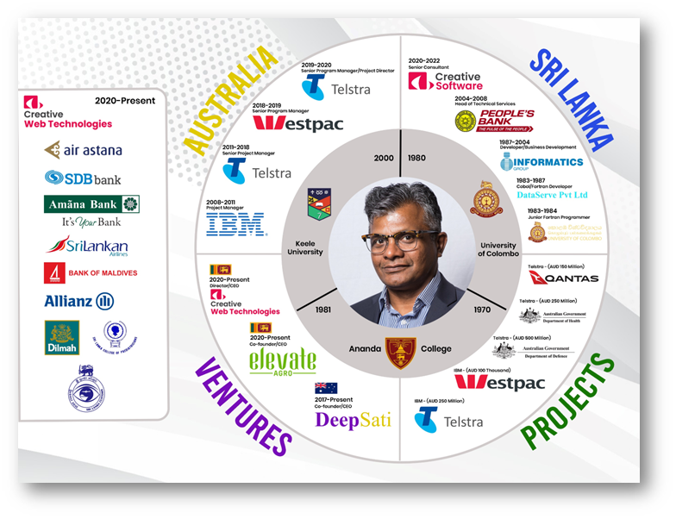

Creative Web Technologies’ Leadership​
Kolitha De Silva
Director CEO - Creative Web Technologies

Slide 11
















Our Clients
Consultation
Hospitality
Logistics
Mobile Workforce
Manufacturing
Enterprise Search
Finance & Banking
Telecommunication
Our clients are from
the following
sectors
Healthcare
E - Learning
Insurance
E - Commerce
Cooperate Auditing
CRM
Retail
Airline

Slide 12
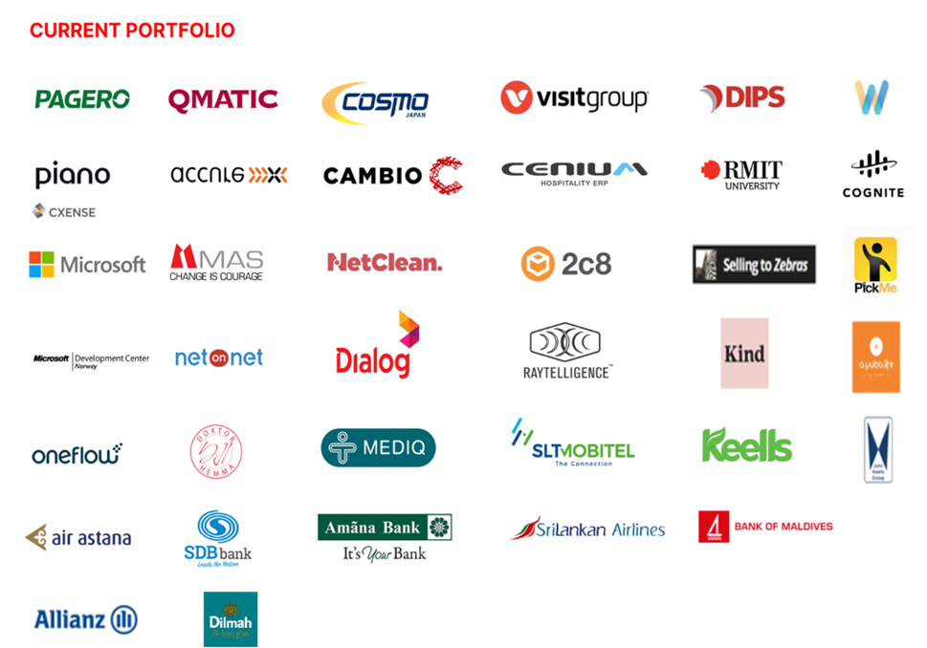






Slide 13
































Our Tech stacks

Slide 14



On Premises
Infrastructure
Multi-cloud
02
03
Hybrid Cloud
Public Cloud
01
04
Oracle Cloud Infrastructure

Slide 15



Microsoft Accreditations
Microsoft Partner Network Program has endorsed the mentioned technical competencies of Creative Software
DevOps
Application
Development
Application
Integration
Our strength is having
Experienced Azure Certified Engineers
Data
Platform
Data
Analytics
Dat
Analytics
Notes:
Nice

Slide 16
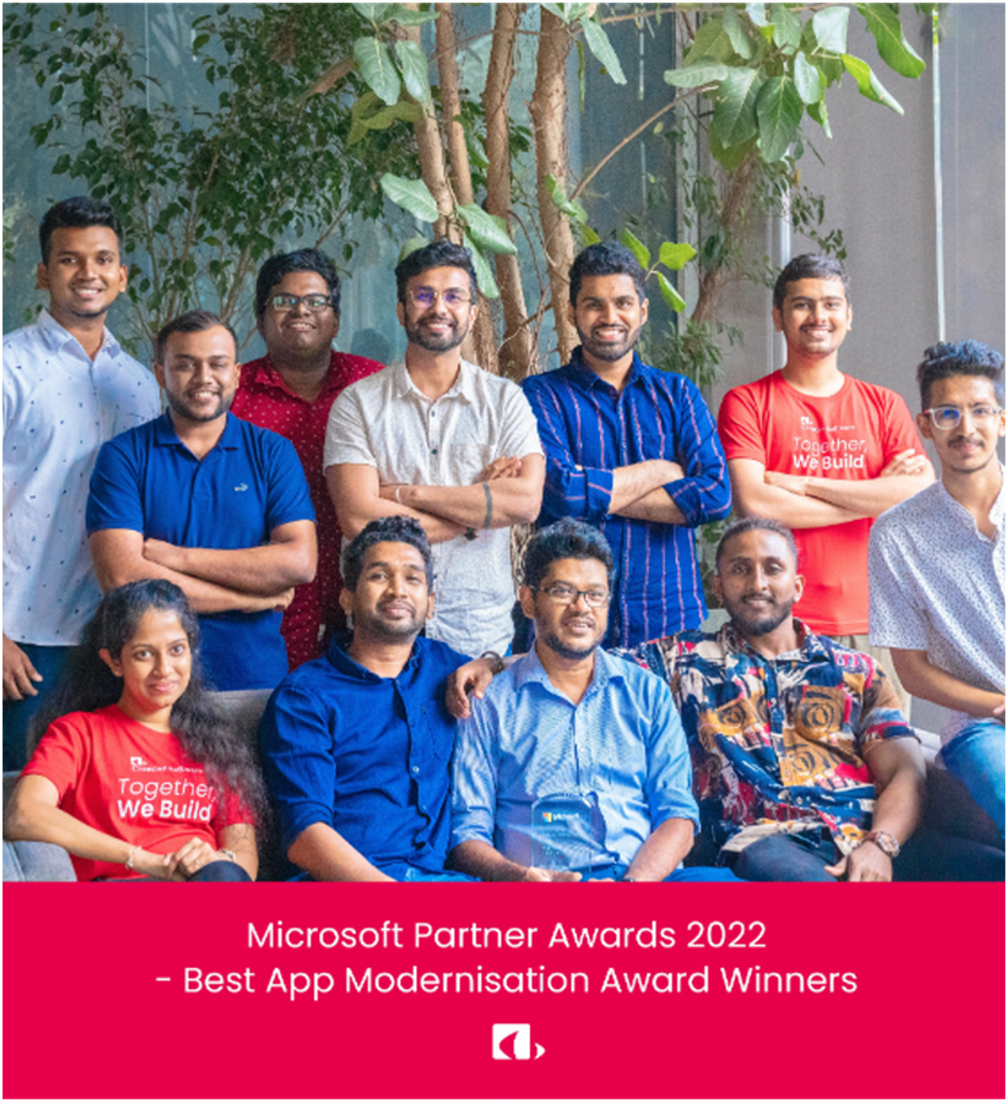
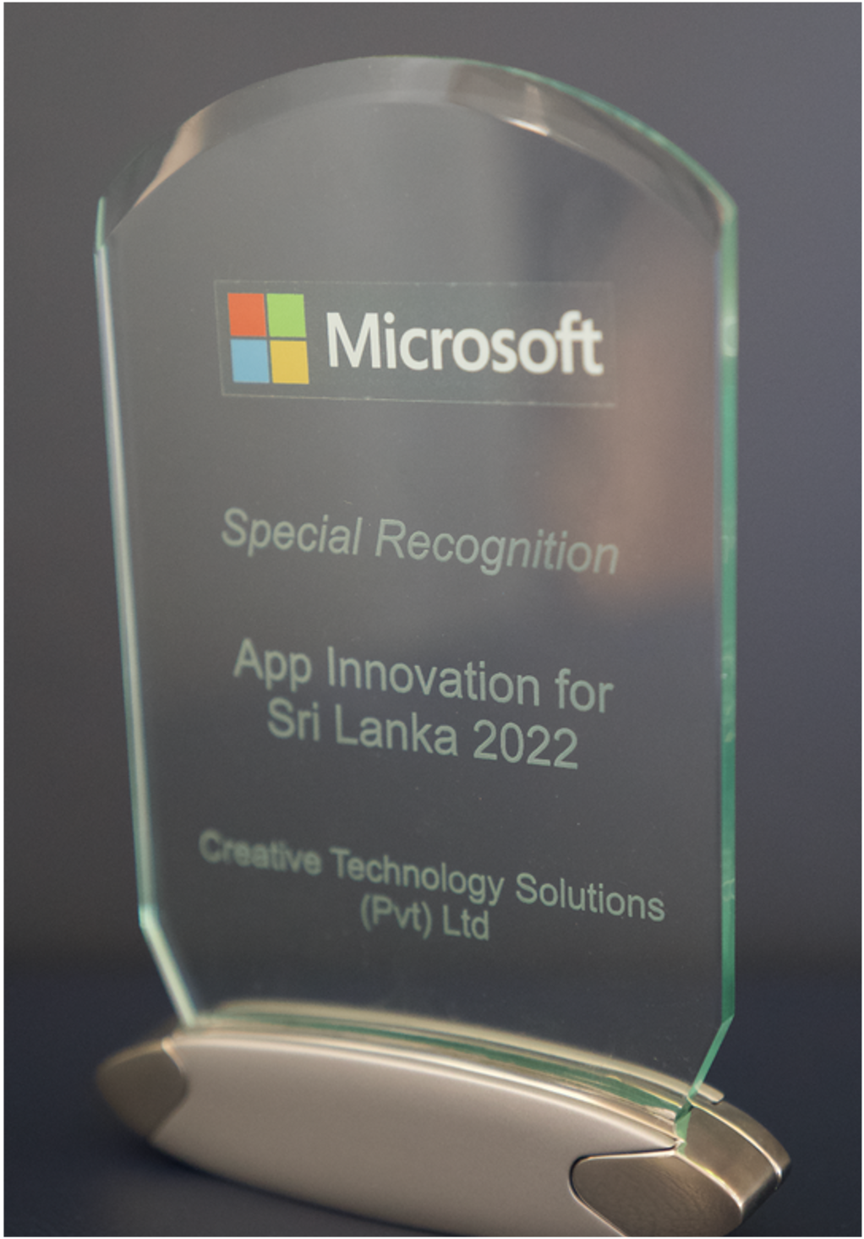
Microsoft Accreditations

Slide 17





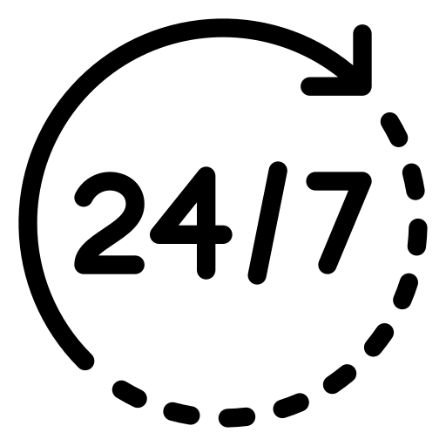




Our Services
Data Engineering & Analytics
AI/ML &
Big Data
Cloud Services
DevOps,
DataOps & SRE
Software Development
& Delivery
24/7 Support &
Maintenance
Design & UX/UI
IFS ERP
Consultancy
Quality
Assurance
Mobile App
Development

Slide 18



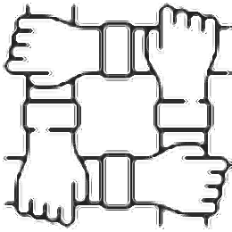
Service Classification
01
02
03
04
Products (IPS)
Solutions
Team
Training
LayUp
DREView
KUHA (Knowladge Unification For Hyper Analytics
SAAS Billing Service
Audit Product
Project Delivery
POC Delivery
Consultancy
Team dedicated
To work as an
Extended team
Industry ready training sessions
Notes:
Now the slide is far better. But consider about the line spacing of the contents. sometimes you may able to increase the line spacing and can use another crisp bullet mechanism to increase the attratciveness of this slide.

Slide 19





Why Creative Web Technologies
Well experienced MPP Expert team with Ex-Microsoft professional and MVPs
Award winning team for excellent solution delivery with highly capable technical and PM skills
Proven for delivering industry best data platforms whilst assuring of low TCO and high ROI
Local presence for ease of business, better support and grater relationship
Greater business domain
expertise

Slide 20
The Roadmap - MDP
Phase 2
Phase 3
Implement all insights/
Analytics requirement
Modernize the data platform to
Cater advance analytics requirements
Phase 1
Phase 4
Deploy Data Platform
Predictive and prescriptive
analytics including AI / ML
The
Roadmap
(mdp)
Notes:
Concept is nice...simple.
But I feel kind of a mismatch. You can improve the same infographic by using colors. Use flat elegent colors....for three location icons...and you can use an drawing inside the big circle.....the black top bar on top of the large circle which connected to other arm is quite highlighting unwantedly......bla bla bla...
Conclusion : Concept is nice try to improve the infographic.

Slide 21
Data Transformation Journey
It’s journey….
Start with hindsight
Prescriptive
Analytics
Dashboards
Data warehouse
Predictive
Analytics
Optimization
Modernize to generate insights
Foresight
Time series
Regressions
Values
Diagnostic
Analytics
More capabilities with foresight
Insight
Descriptive
Analytics
Decision Modeling
Simulations
Information
Hindsight
Difficulty

Slide 22
What is Data Platform?
A data platform is a centralized framework or infrastructure facilitating the collection, storage, processing, and analysis of data within an organization, enabling seamless management and utilization for purposes like business intelligence, analytics, reporting, and decision-making.​
Centralized Data Management
Real-time Data Processing
Enhanced Data Security
Scalability and Flexibility
Improved Data Accessibility
Streamlined Decision-Making

Slide 23
What Makes a Data Platform Modern?
Data & Analytics “Modernization” is a buzzword that’s used a lot, but what exactly does it mean? ​
Below is​ a list of characteristics and capabilities we believe define modern architecture​
Handles all varieties of data sources​
Cloud/hybrid data
integration​
Enables data science and ML
Business-enabled data
engineering
Supports democratization of data and analytics
Large data volumes
Agile delivery
Data catalog and ability to search data assets
Data
virtualization & federated
analytics
Data exploration & analytics sandbox
Search and NLP-based insights
Just-in-time provisioning and scalability
Near real-time streaming capability
Promotes self-services
Automatic elasticity

Slide 24
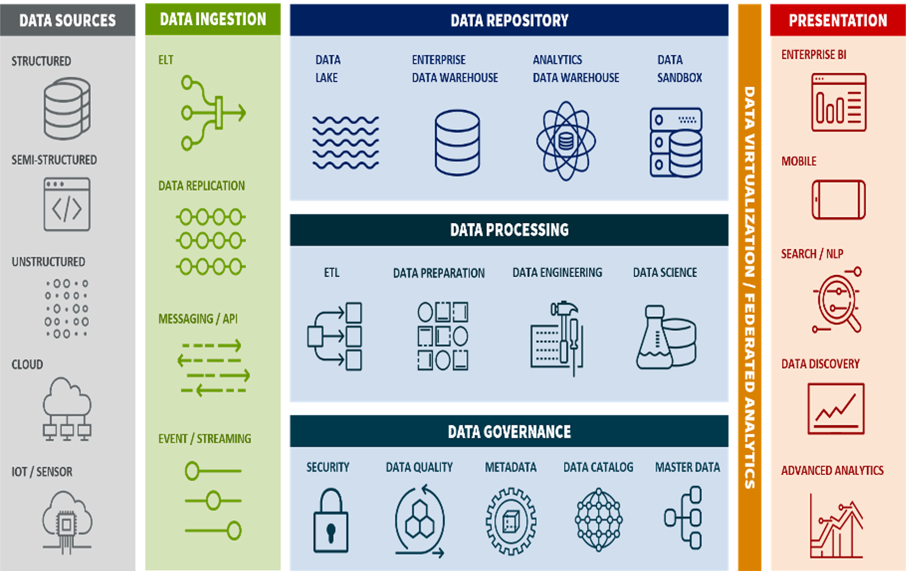
Modern Data Platform
01
Scalability and Flexibility​
02
Data Lake / Lakehouse​
03
Cost Optimization​ Increased
04
Process Efficiency​
05
Agility and Innovation​
06
Enhanced Data Security​
NOTE ​
Any specific data types can be masked before ingesting data to the cloud to meet compliance requirements, if any.​

Slide 25








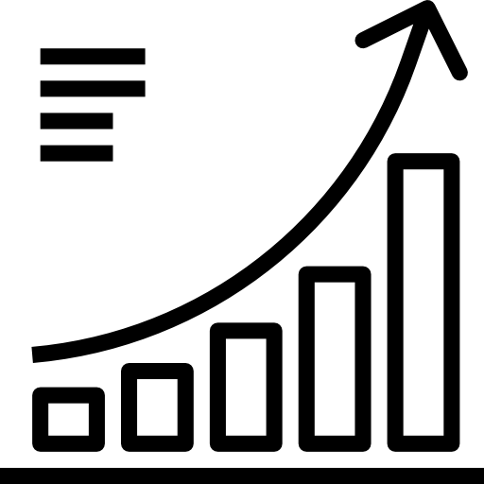
Benefits Realization
Real – Time
Information
Single source
of truth
Drill down capability up
To transaction level
Greater reachability
With control
Consolidation of multiple
Data source
Simple and
User friendly
Quick and efficient Decision-making
(Detailed solution Delivered)
Monthly performance review / Real time data (Delay in presenting the current status)

Slide 26
OUR
PROJECTS

Slide 27
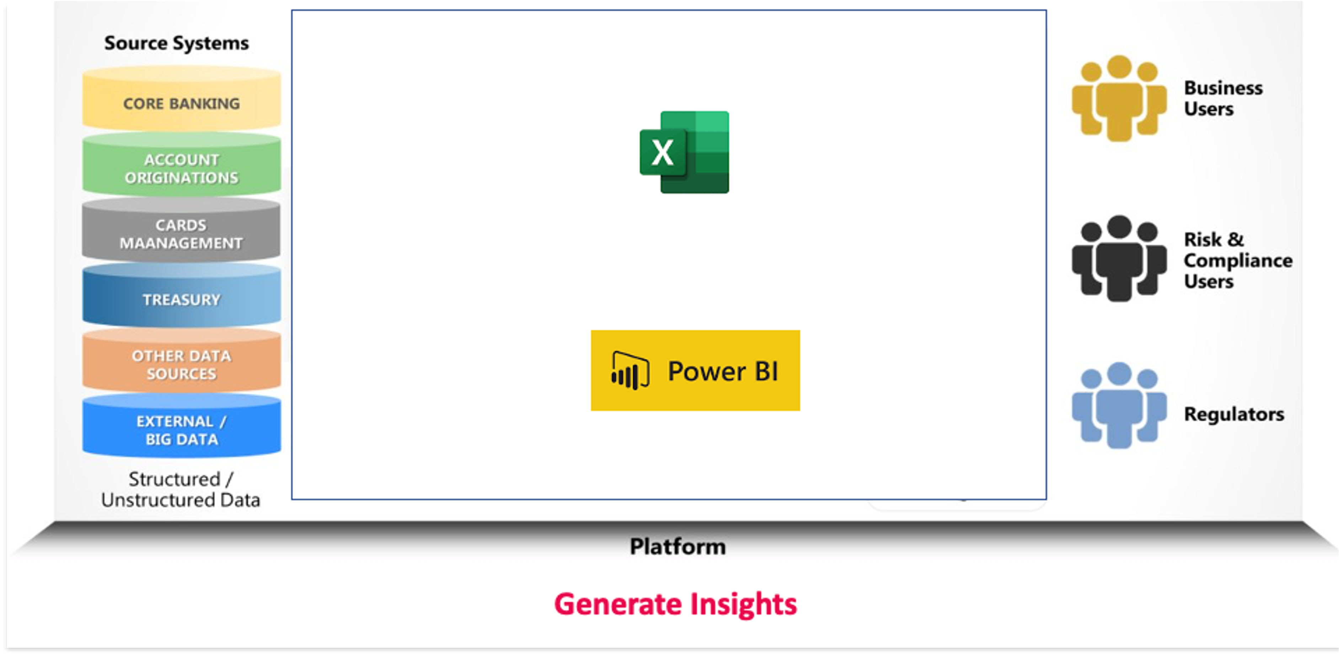
Before Implementation State

Slide 28
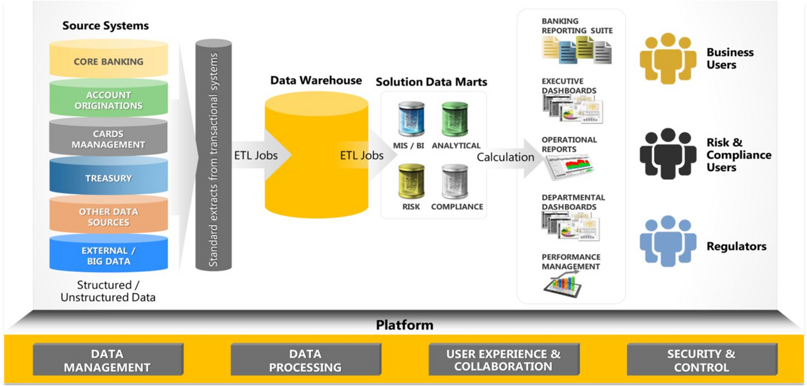
After Implementation State

Slide 29


Modern Data Platform Implementation.
Sri Lankan Airlines and Microsoft selected Creative Software as the Technology partner to deliver Proof of Concepts for Modern Data Platform Implementation.
Modernized the existing Data Warehouse into a Modern Data Platform on Azure with the power of Data Lake, Data bricks, Synapse analytics that brings the ability to make strategic/ management decisions within minutes which had been in days
Air Astana, flagship airline of Kazakhstan selected Creative Software as the Technology partner to for Azure journey and Modernization of airline solutions.
Migrate, Modernized and architect cloud native solutions with the Power of AKS (Kubernetes), Micro Services, API Manager, DevOps and App Gateway and move in to cloud with a proper architecture was a challenging task for Air Astana when we met their team. We could produce a solution that optimized the TCO while addressing all the above challengers.

Slide 30

Modernization of Banking Infrastructure on Azure
Migrating business critical application from AWS to Azure while onboard DevOps to bring business agility, and modernized/integrated with Azure services for lower TCO and better ROI
The bank was struggling with the business-critical virtual banking application due to various reasons and having hard time with managing releases smoothly. It was demanding highest availability and fault tolerance due to the nature of the business. Creative Software team proposed the architecture on Azure after critically evaluating the requirements and existing solution. Once the proposal is accepted, Creative team provisioned Production, Staging, Dev, Test environment and migrated data from AWS to Azure while helping to manage all the stakeholders for a smooth transition.

Slide 31

Allianz DataSphere
We helped Allianz embrace a transformative solution by implementing Azure Synapse and Power BI to seamlessly integrate and analyse data from various sources.
This dynamic combination allowed for the effortless integration of multiple data files from their core system, providing near real-time reporting and empowering informed decision-making. The flexibility and scalability of Azure Synapse ensured adaptability to current data volumes and future growth. Enhanced by the broader Azure ecosystem, the solution offers advanced analytics, data security, and governance. Overall, this implementation streamlined data integration, elevated operational efficiency, and paved the way for strategic decision-making at Allianz Lanka.

Slide 32
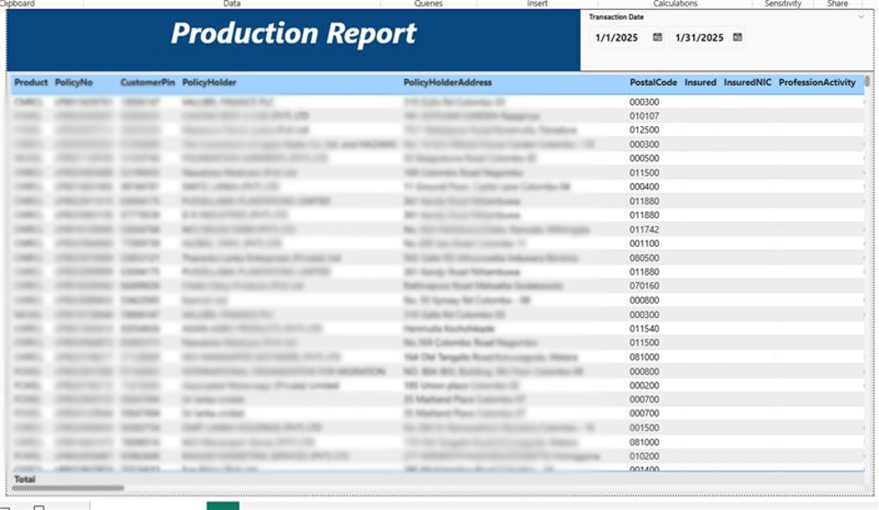
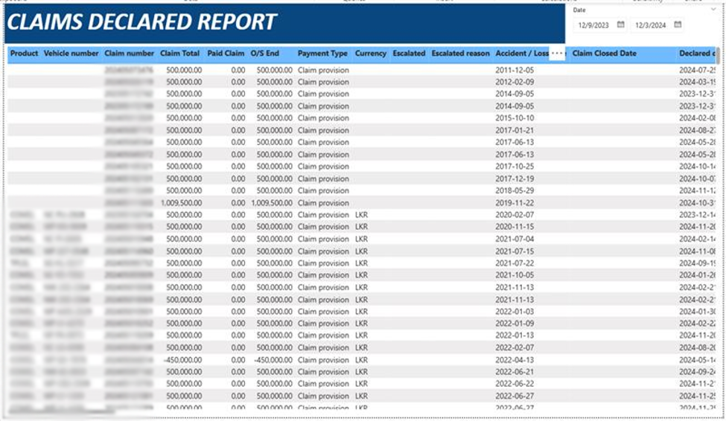
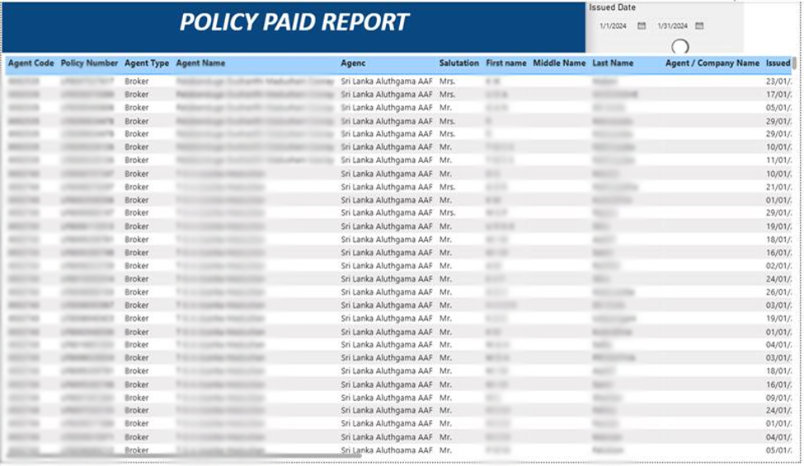
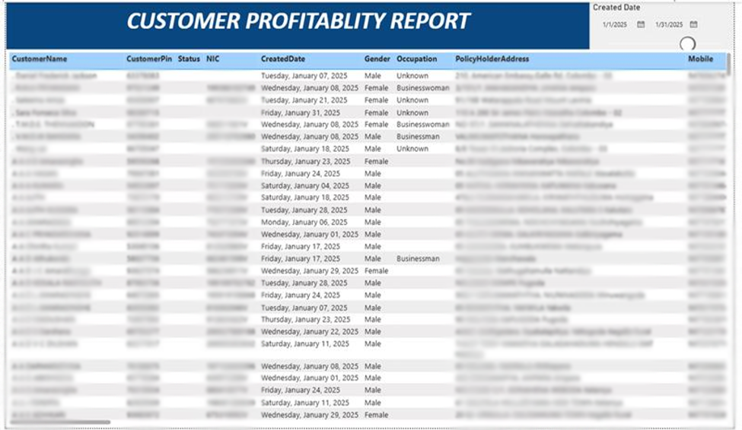

Slide 33
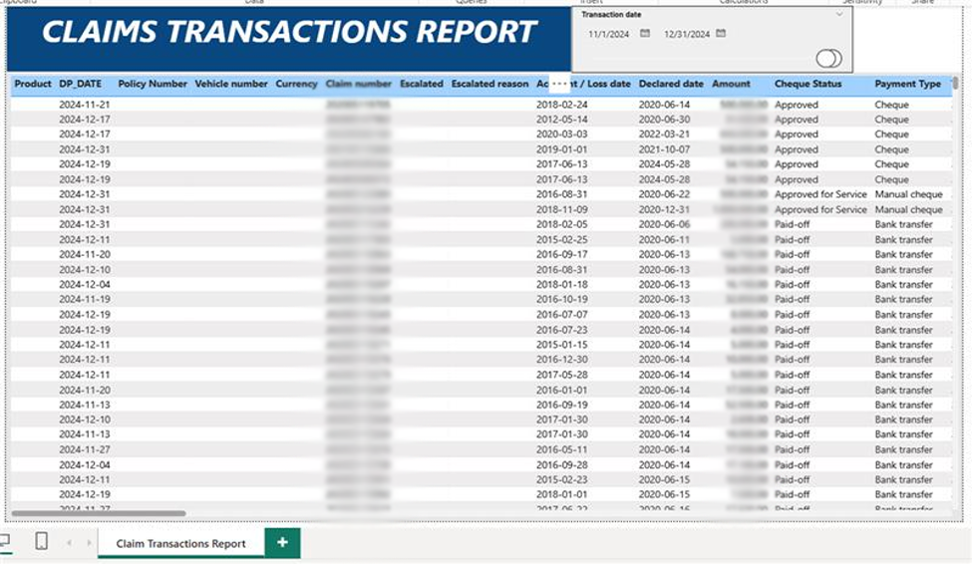
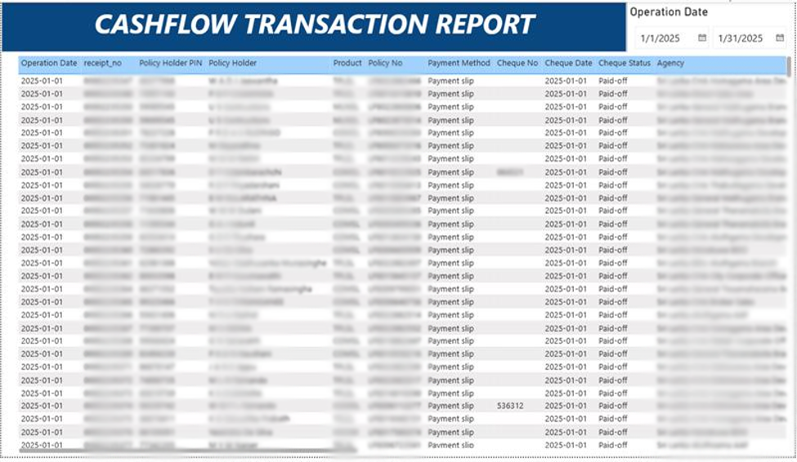
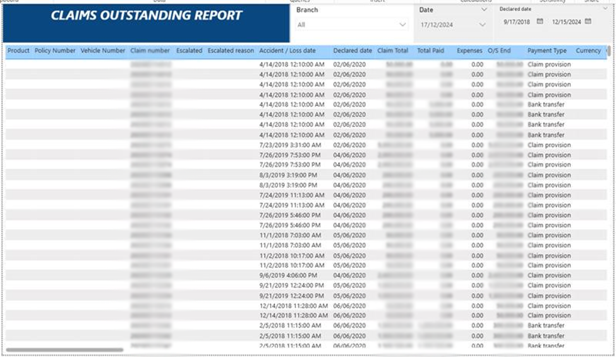

Slide 34

Optimization of Financial Data
At Dilmah we undertook a transformative project to optimize financial data from their custom ERP system which was servicing multiple companies.
Reporting but also empowered Dilmah for continued innovation and efficiency. The project involved meticulous assessment, streamlined data integration using Azure Synapse, and creation of the lake house architecture with implementation of ETL processes for to facilitate reporting to asset in decision making. Power BI reports and visualizations were tailored to meet specific reporting needs, ensuring secure access. Leveraging mapping functionalities, we generated dynamic management reports, centralizing financial data for informed decision-making. This initiative not only streamlined financial reporting but also empowered Dilmah for continued innovation and efficiency.

Slide 35
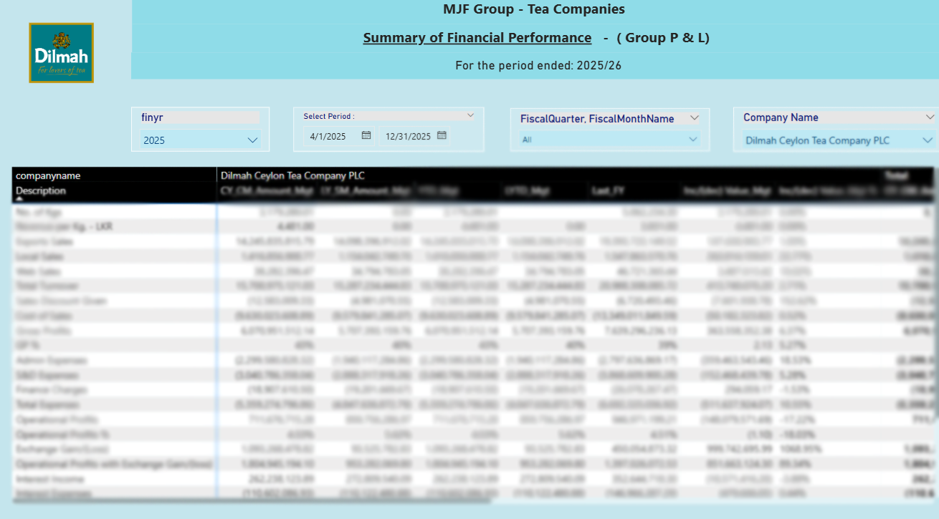
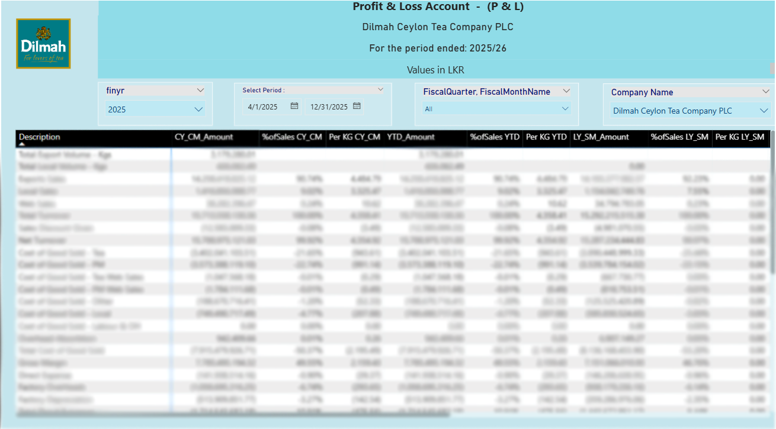
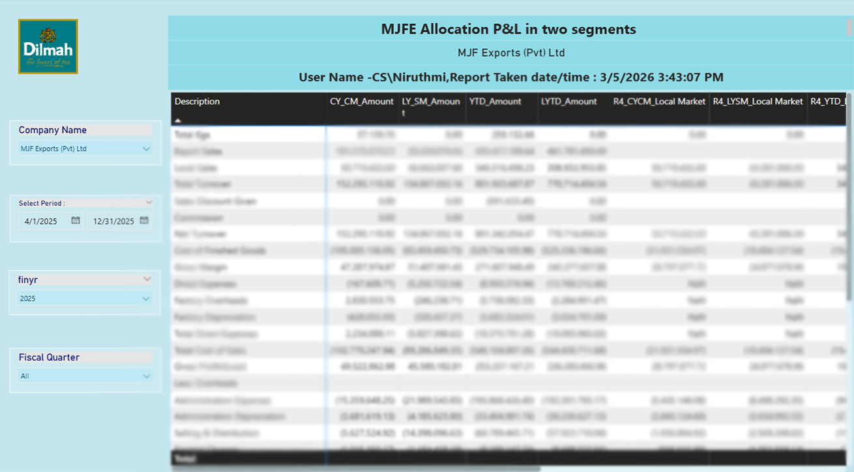
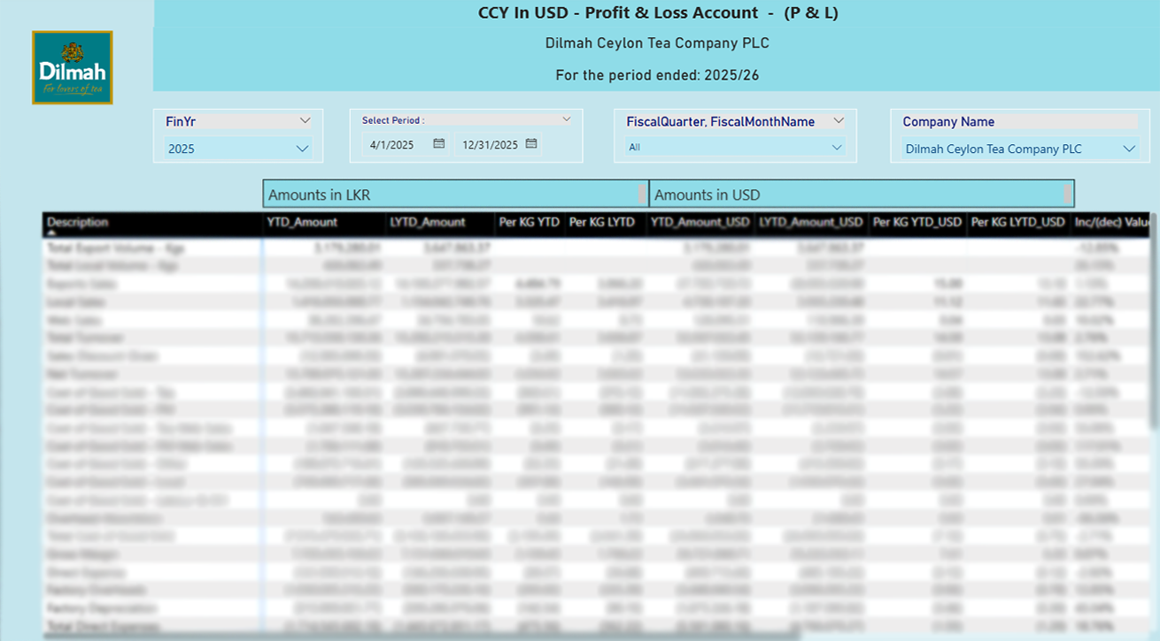

Slide 36
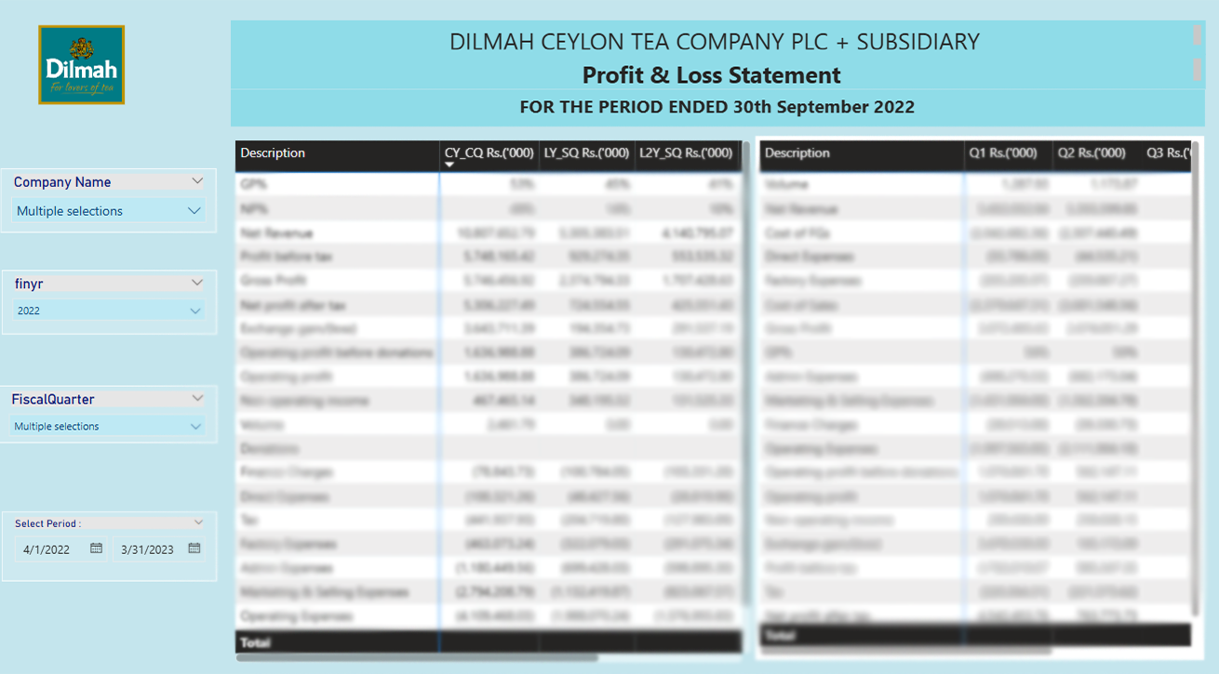
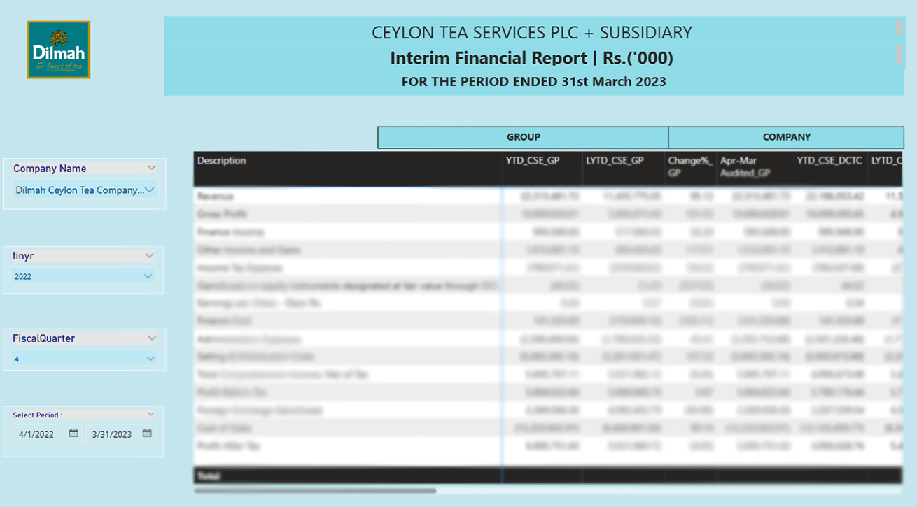
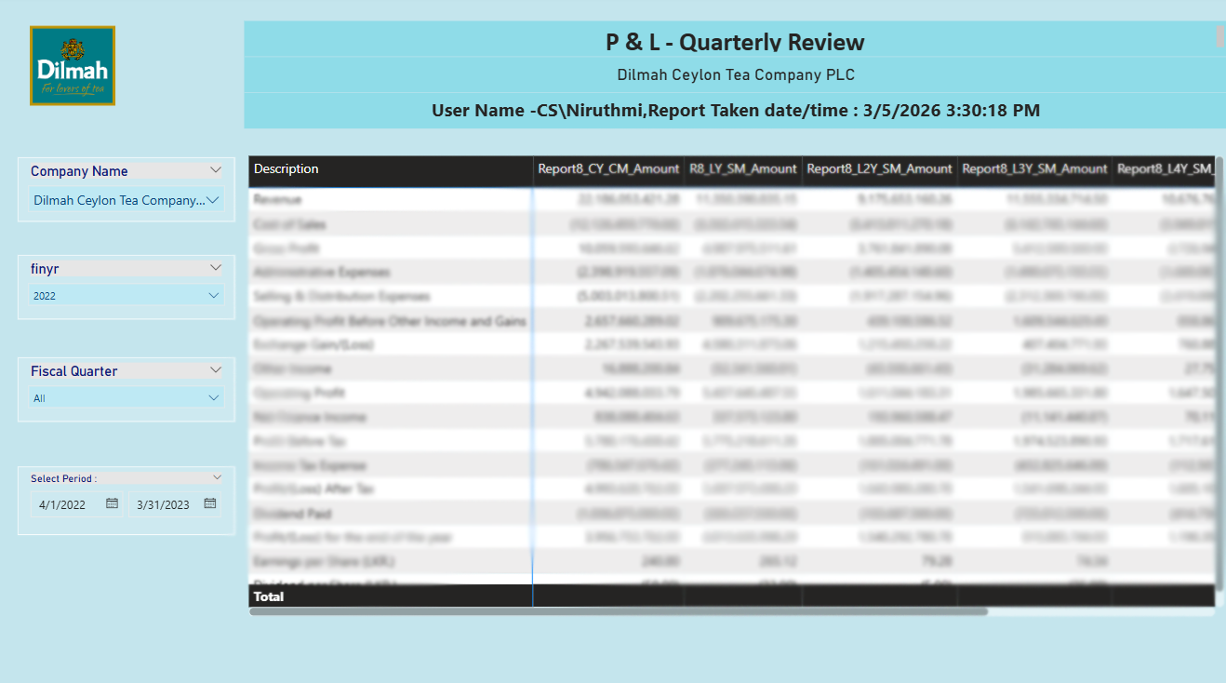
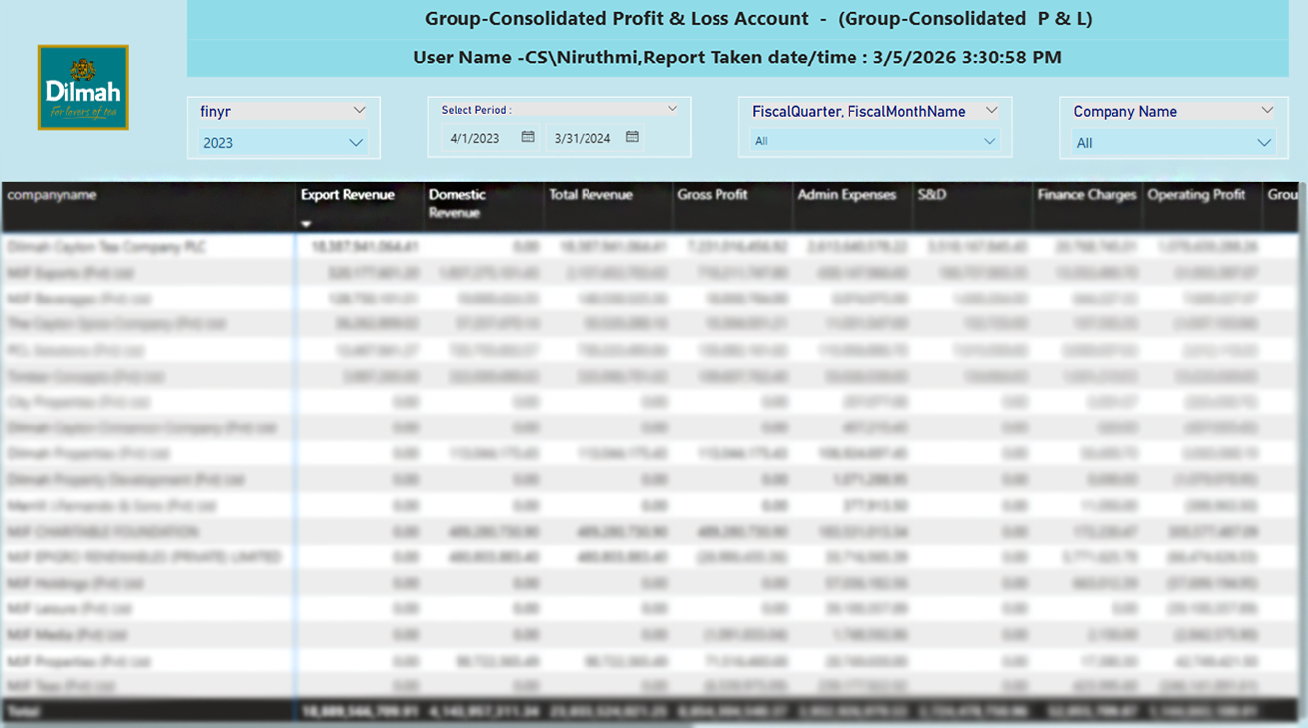

Slide 37
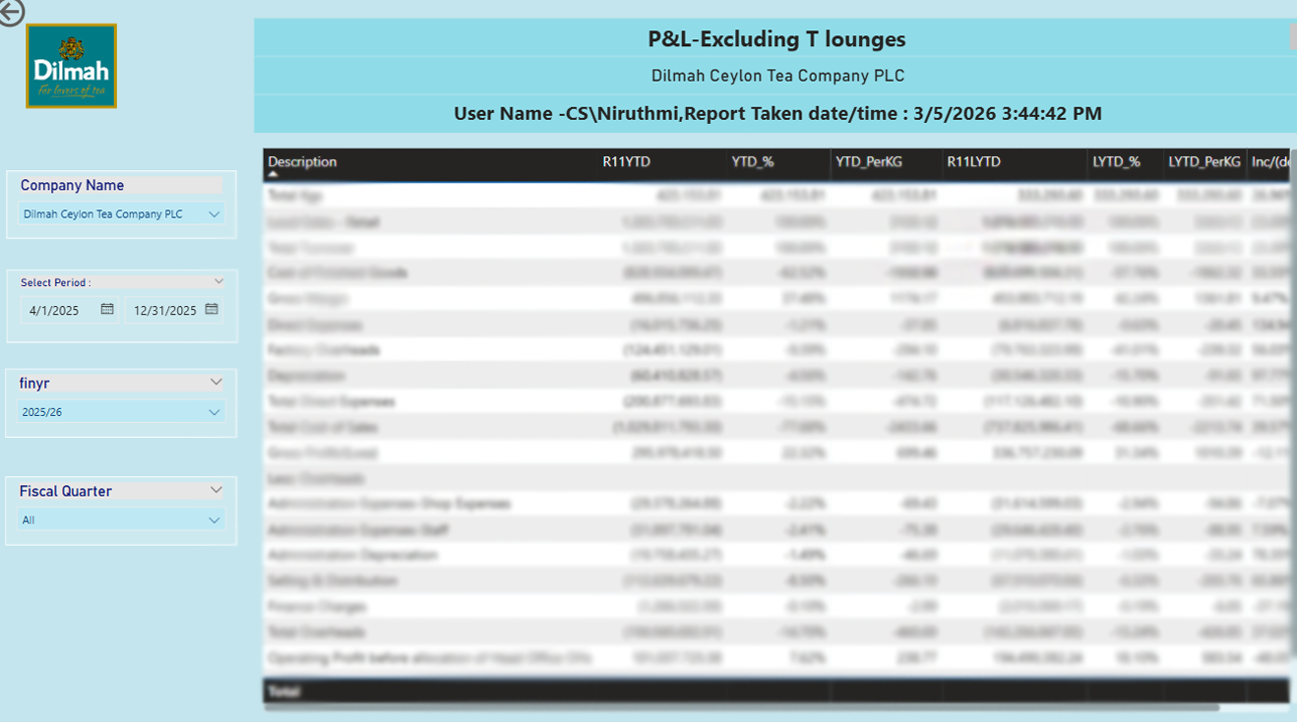
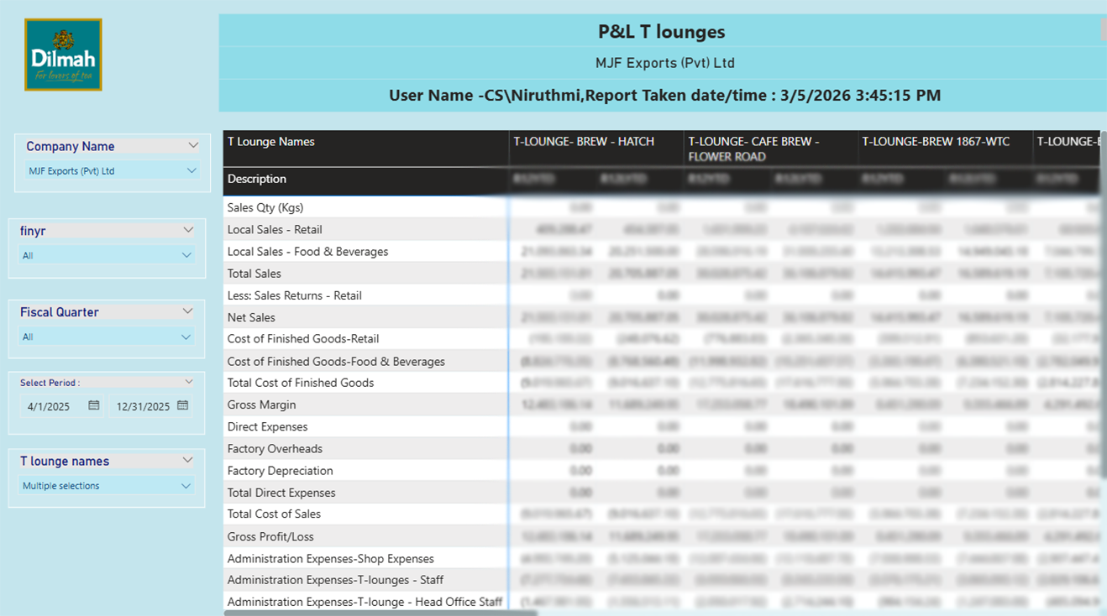
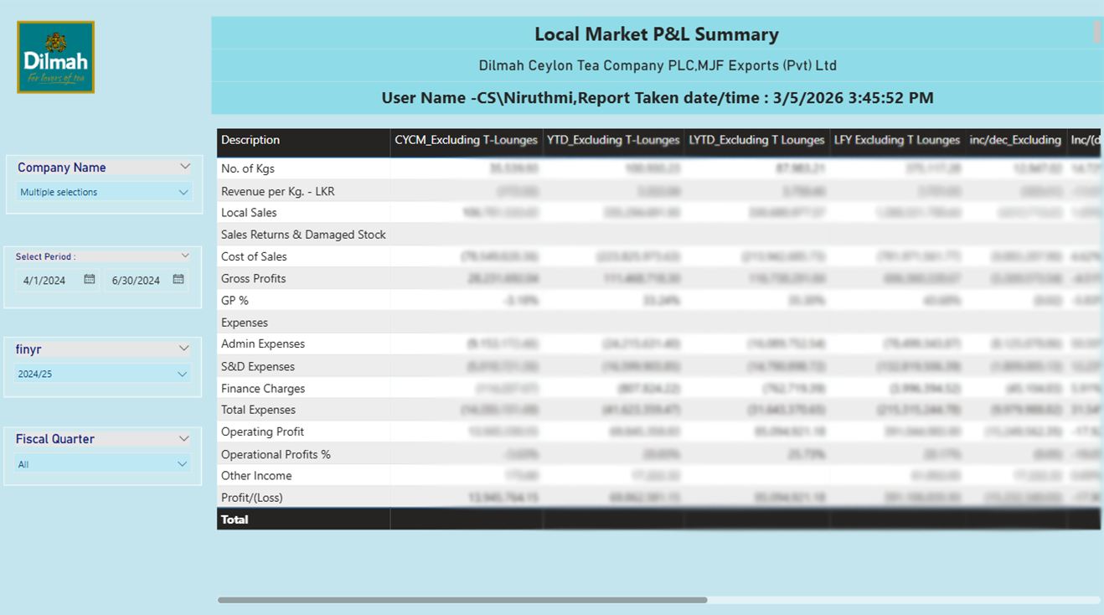
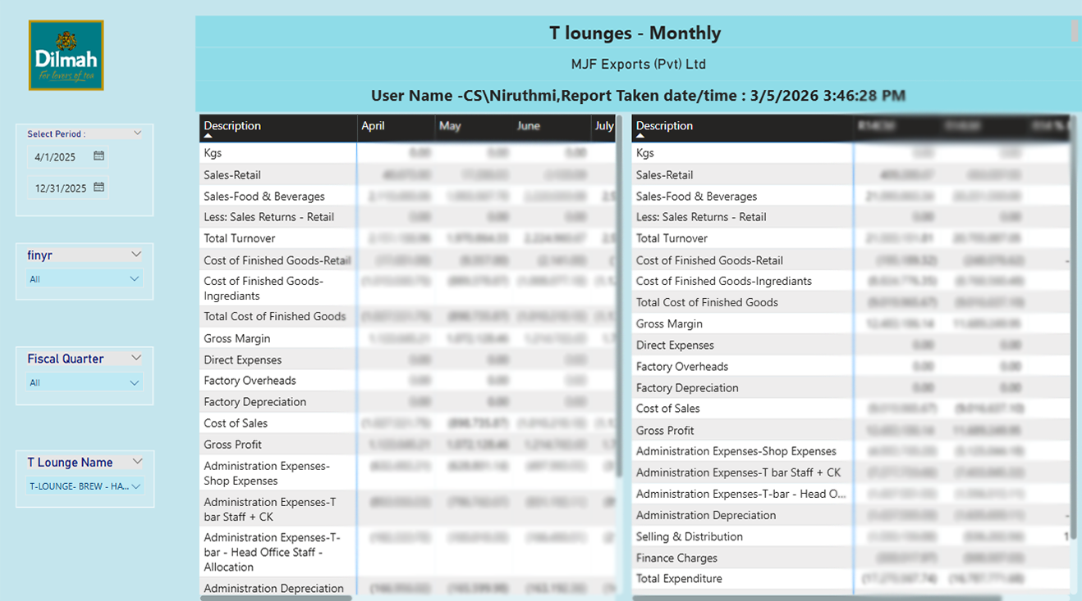

Slide 38

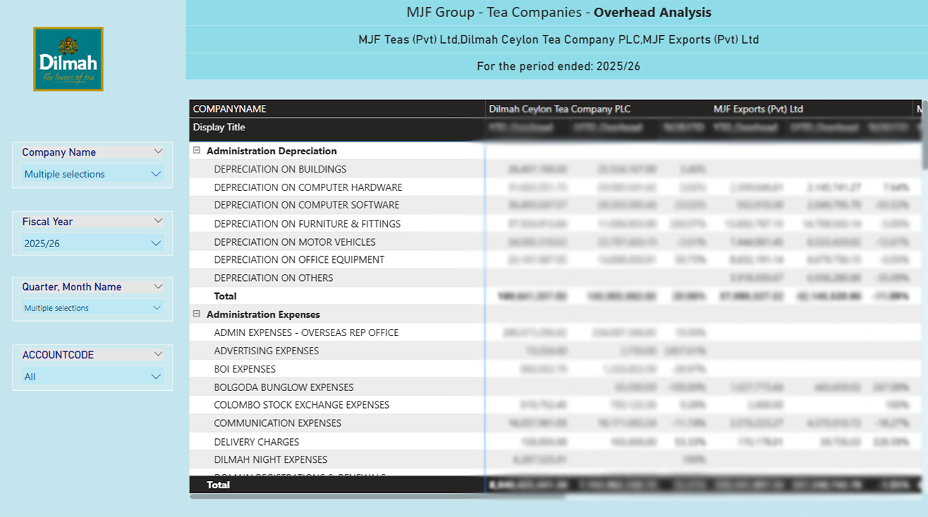
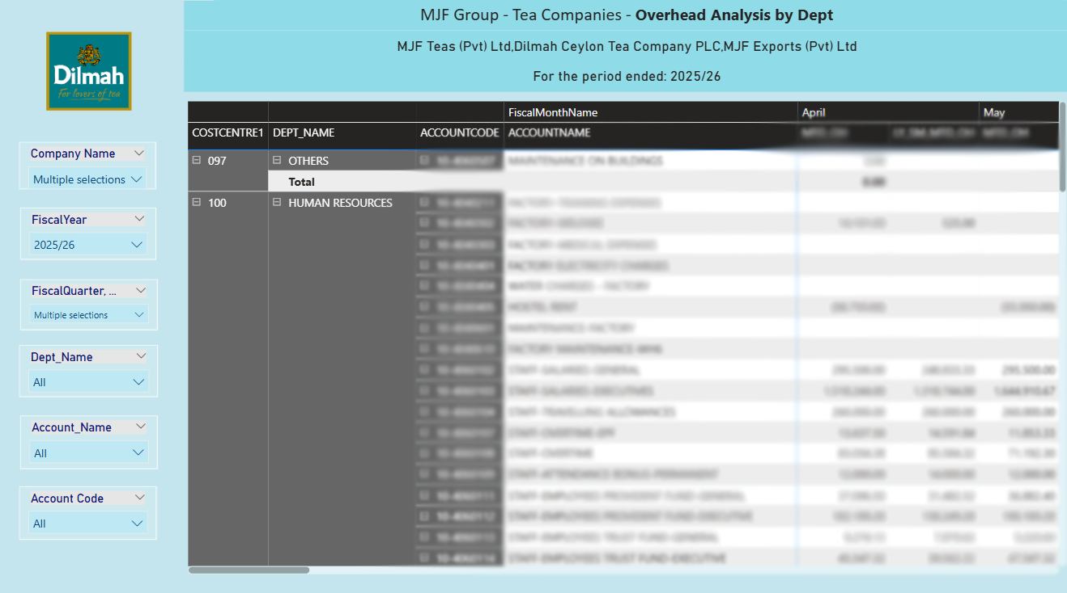
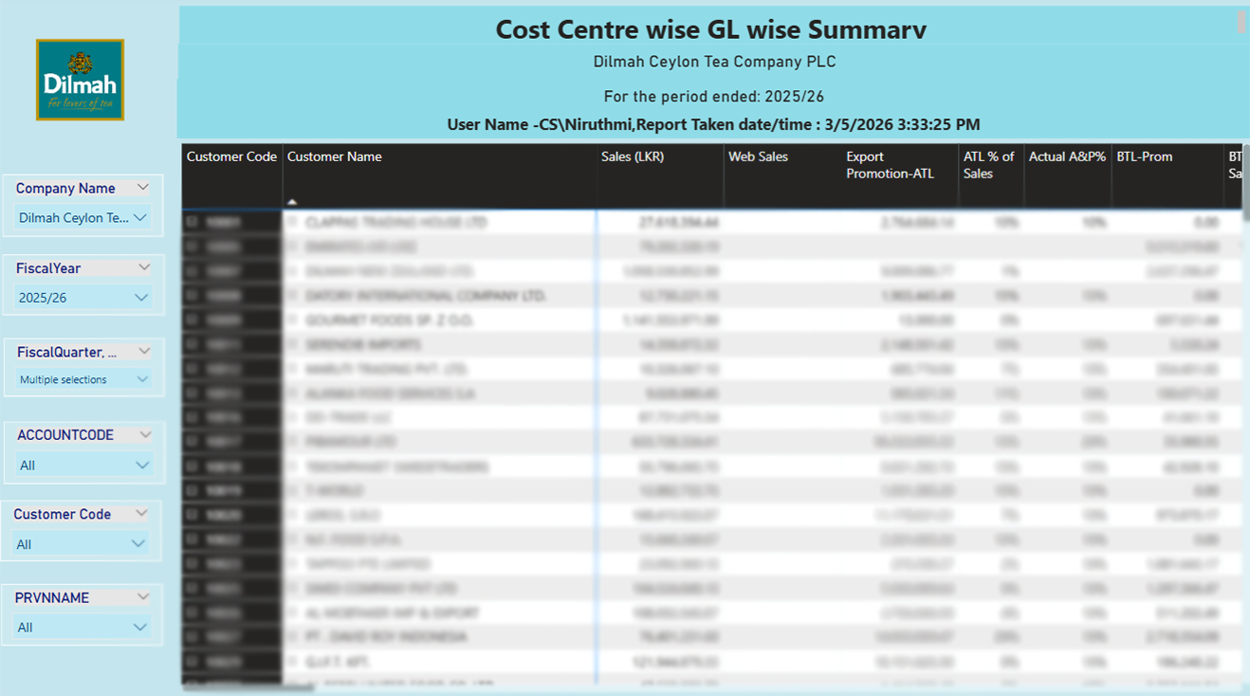

Slide 39
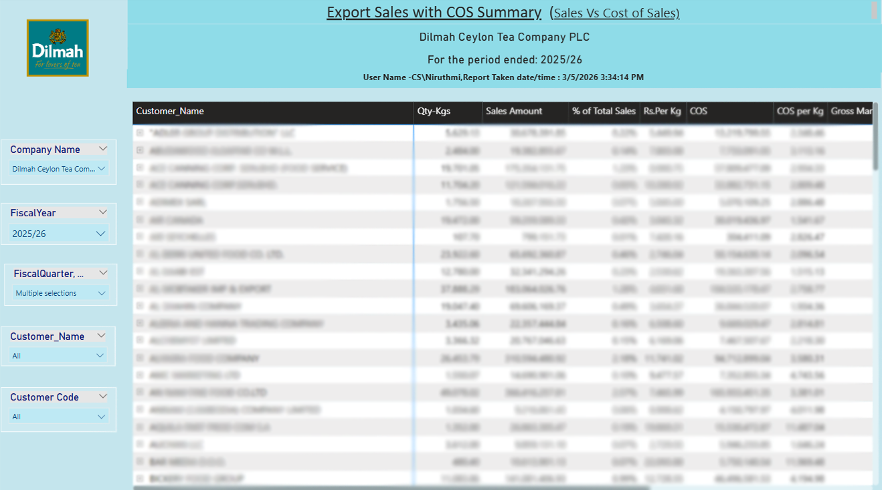
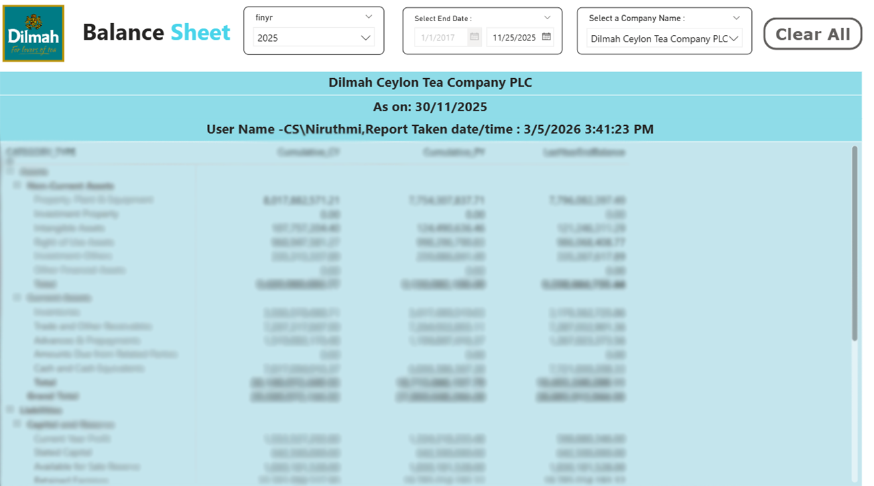
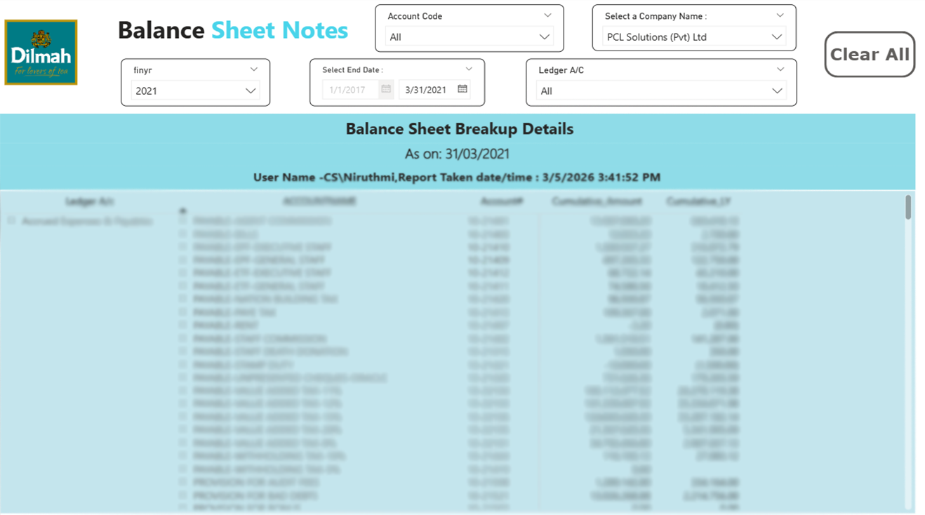

Slide 40
Customer Document Notification System
A web-based service designed to bring transparency, efficiency, and accountability to the clearance process.
Built on Microsoft ASP.NET and SQL Server, CDNS is a secure on-premise platform that allows Sri Lankan traders and agents to monitor Customs Declarations (CusDecs) and cargo movements in real time. By providing remote access to data views, fines, and fraud prevention tools from any device, the system eliminates the need for physical visits while maintaining strict government security standards via OTP-secured logins.
With the capacity to support over 30,000 concurrent users, CDNS significantly enhances operational efficiency through advanced reporting and chatbot support. Future updates, including "Ready to Process" notifications and proactive risk alerts, will further solidify its role as a digital transformation milestone that provides greater transparency and speed to the national trade ecosystem.
Watch our Video for more Info!

Slide 41

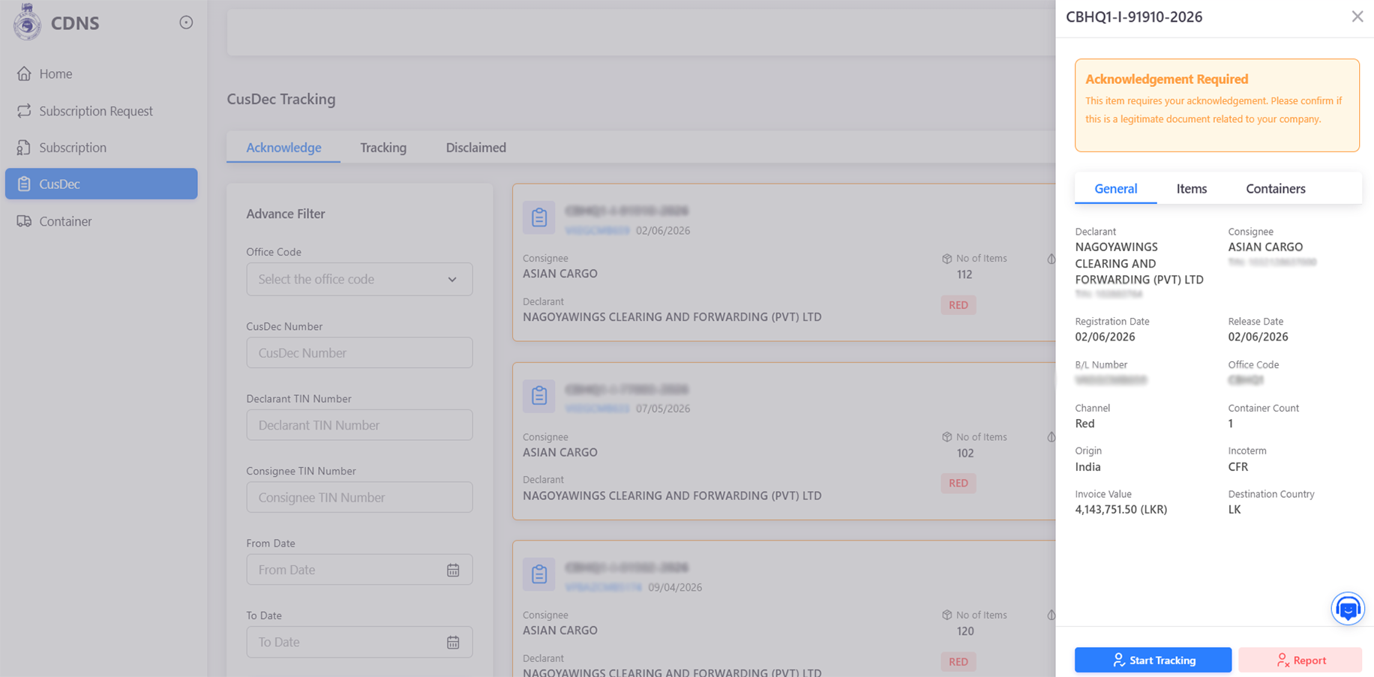
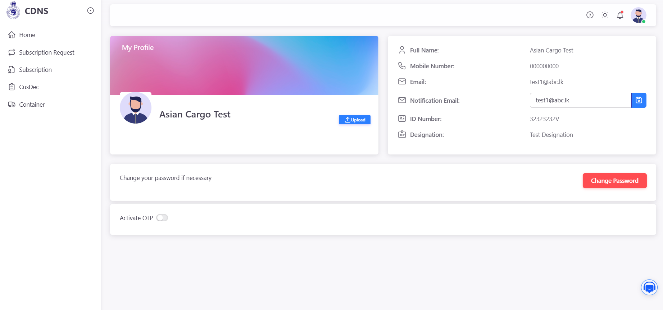
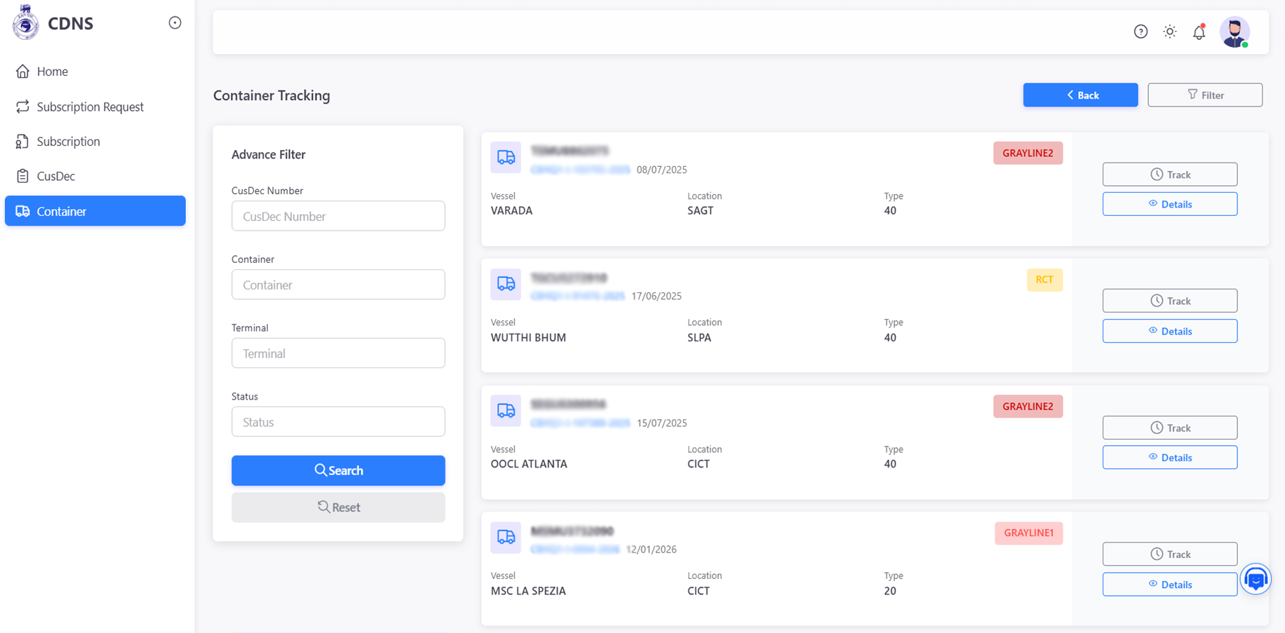

Slide 42
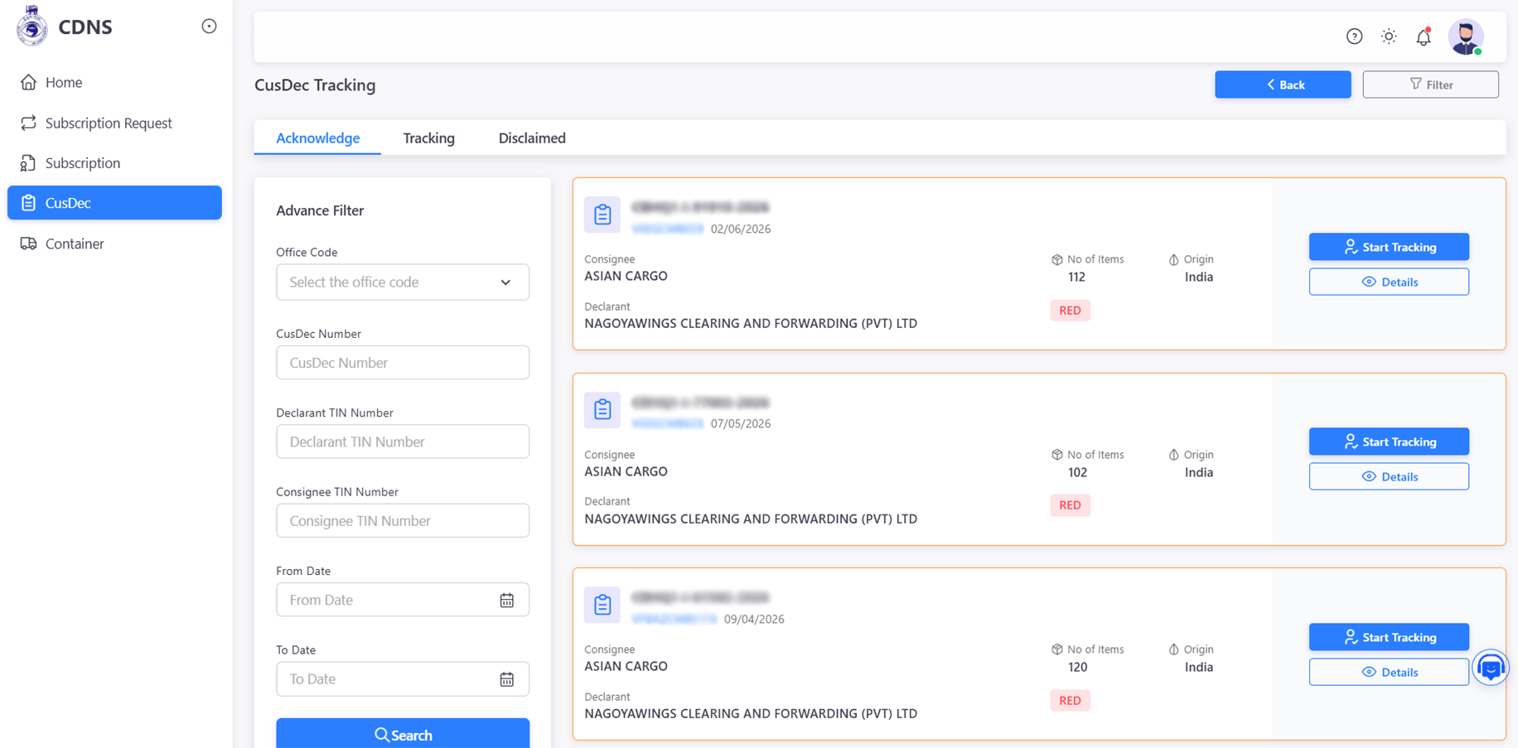
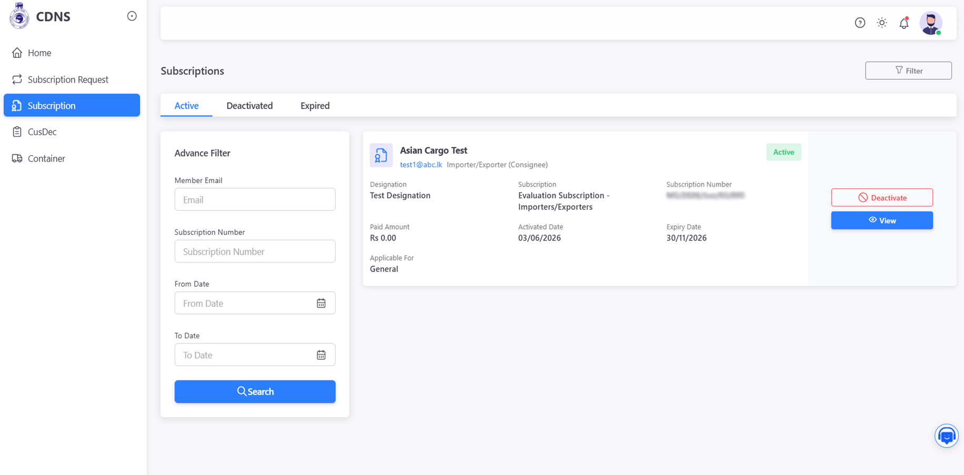
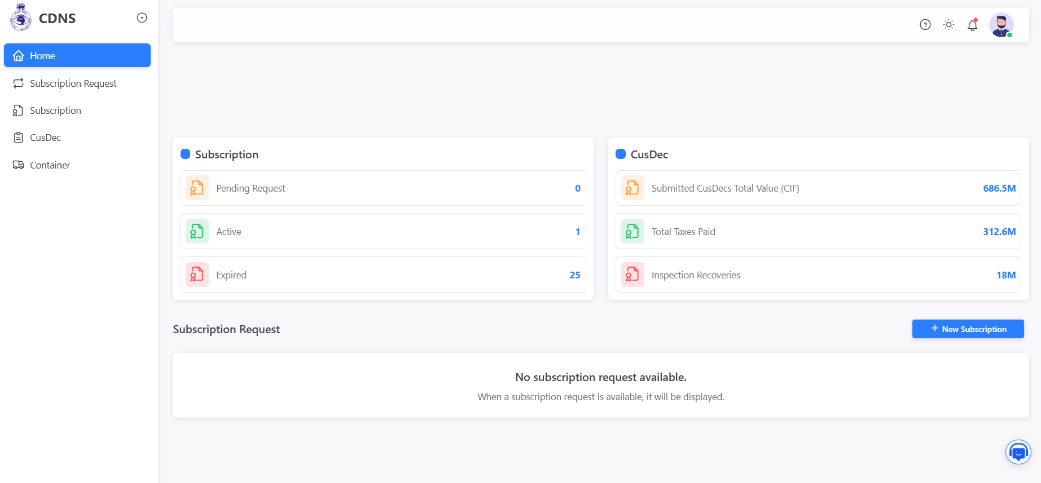

Slide 43
Data Analytics Tool
A web-based service designed to bring transparency, efficiency, and accountability to the clearance process.
Built on SQL Server and Power BI, DAT serves as a centralized intelligence platform that consolidates customs data from diverse sources including ASYCUDA, EREG, ECCR, and RMDB into a single, unified data warehouse. The system utilizes a sophisticated ETL process to extract and clean data, which is then visualized through 16 interactive dashboards to provide real-time insights for senior officials and operational managers across divisions like Revenue, Risk Management, and Cargo.
By transforming complex datasets into actionable intelligence, DAT enhances transparency and decision-making while supporting critical functions such as fraud detection, valuation analysis, and outward remittance monitoring. Looking ahead, the platform is slated for significant upgrades, including the integration of machine learning for predictive analytics, AI-driven trade forecasting, and the development of mobile-friendly dashboards for on-the-go access

Slide 44
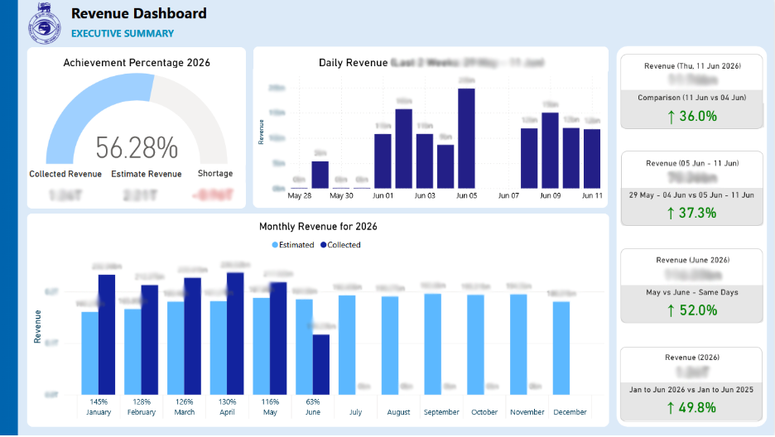
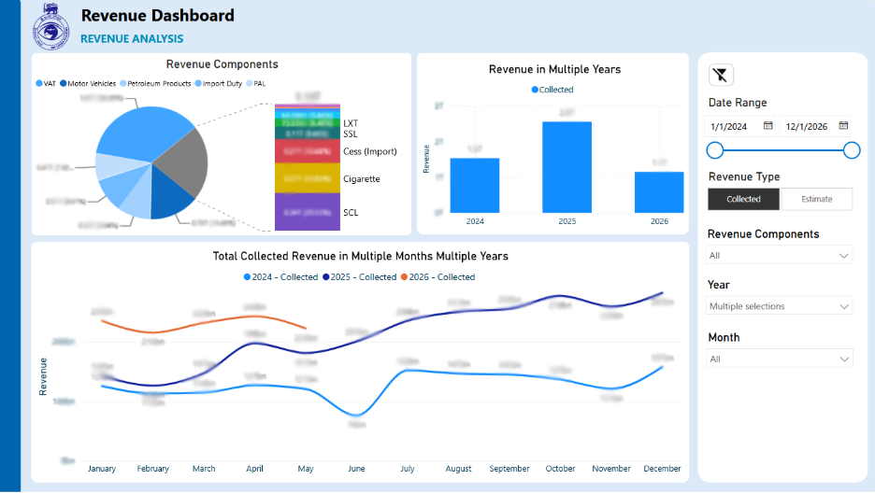
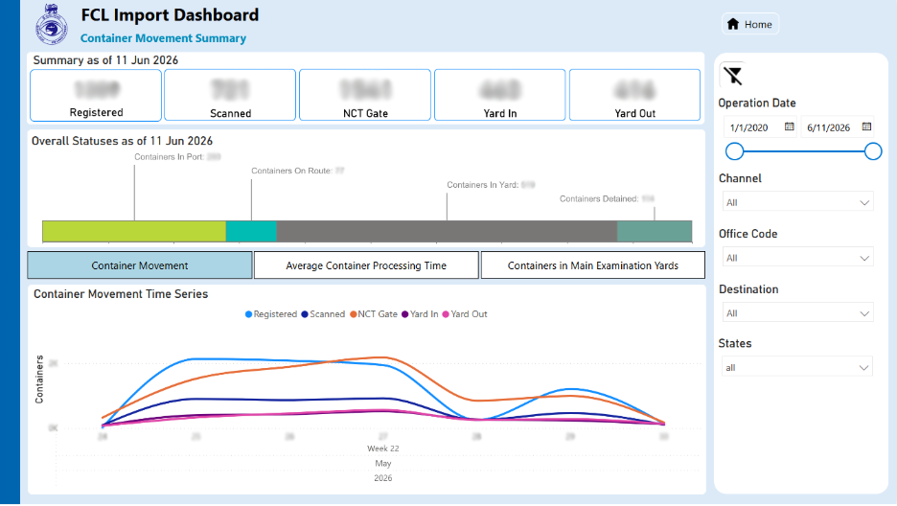
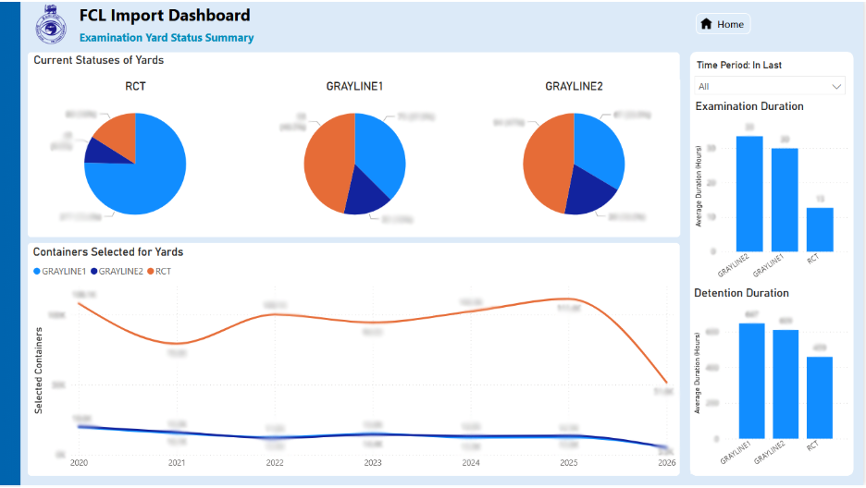

Slide 45





Slide 46





Slide 47





Slide 48

The Light Online Platform
We partnered with the Sri Lanka College of Pediatricians to create a centralized digital platform that bridges the information gap between healthcare professionals and the general public.
The project involved developing a secure, mobile-friendly web application designed to serve Physicians, Nurses, Midwives, and Parents with role-specific content. We implemented a real-time ICU Dashboard to track bed availability and optimize resource allocation, alongside a custom Learning Management System (SLCP Academy) for professional development.
The solution also centralizes critical medical data through a Paediatric Drug Information system and practical clinical guides, while simultaneously empowering parents with accessible, evidence-based child health information through a multilingual blog.

Slide 49





Slide 50
Business Intelligence Proof of Concept
We collaborated with Forte Insurance to implement a modernized data analytics solution that streamlines business performance tracking and enhances data-driven decision-making.
The project focuses on developing an advanced analytics platform utilizing Power BI to consolidate and visualize critical business metrics. The solution includes the implementation of a nightly automated data sync process for the data mart and the creation of interactive dashboards for Budget vs. KPI tracking.
Using refined visualization techniques such as focus-mode table widgets and aligned graph trend lines we optimized the presentation of channel and product line data to match Forte’s existing design standards. Additionally, the engagement involves a comprehensive review of the current Data Warehouse (DWH) architecture to design a scalable, optimized target architecture for production-grade performance.

Slide 51



Slide 52

BML ETL Accelerator
Proposed an Azure architecture to mitigate the issue of delays when loading data from their core banking system to Datawarehouse for lower TCO and better ROI .
BML faces the task of efficiently processing CSV files into their SQL data warehouse. ETL jobs are used to load core banking data into an 8TB SQL Server warehouse, projected to grow 1TB monthly, with an 8-year data retention requirement. This warehouse serves as the source for generating 105 reports via SSRS, Power BI, and Excel. Currently, the ETL processes 55GB daily in 4 hours. Streamlining this process is essential for data handling and timely reporting.
BENIFITS
Insights Acceleration
Agility
Reliability
Efficiency
Empowerment

Slide 53

Architecture
01
05
Bank of Maldives (BML) collaborated with Creative Software to modernize its data infrastructure.
The project involved migrating to Azure Data Platform, incorporating advanced tools to address challenges in insight generation and ad-hoc reporting.
02
06
The project aimed to address challenges in insight generation, ad-hoc reporting, and data processing efficiency.
Bank of Maldives (BML)
A shift from Extract, Transform, Load (ETL) to Extract, Load, Transform (ELT) was executed, optimizing data processing speed and efficiency.
03
07
BML focused on leveraging Azure Data Platform to enhance data engineering processes and optimize agility in responding to dynamic market demands.
Extensive training sessions were conducted to upskill the BML team, ensuring they were proficient in utilizing the new data platform and tools.
04
08
Inadequate features for insights, delays in ad-hoc reporting, and inefficiencies in the ETL process were identified as key challenges that the project aimed to overcome.
The collaboration resulted in a significant transformation, empowering BML with a modernized data platform that offers enhanced capabilities for insights generation, improved data processing efficiency, and increased agility to adapt to evolving customer needs in the data-driven banking landscape.

Slide 54

Our Story Sharing
With
AMANA BANK
-Data Transformation Journey-

Slide 55
Data Consolidation and Analytics
Cost effective
solutions
Unavailability of insights to data
Greater reachability
of data
Amana Bank partners with
Creative Software ​
to develop the Data Warehouse and BI solutions.​
Grater reachability of data
Solution
Spreadsheets generated with distributed data silos were modernized into a central data warehouse with a dashboard that brings the ability to make strategic / management decisions faster​

Slide 56




Dashboards – Sales Performance
The dashboards have the capability to delve into the transaction level, providing access to detailed information.
Sales Performance
OVERVIEW
ADVANCES
Corporate Performance
Operational Performance
Other.......
CIFS
DEPOSIT

Slide 57

Customer
Appreciation
Letter
-Amana Bank-

Slide 58

Why Creative Software

Slide 59


