Slide 1
Computer Systems : 2nd Project
19102100 Choi Jiwoo
21102044 Oh Seyeon

Slide 2
Contents
Data set
Cache hierarchy
Implementation code
Hit/Miss ratio
Cache performance

Slide 3

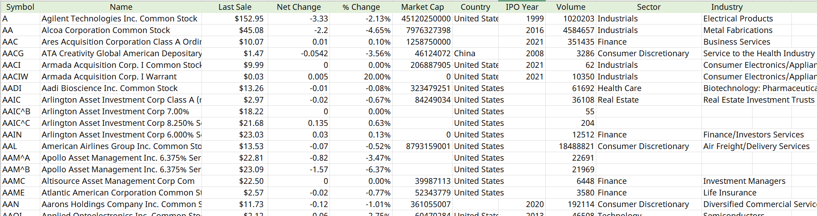
Data set
Stock Data of Listed Companies in U.S.A
- Our scenario : People will often search for companies with
high trading volume or large market capital.
- Number of data elements : 4776
- Attributes
: Symbol, Name, Last Sale, Net Change, Market Cap, Country, IPO, Year, Volume, Sector, Industry
Source : Nasdaq.com

Slide 4
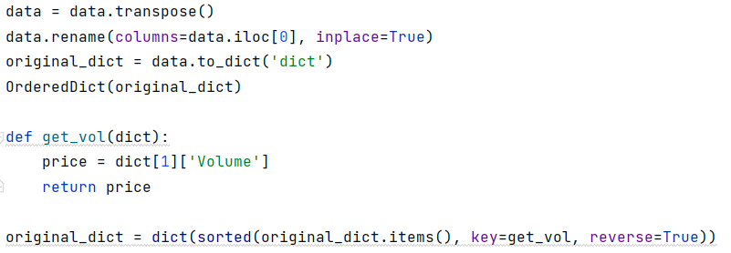
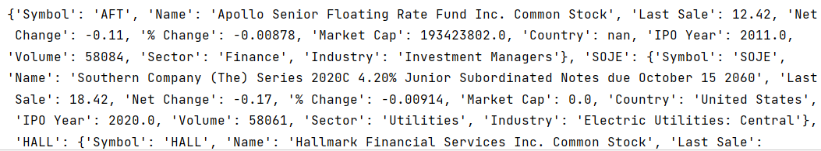
Data set
- Store the data using pandas read_excel( )
- Use Ordered dictionary in Python
: Key → Symbol (Unique)
- Sort data by Volume in descending order
< Data set form >

Slide 5
Cache Hierarchy
1 element
L1
(Reg)
Tag(Key)
Block
16 element
L2
Cache Block
256 element
L3
L4
(Main memory)
4776 element

Slide 6
Implementation code
: Logic
Key = input(“Input key : ”)
If ( key in L1 )
Else ( not in L1 )
If ( in L2 )
Else ( not in L2 )
If ( in L3)
Else ( not in L3 )
!! HIT !!
If ( L2 is full )
Delete oldest used data
Store last used data
Else ( L2 is not full )
Store used data
Find in L2
!! HIT !!
If ( L3 is full )
Delete oldest used data
Store last used data
Else ( L3 is not full )
Store used data
Find in L3
!! HIT !!
Find in L4

Slide 7
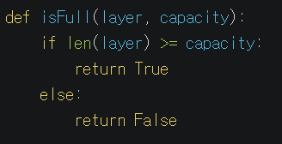
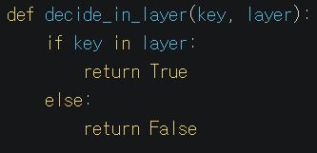
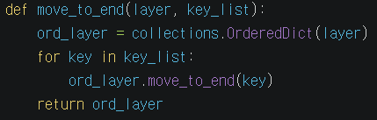
Implementation code
: Function
Check whether cache is full
Check the key in the cache
Move the last used data to the end of cache
*OrderDict : a dictionary in order
- popitem( ) → pop FIFO
- move_to_end( ) → move to end

Slide 8
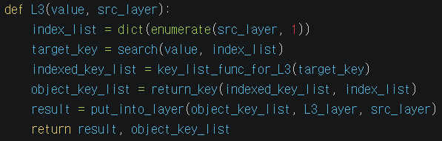
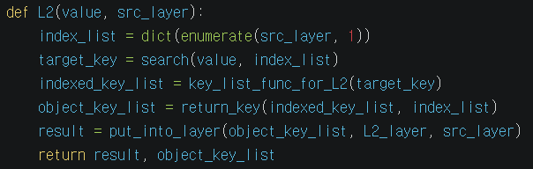
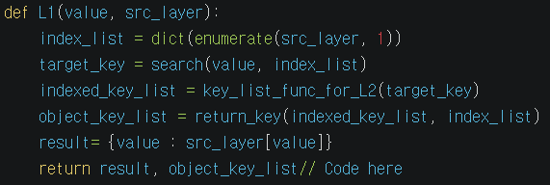
Implementation code
: Function
* Functions in L3, L2, L1
1) index_list = dict(enumerate(src_layer, 1))
: A dictionary with a key of a specific layer as a value and an index of keys as a key
{ ‘A’ : a, ‘B’ : b, ‘C’ : c }
{ 0 : ‘A’, 1 : ‘B’, 2 : ‘C’ }
* It is used to obtain keys around the target key
2) target_key = search(value, index_list)
: Return the same key(index) as the value in the index_list
Notes:
L3 gets object key and source layer(= L4) as parameter
and returns destination layer(= L3) and object key list.
Here, object key list is used for LRU implementation.

Slide 9
Implementation code
: Function
* Function in L3, L2, L1
3) indexed_key_list = key_list_func_for_L3(target_key)
: To implement the spatial locality of cache, return four keys around it, including the keys that the user finds
4) object_key_list = return_key(indexed_key_list, index_list)
5) Result = put_into_layer(object_key_list, L3_layer, src_layer)
: Return the four keys to the list and put them in the upper layer
Cache Block
Cache Block
Target Block
Cache Block
Cache Block
Cache Block
Cache Block
Cache Block
1
3
5
0
2
3
4
2
*L4 → L3 : put 2 blocks (4 elements) in the L3 ( 2-Way Set Associative cache )
*L3 → L2 : put 1 block (2 elements) in the L2 ( directly Mapped cache )
*L2 → L1 : put 1 element in the L1

Slide 10
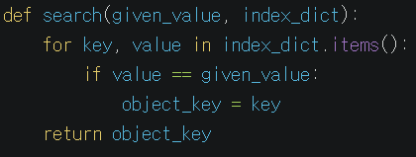
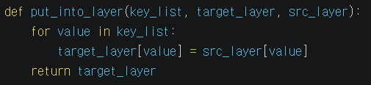
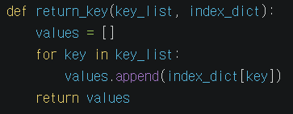
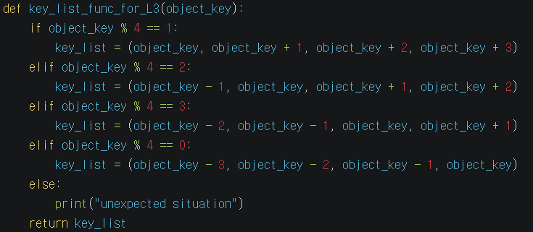
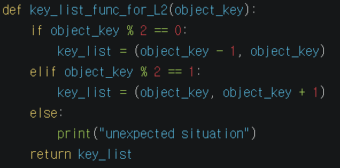
Implementation code
: Function
* Function in L3, L2, L1

Slide 11
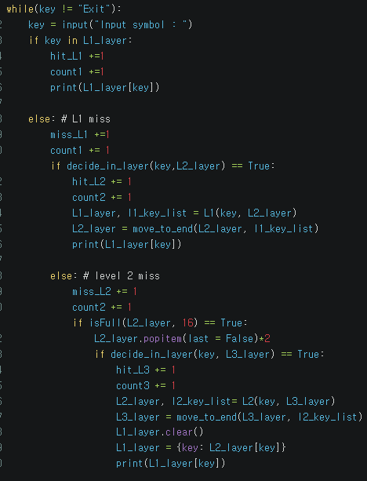
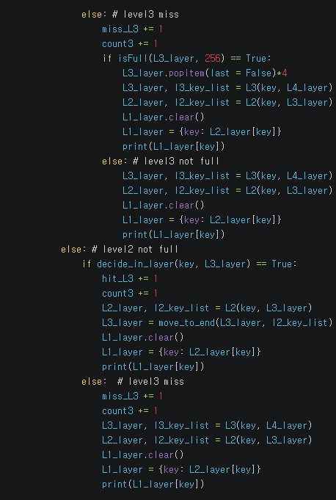
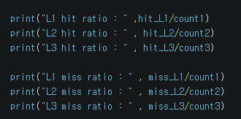
Implementation code
: MAIN
Hit ratio
: is calculated by dividing the number of hits per layer by the number of accesses per layer
Miss ratio
: is calculated by dividing the number of miss per layer by the number of accesses per layer

Slide 12
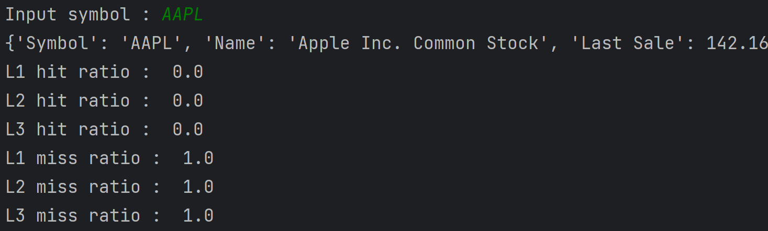
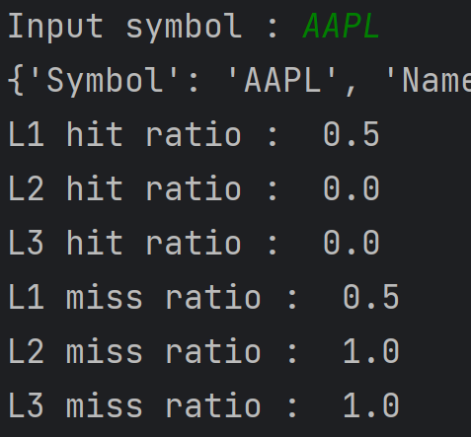
Miss/Hit Ratio
: search 0-2 times
L1 : ()
L2 : ()
L3 : ()
Initial condition
First search for ‘AAPL’
L1 : ()
L2 : ()
L3 : ()
L1 : ('AAPL')
L2 : ('AAPL', 'MSFT')
L3 : ('AAPL', 'MSFT', 'GOOG', 'GOOGL')
Second search for ‘AAPL’
L1 : ('AAPL')
L2 : ('AAPL', 'MSFT')
L3 : ('AAPL', 'MSFT', 'GOOG', 'GOOGL')
L1 : ('AAPL')
L2 : ('AAPL', 'MSFT')
L3 : ('AAPL', 'MSFT', 'GOOG', 'GOOGL')

Slide 13
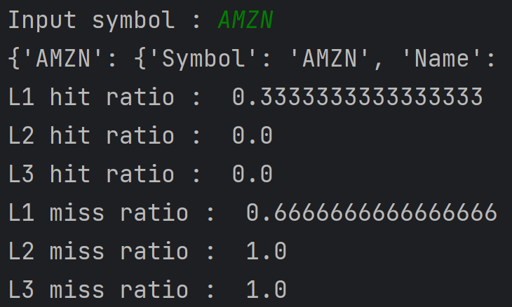
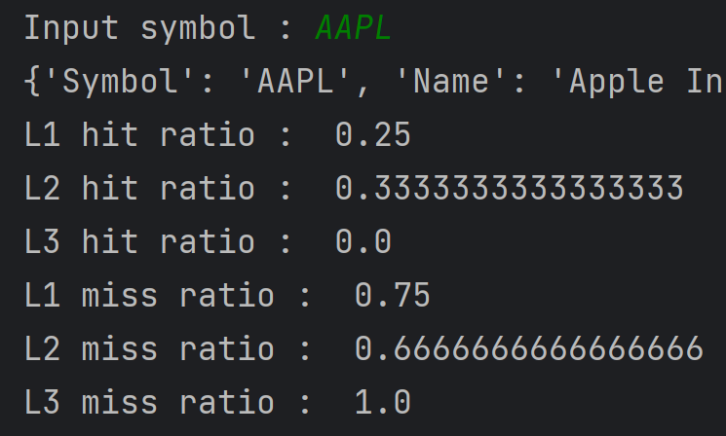
Miss/Hit Ratio
: search 3-4 times
Third search for ‘AMZN’
L1 : (‘AMZN')
L2 : ('AAPL', 'MSFT', 'AMZN', 'BRK/B’)
L3 : ('AAPL', 'MSFT', 'GOOG', 'GOOGL', 'AMZN’,
'BRK/B', 'TSLA', 'UNH'
L1 : ('AAPL')
L2 : ('AAPL', 'MSFT')
L3 : ('AAPL', 'MSFT', 'GOOG', 'GOOGL')
Fourth search for ‘AAPL’
L1 : (‘AMZN')
L2 : ('AAPL', 'MSFT', 'AMZN', 'BRK/B’)
L3 : ('AAPL', 'MSFT', 'GOOG', 'GOOGL', ‘
AMZN’, 'BRK/B', 'TSLA', 'UNH'
L1 : (‘AAPL')
L2 : ('AMZN', 'BRK/B', 'AAPL', 'MSFT')
L3 : ('AMZN’, 'BRK/B', 'TSLA', 'UNH’,
'AAPL', 'MSFT', 'GOOG', 'GOOGL’)

Slide 14
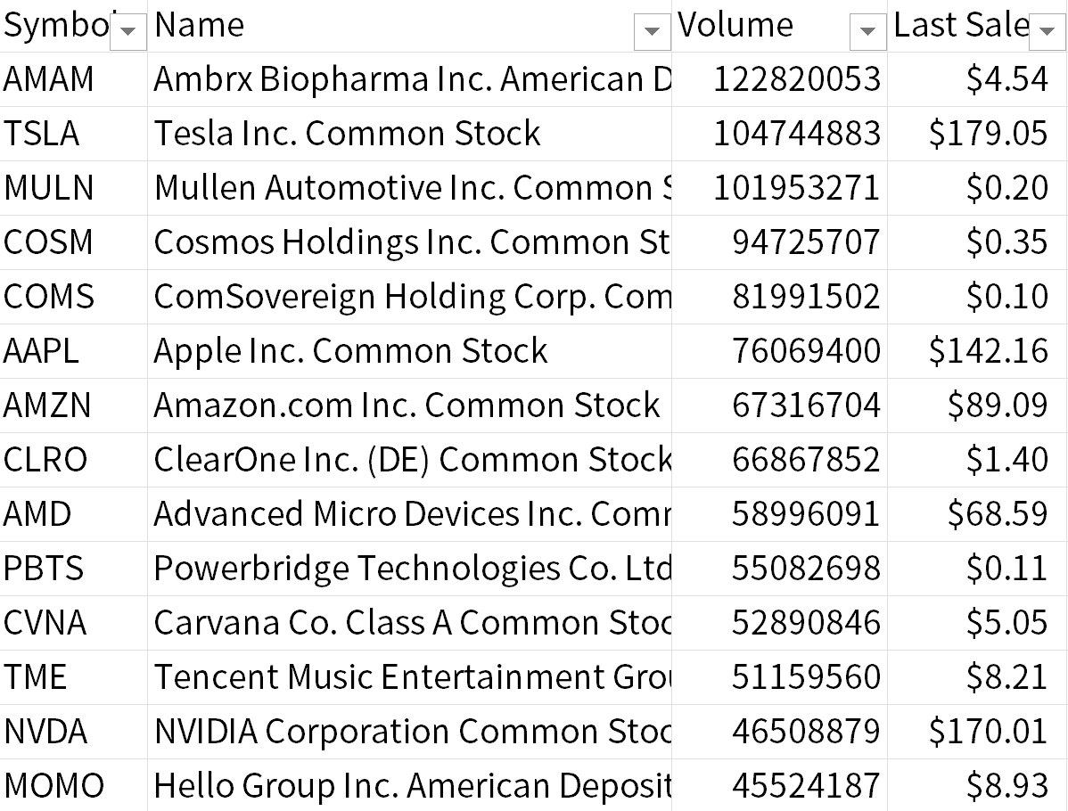
Cache performance
: Measuring
Scenario : Stocks with high trading volume or large market capital are searched more frequently.
def list_by_weight(L4, 5)
the function select 5 elemtents
randomly based on their weight.
weights based on trading volume
Notes:
Now, I’m going to present cache performance of our structure. Since our scenario set suppose that stocks with high trading volume or large market cap usually searched more frequently. Based in our supposition, we sorted our original data which is stored in L4 layer, then we searched iteratly with keys in keylist. In this keylist, there are randomly choosed keys based on their weights in accordance with theire trading volume.

Slide 15
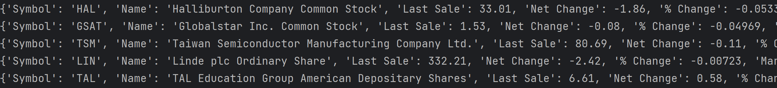
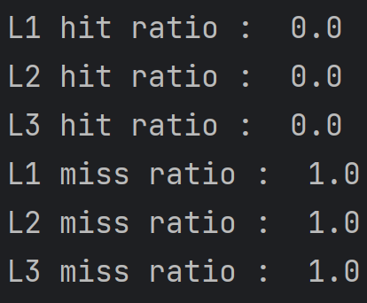
Cache performance
measuring
Since nothing there were no duplicated keys, which means no same search for same key, every try outputs miss!
Then, what about 10,000 times?
Notes:
These are the result for searching randomly selected 5 elemtens.
The first image shows result which we were trying to find. Each of the 5 output is each result for 5 searching.
Next image shows each layers’ keys. Because of the 2-way associatives, we have 10 elements in L2_layer and 20 elements for L3_layer.
The last one shows every miss in every layer since there were no duplicated keys, which means no same search for same key.
Then what about when we try to search 10 thousands times?

Slide 16
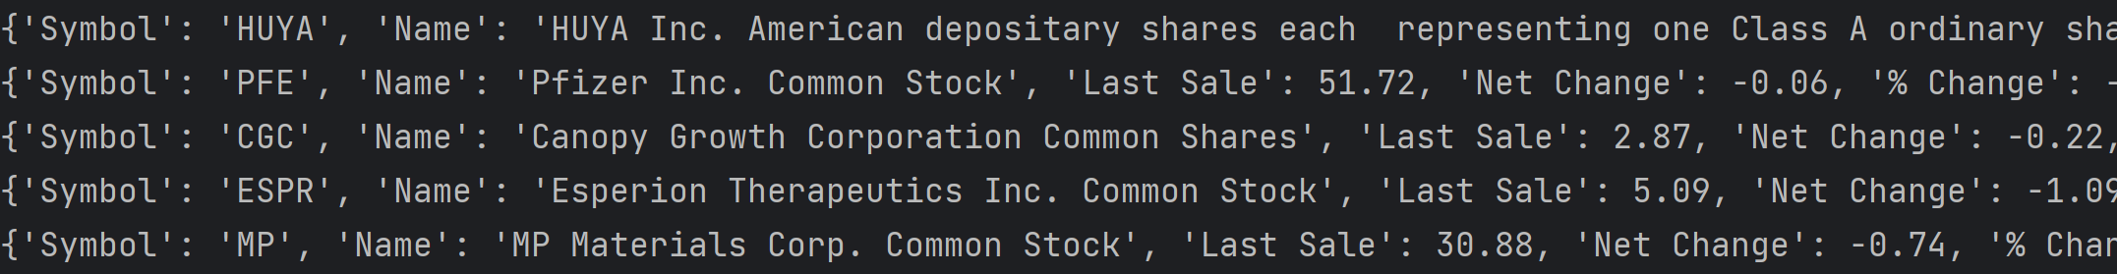
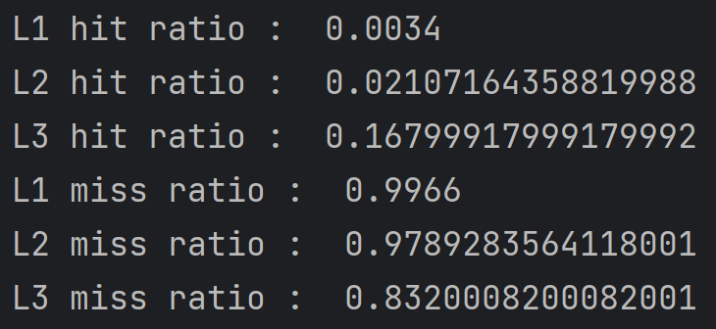
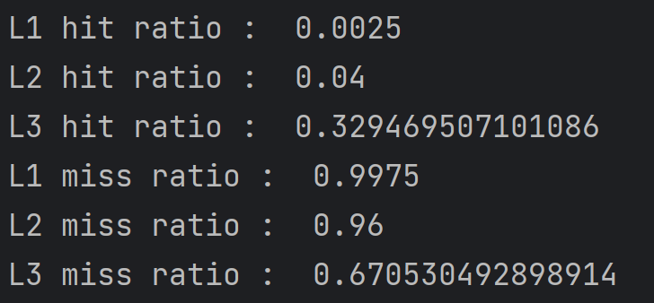
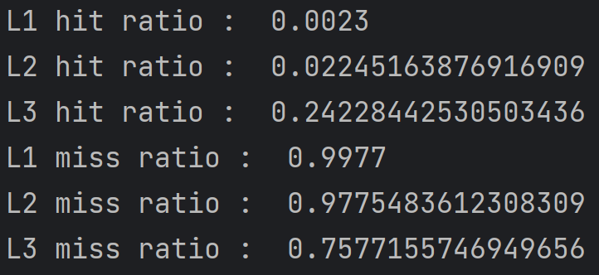
Cache performance
: cases
10,000 times searching
Sorted by “Name”
Sorted by “Volume”
Sorted by “Market Cap”

Slide 17
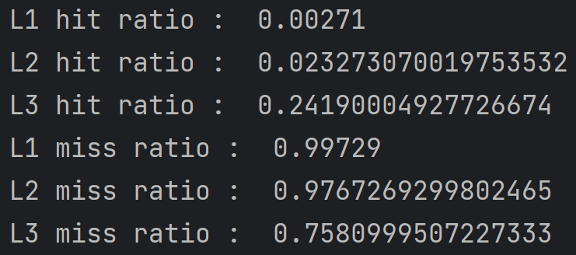
Cache performance
: cases
100,000 times searching
Sorted by “Market Cap”
10,000 times
100,000 times
Notes:
However, when we searched for 100 thousands times, it did now show meaningful difference from 10,000 times.

Slide 18
Cache performance
: cases
10,000 times searching sorted by“Volume”
different block size(4, 8)
Block number | 8 | 4 | difference
avg. L1 hit ratio | 0.002744444 | 0.002588889 | 6%
avg. L2 hit ratio | 0.036510824 | 0.036015428 | 1%
avg. L3 hit ratio | 0.307622911 | 0.326664947 | -6%
Notes:
However, when we searched 10,000 times for different block size, it did not show significant difference.

Slide 19
Thank you

